Slide 1

Awena presentation to CASH
Friday 29th September 2023

Slide 2
The Virtual School is a statutory duty for a Local authority
Local authorities have a duty under the Children Act 1989 to safeguard and promote the welfare of a child looked after by them.
This includes a specific duty to promote the child’s educational achievement, wherever they live or are educated. The authority must, therefore, give particular attention to the educational implications of any decision about the welfare of those children.
The Children and Families Act 2014 amended the Children Act 1989 to require local authorities in England to appoint at least one person for the purpose of discharging the local authority’s duty to promote the educational achievement of its looked-after children, wherever they live or are educated. That person (the VSH) must be an officer employed by the authority or another local authority in England.

Slide 3
History, where we sit & what we do!
We have been in place since 2008 and were called CiCESS, in 2016 we became Cornwall Virtual School and now we are…….. Awena – Cornish for ‘Inspire’
Our service sits within the Education & Community Health service as does Children & Family Services, together we form the ‘Together for Families’ Directorate – Council objective ‘ Cornwall, a brilliant place to be a child & grow up’
The team work from New County Hall two Mondays a month. We maintain an annual Self Evaluation & School Improvement plan linked to Council priorities
We all act as a Corporate parent with high aspirations for our CiC
Ensure the LA discharges its duty to promote the educational achievement of CiC
Create a culture of high educational aspirations, striving for accelerated progress and age related attainment or better for CiC

Slide 4
What we are not able to do for Children in Care (urban myths!)
We are not ‘school improvement’ although there is a link between high quality trauma informed education provision & the success of our CiC
We are not a blue light or behaviour support service – we recognise our support for CiC in schools is likely to start from a trauma informed basis developing to academic support & achievement longer term. We need to work with you to support earlier before the ‘blue light’
We are not ‘long term in school support’– our ‘target group’ for direct support is those CiC not achieving age related expectations – supporting colleagues in school to develop their knowledge of CiC and possible barriers to accessing education
We have a SMALL pot of funding for short term interventions only for CiC –we are unable to fund longer term alternative provision

Slide 5
Profile of our school service
Statutory duty:
768 CiC – 600 are Cornwall CiC, 168 are COLAS, placed in Cornwall by other LAs
Cornish CiC – 132 have EHCP (22%) , 149 (25%) are on SEN support – most of this need is due to high level of trauma and social, emotional, mental health
*41 Separated children seeking asylum – automatically become CiC -16 are 16yrs and under, 25 are post16 – 14 different languages are spoken
2 Children on remand – automatically become CiC
Out of the 600 Cornwall CiC:
19% are pre-school
24% are primary aged CiC
31% are secondary aged CiC
26% are post16 (23 Post16 CiC are NEET)
1 CiC lives in a residential home
Attendance for CiC last year averaged at 90% - using the new DFE system – showing 92% so far this term (Cornwall is 94%)
Suspensions – 184 (62 CiC); PEx – 4 (2 were rescinded)

Slide 6
How can we provide support?
We offer support, guidance, training and challenge to ensure that educational services are effective in maximising the progress that our children make in school. We do this through:
Tracking academic progress, attendance, and education engagement of CiC
Quality assuring all termly Personal Education Plans (PEPs)
Providing support and challenge to schools and partner agencies as the Corporate Parent, to ensure that academic standards are raised for CiC
Using our data to highlight individuals who are not on target to achieve their predicted outcomes and challenging their settings to provide them with additional education support and advice
Ensuring Special Education Needs or Disability needs are identified early and supported appropriately with an appropriate multi-agency plan
Monitoring and challenging schools and colleges to make effective use of the Pupil Premium Grant for CiC and evidencing the impact this makes
Ensuring effective transition between schools, colleges and/or specialist providers
Encouraging a culture that supports our young people to have high aspiration about their futures and removes barriers to accessing education
Leading training for Designated Teachers, Social Workers, Health colleagues, School Governors, Foster Carers and Parents.
Providing advice to social workers and carers to ensure they contribute to the education outcomes of children in school and at home
Celebrating the achievements of children in care
Supporting the delivery of the children in care Corporate Parent plan
Advice, guidance and support from Awena area leads on raising the achievement of children in care and children with a social worker
Regular visits to your school, either face to face or via Teams, your school
Inspection advice and preparation for Ofsted
Drop in sessions/ surgeries to discuss concerns and queries

Slide 7
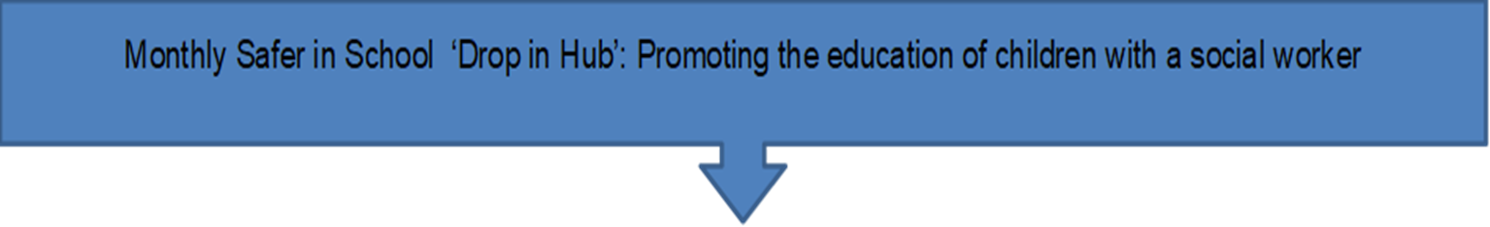
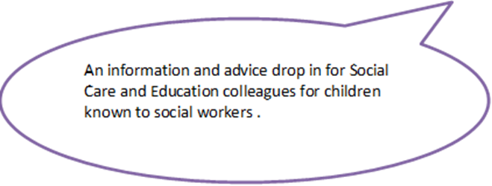
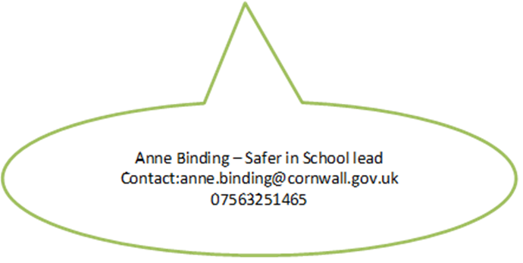
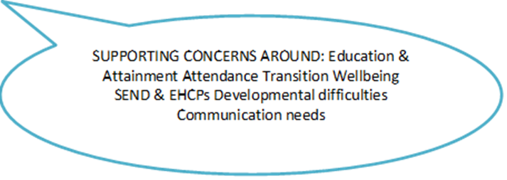
Profile of our extended duties
‘Safer in School’
Children with current vulnerability factors 6353- (includes COLAs and CiC)
420 children on child protection plans
2539 children in need
4124 children with EHCP
Overall attendance of this group is 93.3%
Current CiN (without CiC & COLAs) 1961 – attendance 91%
Current CP (without COLAs) 408 – attendance 86% *

Slide 8
How we are delivering our Extended duties:
Awena is championing a response to the extended duty ‘offer’ as needs have changed over the last two years for our children, families and services.
Our aim is to enable all partners involved in the education of children known to a social worker to work better together so that partnerships are enhanced, engagement in education increases and that all young people reach their potential.
We will:
Provide advice and information to frequently asked questions , telephone advice line and by specialist surgery support.
Provide advice to individual headteachers, principals, designated safeguarding leads, social workers, health colleagues, SENCOs, schools, colleges and early years provision where they have a query.
Advise schools/colleges/early years provision and social workers on how they can work together to support improvements in attendance, punctuality and behaviour avoiding suspension
Support schools, colleges and early years settings to work towards a trauma informed approach through use of a variety of toolkits (Headstart/ Thrive/ Nurture)
Advise schools and early years settings on how to best to use the Pupil Premium Grant to promote attendance, punctuality, attainment and progress
Bring together all partners in TFF, Health and Voluntary sector to help remove the significant barriers to education of adversity and trauma, most commonly abuse and neglect, that these children and young people may experience.

Slide 9
What we are not able to do in our extended duty remit (urban myths!)
We do not have the team capacity to work with individual children, young people and their families - including tracking and monitoring educational progress of individuals or providing academic or other interventions
However – there are new plans in Education Effectiveness to support this group of learners in accessing education – Education Effectiveness are presenting to you on 6th October!
We work in close liaison with Statutory SEN, Education Effectiveness and Social Care to ensure the children are known to TFF and offer drop in surgeries for colleagues to look at plans of action and support
The role of the SiS lead is a strategic one – looking at trends, themes, patterns in attendance, suspensions and access to education not individual case work

Slide 10

Introduction or ‘re-fresh’ on who we are
Emma Phillips – Head of Service
Chloe Phillips – Deputy HOS
Clare Barden – Assistant HOS
Leadership team
Louise Buist- Early years
Mel Frazier – Post16
Claire Atkins – SEN
Sarah Collings – Out of county
Sarah Nation – PEP / PP+
Vicky Thornton – EWO
Tracy Bowers – Headstart & Creative projects
Area leads
Anne Binding
Extended duties – Safer in School
Helen Waring
PLAC & Adoption lead
Sarah Moss
Heather Thomas
Jo Hodgetts
3 x Vacant posts
Learning Advocates /
Out reach support
Aleister Moxham
Alicia Gordon
Support officers
Social Care
Primary & Secondary representation
Care experienced person
Foster carer
Voluntary sector
Head start
Support & Challenge group

Slide 11

Working together….
We are here to work with you, to stay with you every step of the (often difficult) way, to celebrate the amazing work that you do.
The action, above and beyond that you take, the commitment to finding areas of education which our CiC can succeed in
We would like to work with you to develop a robust way which we can help you to demonstrate your success and dedication when you have internal and external inspections
To find ways to shift the lens of CiC from being one of resource and outcomes to one to be sung about - of changing the downward trajectory of these young people to ensure they become successful in our communities and happier in life….

Slide 12
Education support opportunity!
An innovative, unique offer for all Leads for Vulnerable Children / DT’s in Cornwall, starting in Autumn 2023!
We are running a pilot project this year in liaison with the Educational Psychology Service. This offer will give staff the opportunity to take part in structured supervision with an Educational Psychologist with the main aim being, supporting professional development and wellbeing of Designated Teachers and / or Leads for Vulnerable Children. This will be a free, all-inclusive offer. We currently have 5 spaces remaining.
In order for this to be successful, we will need to know if your school would welcome the opportunity to take part. Please can we ask that you email your expression of interest to Awena – Cornwall Virtual School, virtualschool@cornwall.gov.uk . More details can be found on the attached leaflet.
We hope you embrace this as a fantastic opportunity to share experiences and feel supported in an ever increasing demanding role. We are looking forward to working with you on this.

Slide 13
What all this means for schools…
‘The governing body of a maintained school and the proprietor of an academy must ensure that an appropriately qualified and experienced member of staff -the ‘designated teacher’, undertakes the responsibilities within the school to promote the educational achievement of looked-after and previously looked-after children on the school’s roll. They must also ensure that the designated teacher undertakes training that is appropriate to carrying out this duty’
‘in line with the annual safeguarding return (157/175), DTs need to attend at least one Awena network a year for compliance with the return)
‘The governing body, head teacher and school leadership team will want to consider the following in supporting the designated teacher role:
Does the designated teacher have appropriate seniority and professional experience to provide leadership, training, information, challenge and advice to others that will influence decisions about the teaching and learning needs of looked-after and previously looked-after children?
Does the designated teacher have appropriate seniority and skills to work with the school’s senior leadership and governing body to help ensure school policies and approaches appropriately reflect the needs of looked-after and previously looked-after children and act as a champion for them? Governors conference tomorrow at Brannel School

Slide 14
The role of the DT (Designated teacher)
Designated teachers should take lead responsibility for ensuring school staff understand the things which can affect how looked-after and previously looked after children learn and achieve and how the whole school supports the educational achievement of these pupils. This means making sure that all staff: have high expectations of looked-after and previously looked-after children’s learning and set targets to accelerate educational progress are aware of the emotional, psychological and social effects of loss and separation (attachment awareness) from birth families and that some children may find it difficult to build relationships of trust with adults because of their experiences, and how this might affect the child’s behaviour understand how important it is to see looked-after and previously looked-after children as individuals rather than as a homogeneous group, not publicly treat them differently from their peers, and show sensitivity about who else knows about their looked-after or previously looked-after status appreciate the central importance of the looked-after child’s PEP in helping to create a shared understanding between teachers, carers, social workers and, 12 most importantly, the child’s own understanding of how they are being supported have the level of understanding they need of the role of social workers, VSHs and carers, and how the function of the PEP fits into the wider care planning duties of the authority which looks after the child for previously looked-after children, understand the importance of involving the child’s parents or guardians in decisions affecting their child’s education, and be a contact for parents or guardians who want advice or have concerns about their child’s progress at school

Slide 15
Questions to consider around the DT role….
How does the designated teacher role contribute to the deeper understanding of everyone in the school who is likely to be involved in supporting looked-after and previously looked-after children to achieve?
What resource implications might there be in supporting the designated teacher to carry out their role?
What expertise can designated teachers call on within and outside the school such as SENCOs, health and mental health support? And DSL?
What monitoring arrangements might be appropriate to ensure that the role of the designated teacher is providing appropriate support for looked-after and previously looked-after children on the school roll?
‘The designated teacher should be a central point of initial contact within the school. This helps to make sure that the school plays its role to the full in making sure arrangements are joined up and minimise any disruption to a child’s learning.’

Slide 16
How to contact us: virtualschool@cornwall.gov.uk *
*we are a countywide service but we are working with the Council Carbon neutral pledge on travelling smarter and using virtual resources where appropriate

Slide 17
Awena – how we can most effectively work together
What is required from us all as partners:
‘Creating a culture of collaboration & high aspiration so children with a social worker will achieve the most from their education’
Make visible the disadvantages that children with a social worker can experience, enhancing partnerships between education settings and local authorities to help all agencies hold high aspirations for these children
Promote practice that supports children’s engagement in education, recognising that attending an education setting can be an important factor in helping to keep children safe from harm.
Level up children’s outcomes and narrow the attainment gap so every child can reach their potential. This will include helping to make sure that children with a social worker benefit from support to recover from the impact of COVID-19
Enhancing partnerships between education settings and the local authority so agencies can work together. identifying the needs of the cohort and addressing barriers to poor educational outcomes and ensure pupils make educational progress
Offering advice and support to key professionals to help children make progress, including through increasing their confidence in using evidence-based interventions.

Slide 18
Dates for your diary!
Designated teacher Induction face to face – 16th October – am St Erme community Hall
PEP conference face to face – 16th October – pm –St Erme community Hall
Designated teacher Autumn newsletter – news & updates
Autumn conference – 10th November – ‘to know me is to love me’ St Austell training
All communications for education settings is via the Services for Schools newsletter – please make sure you are signed up!

Slide 19
Thank you / Meur ras
If you have any questions or comments
virtualschool@cornwall.gov.uk

