Slide 1


Welcome to the CASH Conference
8.15: Coffee and networking in bar
8.45: SEND Reforms - the National Picture.
Margaret Mulholland, specialist in inclusivity and Special Educational Needs, and SEND policy advisor for ASCL.
9.45: SEND Reforms - the Local Picture.
Rachel Delourme, Head of Inclusion and SEND at Cornwall Council.
10.45: Coffee and networking in bar
11.15: Thinking creatively to strengthen SEND provision in our schools.
11.15: Tute Education
11.35: Outside the Box Education
11.55: Cornwall Marine Academy
12.15: Emotional Logic
12.45: Lunch
1.30: CASH AGM (members only)
2pm: The Cornwall experience of Ofsted
3pm: CASH Exec meeting

Slide 2


Coffee and pastries in the bar:
10.45 – 11.15
Book the October conference now!

Slide 3


Slide 4

OUTSIDE THE BOX
Thinking Creatively to Strengthen
SEND Provision in Cornish Schools
Alternative provision, staff support, and a different way of seeing the problem
Luke Bolsin
Founder of Outside the Box Education & Consultancy
(Formerly SENDCO and Deputy Head at Oak Tree school & Autism advisor for Cornwall Council)
Notes:
Welcome and introduce yourself. 11 years as SENDCO/Deputy Head at Oak Tree School. Keep this brief and warm — 30 seconds max before moving on. Set the tone: this is a conversation, not a sales pitch.

Slide 5

WHAT WE'LL COVER
Today in 20 minutes
01
The challenge we all share
Rising need, finite capacity, and the limits of doing more of the same
02
Thinking creatively about SEND
Why a different lens — not just more resource — changes outcomes
20
03
Our alternative provision offer
EOTAS and enrichment packages, mentoring and bespoke placements for the learners who need something different…
minutes together,
then open floor for
questions and discussion
04
Supporting your staff teams
Training, consultation and problem-solving alongside your existing provision
05
Where this could fit for you
An open conversation — what's live for you right now?
Notes:
Quick run-through of structure. Mention this is meant to be interactive — encourage questions throughout, not just at the end, if the group is small enough.

Slide 6

THE SHARED CHALLENGE
A familiar picture
SEND need is rising. Budgets and specialist capacity — EPs, CAMHS, outreach — are not rising at the same rate. LA budgets meant a lot of the in-house support has dried up. Every Headteacher and SENDCo in this room is making difficult decisions about where time and resource go — often for the children who are hardest to reach with what's already in place.
LET'S TALK
Where is this pressure landing hardest for you right now — a particular cohort, year group, or type of need?
1 in 6
+71%
pupils in England now has an identified SEN need
rise in EHCPs issued over the last decade
Notes:
Pause here and genuinely ask the room. This is the first interactive moment — let people answer, even briefly. Don't rush past this. The stats are illustrative; soften if pushed on exact figures, the point is the direction of travel.

Slide 7
A DIFFERENT LENS
More of the same isn't the answer
When capacity is stretched, the instinct is often to ask: how do we do more of what we're already doing? But for the learners who haven't responded to standard approaches, doing more of the same rarely changes the outcome. Thinking creatively means asking a different question.
MORE OF THE SAME
THINKING CREATIVELY
“How do we deliver more intervention, more 1:1, more of the existing toolkit?”
“What does this child actually need, and who is best placed to provide it?”
Notes:
This is the conceptual heart of the pitch. Don't overstay here — the point is simple and the audience will get it quickly. Move to the discussion prompt if time allows: ask whether this resonates with their own experience of intervention fatigue.

Slide 8

DISCUSSION
What gets in the way of creative thinking?
Time pressure — no space to step back and reframe a child's needs
“What would you add to this list, from your own context?”
Risk aversion — sticking with what's known and defensible
Capacity — the people with the right expertise are already stretched
Habit — the existing toolkit becomes the only toolkit
Take 1–2 minutes to discuss at your tables
Notes:
Genuine discussion slide — let the room talk. If short on time, this can be a rhetorical pause rather than full table discussion, but try to get at least a few verbal responses. This builds buy-in before you present the OTB offer.

Slide 9


THIS IS WHERE WE COME IN
Two ways Outside the Box can help
Alternative Provision
Staff Training & Consultancy
Direct, hands-on support for individual learners who need something different from mainstream provision. Circuit breakers, mentoring programmes, or re-integration support
Building the confidence, knowledge and strategies of your existing staff teams. We are cheaper, and arguably more versed in SEMH/SEND than many external advisors.
Notes:
Short transition slide — set up the two-part structure of the rest of the talk. Keep this brief, it's a signpost not content.

Slide 10



PART ONE
Our alternative provision offer
For learners whose needs aren't being met by mainstream provision alone, OTB offers flexible, relationship-led alternative provision — built around the individual child, not a fixed programme.
EOTAS Type Placements
1:1 & Small Group Mentoring
Education Otherwise Than At School — part-time bespoke placements for learners who cannot currently access mainstream education
Relationship-based mentoring sessions in school or in the community, building trust before behaviour change. Block purchase options for targeted cohorts.
Outdoor & Physical Engagement or creative sessions
Flexible, Phased Reintegration
Using movement, creativity and outdoor experience as the route into emotional regulation and engagement. Very common need in ND learners
Working alongside school to plan a realistic, graduated return — not an all-or-nothing transition. This has been particularly effective with ADHD/low impulse control learners.
Notes:
Walk through each of these briefly — this is the core service slide so don't rush, but also don't read every word on the slide. Speak to the principle behind each one. If pressed, EOTAS placements can be full-time or just a few sessions a week depending on need.

Slide 11
WHO BENEFITS MOST
The learners we're often asked to help
1
Persistent emotionally-based non-attendance (EBSNA)
2
Escalating dysregulated or unsafe behaviour despite existing support
3
SEMH need not yet matched by a diagnosis or formal pathway
4
Neurodivergent learners struggling with the mainstream sensory or social environment
5
Learners at risk of, or returning from, suspension or exclusion
6
Children for whom relationship — not curriculum — is the missing piece
Notes:
This slide should feel recognisable — pause slightly after reading to let heads nod. These are the children every SENDCo in the room is already thinking about. Don't need to read every line verbatim, paraphrase naturally.

Slide 12

DISCUSSION
Is there a learner in your school right now who fits one of those profiles?
You don't need to name them or share details — just hold them in mind. What has already been tried? What hasn't worked, and why do you think that is?
Keep this child in mind as we go through what we offer — it'll help anchor whether this could be useful for your context.
Notes:
Don't necessarily need verbal answers here — this is a private reflection prompt to make the next slides land more personally. A brief pause (5-10 seconds) is enough. You can softly invite one or two shares if the room is engaged.

Slide 13
PART TWO
Supporting your staff teams
Sometimes the most effective intervention isn't direct work with a child at all — it's building the knowledge, confidence and shared language of the staff around them. We offer training and consultancy that strengthens your existing provision from within.
Problem-Solving Consultation
Whole-Staff CPD Training
Embedded, Ongoing Support
Working alongside SENDCos and teams on specific, named, challenging situations — a fresh pair of eyes and shared problem-solving, using solution focused approaches
Single sessions or ongoing programmes covering trauma-informed practice, emotion coaching, PACE and neurodiversity awareness, de-escalation, ASC.
Regular check-ins and consultation that build internal capability over time, rather than one-off input
Notes:
Emphasise: this is not just about the hardest cases. Whole-staff CPD builds the baseline so fewer situations escalate to crisis in the first place. Mention named approaches briefly if asked — PACE (Dan Hughes), Emotion Coaching (Gottman) — but don't over-explain unless there's specific interest.

Slide 14


THE OTB DIFFERENCE
Why direct support and staff training together
Direct provision for a child without building staff capacity creates dependency. Staff training without direct experience of the hardest cases can feel theoretical. We do both — and let each inform the other.
Direct work
with a learner
Insight into what
actually helps
Shared with your
staff team
Sustainable
capacity in school
Notes:
This is the synthesis slide — pulling together why OTB's model is distinctive rather than just listing services. The flow diagram should feel like a virtuous cycle, not a one-off transaction.

Slide 15

DISCUSSION
Where could this fit in your school?
Is there a gap right now — a child, a cohort, or a staff confidence gap — this could help with?
1
No pressure, no pitch
We're genuinely happy to just be a resource you know exists — reach out whenever it's useful, even just to think something through. We are more than happy to do this at no charge initially…
We also offer one free half day of advice and support to all MATS across Cornwall…
Would direct support for a learner be more useful, or building your staff team's own capability?
2
What would need to be true for this to be worth a conversation after today?... What kind of AP do YOU want for your learners requiring it?
3
Notes:
Genuinely open discussion slide. Let this run a bit longer if engagement is good — this is where real conversations and leads emerge. Resist the urge to fill silence; let heads think.

Slide 16
Let's keep talking
Whatever's live for you right now — a learner, a staff need, or just a question — get in touch.
Luke Bolsin
07766 168788
www.outsidetheboxeducation.org/
Director, Outside the Box
Call or text anytime
Find out more online
Thank you for your time
Notes:
Closing slide. Thank the room, reiterate that you're happy to be approached informally, and invite questions if there's time remaining. Leave this slide up during Q&A so contact details stay visible.

Slide 17




Supporting the Next Generation
www.cornwallmarineacademy.co.uk

Slide 18




Cornwall Marine Academy (CMA)
Cornwall Marine Academy CIC (part of Cornwall Marine Network) was created in 2008 to raise awareness of the wide range of career opportunities in the Marine sector, delivering vocational training and work experience to young people aged 9 to 24 and support their employability and progression onto further education, an Apprenticeship or a job
Supported more than 40,000 young people in Cornwall through careers advice, taster sessions, vocational experiences, improved employability skills and pre-apprenticeship training.
Created meaningful Vocational Work Experience placements for 4,000 Young People aged 14-16 (some placements were 50 days over two years per person).
On average, CMA CIC and our team of Marine Ambassadors provides Marine careers advice annually to around 20% of all Year 10 and Year 11 students at Cornwall secondary schools.
In 2023, CMA delivered its first support programme to a local Primary School and continues to expand this offer (Key Stage 2 +).
CMA CIC has created a team of 106 volunteer Marine Ambassadors from member businesses who share Marine careers advice at local secondary schools.
www.cornwallmarineacademy.co.uk

Slide 19
Marine Sector Landscape
x900 Businesses; 99.5% SME’s; of which 86% Micros
16,052 jobs directly supported by the marine sector in Cornwall
plus 1,400 marine volunteers
Marine sector GDP £1.12 billion per annum to Cornwall economy
6.4% (1 in 15 people) of Cornwall's employment
60% of sector is Leisure Marine
Ports, Harbours and Marinas – Boatbuilding, Ship and Boat Repair - Marine Engineering and Manufacturing
Marine Leisure, Tourism and Health - Marine Technology, Data and Autonomy - Fisheries and Aquaculture
Marine and Offshore Resources (Floating Offshore Wind, Wave, Tidal)

Slide 20

CMA Services and Activities
Supporting Your School To Meet Gatsby Benchmarks
Bespoke, flexible and tailored support
Courses, Workshops, Engagement & Delivery Employability skills workshops
Boatbuilding, Sustainability, Engineering Days
Prepare to Earn - Accredited training courses
Money Matters and Budgeting Skills
Employer/Ambassador engagements - Site visits, talks, work experience
www.cornwallmarineacademy.co.uk

Slide 21
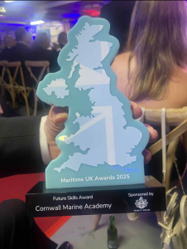
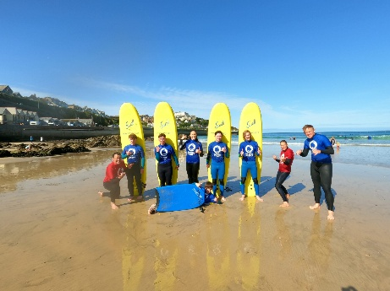
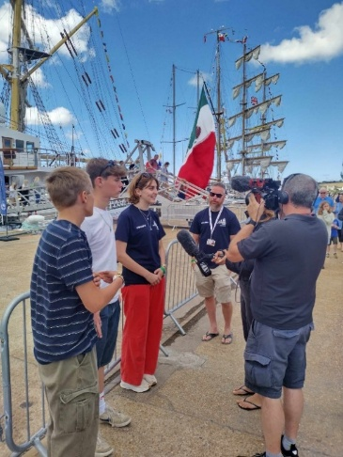
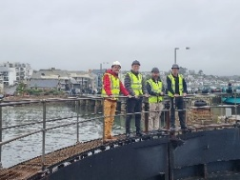
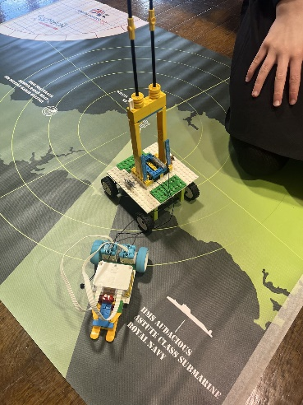
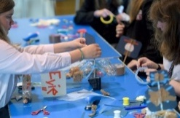
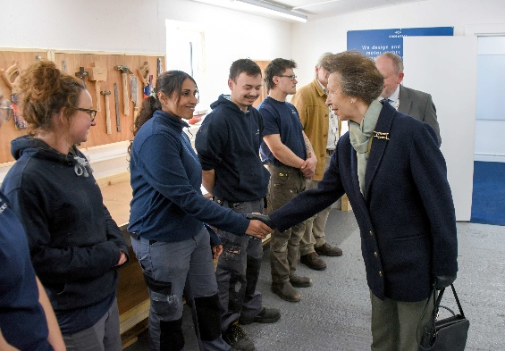
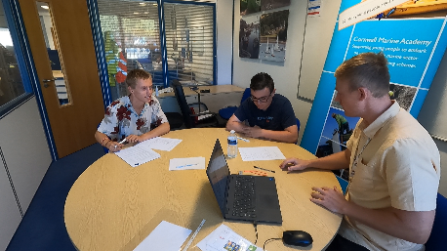
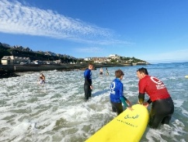
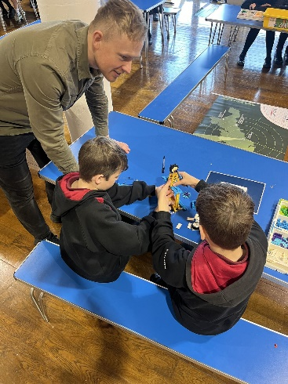
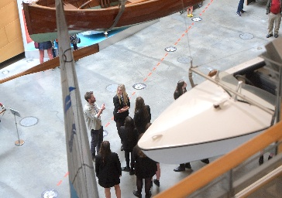
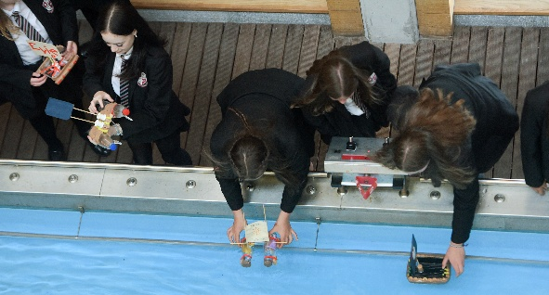
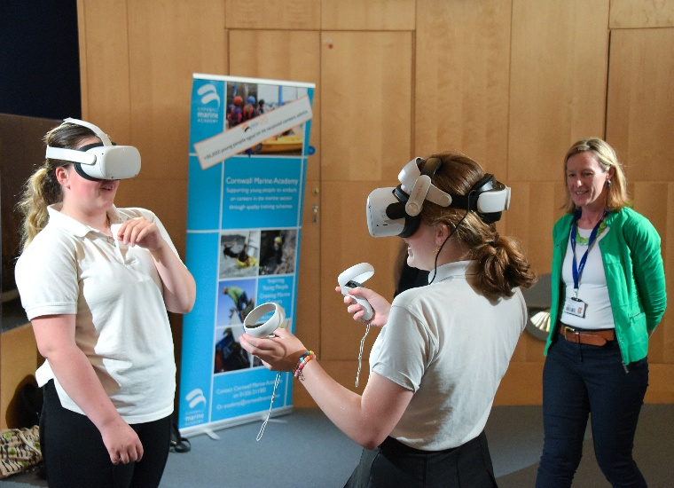
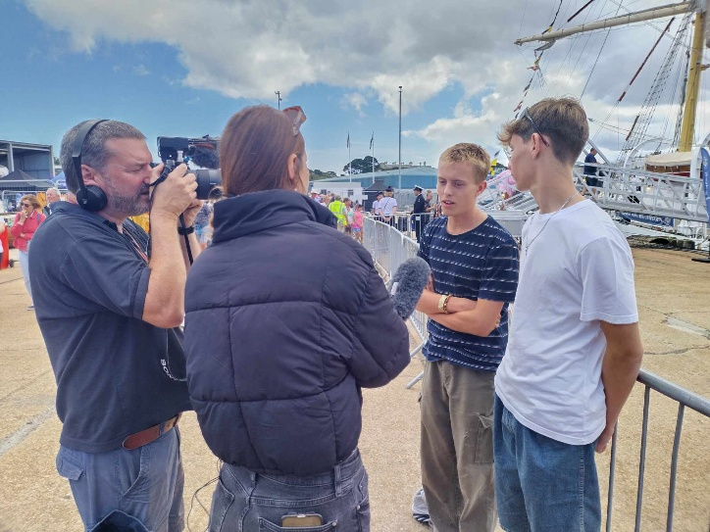
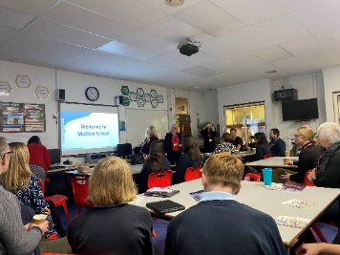
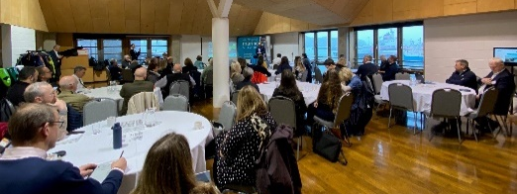
Engagements and Activities
Maritime Roadshow for Girls
STEM based Lego Submerged
Virtual Reality based learning
Work Placements
School Outreach Programme
Vocational and Employability Training
Industry Visits and Education Days
Work Experience

Slide 22
CMA
We discover your individual school needs, gaps and the support you require
We provide solutions to support your school and students
We can create new and bespoke delivery packages for your school
We think about the next generational workforce – and want students to understand the brilliant careers and opportunities in Cornwall
www.cornwallmarineacademy.co.uk

Slide 23
Any Questions?
“We cannot recommend the Cornwall Marine Academy enough! Our students recently completed a course that was outstanding from beginning to end. It was wonderful to see the students engage with the local boat-building industry—an incredible world of opportunity that exists right on their doorsteps.”
“We’ve seen a real shift in student aspirations and conduct since their return. The staff were supportive and invested, but we’d like to give a special shout-out to Joe, whose leadership and enthusiasm made him a fantastic ambassador for the Academy. An amazing, high-value experience for everyone involved!”
James Rogers – Headteacher - Treviglas Academy
academy@cornwallmarine.net
www.cornwallmarineacademy.co.uk

Slide 24

An Introduction To
Emotional Logic

Slide 25
My background
Primary Headteacher
Exciting Education Ltd
Emotion Logic charity
Plymouth Multi Agency Support Team
Chair Plymouth Foster Panel
Vice Chair Cornwall Foster Panel cornishcritters.com

Slide 26
FAQs
What am I going to be doing today?
Will I have to talk about personal situations and share my emotions with others?

Slide 27
What is Emotional Logic?

Slide 28
A technique developed by British GPs in the 1990s and used around the world
Learn to recognise and understand your unpleasant emotions and your core values that underpin these
Learn how to make plans to move forward effectively without causing more problems!
It’s coaching not therapy - something you can learn and teach your family and friends

Slide 29
The Healthy
Adjustment
Process

Slide 30







The Healthy Adjustment Process

Slide 31
Step 1
Making sense of how we are feeling
“Use the cards to show me how you feel”
You can’t get it wrong
Use as few or as many cards as you feel relevant

Slide 32
Scenario
Imagine you are 13 years old.
You’ve not been invited to the party!
Look at the cards
What would your pattern look like?

Slide 33
My pattern

Slide 34
Step 2
Discover what you have lost by naming some hidden values
Children and adults often need training how to do this!

Slide 35
What can I no longer do?
Feel part of a group
Feel wanted
Be happy
Have my usual confidence
Visit my friend’s house at the weekend
Sleep well
Relax and unwind
Hang out with a friend
Have fun with somebody
Trust those friends
Have my point of view heard
Understand why this happened
Enjoy the party food
Watch the movie
Plus many more…

Slide 36
Now that I have lost a friend, what can I no longer do?
I no longer have someone to:
Have fun with
Hang out with at breaktime
Go to football club with
Walk home with
Do online gaming with
Share my worries with
Do my homework with
Invite to my house
Borrow things from
Feel safe and relaxed with

Slide 37
Why is this list helpful?
Your personal loss list reflects your personal values
You know exactly what you have lost and therefore what to focus on trying to re-gain
Your Emotional Logic coach helps you design a personal, solution focussed, values based, action plan.

Slide 38
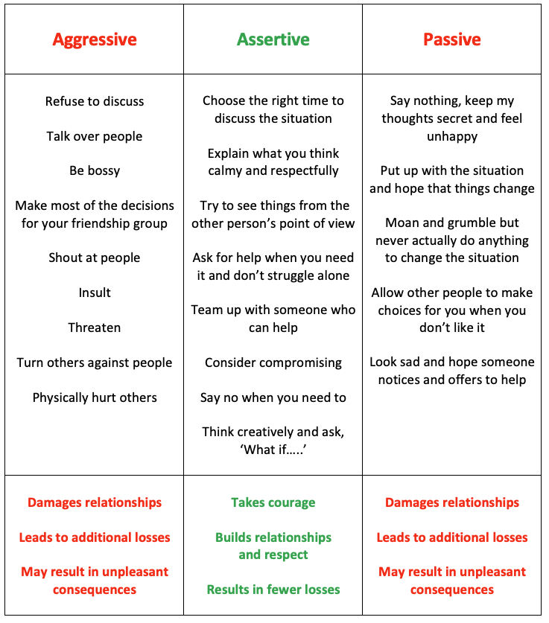
How do you Bargain?
When you are under pressure, which way
do you usually go?
When is Bargaining not a good idea?

Slide 39
What do schools say about the impact?
Strengthen relationships at all levels (peers/staff/personal)
Improved behaviour from pupils in school (87.8%)
Improved pupils’ focus on learning (86.1%)
Reduced anxiety (87.8%)
Increased pupils’ confidence (90.9%)
Increased attendance (76.3%)
Data based on 501 school survey responses
Most children had experienced significant trauma

Slide 40
How we can help you
We offer 1:1 support for children in education settings, one day per week, over half a term.
We can train members of staff to use our lesson plans to teach the basic concepts to all ages (Foundation Award)
You can do further training and become a fully qualified Emotional Logic Coach (Coaching Award)

Slide 41
Further training – The Foundation Award
Train to use our resources with children in school
Help yourself and your family
Accredited by the DfE through their Matrix Standard Award and gives you 30 CPD points
Approximately 30 hours. Two training days and online learning/coursework over 7 weeks.
Aligned with PACE
(Playfulness, Acceptance, Curiosity, Empathy)
Wed 21st Oct/Mon 23 Nov St Austell
Notes:
Learning objectives for the session

Slide 42


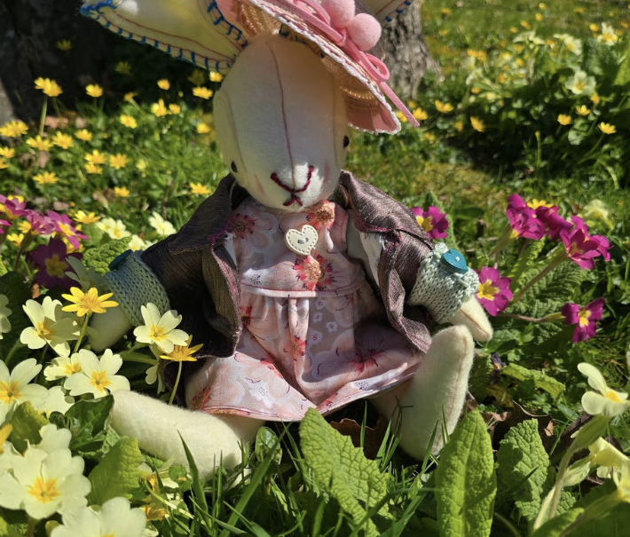
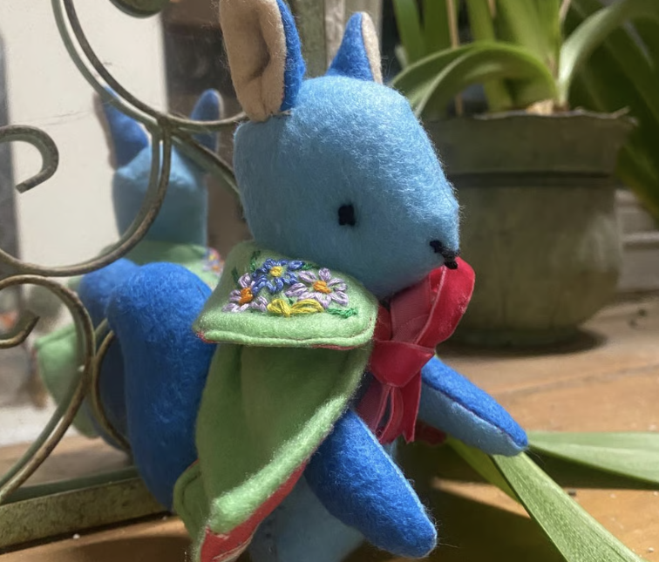
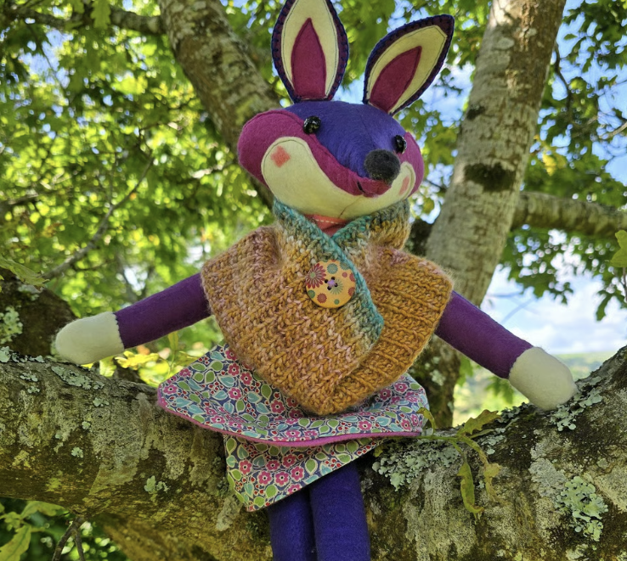
BOGOF Funded places only for Cornish schools
www.cornishcritters.com

Slide 43




www.excitingeducation.co.uk
chris@excitingeducation.co.uk
07854 120286

Slide 44
Lunch through the bar: 12.45 – 1.30
Book the October conference now!

Slide 45

AGM: Agenda
CASH Impact Report and Development Plan
Report from the Treasurer
Election of Exec Committee 2026-2028
AOB (previously raised with the Chair)

Slide 46

Impact Report
The priorities you set for this academic year were around
Connections And Support for Heads.
In particular,
Supporting colleagues navigate the national and local policy changes.
Increasing CASH’s voice both locally and nationally to influence policy change.

Slide 47


Slide 48

Navigating National Policy
Department for Education
Inspections & Accountability | Curriculum& Assessment | Funding & Resourcing | Policies, Regulations Legislation | Inclusion & SEND | Attendance& Safeguarding | Support
Ofsted | Curriculum & Assessment Review National Curriculum RSE legislation | National Funding Formula PP Inclusive Mainstream fund Early intervention funding | Children’s Wellbeing & Schools Act Every child Achieving and Thriving Post 16 Education and Skills White Paper | Works with LA to strengthen mainstream inclusion through Local Area Review and SEND Reform Plan | Statutory guidance KCSIE Focus on child poverty Mandates multi-agency support | English Hubs Maths Hubs RISE Funded NPQs

Slide 49

What does that look like in Cornwall?
Inspections & Accountability | Simon Rowe (Senior HMI) leads the SW team Several trained Ofsted inspector -Headteachers through OneCornwall.
Curriculum & Assessment | Schools/Trusts set their own curricula aligned with the DfE legislation. New NC comes into force in 2028.
Funding & Resourcing | Local funding decisions regarding the DSG are taken by Schools Forum which holds the LA to account.
Policies | The Cornwall Education Partnership (CEP) sets the strategic priorities for Cornwall
Support (funded by DfE) | Kernow English Hub, CODE Maths Hub RISE groups: SW RIIA Networks: SWAN (Attendance), SWDN (Disadvantaged), SW SEND & AP Network. South-West Secondary RISE conferences OneCornwall

Slide 50
Inclusion & SEND | The SEND Centres of Excellence CEP sub-group focuses on improving SEND outcomes through the Inclusion Charter, Ordinarily Available Provision, and developing Experts at Hand as part of the SEND Reform Plan. This work is overseen by the SEND, Inclusion and AP Board with co-chairs from Health and Education.
Attendance & Safeguarding | The ‘Inclusive Education Communities’ CEP sub-group focuses work on reducing exclusions, suspensions and children who are NEET/EHE. The ‘Attendance and Belonging’ CEP sub-group focuses on improving attendance. The Neurodiversity Steering group, chaired by the ICB and the MHSTs feed into this strategy. Cornwall is feeding directly to the DfE with regards to poverty through the ‘Pretty Poverty’ Report. OSCP coordinates Safeguarding information sharing across Cornwall and IoS. Prevent Board links to Home Office.

Slide 51



How has CASH supported members with these strands?
Inspections & Accountability | Input from Simon Rowe and trained inspectors at CASH conferences (March & July) regarding implications of the new Ofsted framework. Input from Tom Sherrington at November conference around coaching and walkthrus
Curriculum & Assessment | Input from Tom Middlehurst (ASCL Deputy Director of Policy) at March CASH conference regarding the implications of the Curriculum and Assessment Review on school leaders. AQA and Pearson presentations at CSFT meetings (March and June) re post-16 reforms and the changes to the post-16 pathways.

Slide 52


Funding & Resourcing | Schools’ Forum consultation circulated to all CASH members for consideration. Briefing session run by Bill Marshall (Chair of Schools’ Forum) to answer questions prior to deadline. Summary provided in Bulletin. CASH represented on Schools Forum by Bill, Craig and Kate.
Policies, Regulations Legislation | CEP priorities (attendance, inclusion and SEND) see below. CASH represented on CEP by KL. Info cascaded in Bulletin. Conferences bring policy to life (ASCL/LA representation).

Slide 53

Inclusion & SEND | Input from Margaret Mulholland (ASCL SEND Specialist) at July CASH conference. Input from Rachel Delourme (LA), Rochelle Bones & Lynz Attwood (ICB – Health) at Sept Conference. CASH SENDCos involved in co-construction of OAP. Heads given the opportunity to provide feedback for the SEND LA mid-point review. KL involved with drafting local SEND Reform Plan, the construction of the OAP and the design of the Experts at Hand model. CASH SENDCo conferences. Bulletin information

Slide 54

Attendance & Safeguarding | KL represents CASH at all Attendance and Safeguarding groups. (Jim from Budehaven sit on the CACE reference group). KL liaising with DfE and LA around attendance barriers. Jen Blunden (Chair of IEC) attended March CASH conference. KL to chair next year. All schools invited to be involved in LA funded Attendance Project led by Elpida Achtaridou from Marjons University. All schools invited to be part of the Attendance and Belonging CEP Work. All information from OSCP cascaded to CASH DSLs through network meetings and emails. CASH/CAPH/CACE DSL network meetings 3x per year (input from LA and others)

Slide 55

Support | CASH conferences provide ‘Headspace’ for strategic thinking and sharing ideas. Input at CASH conferences from range of organisations to support Heads: Eg: TuteEducation Outside the Box Education AQA Careers Hub Restorative Justice Working Step Into Teaching etc. Network meetings for SENDCos, DSLs and Heads of Sixth well attended and reviewed. Subject AQA networks (English, Maths, Science, Art, Geography) not well attended. (These were virtual). Buddying for new Heads. Email/phone support. Weekly newsletter.

Slide 56

Other CASH support this year
Free access to all CAPH professional learning, The Decider Mental Health support ,CEP Attendance & Belonging day, CCE Teacher-Leader L6 Creative Thinking course, Cognition Learning Tech Challenge, RISE events, and EEF Research opportunities
Discounts with PTI, Third Space Learning, BrightCore Consultancy, CELT Professional Learning
Exclusive access to Walkthrus day with Tom Sherrington at Budehaven
Priority access to The Talent Tap, social mobility offer for Year 13s; Academy 21, Tec Girls AI in Education conference, Babcock Governors for Schools programme

Slide 57

Research opportunities
Dame Sonia Blandford presented the ‘Are We Included?’ Plymouth University research project at our September conference.
All schools have been invited to participate in the LA-funded attendance research work, led by Elpida Achtaridou from Marjons University.
Several schools have engaged with Exeter university regarding research work:
  School-based resilience with young people involved with Youth Justice (Budehaven)
  Protective factors that make success for Neuro-Divergent children (Pencalenick)
  Efficacy of PACE - Playfulness, Acceptance, Curiosity, Empathy – (Penryn)
CELT schools are involved in research work with Falmouth University regarding NEETs

Slide 58

Future opportunities
Next year, there will be several opportunities to measure the impact of external interventions coordinated by the ‘Inclusive Education Communities’ Ops Board sub-group:
The impact of MHSTs (Mental Health Support Teams) on your learners. (NHS)
The impact of NeST workers (Neurodevelopmental Support Team) on your learners. (LA)
The impact of the OnTrack NEET tracker tool. (Careers Hub)
The impact of literacy interventions on those below ARE. (Kernow English Hub)

Slide 59

Your own research?
The impact of using Tute Online as a reintegration tool.
The impact of student engagement with ‘Outside the Box’ on attendance and engagement.
The impact of Ordinarily Available Inclusive Practice on the outcomes for SEND learners.
Undertake small-scale research work and share with CASH colleagues!

Slide 60


CASH Development Plan

Slide 61
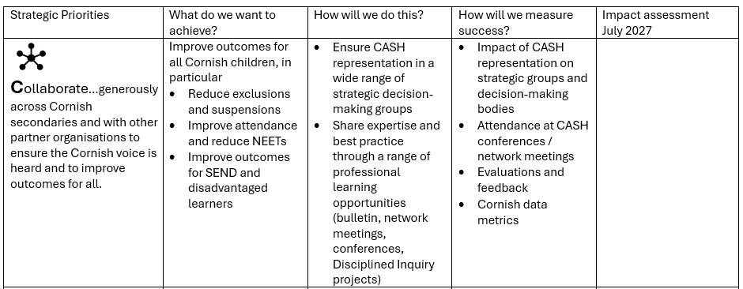

Slide 62
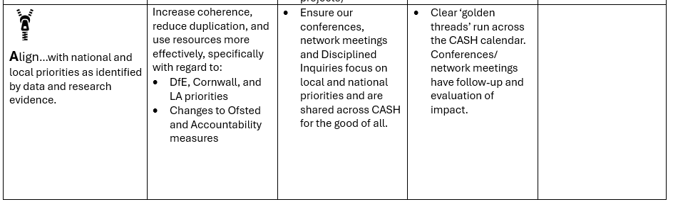

Slide 63
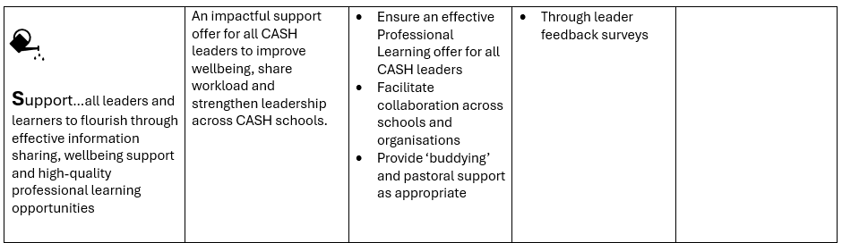

Slide 64
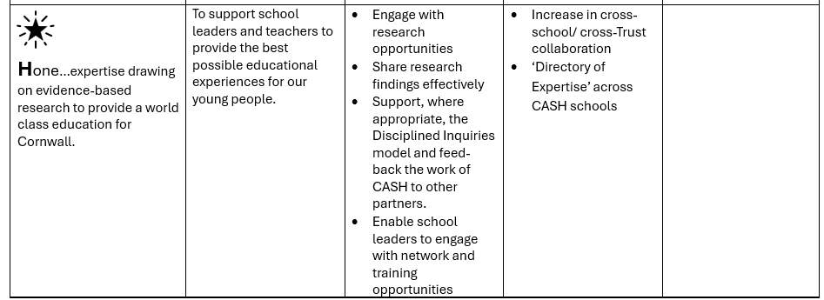

Slide 65

Report from the Treasurer

Slide 66

Election of CASH Executive Committee
We have 9 candidates for 8 places.
According to our Terms of Reference, “The Executive Committee shall seek as far as possible to be representative of the CASH members by striving to achieve a balance of the different size, type of schools and circumstances of different schools across Cornwall including:
11-18 schools
11-16 schools
Special schools
Alternative Education Providers
Heads of school
Headteachers in their first two years of Headship

Slide 67
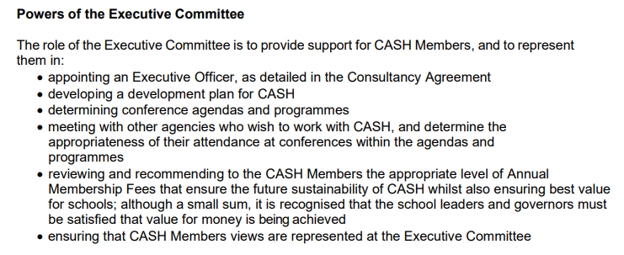

Slide 68
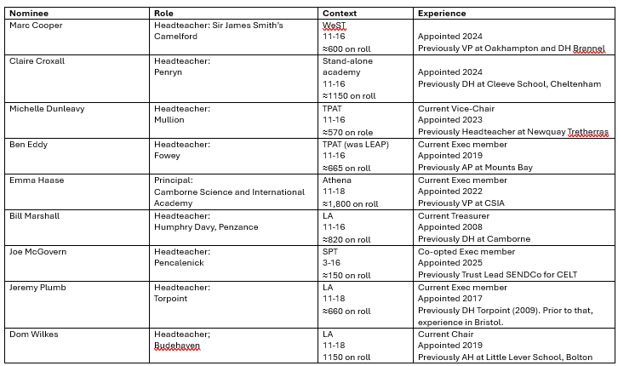

Slide 69


Slide 70
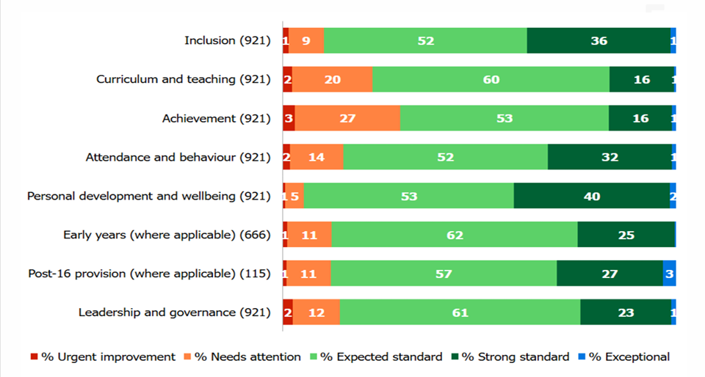
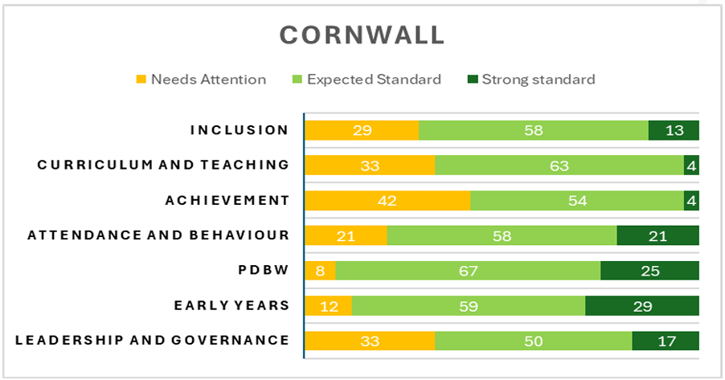
National data vs Cornish data

Slide 71

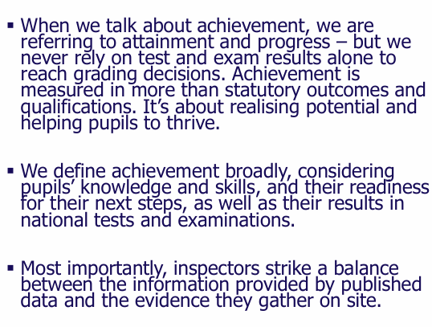

Slide 72
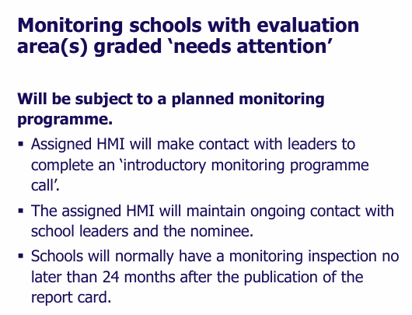
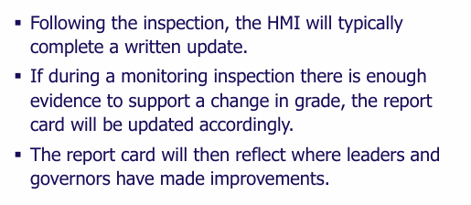
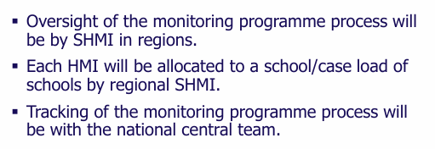

Slide 73

Experts at Hand!
Simon Horner, Executive Headteacher, Mounts-Bay (TPAT): recently trained OI.
Melissa Lock, Headteacher, Hayle (TPAT), recently inspected.
Deborah Mitchell, CEO Restorative Justice Working, CIO, re strategies to support the ‘Inclusion’ judgement.
Paul Boyes, Headteacher, Looe (SMART), recently inspected.

Slide 74

Post-Ofsted Reflections
Hayle Academy
2nd –3rd June 2026

Slide 75

We are Hayle...
614 students ARB: 22 students (PAN 20)
31.14% eligible for PP funding 31.3% with FSM
20.5% with SEND 16.3% with an EHCP 6% Young Carers

Slide 76
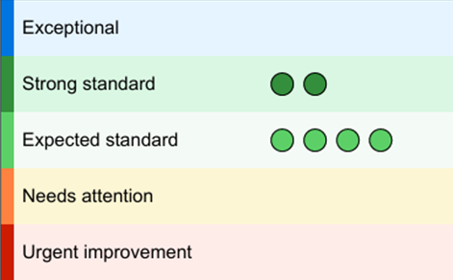
Ofsted recognises inclusion and personal development as significant strengths of Hayle Academy
“Pupils are proud to attend this school”
“A kind, respectful community where pupils feel safe”
“Pupils are warmly welcomed… this helps to create a strong sense of belonging”
“Leaders have established a calm and purposeful learning environment”
Inclusion is a real strength, noting that support for pupils “impacts positively on their progress and wellbeing” and that pupils “thrive at school and are well prepared for their next steps”

Slide 77
Ofsted recognises inclusion and personal development as significant strengths of Hayle Academy
Our work with vulnerable groups, where provision “makes a demonstrable difference” and is always in pupils’ best interests
“The personal development programme is a strength of the school”
Our pupils “benefit from a range of experiences and opportunities” that broaden their horizons
Pupils “benefit from learning a well-planned, ambitious curriculum that sets them up to be successful in their next steps.”
Leaders are “passionate about supporting pupils… to ‘dream big to achieve more’” and ensure that changes are made in the best interests of pupils.

Slide 78
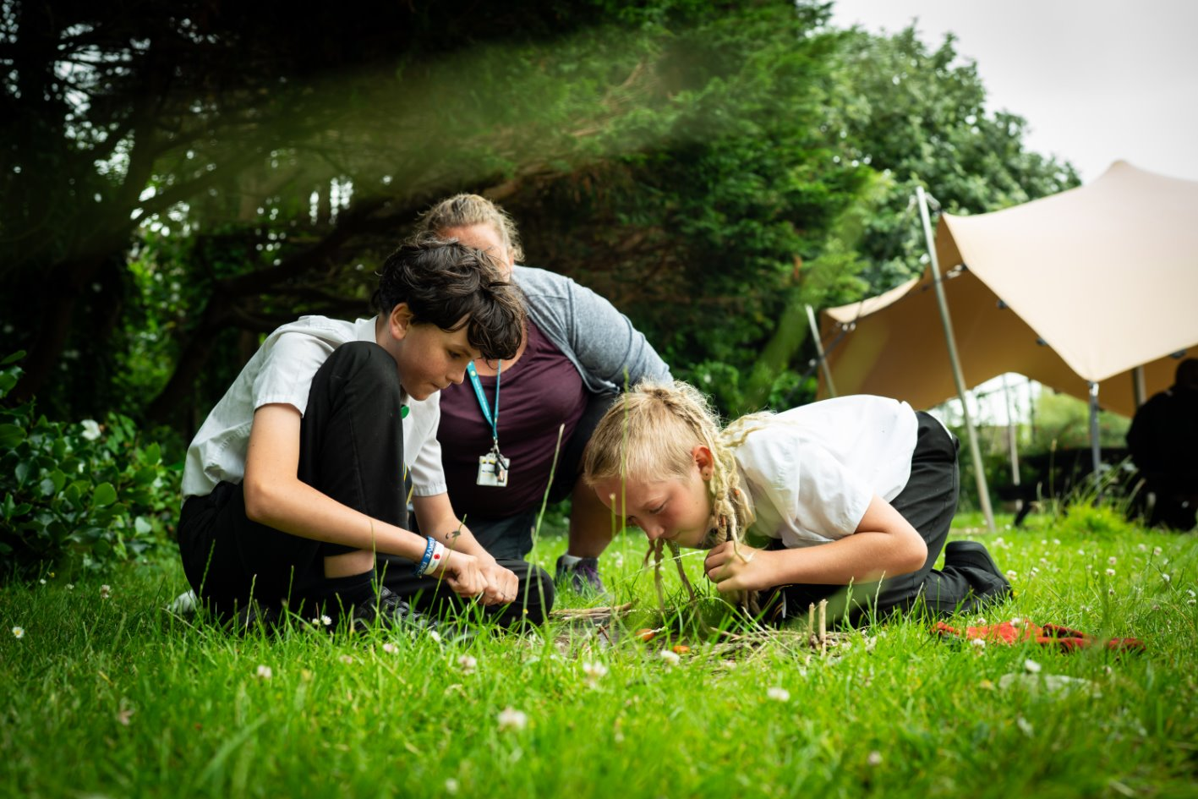
Inspection Structure
Team: 4 inspectors + 1 shadow
Fast-moving with multiple simultaneous lines of enquiry
Pre-Inspection Phase
Know the framework – secure fit
Pre-snagging & last report actions
Prepare for the calls – no surprises
Shared our own self-evaluation
TT set up for 2 days
Ready the upload documents
Communication with families (changes), and messaging drafted in readiness for the call
Nominee
  Time Frame
As expected

Slide 79

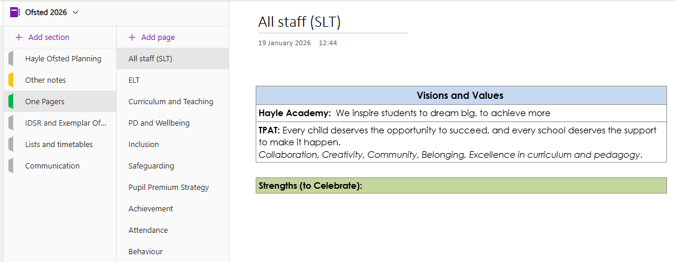
OneNote

Slide 80

Day 1
Lesson Focus
Tuesday morning focused heavily on:
Lesson visits across the school
Case sampling
First-hand evidence of teaching, behaviour and curriculum implementation
SCR compliance
In addition...
With children at 3 points - before school, break and lunch
Site walk with the HMI
Staff groups after school
Student groups – Y9/10 single sex
Leadership meetings – attendance, inclusion, etc. (No separate C & T).
Triangulation between:
What leaders say
What staff understand and implement
What is seen in lessons and books
What pupils can articulate

Slide 81

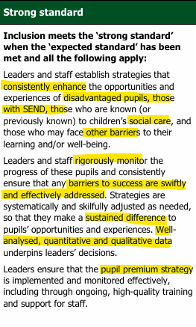

Slide 82
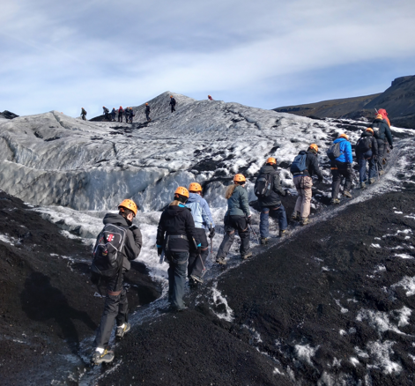


Slide 83
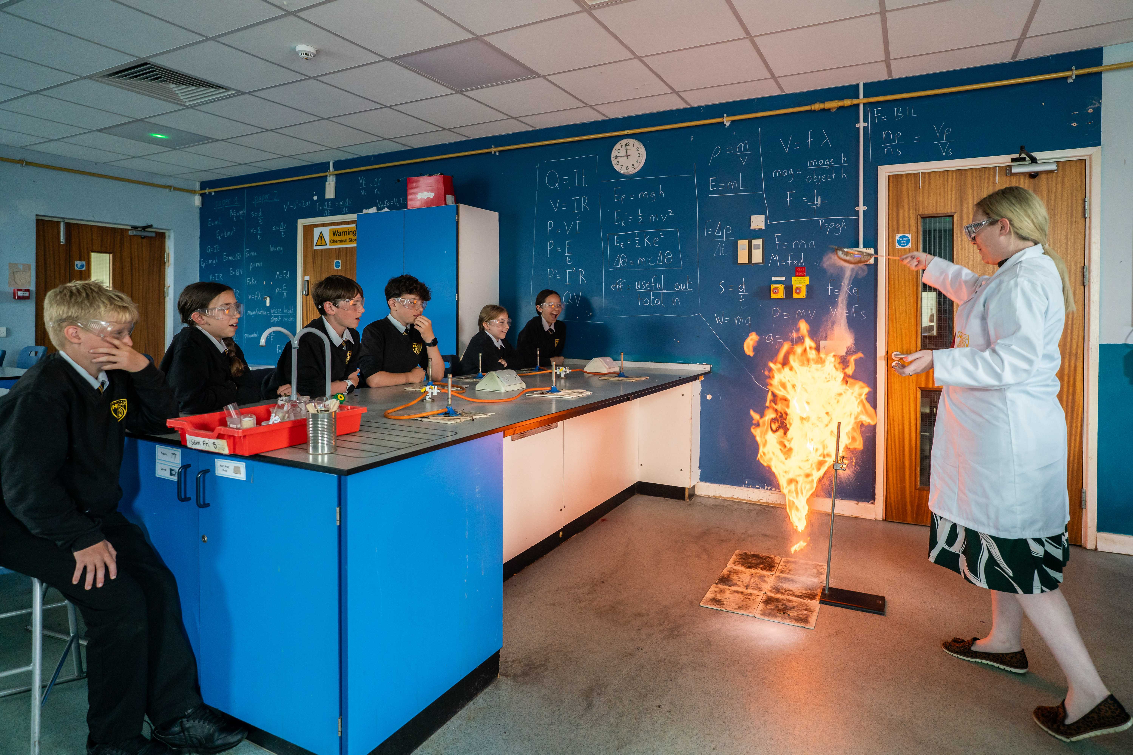
Final thoughts...
'Can't unsee what they see on the Tuesday morning in lessons'​
Book Scrutiny​
Pupil Premium ​
PD: Tracking over time and representation across student groups​
‘Typicality’ and ‘Rigorous Monitoring’ standards are relentless.​
Safeguarding: Ensuring core systems and record keeping was secure and compliant reduced pressure significantly.​
Inclusion – hunting in lessons then questioning in meetings​ & evidence of impact over time
Inspectors came with a clear pre-understanding of performance from the IDSR. “What are you doing about it?” and “What difference is it making?”​
Repeated focus was placed on securing the foundations across different leader focused meetings: reading, spelling, handwriting, numeracy.​
Celebrate, validate and highlight​

Slide 84




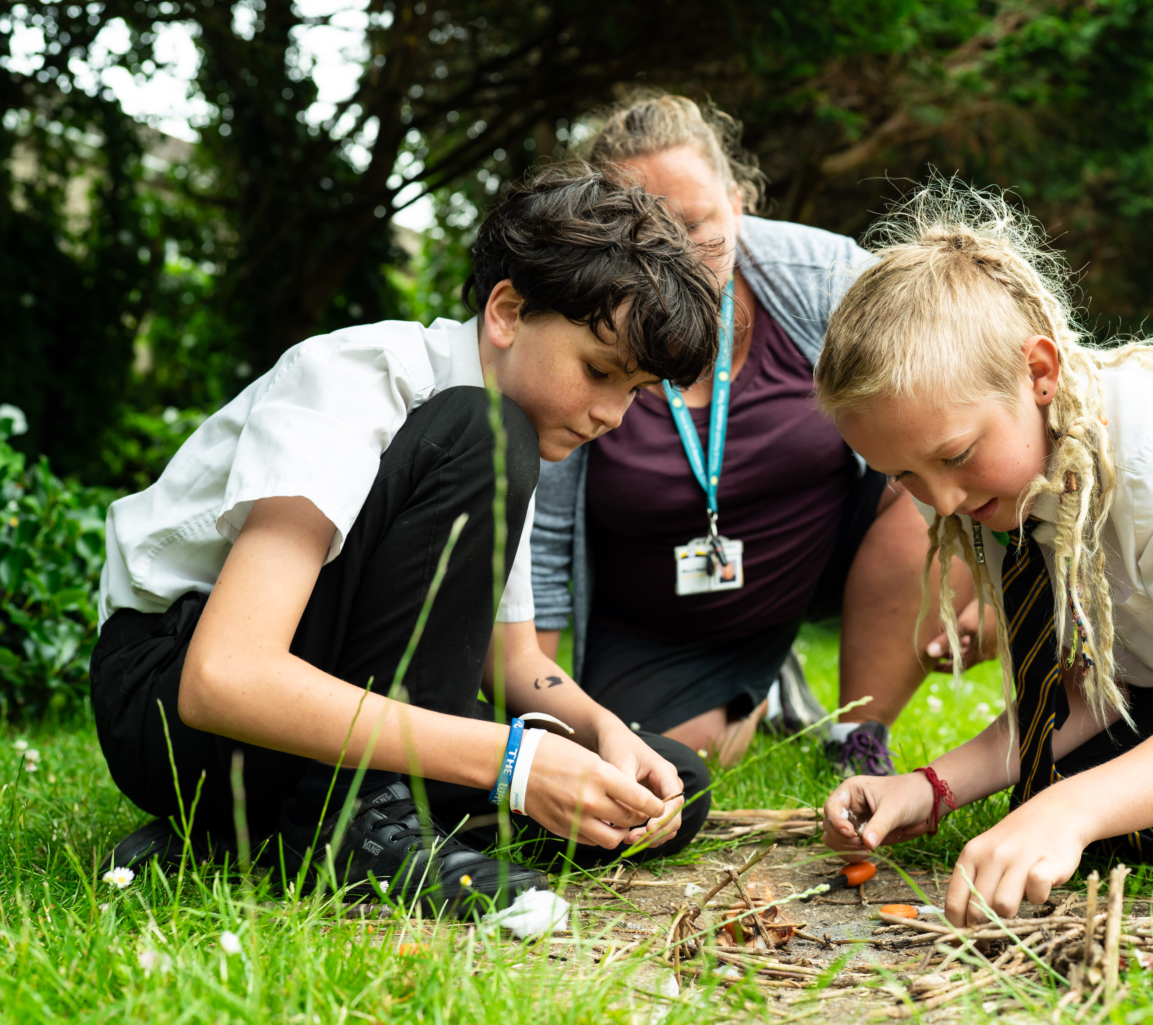
Thank you for listening...
Any questions?

Slide 85


Slide 86




Looe

Slide 87
Home time! (Not for you, Exec!)
Book the October conference now!

