Slide 1


Post-Ofsted Reflections
Hayle Academy
2nd –3rd June 2026

Slide 2

We are Hayle...
614 students ARB: 22 students (PAN 20)
31.14% eligible for PP funding 31.3% with FSM
20.5% with SEND 16.3% with an EHCP 6% Young Carers

Slide 3
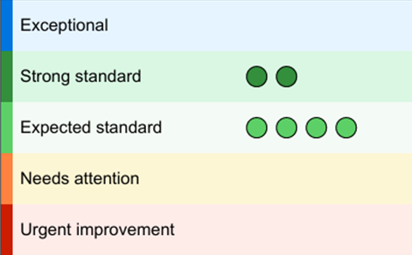
Ofsted recognises inclusion and personal development as significant strengths of Hayle Academy
“Pupils are proud to attend this school”
“A kind, respectful community where pupils feel safe”
“Pupils are warmly welcomed… this helps to create a strong sense of belonging”
“Leaders have established a calm and purposeful learning environment”
Inclusion is a real strength, noting that support for pupils “impacts positively on their progress and wellbeing” and that pupils “thrive at school and are well prepared for their next steps”

Slide 4
Ofsted recognises inclusion and personal development as significant strengths of Hayle Academy
Our work with vulnerable groups, where provision “makes a demonstrable difference” and is always in pupils’ best interests
“The personal development programme is a strength of the school”
Our pupils “benefit from a range of experiences and opportunities” that broaden their horizons
Pupils “benefit from learning a well-planned, ambitious curriculum that sets them up to be successful in their next steps.”
Leaders are “passionate about supporting pupils… to ‘dream big to achieve more’” and ensure that changes are made in the best interests of pupils.

Slide 5
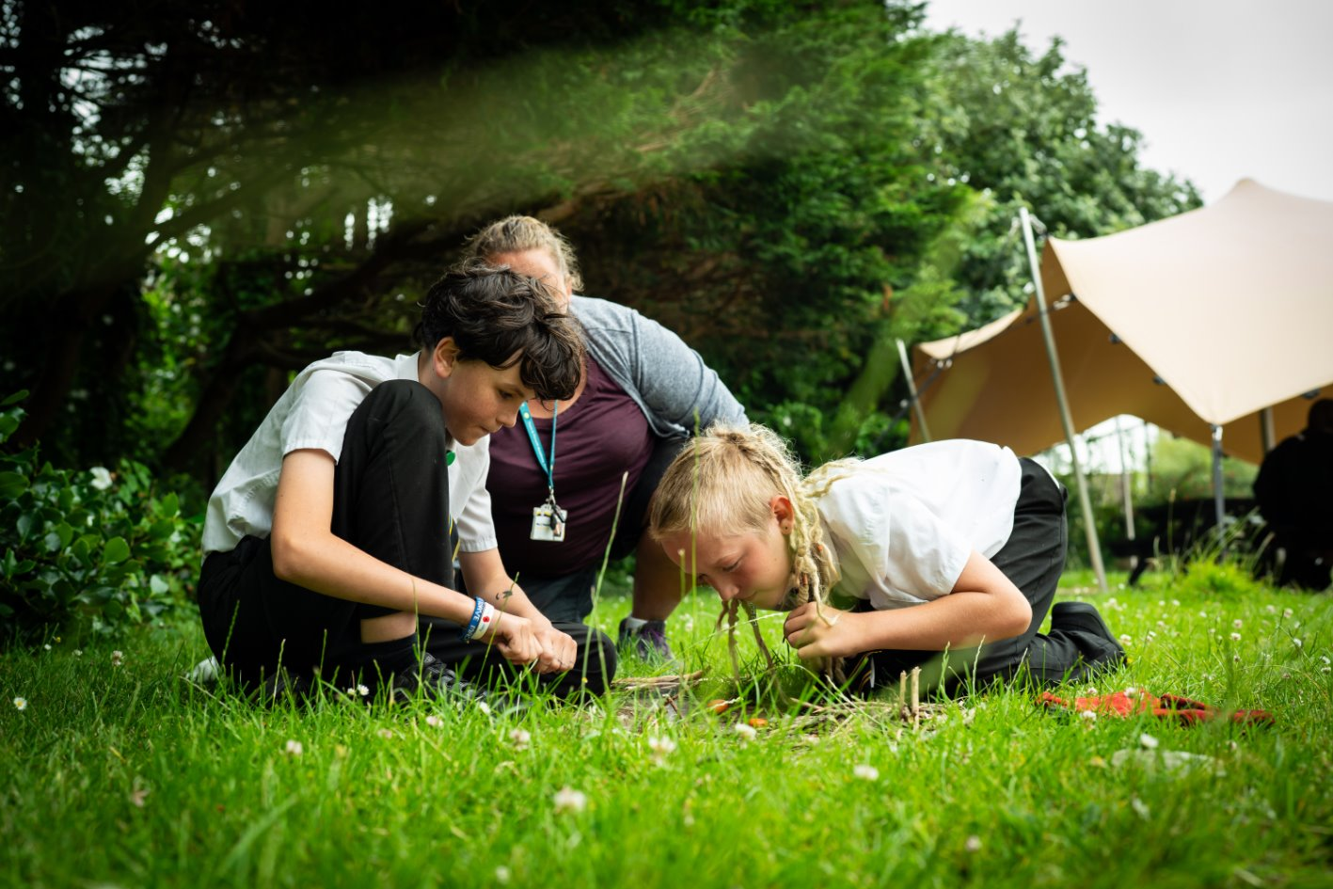
Inspection Structure
Team: 4 inspectors + 1 shadow
Fast-moving with multiple simultaneous lines of enquiry
Pre-Inspection Phase
Know the framework – secure fit
Pre-snagging & last report actions
Prepare for the calls – no surprises
Shared our own self-evaluation
TT set up for 2 days
Ready the upload documents
Communication with families (changes), and messaging drafted in readiness for the call
Nominee
  Time Frame
As expected

Slide 6

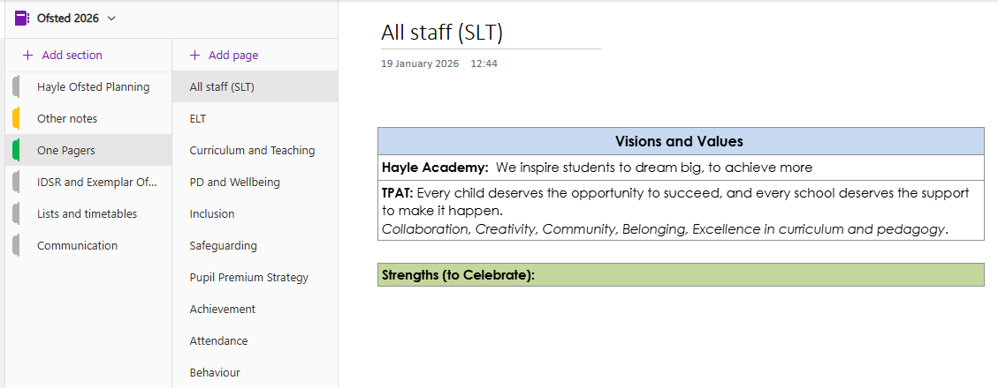
OneNote

Slide 7
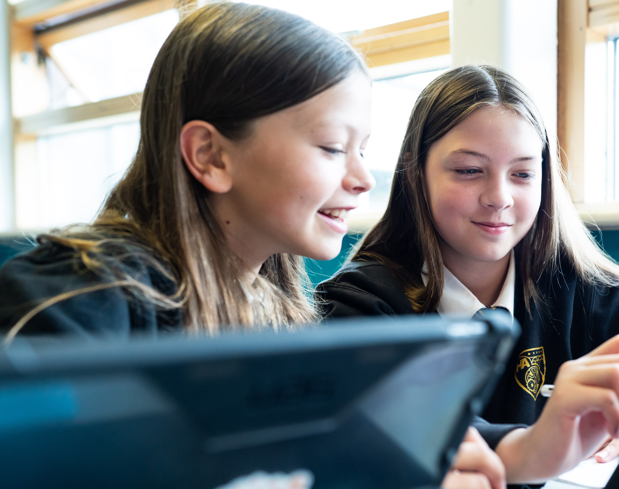
Day 1
Lesson Focus
Tuesday morning focused heavily on:
Lesson visits across the school
Case sampling
First-hand evidence of teaching, behaviour and curriculum implementation
SCR compliance
In addition...
With children at 3 points - before school, break and lunch
Site walk with the HMI
Staff groups after school
Student groups – Y9/10 single sex
Leadership meetings – attendance, inclusion, etc. (No separate C & T).
Triangulation between:
What leaders say
What staff understand and implement
What is seen in lessons and books
What pupils can articulate

Slide 8
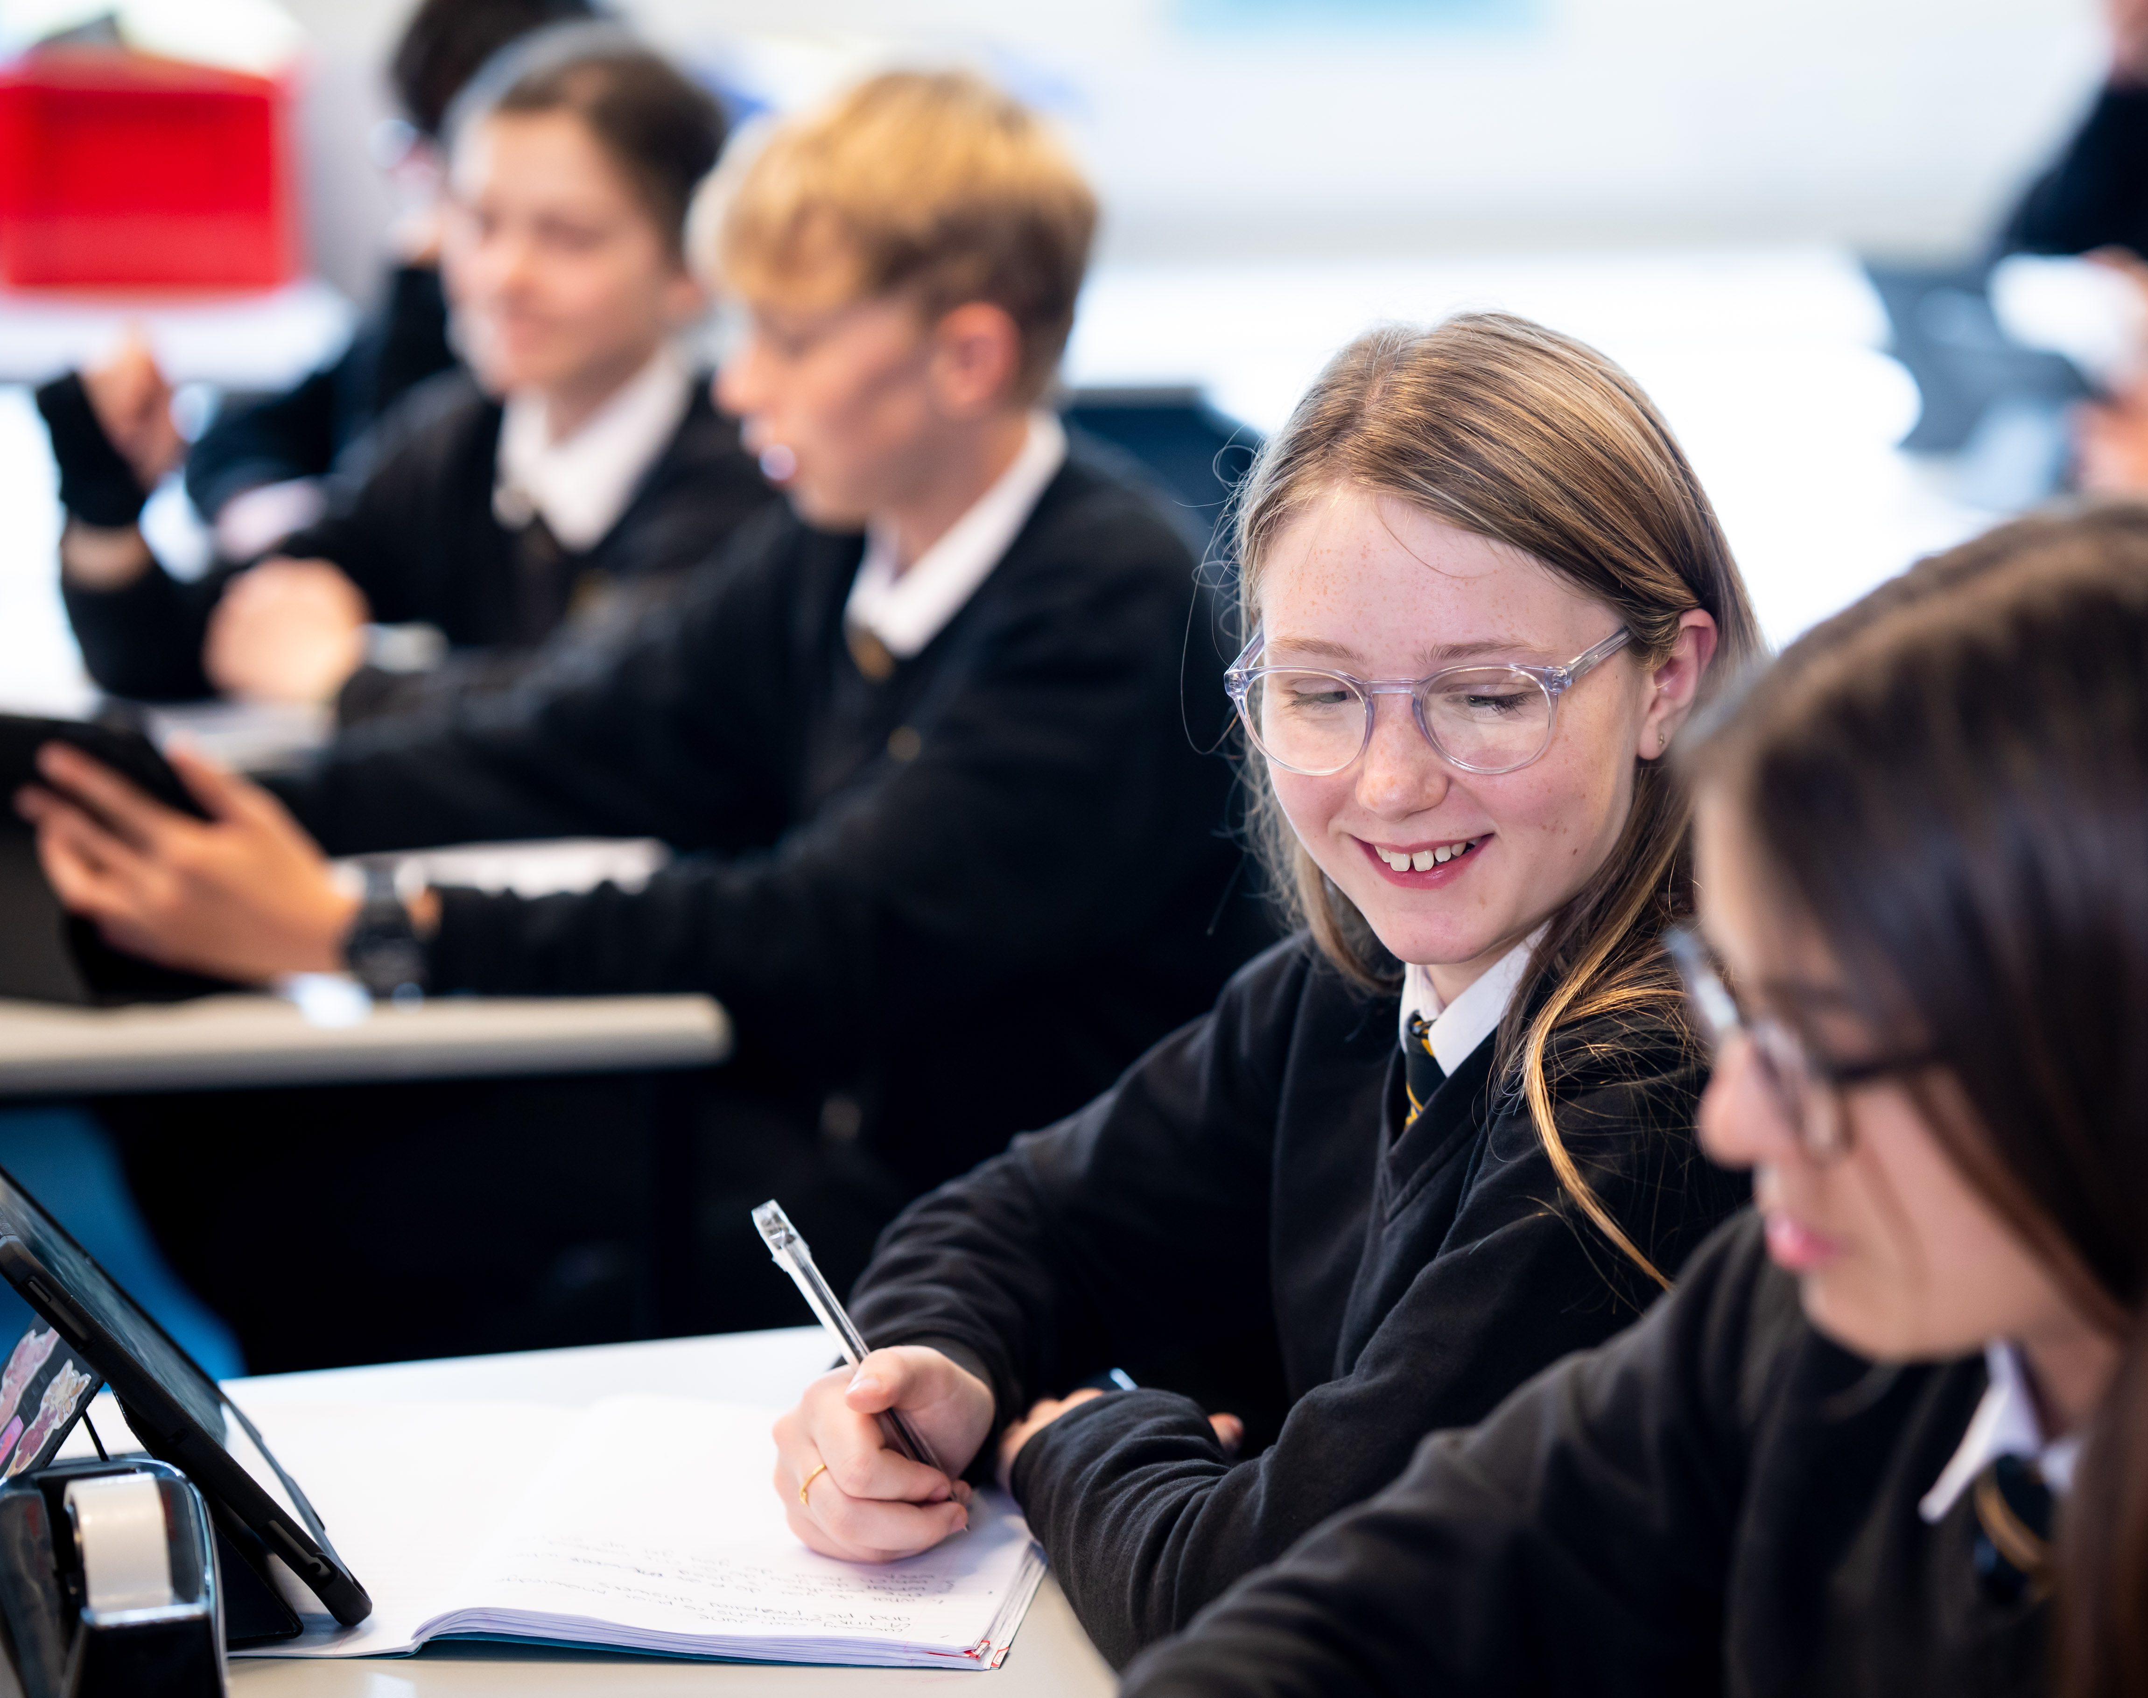
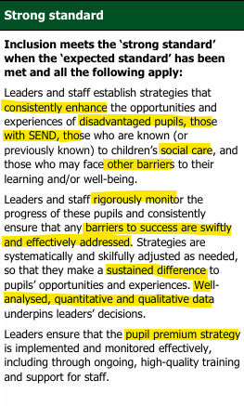

Slide 9
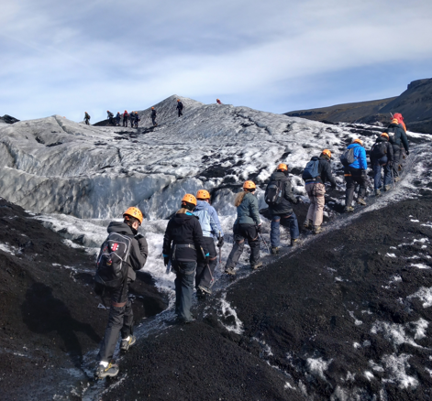
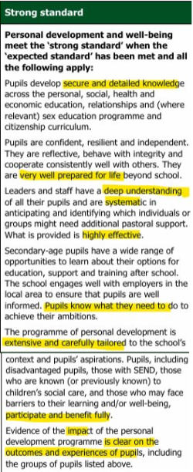

Slide 10
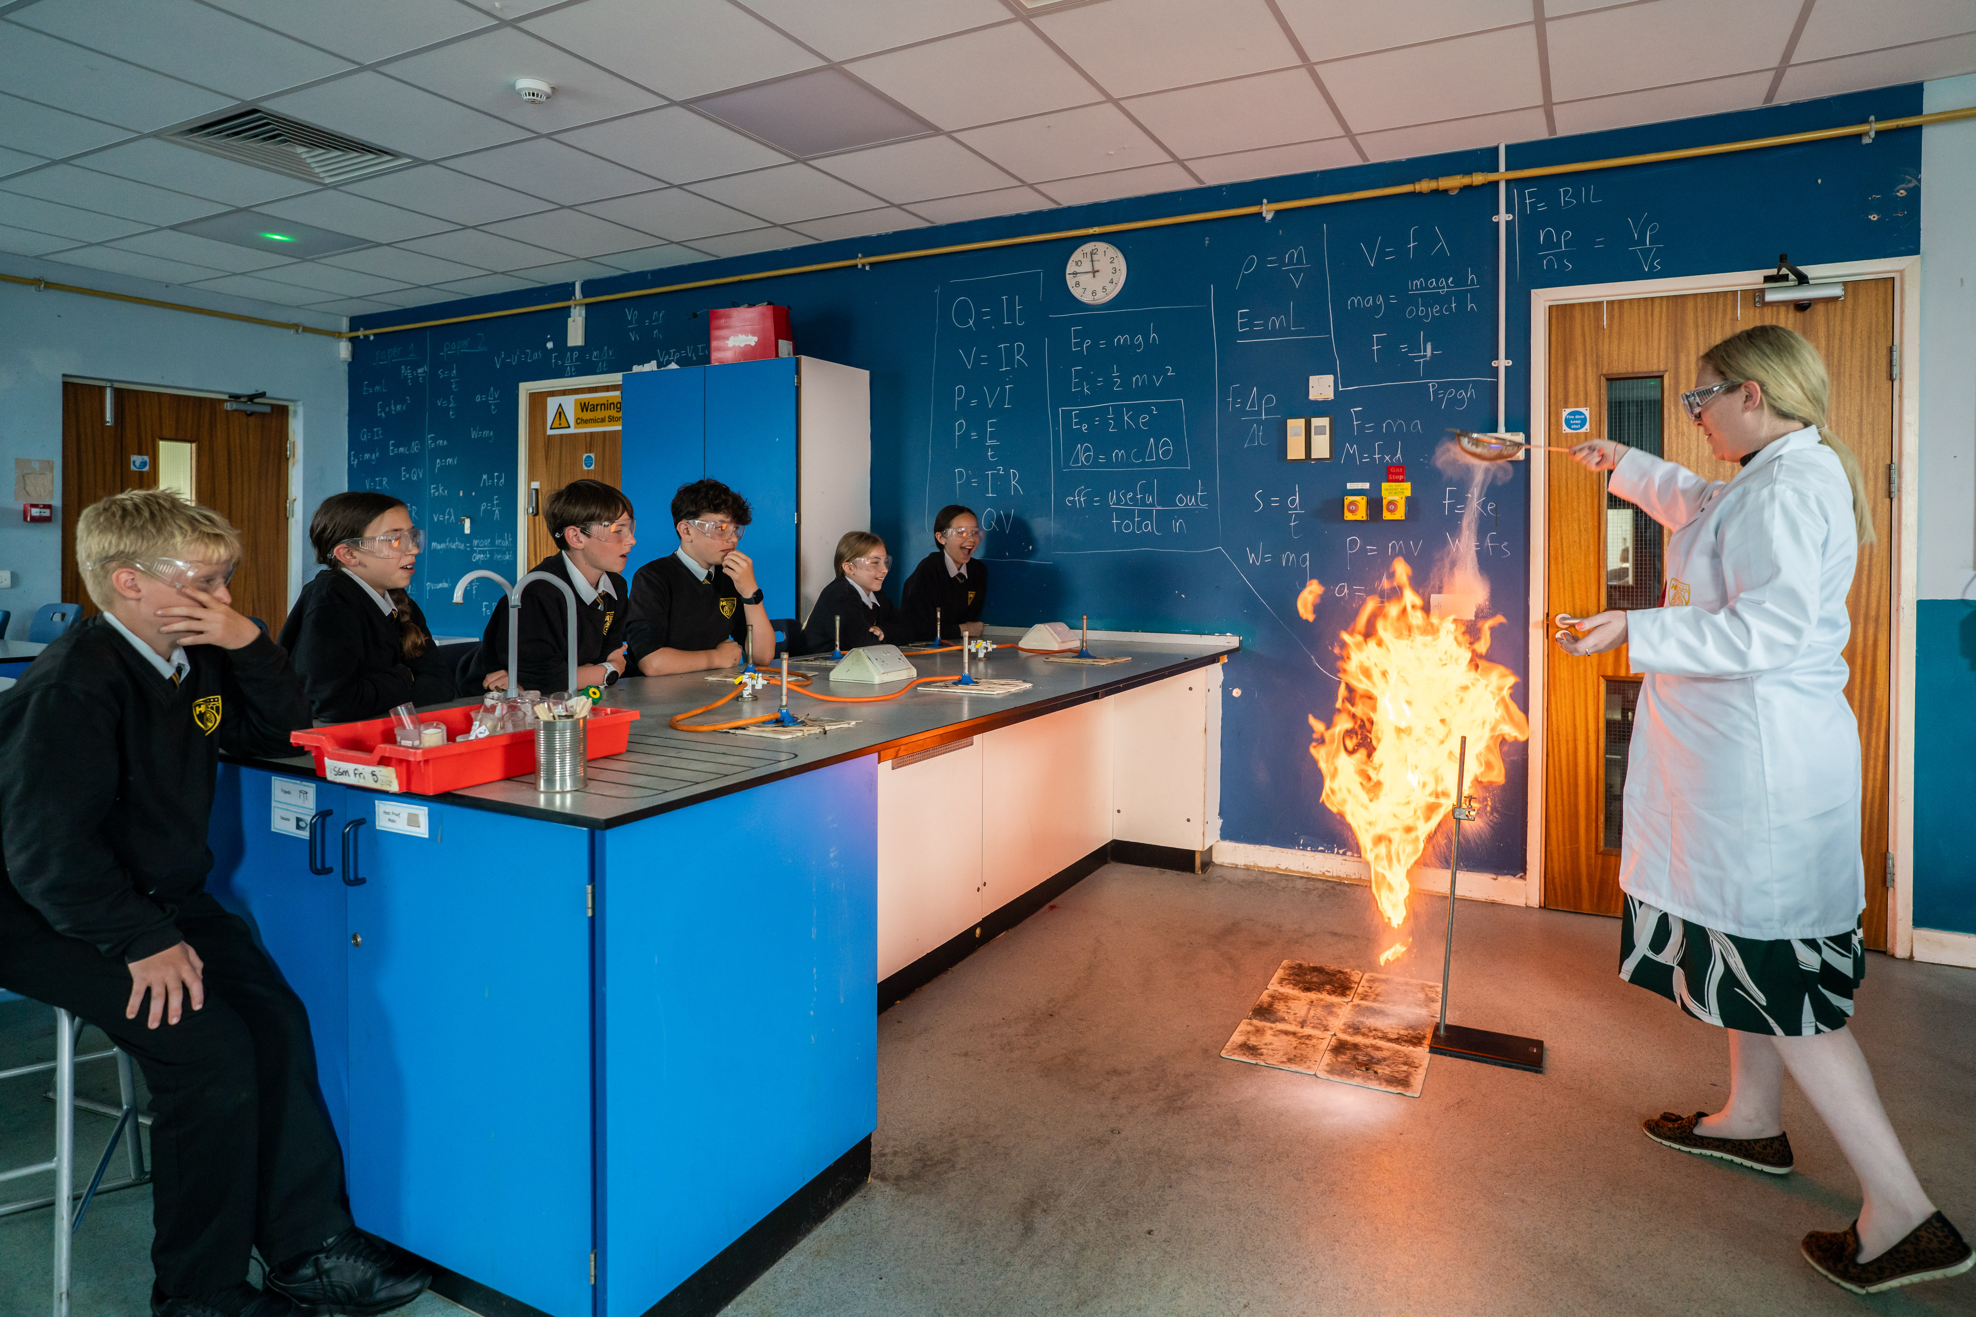
Final thoughts...
'Can't unsee what they see on the Tuesday morning in lessons'​
Book Scrutiny​
Pupil Premium ​
PD: Tracking over time and representation across student groups​
‘Typicality’ and ‘Rigorous Monitoring’ standards are relentless.​
Safeguarding: Ensuring core systems and record keeping was secure and compliant reduced pressure significantly.​
Inclusion – hunting in lessons then questioning in meetings​ & evidence of impact over time
Inspectors came with a clear pre-understanding of performance from the IDSR. “What are you doing about it?” and “What difference is it making?”​
Repeated focus was placed on securing the foundations across different leader focused meetings: reading, spelling, handwriting, numeracy.​
Celebrate, validate and highlight​

Slide 11
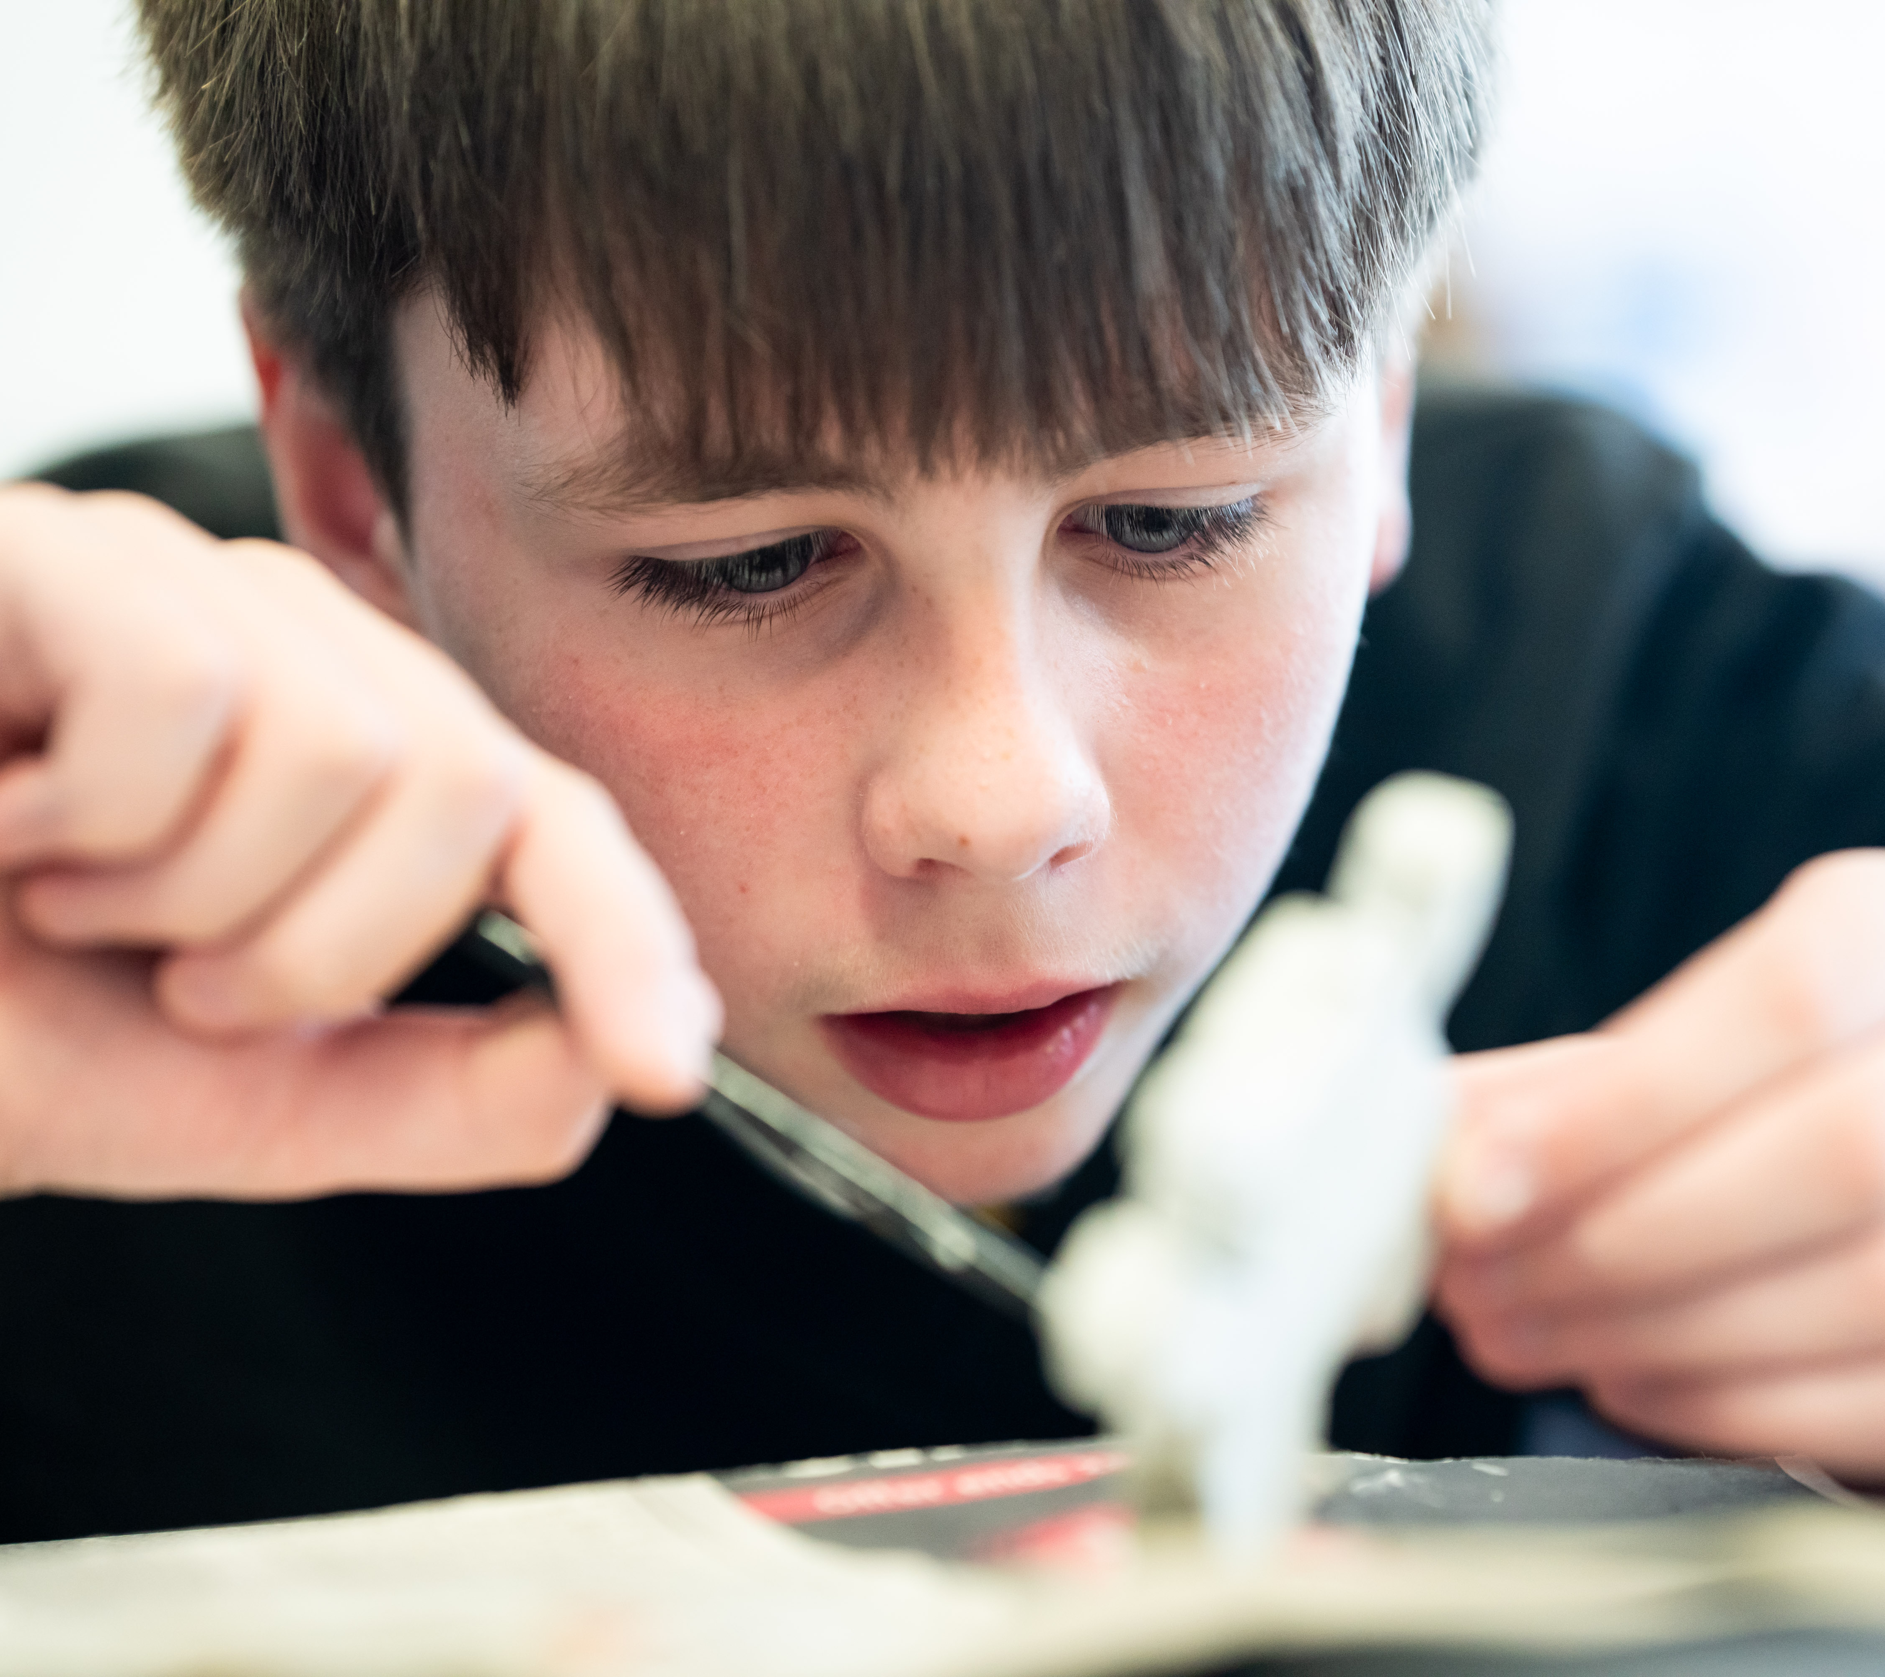

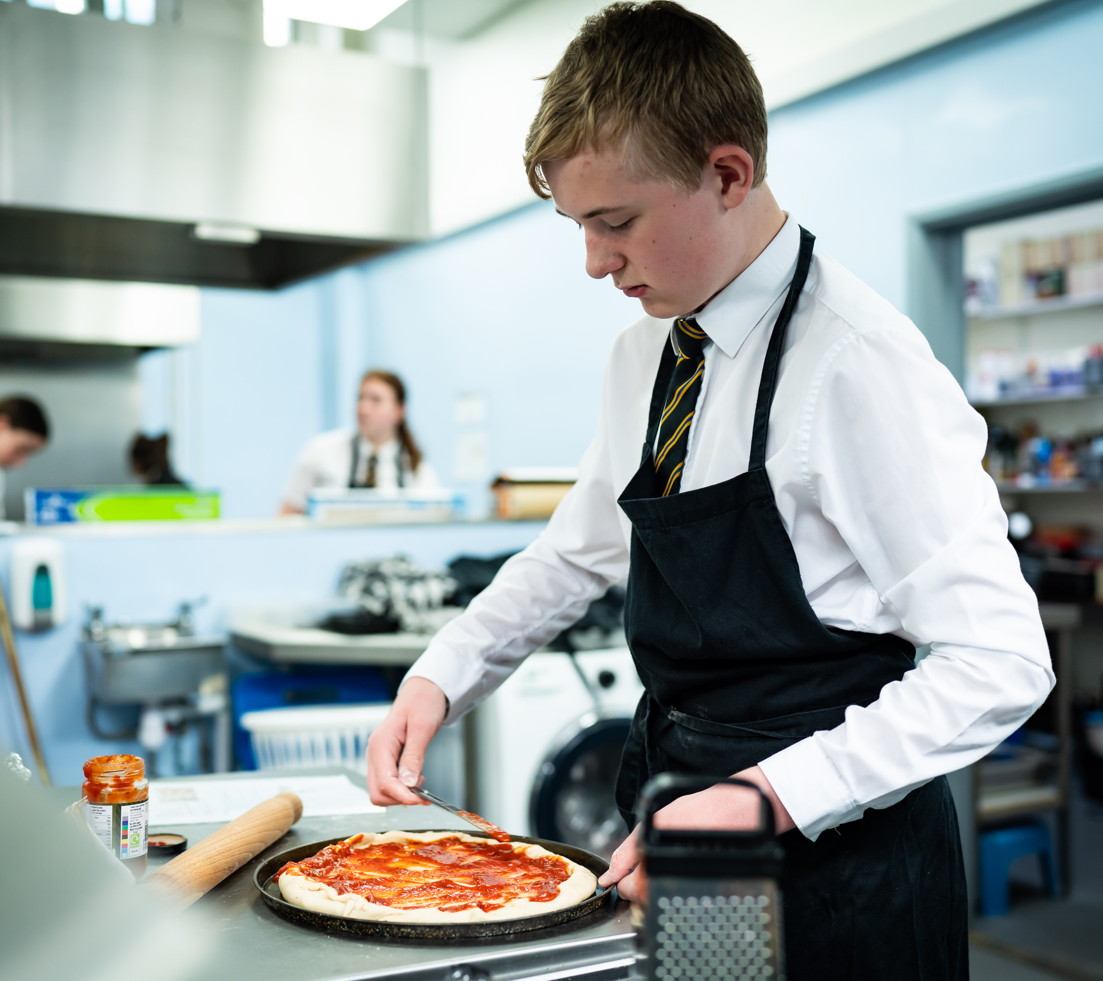
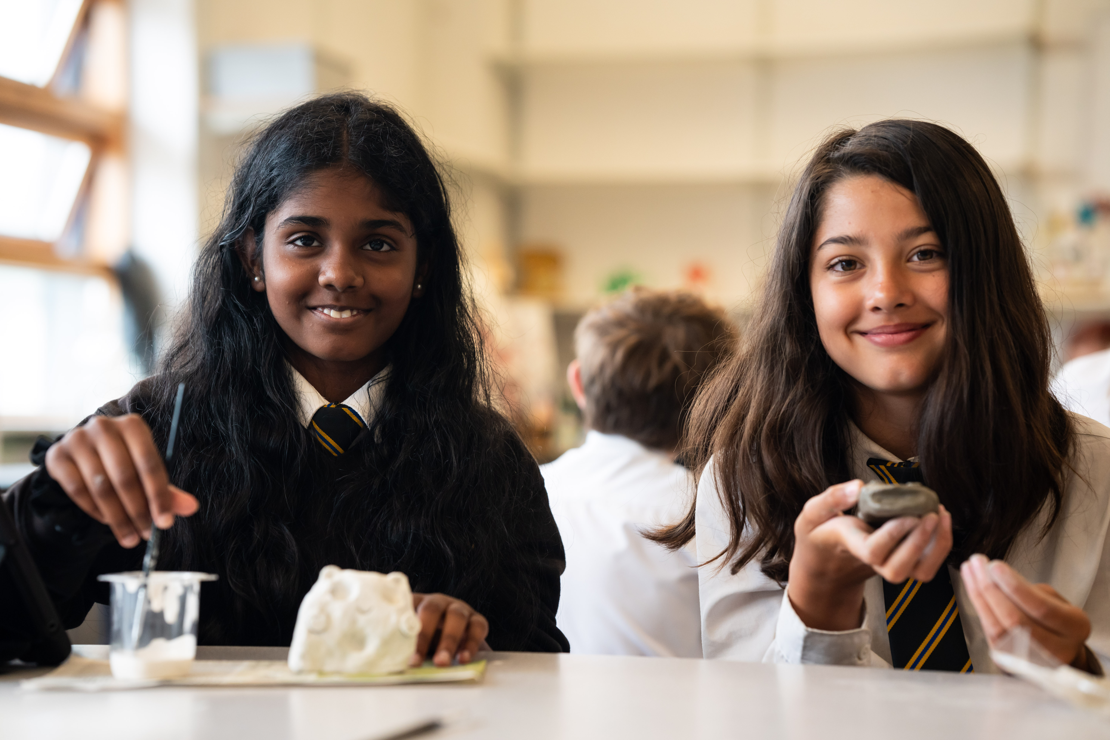
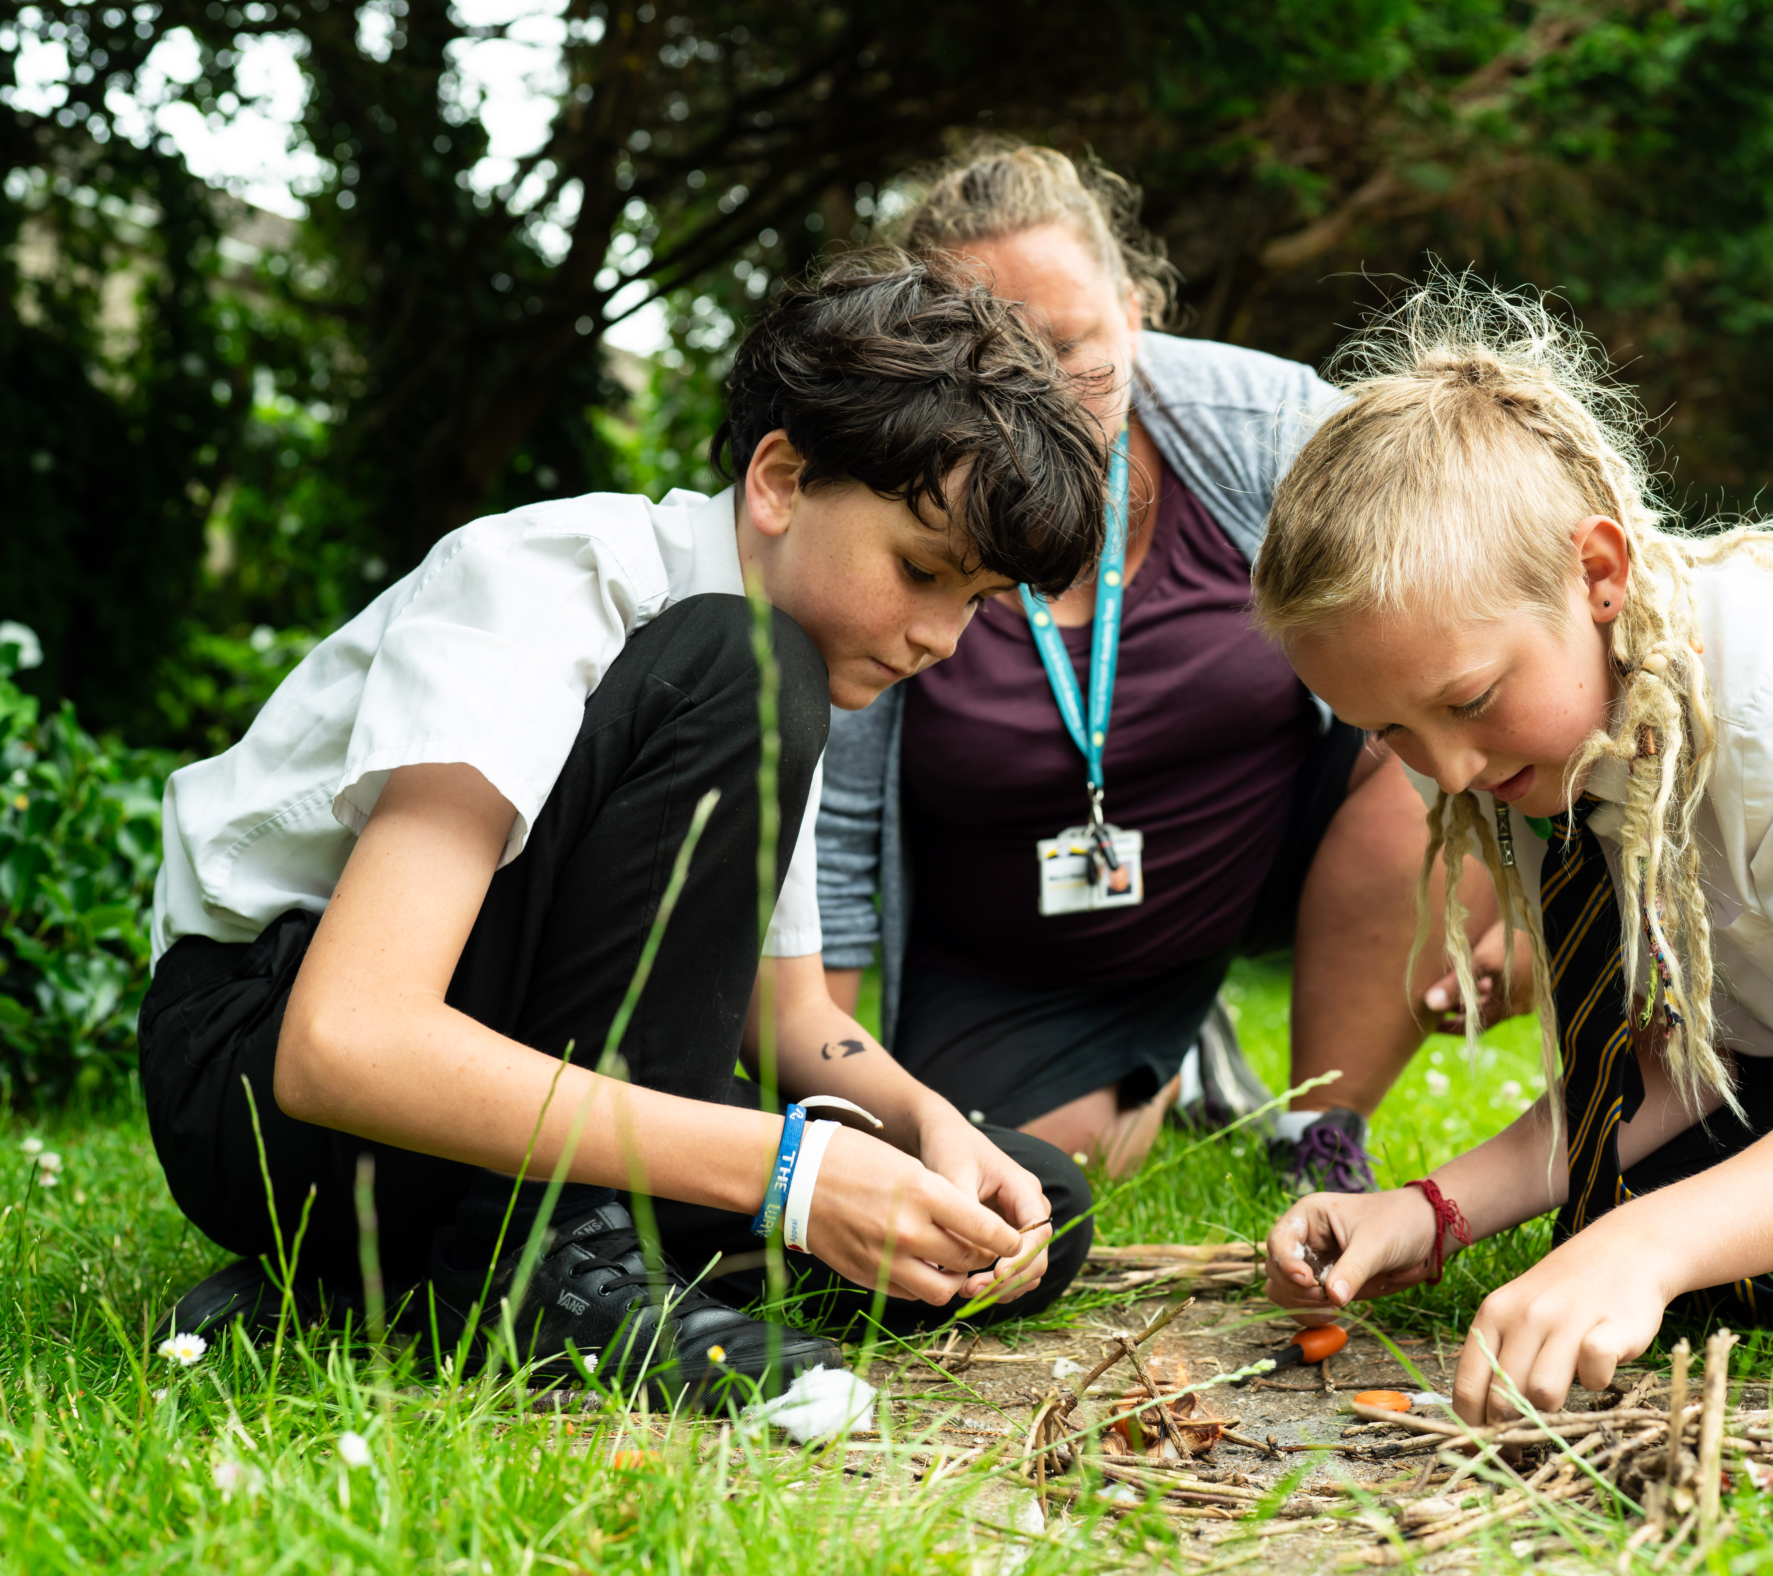
Thank you for listening...
Any questions?

