Slide 1



STRENGTHENING SEND PROVISION THROUGH ONLINE EDUCATION
Practical support for inclusion, continuity, and reintegration
July 2026

Slide 2


TUTE EDUCATION
An education system that enables any child, anywhere to achieve their potential
WHO
WHY
WHAT
HOW
Schools and LAs Working across mainstream, inclusion, SEND, and AP
Pupils facing barriers to education SEND, EBSA, SEMH, medical needs, absence, and risk of exclusion
Early support Putting education in place before needs escalate
Inclusion Helping pupils remain connected to their school and curriculum
Reintegration Supporting a successful return or transition
Broad, balanced curriculum Live lessons aligned to national curriculum and qualifications
Flexible online provision Short, medium, or longer-term support, with no commitment
Academic and pastoral support Teaching, mentoring, student support, and support for families
Qualified teachers Experienced in supporting vulnerable learners
SEND and inclusion expertise Specialist teams supporting access, adaptation, and participation
Purpose-built platform Underpins high-quality online delivery end to end
Quality and safeguarding DfE-accredited provision with robust safeguarding and quality assurance
Partner not provider
Closing gaps in education
Tailored solutions
Integrated online model
Tute Education
CASH summer conference
“Leaders and staff at Tute Education ensure that, from the moment of enrolment, pupils have every opportunity they need to succeed” Ofsted 2025
Academic year
2025-26

Slide 3


MORE COMPLEXITY. LIMITED CAPACITY.
Schools are supporting growing numbers of pupils with increasingly complex needs
At the same time, reform is placing greater emphasis on
Earlier intervention
Support before needs escalate
Stronger mainstream inclusion
More pupils supported within local school systems
Flexible, targeted provision
Support matched to need and able to adapt as circumstances change
Better transitions and reintegration
Clearer routes between settings, support, and suitable education
Rising need and greater expectations are outpacing available capacity and expertise
Tute Education
CASH summer conference

Slide 4

PRACTICAL WAYS SCHOOLS CAN USE TUTE
Flexible provision that can be commissioned around need, capacity, and context
A practical way to strengthen inclusion, maintain learning, and extend school capacity
Support an inclusion base | Maintain learning during absence | Build a flexible timetable | Enable transition and reintegration | Extend curriculum capacity
Deliver curriculum teaching across mixed year groups and pathways, while school staff retain pastoral and specialist support around each pupil. | Provide short, medium, or longer-term provision from home, school, or another suitable setting, with consistent teaching, and clear attendance and progress reporting. | Combine established programmes into the right timetable within 48 hours, or commission a bespoke offer aligned to your curriculum, with the flexibility to adapt as needs change. | Maintain learning while confidence is rebuilt, with regular communication between Tute and the school to review progress and readiness for the next step. | Add qualified teaching where staffing, cohort size, or subject viability makes in-house delivery difficult.
SEND support is built into provision from enrolment onwards, with teaching, adaptations, review, and communication coordinated around the pupil.
Tute Education
CASH summer conference

Slide 5

EFFECTIVE COLLABORATION IN PRACTICE
Proven and impactful
For the student to work at the pace required to meet her needs. To allow opportunity for ‘over learning’ to demonstrate her ability and build confidence
Tute Education
CASH summer conference

Slide 6
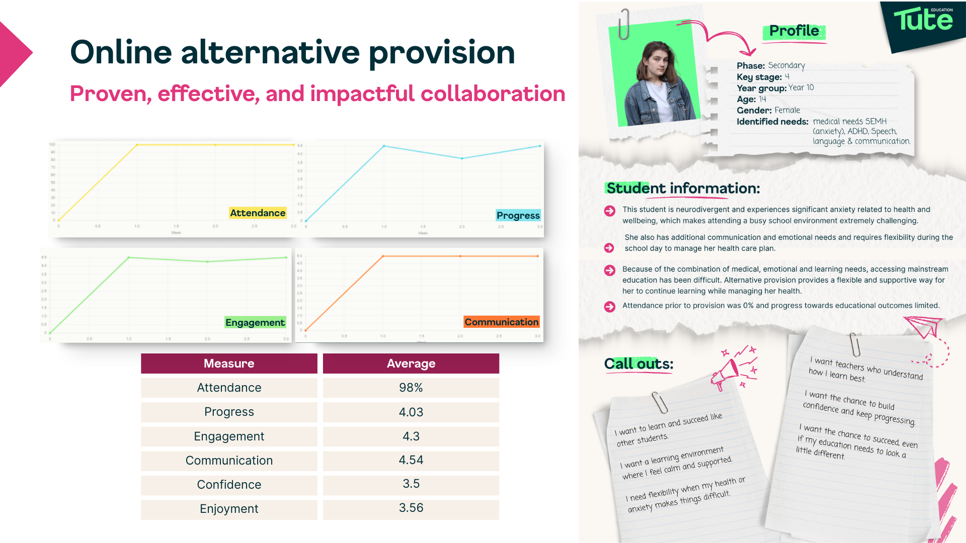
EFFECTIVE COLLABORATION IN PRACTICE
Proven and impactful
Tute Education
CASH summer conference

Slide 7
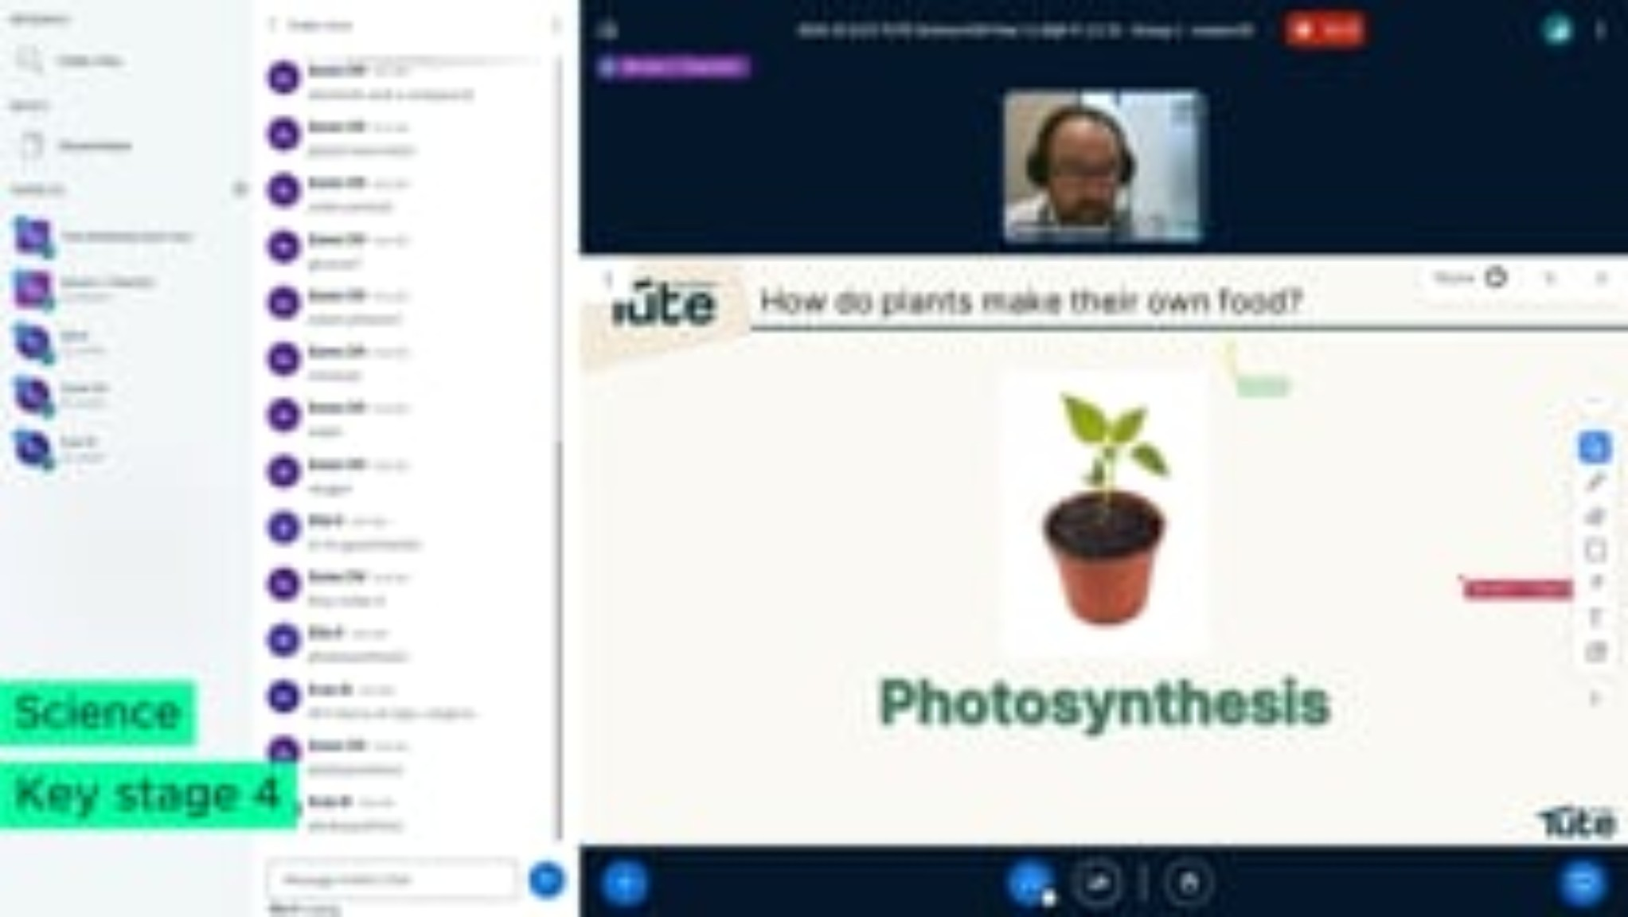

Slide 8




ACCREDITED BY THE DfE - OEAS
Recognition of our commitment to quality and our students
Every opportunity to succeed
Highly-skilled teachers
Safety at the heart
“Leaders and staff at Tute Education Ltd (Tute Education) ensure that, from the moment of enrolment, pupils have every opportunity they need to succeed.”
“Teachers are highly skilled and know their pupils extremely well. They understand their needs – both academically and pastorally – and work tirelessly to build pupils’ confidence.”
“Leaders have put keeping children safe at the heart of everything the setting does. As one leader stated during the visit, ‘If pupils don’t feel safe, they cannot learn.’”
Strong relationships
Learning that rebuilds confidence
Life-changing impact
“The setting’s work is underpinned by strong relationships.”
“Pupils are extremely positive about their experiences. They feel happy, safe and appreciate the lengths to which staff go in order to make learning accessible and fun.”
“As one parent wrote, ‘It has been life-changing for my child. They now enjoy learning again and are happy.’”
Tute Education
CASH summer conference

