Slide 1


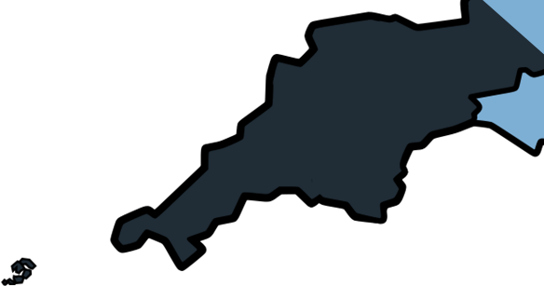

Supporting the Next Generation
www.cornwallmarineacademy.co.uk

Slide 2
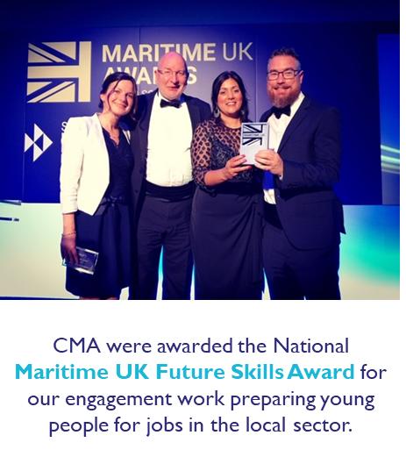



Cornwall Marine Academy (CMA)
Cornwall Marine Academy CIC (part of Cornwall Marine Network) was created in 2008 to raise awareness of the wide range of career opportunities in the Marine sector, delivering vocational training and work experience to young people aged 9 to 24 and support their employability and progression onto further education, an Apprenticeship or a job
Supported more than 40,000 young people in Cornwall through careers advice, taster sessions, vocational experiences, improved employability skills and pre-apprenticeship training.
Created meaningful Vocational Work Experience placements for 4,000 Young People aged 14-16 (some placements were 50 days over two years per person).
On average, CMA CIC and our team of Marine Ambassadors provides Marine careers advice annually to around 20% of all Year 10 and Year 11 students at Cornwall secondary schools.
In 2023, CMA delivered its first support programme to a local Primary School and continues to expand this offer (Key Stage 2 +).
CMA CIC has created a team of 106 volunteer Marine Ambassadors from member businesses who share Marine careers advice at local secondary schools.
www.cornwallmarineacademy.co.uk

Slide 3
Marine Sector Landscape
x900 Businesses; 99.5% SME’s; of which 86% Micros
16,052 jobs directly supported by the marine sector in Cornwall
plus 1,400 marine volunteers
Marine sector GDP £1.12 billion per annum to Cornwall economy
6.4% (1 in 15 people) of Cornwall's employment
60% of sector is Leisure Marine
Ports, Harbours and Marinas – Boatbuilding, Ship and Boat Repair - Marine Engineering and Manufacturing
Marine Leisure, Tourism and Health - Marine Technology, Data and Autonomy - Fisheries and Aquaculture
Marine and Offshore Resources (Floating Offshore Wind, Wave, Tidal)

Slide 4

CMA Services and Activities
Supporting Your School To Meet Gatsby Benchmarks
Bespoke, flexible and tailored support
Courses, Workshops, Engagement & Delivery Employability skills workshops
Boatbuilding, Sustainability, Engineering Days
Prepare to Earn - Accredited training courses
Money Matters and Budgeting Skills
Employer/Ambassador engagements - Site visits, talks, work experience
www.cornwallmarineacademy.co.uk

Slide 5
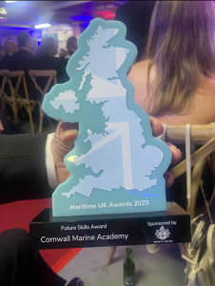
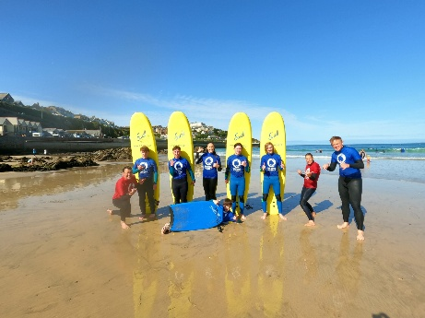
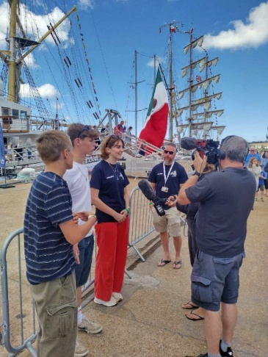
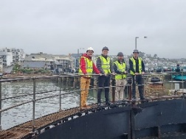
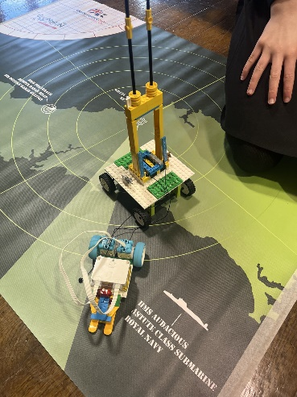
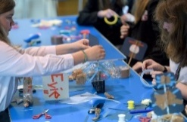
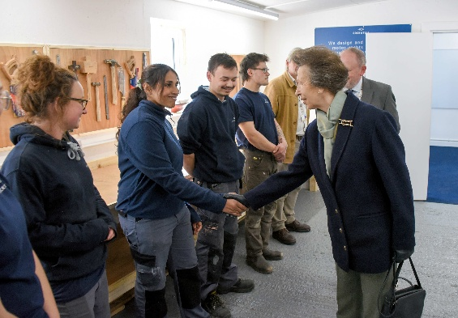
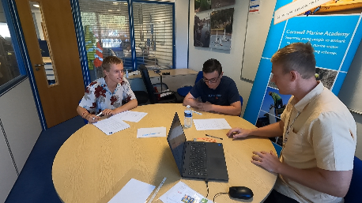
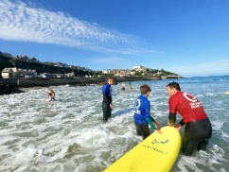
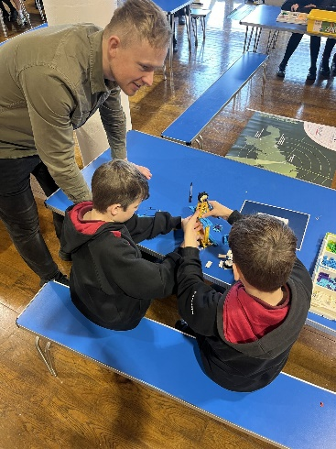
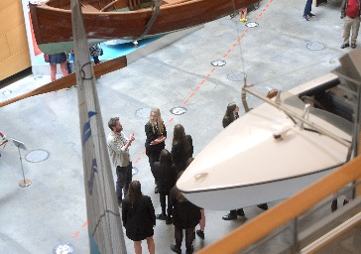
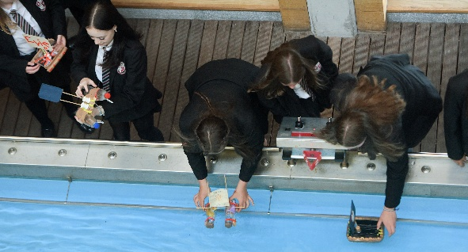
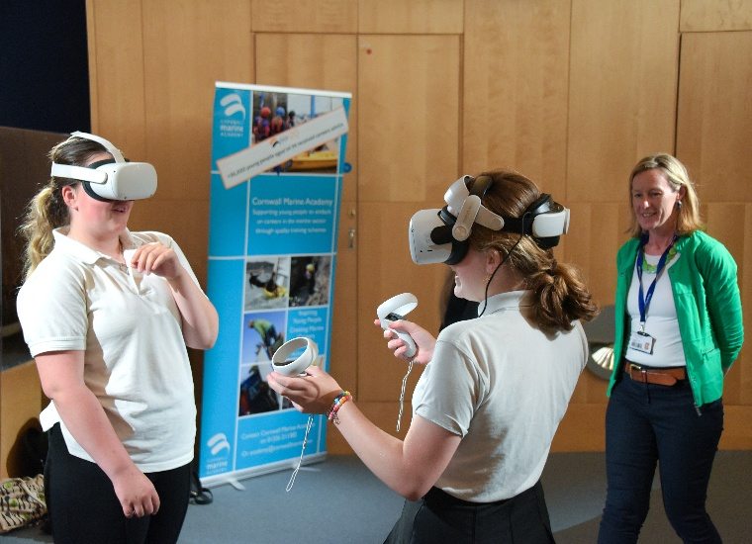
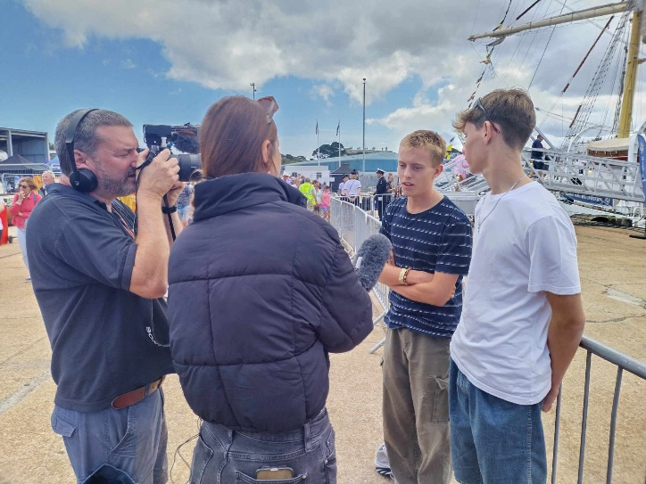
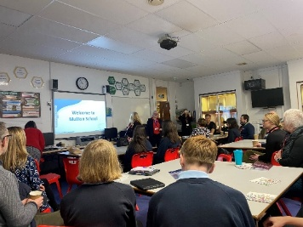
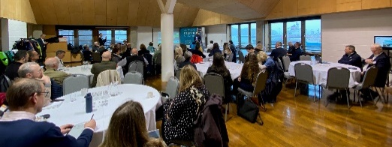
Engagements and Activities
Maritime Roadshow for Girls
STEM based Lego Submerged
Virtual Reality based learning
Work Placements
School Outreach Programme
Vocational and Employability Training
Industry Visits and Education Days
Work Experience

Slide 6
CMA
We discover your individual school needs, gaps and the support you require
We provide solutions to support your school and students
We can create new and bespoke delivery packages for your school
We think about the next generational workforce – and want students to understand the brilliant careers and opportunities in Cornwall
www.cornwallmarineacademy.co.uk

Slide 7
Any Questions?
“We cannot recommend the Cornwall Marine Academy enough! Our students recently completed a course that was outstanding from beginning to end. It was wonderful to see the students engage with the local boat-building industry—an incredible world of opportunity that exists right on their doorsteps.”
“We’ve seen a real shift in student aspirations and conduct since their return. The staff were supportive and invested, but we’d like to give a special shout-out to Joe, whose leadership and enthusiasm made him a fantastic ambassador for the Academy. An amazing, high-value experience for everyone involved!”
James Rogers – Headteacher - Treviglas Academy
academy@cornwallmarine.net
www.cornwallmarineacademy.co.uk

