Slide 1

An Introduction To
Emotional Logic

Slide 2
My background
Primary Headteacher
Exciting Education Ltd
Emotion Logic charity
Plymouth Multi Agency Support Team
Chair Plymouth Foster Panel
Vice Chair Cornwall Foster Panel cornishcritters.com

Slide 3
FAQs
What am I going to be doing today?
Will I have to talk about personal situations and share my emotions with others?

Slide 4
What is Emotional Logic?

Slide 5
A technique developed by British GPs in the 1990s and used around the world
Learn to recognise and understand your unpleasant emotions and your core values that underpin these
Learn how to make plans to move forward effectively without causing more problems!
It’s coaching not therapy - something you can learn and teach your family and friends

Slide 6
The Healthy
Adjustment
Process

Slide 7
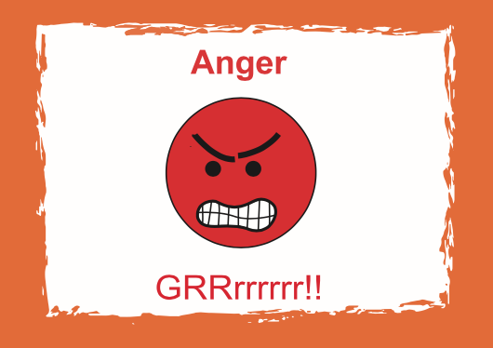
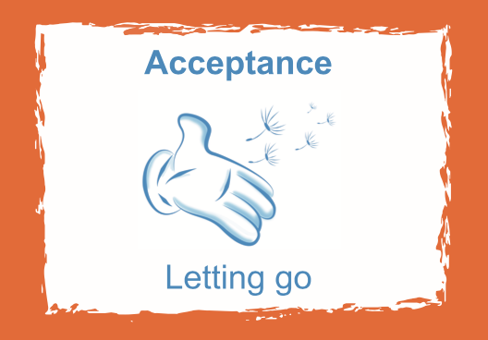

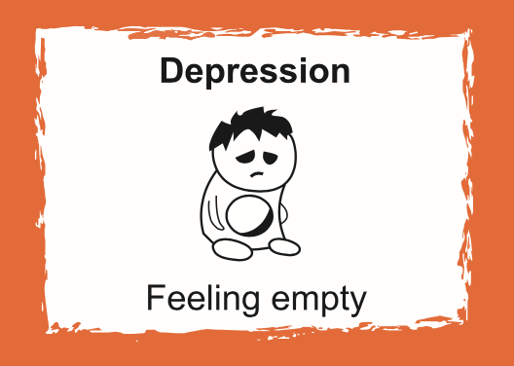

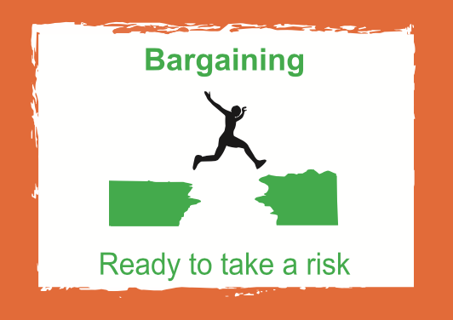

The Healthy Adjustment Process

Slide 8
Step 1
Making sense of how we are feeling
“Use the cards to show me how you feel”
You can’t get it wrong
Use as few or as many cards as you feel relevant

Slide 9
Scenario
Imagine you are 13 years old.
You’ve not been invited to the party!
Look at the cards
What would your pattern look like?

Slide 10
My pattern

Slide 11
Step 2
Discover what you have lost by naming some hidden values
Children and adults often need training how to do this!

Slide 12
What can I no longer do?
Feel part of a group
Feel wanted
Be happy
Have my usual confidence
Visit my friend’s house at the weekend
Sleep well
Relax and unwind
Hang out with a friend
Have fun with somebody
Trust those friends
Have my point of view heard
Understand why this happened
Enjoy the party food
Watch the movie
Plus many more…

Slide 13
Now that I have lost a friend, what can I no longer do?
I no longer have someone to:
Have fun with
Hang out with at breaktime
Go to football club with
Walk home with
Do online gaming with
Share my worries with
Do my homework with
Invite to my house
Borrow things from
Feel safe and relaxed with

Slide 14
Why is this list helpful?
Your personal loss list reflects your personal values
You know exactly what you have lost and therefore what to focus on trying to re-gain
Your Emotional Logic coach helps you design a personal, solution focussed, values based, action plan.

Slide 15
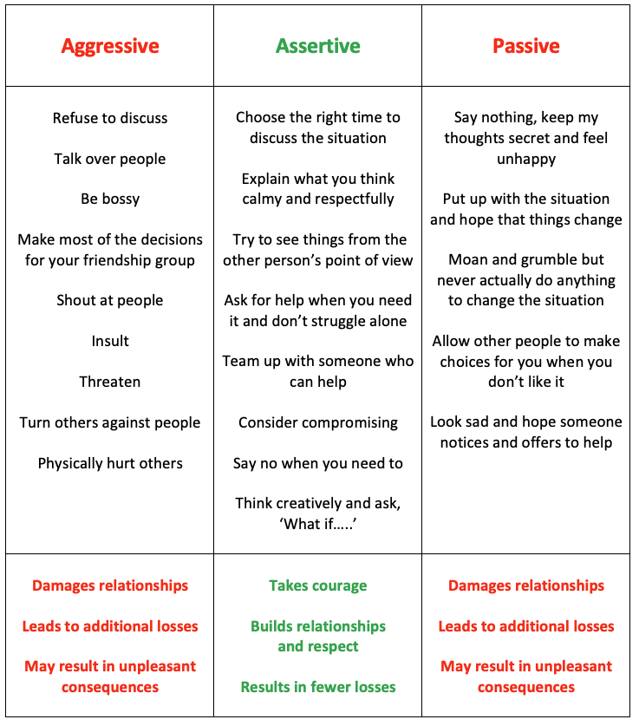
How do you Bargain?
When you are under pressure, which way
do you usually go?
When is Bargaining not a good idea?

Slide 16
What do schools say about the impact?
Strengthen relationships at all levels (peers/staff/personal)
Improved behaviour from pupils in school (87.8%)
Improved pupils’ focus on learning (86.1%)
Reduced anxiety (87.8%)
Increased pupils’ confidence (90.9%)
Increased attendance (76.3%)
Data based on 501 school survey responses
Most children had experienced significant trauma

Slide 17
How we can help you
We offer 1:1 support for children in education settings, one day per week, over half a term.
We can train members of staff to use our lesson plans to teach the basic concepts to all ages (Foundation Award)
You can do further training and become a fully qualified Emotional Logic Coach (Coaching Award)

Slide 18
Further training – The Foundation Award
Train to use our resources with children in school
Help yourself and your family
Accredited by the DfE through their Matrix Standard Award and gives you 30 CPD points
Approximately 30 hours. Two training days and online learning/coursework over 7 weeks.
Aligned with PACE
(Playfulness, Acceptance, Curiosity, Empathy)
Wed 21st Oct/Mon 23 Nov St Austell
Notes:
Learning objectives for the session

Slide 19


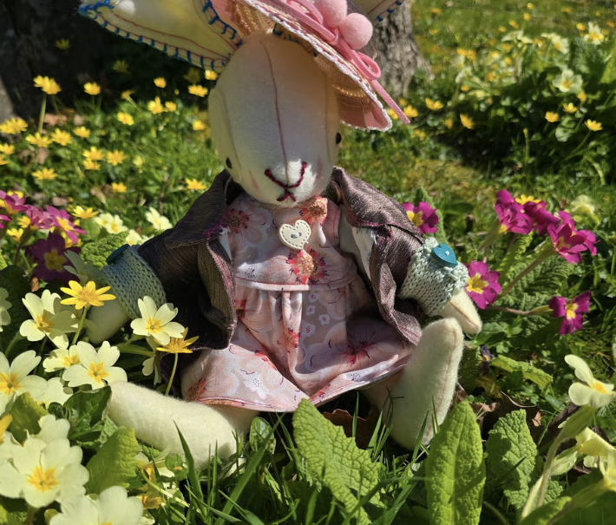
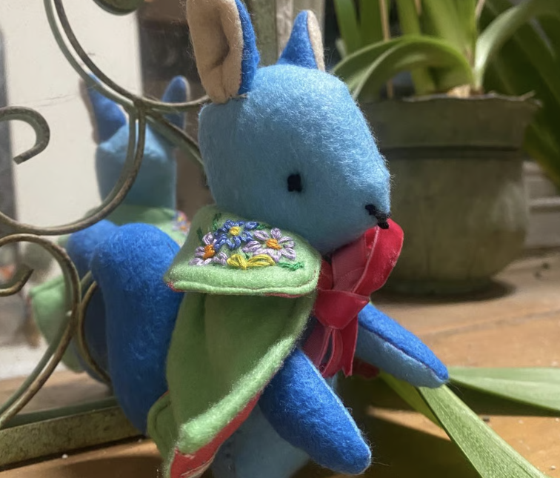
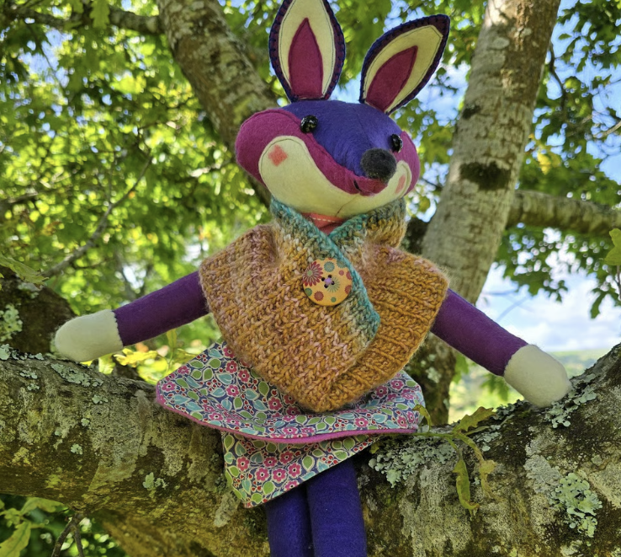
BOGOF Funded places only for Cornish schools
www.cornishcritters.com

Slide 20




www.excitingeducation.co.uk
chris@excitingeducation.co.uk
07854 120286

