Slide 1

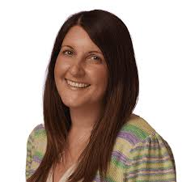
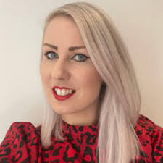



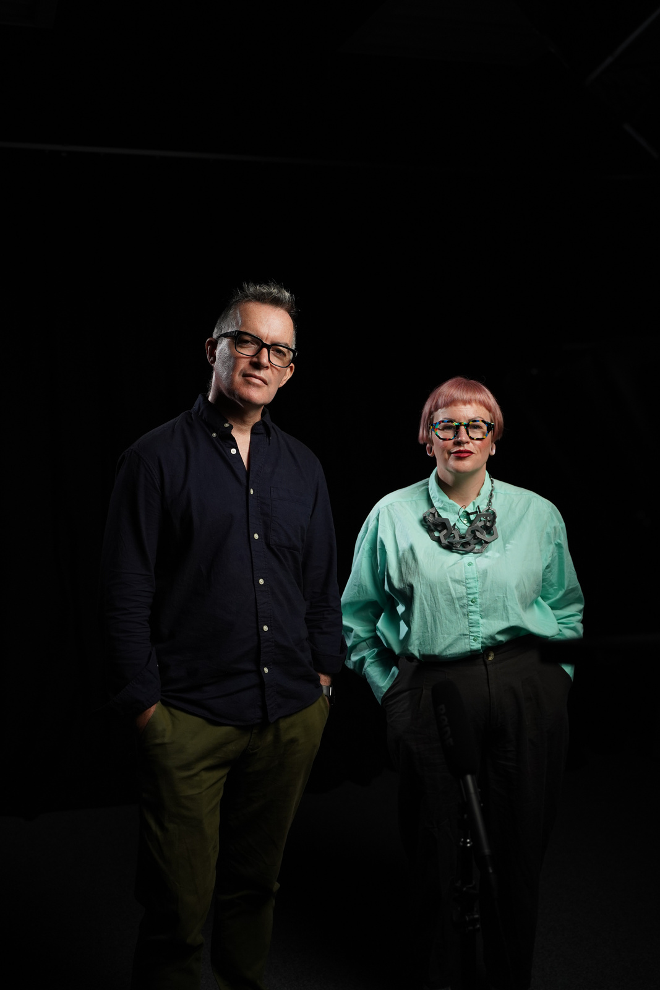

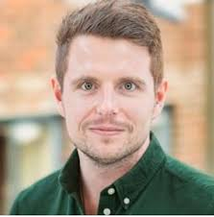






PROFESSIONAL DEVELOPMENT & COLLABORATION OPPORTUNITIES

Slide 2


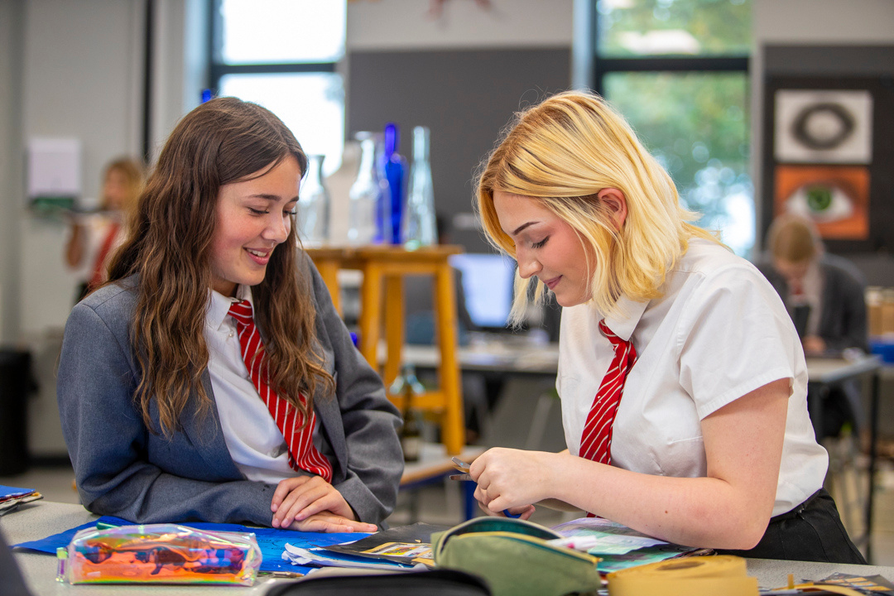

LEADING EXCEPTIONAL
TEACHING AND LEARNING
PROFESSOR HAILI HUGHES &
PROFESSOR CARL HENDRICK

Slide 3




ENGLISH HUB EVENTS

Slide 4
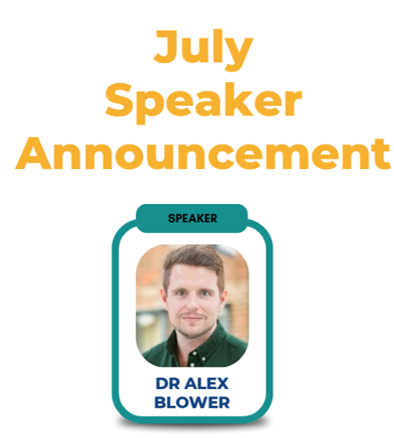


SUPPORT STAFF CONFERENCE
3 JULY
JOIN OUR SUPPORT STAFF CONFERENCE ON 3 JULY AT PENRICE ACADEMY.
FOCUS: SEND, PASTORAL, SAFEGUARDING, BEHAVIOUR.

Slide 5

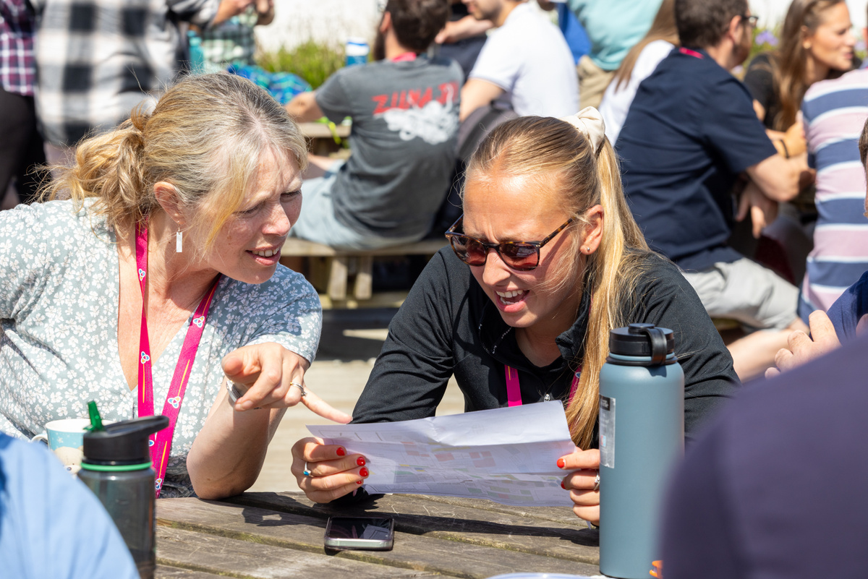
PRIMARY AND SECONDARY CURRICULUM DAY
3 JULY
PRIMARY
SECONDARY
A whole day focused on curriculum development - working towards an aligned curriculum across our schools
A whole day in subject areas, working on curriculum developments and the sharing of expertise. Core subjects - focus on aligned curriculum development.

Slide 6
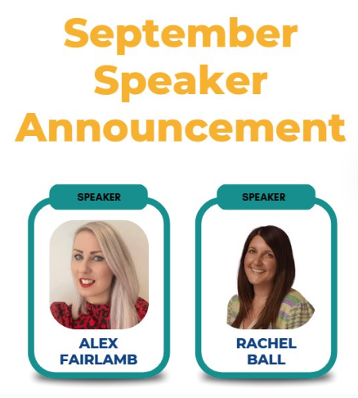

A day of inspiring external speakers, focusing on faded scaffolding and how we gradually build independence in learners. This will be followed by deliberate rehearsal, led by Steplab, to embed and jump-start excellent teaching and learning habits from day one of the new academic year.
ALL STAFF INSET
1 SEPT AT PENRICE
ACADEMY

Slide 7

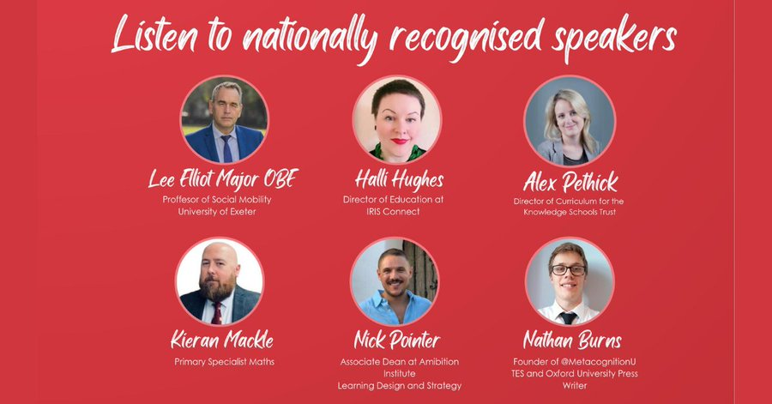
COLLABORATION OPPORTUNITY
SATURDAY
10TH OCTOBER 2026

Slide 8
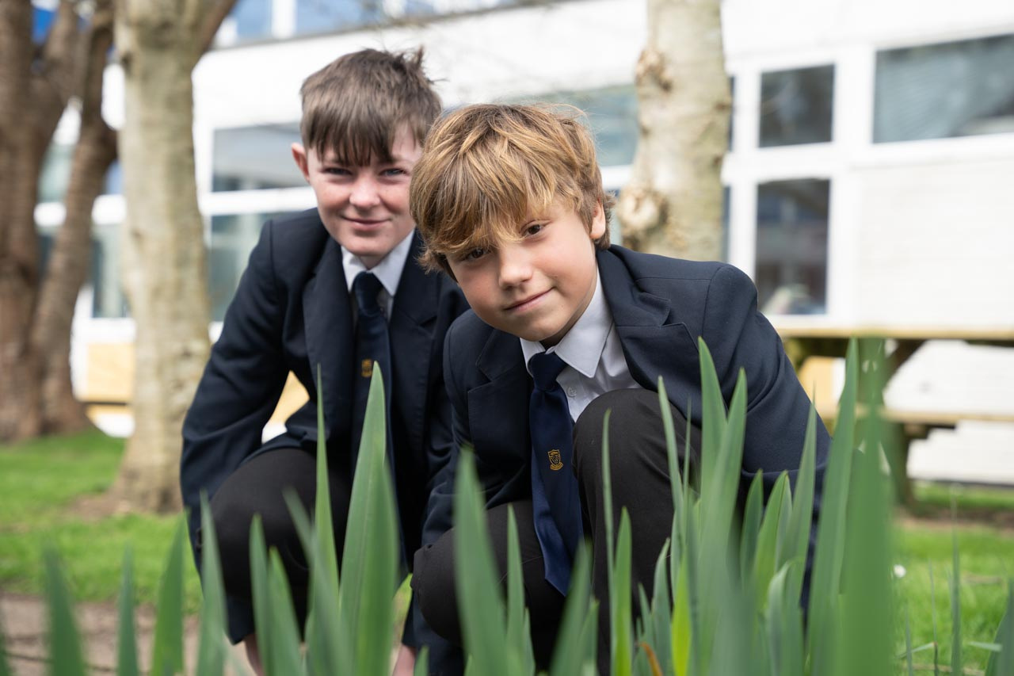
LEADING INCLUSION & ASPIRING DDSL/DSL PROGRAMME

Slide 9
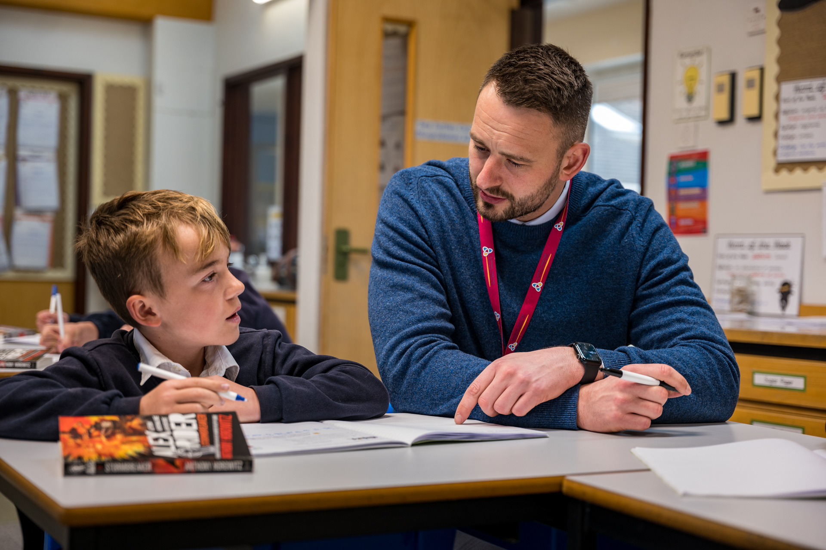
PRIMARY & SECONDARY DEPUTY HEADTEACHER PROGRAMME
Explore inspiring stories of achievement and perseverance, showcasing how innovative ideas and dedication can lead to remarkable outcomes.

Slide 10
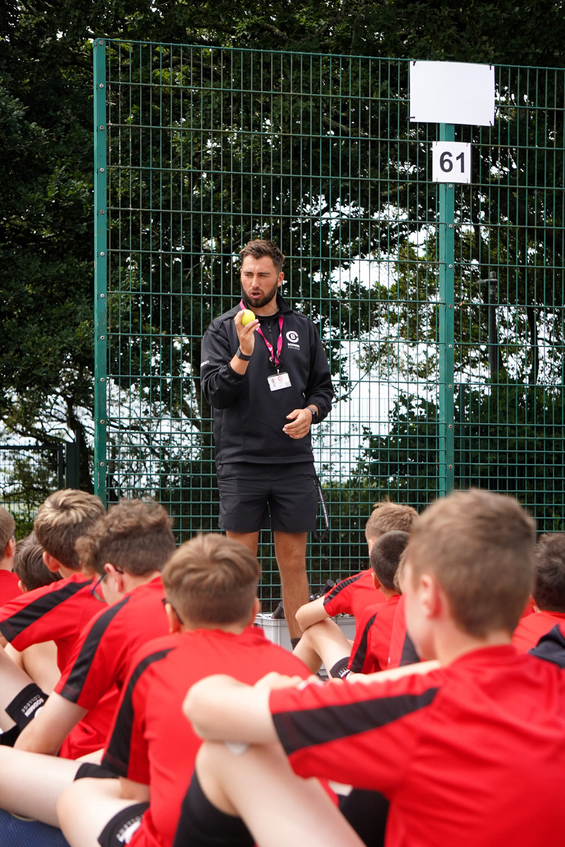
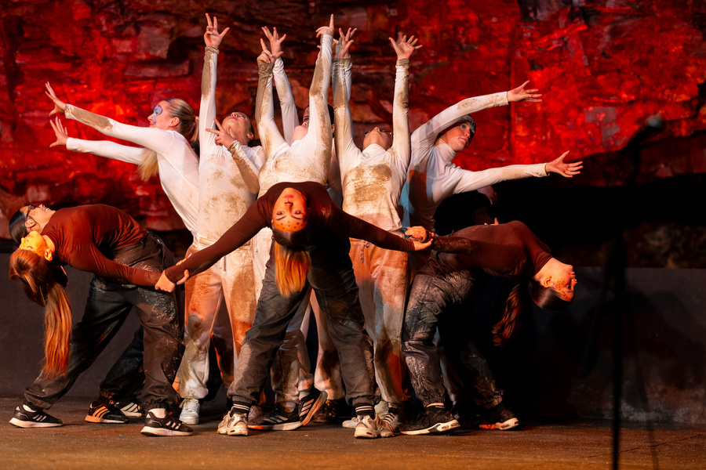
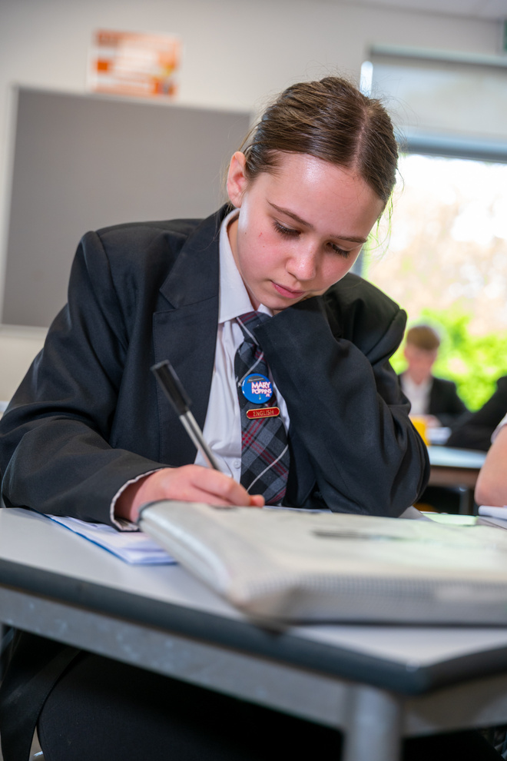
SECONDARY HEADTEACHER DEVELOPMENT PROGRAMME
SEPT 2026

Slide 11


STEPLAB PD INTENSIVE COURSE
24 MARCH

Slide 12


RISE DISCOVERY
MORNING
27 MARCH

Slide 13



HBISSENDEN@CELTRUST.ORG
CONTACT
HAYLEY BISSENDEN

