Slide 1


Our Safeguarding Children Partnership
Prevent Briefing: Safeguarding Risks from Global Conflict and the Digital Space Today.
Steve Rowell
Preventing Extremism & Terrorism Lead
Cornwall & Isles of Scilly
Notes:
---

Slide 2

Prevent Briefing for the Our Safeguarding Children Partnership
Purpose of the Briefing
  Supports Safeguarding Partnership members to understand Prevent-related risks affecting children and young people in health and education contexts.
Impact of Global Conflict
  Explains how international conflicts influence children’s wellbeing and vulnerability within the UK, especially via digital exposure.
Prevent Safeguarding Duty
  Reinforces Prevent as safeguarding focused on early identification, support, and protection, not criminalisation or surveillance.
Notes:
---
This slide references information from the following file: https://cornwallservices-my.sharepoint.com/personal/steve_rowell_cornwall_gov_uk/_layouts/15/Doc.aspx?sourcedoc=%7B05CC2B2F-D357-4DFF-94A5-23A9EBE7D574%7D&file=CAPH%20CASH%20Prevent%20Report%20update.docx&action=default&mobileredirect=true
This briefing has been prepared to support members of the Safeguarding Children Board in understanding the current Prevent-related safeguarding context affecting children and young people, as experienced by CAMHS (CAPH) and Child and Adolescent Sexual Health Services (CASH). It brings together national intelligence, education-sector experience, and local safeguarding practice to provide a clear, proportionate overview of risk. The presentation is not intended to provide political analysis of international events, but to explain why ongoing global conflict, particularly in the Middle East, has a direct and practical impact on children’s wellbeing and vulnerability within the UK. A key objective is to reinforce that Prevent remains a safeguarding duty grounded in early identification, support, and protection from harm, rather than surveillance or criminalisation. The briefing recognises that children encounter global events primarily through the digital space, often without context, moderation, or adult support. This exposure can be emotionally distressing, confusing, and, for some vulnerable children, a pathway into harmful narratives. For board members, the relevance lies in governance, assurance, and system leadership. This includes understanding emerging contextual risks, ensuring partner agencies maintain staff confidence and capability, and promoting consistent, child-centred responses across education, health, and safeguarding services. The presentation also reflects the Cornwall safeguarding context, where schools and services are reporting increased questions, emotional responses, and online tensions among young people linked to international conflict. By setting out the risk landscape, impacts, and recommended actions, this briefing aims to support informed decision-making, reinforce shared safeguarding language, and ensure that Prevent activity remains proportionate, balanced, and integrated within wider child protection and mental health frameworks.

Slide 3
Global Conflict and Its Relevance to Children
Notes:
---
This slide references information from the following file: https://cornwallservices-my.sharepoint.com/personal/steve_rowell_cornwall_gov_uk/_layouts/15/Doc.aspx?sourcedoc=%7B05CC2B2F-D357-4DFF-94A5-23A9EBE7D574%7D&file=CAPH%20CASH%20Prevent%20Report%20update.docx&action=default&mobileredirect=true
Why the Middle East Conflict Matters for Schools and Services, The Digital Space as the Primary Risk Environment

Slide 4

Why the Middle East Conflict Matters for Schools and Services
Impact of Social Media Exposure
  Children face rapid, graphic conflict content on social media, affecting their emotional wellbeing and behavior.
Emotional and Social Effects
  Exposure leads to distress, anger, confusion, and increased tension between peers in schools.
Contextual Risk and Safeguarding
  Schools must recognize conflict exposure as contextual risk impacting vulnerable children’s safety and inclusion.
Supporting Resilience and Inclusion
  Leaders should promote calm, proportionate responses focusing on wellbeing, resilience, and inclusion.
Notes:
---
This slide references information from the following file: https://cornwallservices-my.sharepoint.com/personal/steve_rowell_cornwall_gov_uk/_layouts/15/Doc.aspx?sourcedoc=%7B05CC2B2F-D357-4DFF-94A5-23A9EBE7D574%7D&file=CAPH%20CASH%20Prevent%20Report%20update.docx&action=default&mobileredirect=true
The ongoing conflict in the Middle East has particular relevance for schools and children’s services because of how it is experienced by young people rather than because of its geopolitical detail. Since October 2023, the conflict has unfolded in real time across social media platforms, meaning children and adolescents are exposed to graphic imagery, emotive language, and polarised narratives at unprecedented speed and volume. Unlike traditional news consumption, this content is often algorithmically amplified, repeatedly presented, and stripped of historical or political context. For schools, the issue is not whether pupils hold opinions about global events, but how repeated exposure to disturbing material can affect emotional wellbeing, relationships, and behaviour. Research and policing assessments consistently identify international conflicts as catalysts for grievance-based narratives and identity polarisation within Western countries, including the UK. In practical terms, schools report pupils expressing distress, anger, or confusion, as well as increased tension between peers linked to perceived identity or belief differences. For some children, particularly those already experiencing vulnerability, this content can become personally meaningful, feeding a sense of injustice or belonging to simplified ‘us versus them’ worldviews. The relevance for safeguarding systems lies in recognising this as contextual risk: harm arising from environments children navigate, particularly online spaces. By understanding why this conflict matters in educational and safeguarding contexts, leaders can better support staff to respond calmly, proportionately, and with a focus on wellbeing, resilience, and inclusion rather than avoidance or overreaction.

Slide 5

The Digital Space as the Primary Risk Environment
Digital Space as Primary Environment
  Children mainly encounter conflict information through digital platforms like TikTok and Instagram, making the digital space their primary information source.
Influence of Short-Form Videos
  Short-form videos emphasize emotional and simplified messaging, often overshadowing balanced explanations, influencing young viewers deeply.
Algorithm-Driven Content Exposure
  Algorithms maximize engagement by directing users quickly towards extreme or distressing conflict content, accelerating exposure to harmful narratives.
Safeguarding Challenges and Responses
  Effective filtering, staff awareness, and digital literacy education are crucial to address emotional impact and protect vulnerable youth online.
Notes:
---
This slide references information from the following file: https://cornwallservices-my.sharepoint.com/personal/steve_rowell_cornwall_gov_uk/_layouts/15/Doc.aspx?sourcedoc=%7B05CC2B2F-D357-4DFF-94A5-23A9EBE7D574%7D&file=CAPH%20CASH%20Prevent%20Report%20update.docx&action=default&mobileredirect=true
For children and young people, the digital space is the primary environment in which they encounter information about the Middle East conflict. Platforms such as TikTok, Instagram, YouTube, X, and Telegram are commonly cited by pupils as their main sources of news and commentary. Short-form video content is particularly influential, as it prioritises emotionally charged imagery, personal testimony, and simplified messaging over balanced explanation. Platform algorithms are designed to maximise engagement, which can result in users being rapidly directed towards increasingly extreme or distressing content once they interact with conflict-related material. Evidence from UK and European case studies indicates that when international conflict content is involved, pathways into harmful narratives can develop over days or weeks rather than months or years. This acceleration presents challenges for safeguarding, as changes in mood, language, or online behaviour may emerge quickly. The digital environment also reduces opportunities for adult mediation, meaning children often process complex and violent material alone or with peers who are equally ill-equipped to contextualise it. For safeguarding leaders, understanding the digital space as a risk environment reinforces the importance of effective filtering and monitoring systems, staff awareness of online trends, and education in critical digital literacy. It also highlights why responses must address emotional impact and vulnerability rather than focusing solely on content removal or disciplinary measures. Recognising the digital space as a core safeguarding context is essential to protecting children from harm in the current risk landscape.

Slide 6
Misinformation, Vulnerability, and Prevent Risks
Notes:
---
This slide references information from the following file: https://cornwallservices-my.sharepoint.com/personal/steve_rowell_cornwall_gov_uk/_layouts/15/Doc.aspx?sourcedoc=%7B05CC2B2F-D357-4DFF-94A5-23A9EBE7D574%7D&file=CAPH%20CASH%20Prevent%20Report%20update.docx&action=default&mobileredirect=true
Misinformation, Disinformation, and Narrative Harm, Prevent-Related Vulnerabilities and Pathways to Concern

Slide 7

Misinformation, Disinformation, and Narrative Harm
Nature of Misinformation
  Misinformation includes old videos, fabricated figures, and manipulated imagery used to provoke emotional responses.
Impact on Youth
  Young people struggle to differentiate real from false content, leading to anxiety and hostility towards others.
Safeguarding Risks
  Repeated exposure to false information normalises violence and damages trust in credible sources.
Preventive Measures
  Critical thinking education and safe discussion spaces are essential to mitigate harm from misleading narratives.
Notes:
---
This slide references information from the following file: https://cornwallservices-my.sharepoint.com/personal/steve_rowell_cornwall_gov_uk/_layouts/15/Doc.aspx?sourcedoc=%7B05CC2B2F-D357-4DFF-94A5-23A9EBE7D574%7D&file=CAPH%20CASH%20Prevent%20Report%20update.docx&action=default&mobileredirect=true
The Middle East conflict has been widely described as a ‘social media war’, characterised by extensive misinformation and disinformation that significantly increases safeguarding risk for children and young people. Common features include old or unrelated videos presented as current events, fabricated casualty figures, manipulated or AI-generated imagery, and highly emotive ideological framing designed to provoke outrage. Teenagers consistently report difficulty distinguishing between reliable information and false or misleading content, particularly when it is shared by peers or influential online figures. This environment can lead to heightened anxiety, black-and-white thinking, and hostility towards perceived outgroups. From a safeguarding perspective, misinformation is harmful not only because it is inaccurate, but because of its emotional and psychological impact. Repeated exposure to shocking or deceptive material can normalise violence, reinforce grievance narratives, and undermine trust in credible sources. National guidance, including from the Department for Education, now explicitly recognises misinformation and disinformation as safeguarding risks within online safety expectations. For Prevent, the concern is not political belief but the way misleading narratives can intersect with vulnerability, identity formation, and emotional distress. Addressing this risk requires more than content restriction; it requires equipping children with critical thinking skills, ensuring adults understand current online trends, and creating spaces where pupils can question and discuss what they encounter without fear or judgement.

Slide 8

Prevent-Related Vulnerabilities and Pathways to Concern
Pathways to Concern
  Key pathways include grievance amplification, identity fusion, desensitisation, and rapid entry into extremist ecosystems.
Diverse Ideological Contexts
  These pathways are not limited to one ideology but span Islamist, far-right, hybrid, and conspiracy narratives.
Indicators and Vulnerabilities
  Indicators include emotional distress, fixation on conflict content, withdrawal, and online hostility; these are vulnerabilities, not terrorism signs.
Safeguarding and Support
  Early support, professional discussion, and integrating safeguarding and mental health processes are crucial responses.
Notes:
---
This slide references information from the following file: https://cornwallservices-my.sharepoint.com/personal/steve_rowell_cornwall_gov_uk/_layouts/15/Doc.aspx?sourcedoc=%7B05CC2B2F-D357-4DFF-94A5-23A9EBE7D574%7D&file=CAPH%20CASH%20Prevent%20Report%20update.docx&action=default&mobileredirect=true
Prevent-related concerns arise not from exposure to conflict content alone, but when that exposure connects with broader vulnerabilities in a child or young person’s life. Current national assessments identify several key pathways to concern relevant to the present context. These include grievance amplification, where global events are framed as personal injustice; identity fusion, involving rigid ‘us versus them’ thinking; desensitisation to violence through repeated exposure to graphic imagery; and rapid movement into extremist ecosystems via recommended content or encrypted platforms. Importantly, these pathways are not confined to a single ideology. They may involve Islamist narratives, far-right or anti-Muslim narratives, hybrid or mixed belief systems, or conspiracy-driven worldviews. For safeguarding professionals, this reinforces the need for curiosity and proportionate assessment rather than assumptions. Most pupils will not progress along these pathways, but those who do often present with overlapping indicators such as emotional distress, fixation on conflict content, withdrawal, or increased online hostility. Prevent guidance is clear that these are vulnerabilities, not indicators of terrorism. The appropriate response is early support, professional discussion, and integration with wider safeguarding and mental health processes. Understanding these pathways enables board members and leaders to assure themselves that local practice is aligned with national expectations and remains firmly rooted in child-centred safeguarding principles.

Slide 9
Impact on Wellbeing and School Communities
Notes:
---
This slide references information from the following file: https://cornwallservices-my.sharepoint.com/personal/steve_rowell_cornwall_gov_uk/_layouts/15/Doc.aspx?sourcedoc=%7B05CC2B2F-D357-4DFF-94A5-23A9EBE7D574%7D&file=CAPH%20CASH%20Prevent%20Report%20update.docx&action=default&mobileredirect=true
Emotional and Mental Health Impact on Children and Young People, Implications for School Culture and Peer Relationships

Slide 10

Emotional and Mental Health Impact on Children and Young People
Mental Health Effects
  Exposure to conflict imagery increases anxiety, sleep problems, emotional numbing, anger, and reactivity in adolescents.
Behavioral Responses
  Children may show distress, emotional dysregulation, withdrawal, disengagement, or increased online conflicts in schools.
Supportive Interventions
  Effective support involves reassurance, discussions, trauma-informed care, and linking Prevent with mental health and pastoral support.
Safeguarding and System Response
  Systems must provide timely support pathways and empower staff to address emotional harm from online exposure confidently.
Notes:
---
This slide references information from the following file: https://cornwallservices-my.sharepoint.com/personal/steve_rowell_cornwall_gov_uk/_layouts/15/Doc.aspx?sourcedoc=%7B05CC2B2F-D357-4DFF-94A5-23A9EBE7D574%7D&file=CAPH%20CASH%20Prevent%20Report%20update.docx&action=default&mobileredirect=true
Sustained exposure to graphic and emotive conflict imagery has a well-documented impact on adolescent mental health, and this is increasingly reflected in school and service settings. Research indicates associations with heightened anxiety, sleep disruption, emotional numbing, anger, and increased reactivity. For some children, particularly those with pre-existing mental health needs or trauma histories, such exposure can exacerbate symptoms or contribute to new difficulties. In practical terms, schools report pupils becoming visibly distressed during discussions, struggling to regulate emotions, or becoming preoccupied with online content. Others may respond through withdrawal, disengagement from learning, or increased online arguments. These presentations fall squarely within safeguarding and wellbeing, not solely Prevent. Recognising the emotional impact is critical to ensuring responses are supportive rather than punitive. Children need reassurance, opportunities to talk, and help to contextualise what they are seeing. For safeguarding systems, this underscores the importance of linking Prevent awareness with mental health support, pastoral care, and trauma-informed practice. Board-level oversight should consider whether local pathways enable timely support and whether staff feel confident in addressing emotional harm arising from online exposure. By foregrounding wellbeing, services can reduce risk, build resilience, and maintain trust with children and families during periods of heightened global tension.

Slide 11

Implications for School Culture and Peer Relationships
Impact on School Culture
  Global conflicts and online narratives increase tensions in schools linked to identity and community affiliation.
Challenges in Facilitating Dialogue
  Staff face difficulties maintaining safe, balanced discussions without seeming biased during emotionally charged topics.
Safeguarding and Support
  Clear leadership, empathy, and safe spaces help mitigate conflict, safeguarding vulnerable pupils effectively.
Role of Safeguarding Boards
  Safeguarding boards provide guidance, training, and reassurance to schools addressing conflict and safeguarding roles.
Notes:
---
This slide references information from the following file: https://cornwallservices-my.sharepoint.com/personal/steve_rowell_cornwall_gov_uk/_layouts/15/Doc.aspx?sourcedoc=%7B05CC2B2F-D357-4DFF-94A5-23A9EBE7D574%7D&file=CAPH%20CASH%20Prevent%20Report%20update.docx&action=default&mobileredirect=true
The impact of global conflict and online narratives extends beyond individual wellbeing to influence school culture and peer relationships. Schools have reported increased tensions between pupils linked to perceived identity, belief, or community affiliation, often fuelled by content encountered online rather than direct experience. Classroom discussions can become emotionally charged, and staff may feel uncertain about how to facilitate safe, balanced dialogue without appearing to take sides. There may also be an increase in online disputes that spill into the school environment, affecting relationships and behaviour. These dynamics present a safeguarding challenge, as unresolved conflict can contribute to exclusion, bullying, or further vulnerability. Effective responses involve clear leadership, consistent messaging, and a focus on respect, empathy, and shared values rather than political debate. Creating safe spaces where pupils can ask questions, express worries, and be heard without judgement is a key protective factor. For safeguarding boards, the implication is the need to support schools with guidance, training, and reassurance that addressing these issues is part of their safeguarding role. By promoting inclusive practice and calm, informed responses, schools can mitigate harm, maintain cohesion, and support children to navigate complex issues safely.

Slide 12
Leadership Responsibilities and Recommendations
Notes:
---
This slide references information from the following file: https://cornwallservices-my.sharepoint.com/personal/steve_rowell_cornwall_gov_uk/_layouts/15/Doc.aspx?sourcedoc=%7B05CC2B2F-D357-4DFF-94A5-23A9EBE7D574%7D&file=CAPH%20CASH%20Prevent%20Report%20update.docx&action=default&mobileredirect=true
Prevent as Safeguarding: Leadership and System Responsibilities, Key Practical Recommendations and Conclusion

Slide 13

Prevent as Safeguarding: Leadership and System Responsibilities
Embedding Prevent in Safeguarding
  Prevent must be integrated within all safeguarding frameworks focusing on vulnerability and wellbeing over enforcement.
Leadership and Staff Support
  Leaders create a culture where staff feel confident to notice, report concerns, and seek advice in sensitive cases.
Digital Monitoring and Awareness
  Effective digital filtering and understanding of online platforms help protect children from harmful influences.
Multi-agency Oversight and Training
  Safeguarding boards ensure consistent Prevent understanding, up-to-date training, and learning from case reviews.
Notes:
---
This slide references information from the following file: https://cornwallservices-my.sharepoint.com/personal/steve_rowell_cornwall_gov_uk/_layouts/15/Doc.aspx?sourcedoc=%7B05CC2B2F-D357-4DFF-94A5-23A9EBE7D574%7D&file=CAPH%20CASH%20Prevent%20Report%20update.docx&action=default&mobileredirect=true
Statutory guidance is clear that Prevent must be embedded within existing safeguarding frameworks and approached as a proportionate, supportive duty. For leaders and board members, this means assuring themselves that systems prioritise vulnerability and wellbeing rather than ideology or enforcement. Schools and services are expected to demonstrate awareness of contextual risks, staff confidence in noticing and reporting concerns, and clear processes for escalation and support. Digital filtering and monitoring arrangements should be robust, but equally important is staff understanding of how online platforms and algorithms influence what children see. Leadership also involves creating a culture where staff feel supported to raise concerns and seek advice, particularly in complex or sensitive cases. Prevent should align with the ‘Notice, Check, Share’ approach, ensuring concerns are discussed with designated safeguarding leads and local Prevent teams as appropriate. For the Safeguarding Children Board, oversight includes ensuring that multi-agency partners share a consistent understanding of Prevent, that training is up to date, and that learning from local and national cases informs practice. Strong leadership and clear governance remain among the most effective protective factors for children in a rapidly evolving risk environment.

Slide 14

Key Practical Recommendations and Conclusion
Staff Training on Online Risks
  Regular staff briefings focus on emerging online risks and emphasize wellbeing over political debate.
Safe Spaces and Respectful Dialogue
  Schools create safe environments where pupils can express concerns with clear behavioural expectations.
Clear Reporting Pathways
  Staff are confident in consulting safeguarding leads and local Prevent teams when concerns arise.
Parental Engagement and Mental Health
  Engaging parents via newsletters and linking Prevent awareness to mental health support is essential.
Notes:
---
This slide references information from the following file: https://cornwallservices-my.sharepoint.com/personal/steve_rowell_cornwall_gov_uk/_layouts/15/Doc.aspx?sourcedoc=%7B05CC2B2F-D357-4DFF-94A5-23A9EBE7D574%7D&file=CAPH%20CASH%20Prevent%20Report%20update.docx&action=default&mobileredirect=true
In response to the current risk landscape, several practical actions are recommended for schools and safeguarding partners. These include regularly briefing staff on emerging online risks linked to global events, reinforcing that discussions should focus on wellbeing and resilience rather than political positions. Schools should actively create safe spaces for pupils to ask questions and express concerns, supported by clear behavioural expectations and respectful dialogue. Reporting pathways should be well understood, with staff confident in consulting designated safeguarding leads and local Prevent teams when concerns arise. Engaging parents through newsletters or school websites can help raise awareness of what children may encounter online during international crises. Importantly, Prevent awareness should be linked to wider mental health and pastoral support, recognising emotional harm as a significant risk factor. In conclusion, ongoing events in the Middle East continue to shape the online experiences and safeguarding needs of children and young people. The digital environment has changed the pace and nature of risk, but the core safeguarding principles remain the same: early identification, proportionate response, and a child-centred approach. Through informed leadership, confident staff, and strong safeguarding cultures, systems can protect children effectively while maintaining trust and inclusion.

Slide 15
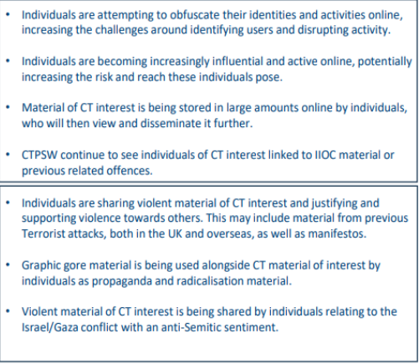
Strategic Threat Briefing - Online Space

Slide 16














Dangerous Social Media Platforms
TAM TAM
Holla
WHISPER
Notes:
Gab 4chan and telegram promotes itself as a free speech-oriented alternative to Twitter, and clearly hosts anti-immigrant and antiMuslim content. Telegram promotes itself as a secure and private alternative to WhatsApp, however the channel function allows for white supremacist and white nationalist material to be disseminated.
TOR uses complex encryption developed by the CIA for sharing content, documents and messages.
Others include snapchat, ASK.fm Whisper, Omegle (Stanger chat), periscope, housparty, voxer, Holla, Tumblr, Vsco, BIGO Live, and many more.
All of these are classed as significantly dangerous sites, and should be avaoided.

Slide 17
Channel Referrals Cornwall
Breakdown of risk data
98% male
Age range 7-17yrs accounts for 96% of referrals
Internet/online gaming forums/chat rooms
Most have obvious vulnerabilities
Education making most referrals (65%)
Cornwall referral volume is higher than comparable areas
HMICFRS/OFSTED/OSCT inspections – leading the way

Slide 18
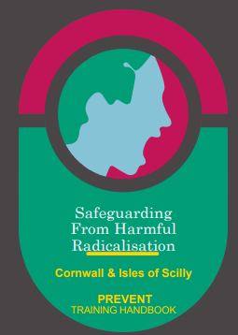
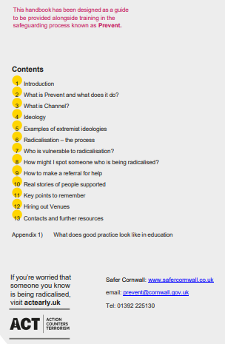
Cornwall & IOS Prevent Handbook
https://safercornwall.co.uk/preventing-violent-extremism/

Slide 19
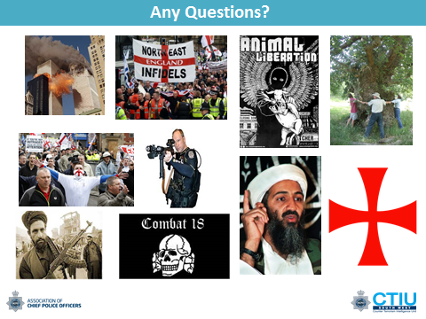
Thanks for listening

Slide 20
Children’s Services
Samantha Lawton – Operational Manager CAMHS
Cornwall Partnership NHS Foundation Trust

Slide 21

Hello!
Overview of services
CAMHs;
Successes
Priorities
INT plans
CAMHS - Child and Adolescent Mental Health service

Slide 22
Overview of Cornwall Partnership NHS Foundation Trust Children’s Services
Youth Justice Service
Community Nursing, epilepsy, palliative care, short breaks
Speech & language, neurodiversity diagnosis & assessment, learning disabilities
Pre-birth
Pre-school
School
Adulthood
THINK FAMILY
Thriving Together
MHST
Special Parenting
CAMHS, ADHD, Eating Disorders including ARFID (avoidant restrictive food intake disorder), Crisis Mental Health Services including COAST and LD Key workers
Sowenna – General Adolescent Unit

Slide 23

Celebrating Success
Mental Health
Number 6 in England for CAMHs Access 2025/26
27% reduction in Emergency Department attendance for CYP in Mental Health crisis
Safe place opened at Sowenna
Thriving Together; Multiagency consultation model embedded and effective
COAST (Community Outreach and Support Team); Zero Specialist Eating Disorder Unit admissions
Gender Identity Service pathway established

Slide 24
CAMHs waits reducing
Referral to assessments waits have fallen significantly. Mean wait fallen from 101 days in April to 60 days in March
+25% rise in clinical appointments recorded and delivered
Source: RIO April 2025 to March 2026, CAMHs referral to assessment waits

Slide 25
CAMHS Community and acute mental health teams are reducing admissions
Whilst referrals to MARRS (Multiagency Rapid Response Service) have increased over the past 3 fiscal years, the number of Cornish patient admissions to Sowenna has fallen resulting in the MARRS referral to admission conversion rate more than halving from 9.5% to 4%.
Year | MARRS Referrals | Cornish Admissions | Conversion
2023/24 | 517 | 49 | ~9.5%
2024/25 | 582 | 39 | ~6.7% ⬇️
2025/26 (YTD) | 622 | 25 | ~4.0% ⬇️⬇️

Slide 26

2026/27 Priorities
MH Support Team in School Expansion
Three key shifts
  From hospital to community
  From analogue to digital
  From treatment to prevention
For MHSTs
  100% coverage by 2029/30
  Schools, colleges, alternative provision, electively home educated
  Deliver the national model, evidence-based interventions, supporting mental health lead and giving advice to secondary school staff
Notes:
FROM TREATMENT TO PREVENTION – ROLE OF MHSTs in MH wellbeing, prevention through support earlier from Primaries but also now secondaries. One of the only services named directly in the 10 year plan for CYP

Slide 27
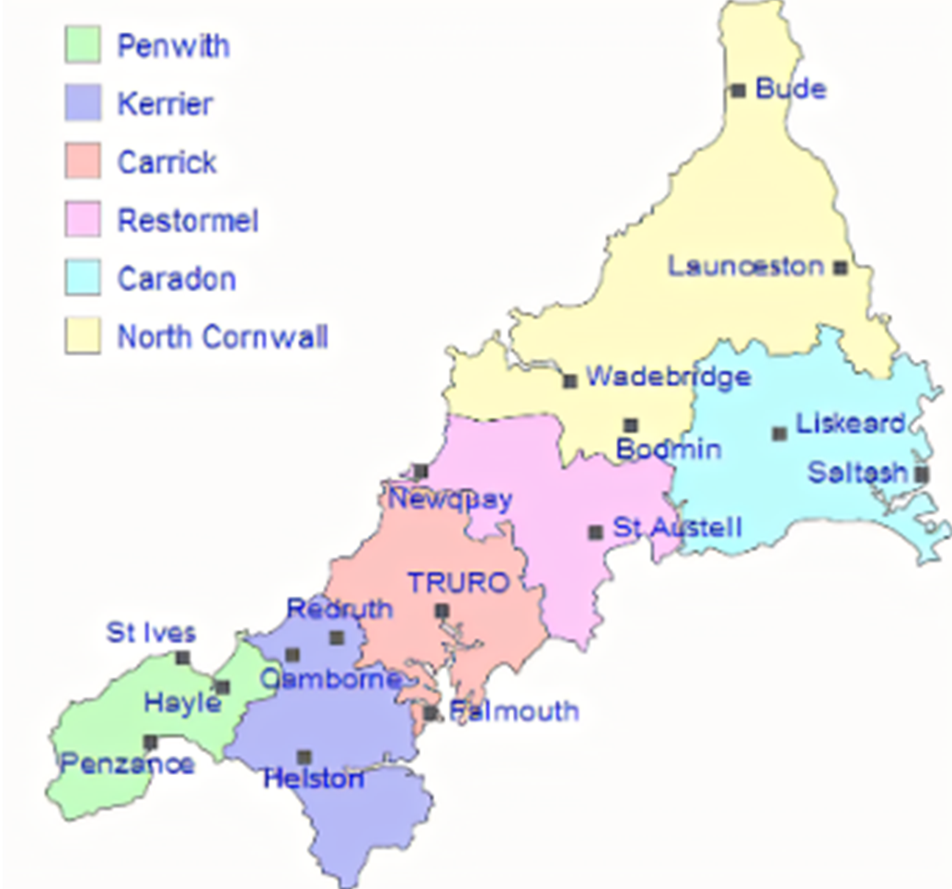
MHST expansion – 2026/27
One new team, Restormel (Jan 2026)
Our first dedicated team for secondary schools
Supported by a new strategic partnership board and co-produced
Two more teams in September 2026 in Launceston and North Kerrier

Slide 28

2026/27 Priorities
Reduce waits in community CAMHS
Continue to reduce waits from referral to assessment
Reduce waits from assessment to intervention
  Flow
  New intervention groups
  Clear contracted endings
Continue to see 75%+ crisis patients within 24 hours
Increasing clinical contacts
National measurement of quality of contacts
Improved links with Local Authority and VCSE
Improve transition to adult services
Notes:
FROM TREATMENT TO PREVENTION – ROLE OF MHSTs in MH wellbeing, prevention through support earlier from Primaries but also now secondaries. One of the only services named directly in the 10 year plan for CYP

Slide 29
Integrated Neighbourhood Teams

Slide 30
INT & Principles of Neighbourhood Commissioning
Ambition
Moving community services from the acute into community
Named paediatrician and MH lead for INT triage MDTs where demand is high
Prevent: lifestyle medicine, sleep, nutrition, child development focus
Reduce: targeted professionals involved, health coaches, wellbeing workers, family support, sustainable model for inclusion in schools in areas of high need
Delay: increased family support, complex MDTs, shared care, community assessment days

Slide 31
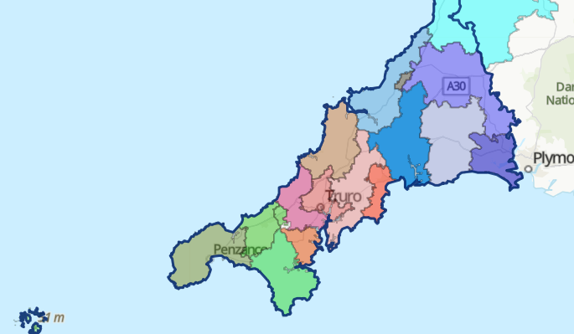
INT roll out CYP
Children and Young people 25/26
  Bosvena Three Harbours
  Truro PCN
  St Austell Healthcare
  North Kerrier
Children and Young people 26/27
  Complex CYP MDT operating in each INT
  Links with Local Authority family support teams
  Links with schools via MHST expansion

Slide 32

Outcomes
Reduce outpatient demand and attendance to the acute
Reduce avoidable demand for community services (10% reduction in SaLT and Neurodiversity, 5% in specialist mental health)
Reduce numbers waiting and wait times
Increase school attendance and reduce exclusions

Slide 33

Any questions?

Slide 34
Appendix

Slide 35
Overview of CAMHS Community Services
Provides assessment, consultation, and treatment for children and young people (ages 5-18) with moderate to severe mental health difficulties.
Focus on complex, co-occurring needs, involving families, carers, and professional networks.
Conditions include mood, anxiety, eating disorders, trauma, autism spectrum disorder, and more.
Offers psychological interventions tailored to individual goals and needs.
Collaborates with education, social care, the voluntary care sector and community groups.

Slide 36
Service Structure & Offer
Service divided into Integrated Care Areas - East, Mid, West, moving to place-based model as per 10 year plan.
Available Monday-Friday, 9am-5pm.
Initial, targeted, and intensive treatments based on NICE guidelines.
Patient choice options meeting central to decision making
First intervention: holistic, reviewed after 6 sessions.
Follow-up treatments: goal-focused and evidence-based.
Multi-disciplinary team includes psychiatrists, psychologists, clinical associate psychologists, allied health professionals, nurses, psychotherapists and support workers.
EAST
MID
WEST

Slide 37
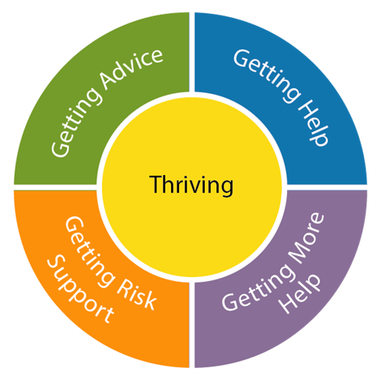

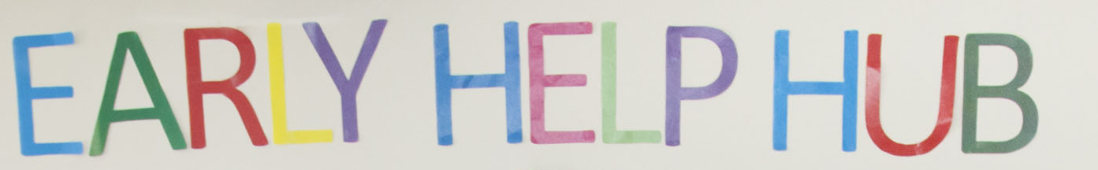
Referral & Support Process
Referral triage by qualified mental health professionals
Acceptance letter and invite to options meeting
Targeted NICE guidance intervention alongside individual care, safety and risk plans
Needs may be better met elsewhere in the system

Slide 38

Last time we…
Agreed to implement the Participation Framework across the partnership
Committed to feeding back with examples of pledge use
We agreed a shared understanding…
that the voice of the child is more than just speaking and to us means
Consider me and my views and rights at all levels of decision making in all encounters, in everyday spaces ‘Everywhere I Am’

Slide 39

OSCP Participation Framework
Framework was agreed by this Partnership Forum and is now published on our website.
The framework has been built around what children have told us and asked us for so far using the structure of the four interrelated stages of the Lundy Model.
It provides us with a shared vision for the ways in which we collectively approach participation in our individual agencies and settings.
As part of my ongoing work, I would like to support all partners to
embed the OSCP Participation Framework in a meaningful, consistent way
and for us to agree a system for reporting and monitoring impact

Slide 40
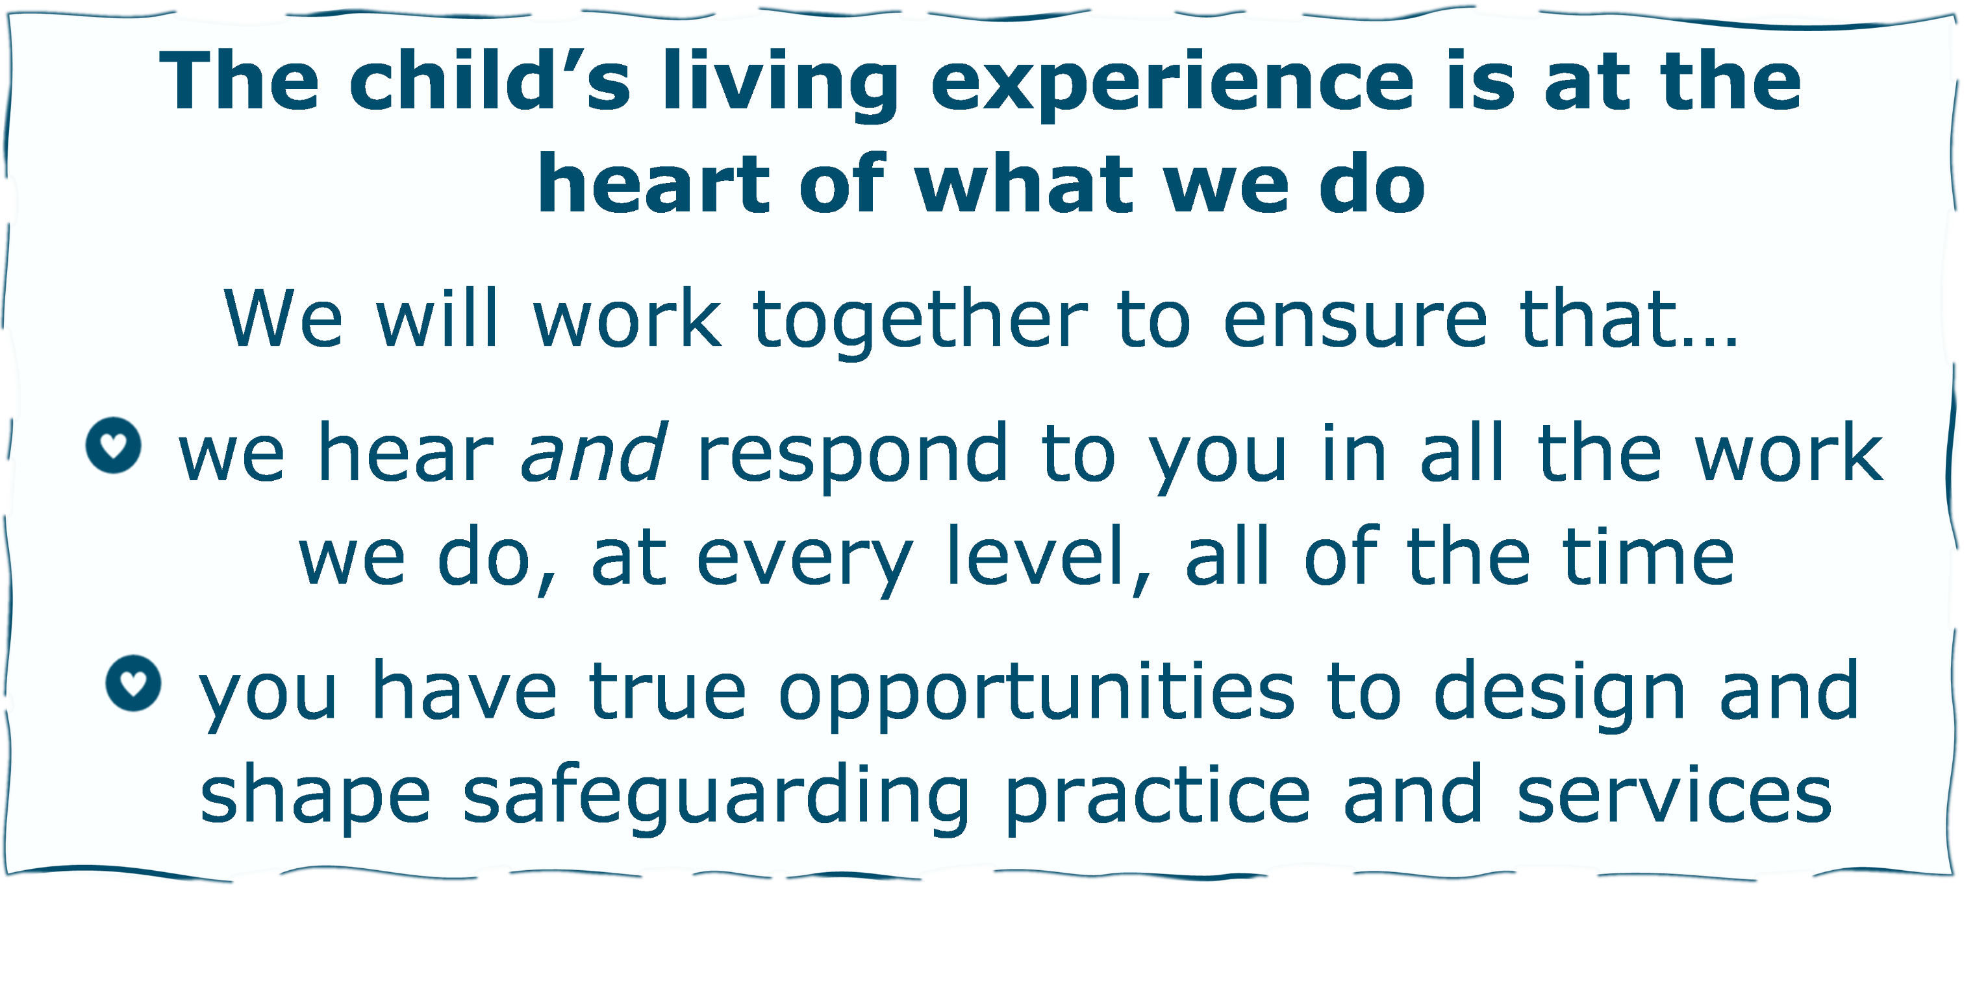
OSCP Pledge
Notes:
Children from CIOS asked us to develop a unifying motto for use across OSCP about our commitment and approach towards involving them in service design and delivery. We developed this pledge based on what they said…
This means we will provide every day inclusive engagement opportunities for all.

Slide 41
Reporting
to encourage habits of self assessment / a culture of everyday awareness at all levels
What | If so, how? |  | So What?
In this meeting / activity today Was the child’s living experience at the heart of what you did? Did you work together to ensure that you heard and responded to the voice of the child? Did you identify opportunities for C&YP to design and shape safeguarding practice and services? |  | What difference did it make to any of the following? the child parents and carers professional practice or services partnership working
Notes:
this template was designed to routinely encourage a 2-minute self assessment exercise and ensure any critical reflection, learning or practice development generated is recorded and fed back to us
please use some or all of it in a way that suits you

Slide 42
Reporting
Have you used the OSCP Pledge in other ways? Please tell us more…
What difference has it made to any of the following?
The child | Parents and carers | Professional practice or services | Partnership working
Notes:
please use some or all of it in a way that suits you, we don’t want it to be onerous, we just want to capture the myriad of good practice

Slide 43
Gaps / What Else
How are you hearing the voice* of Babies, Children & Young People What else can you do? What do you need? How can we help each other? * The voice of the child is more than just speaking and to us means Consider me and my views and rights at all levels of decision making in all encounters, in everyday spaces ‘Everywhere I Am’ | Space | Voice
 | Audience | Influence
Notes:
Again – we are all learning together and sharing challenges as well as good examples so let us know…

Slide 44

Your Examples
Operational practice:
Children spoken to alone where appropriate during policing interactions (victim, witness, suspect).
Consistent practitioners (e.g. Youth Missing Officers, neighbourhood officers) creating trust over time.
Multi‑agency practice:
Safe spaces created within schools, sports clubs, family hubs and community settings through partnership working.
Use of evening groups and social engagement spaces.
Organisational development:
Supervision and reflective practice supporting staff to create space for meaningful conversations.
Improved physical and community spaces (e.g. family hubs).
Understanding the legal and policy framework:
Children Act, Working Together 2023, and UN Convention on the Rights of the Child underpin the duty to create space for children’s views.
Notes:
(This summary of examples from 25/26 has been generated by AI from an excel spreadsheet – full details available on request).
Briefly, to recap before we start the 1/4ly reporting

Slide 45

Your Examples
Professional practice guidance & training:
Use of Achieving Best Evidence (ABE) guidance and specialist training (PIP/SCAIDP).
SVPP funded Participation Framework delivered with YPC and embedded across Safer Cornwall.
Casework and direct practice:
Police recording children’s own words in PPNs, Niche records and youth justice processes.
Age appropriate methods:
Babies (0–2): behaviour, presentation, non verbal cues, BWV evidence of environment.
Younger children: simple language, play, drawing, visual aids, intermediaries.
Teenagers/YP: respectful conversations, explanation of rights, contextual understanding (MH, school, peers, online life).
Audit evidence:
QAPM audits (Cornwall Council, C&FS, TFF - Jan 2026) showing strong examples of direct work and child centred assessments written to the child.
Conceptual framework:
Explicit recognition that “voice is more than speaking” – includes behaviour, context, lived experience (“Everywhere I Am”).
Notes:
This summary of examples from 25/26 has been generated by AI from an excel spreadsheet – full details available on request).
Briefly, to recap before we start the 1/4ly reporting

Slide 46

Your Examples
Governance and partnership structures:
Feedback loops into Partnership Forums, boards and strategic meetings.
Multi‑agency safeguarding processes:
Children’s views informing MASH/MARU decision‑making.
Voice of the child brought into Strategy Meetings, Child Protection Conferences, MARAC and MAPPA.
Practice development processes:
Ongoing improvement of PPN processes through CPD and practitioner/user feedback
Quality assurance evidence:
QAPM audits (Cornwall Council, C&FS, TFF - Jan 2026) highlighting practitioners adapting their approach to ensure children’s views are captured and considered, even when engagement is difficult.
Notes:
This summary of examples from 25/26 has been generated by AI from an excel spreadsheet – full details available on request).
Briefly, to recap before we start the 1/4ly reporting

Slide 47
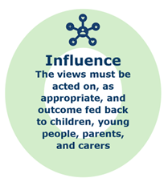
Your Examples
Audit and review findings:
• Case audits showing improved risk assessment and earlier identification of harm when voice of the child is captured.
• Learning from Local Child Safeguarding Practice Reviews (LCSPR), Rapid Reviews and Learning from Experience reviews.
Inspection evidence:
• HMICFRS inspection findings recognising effective child centred and voice informed policing practice.
Research evidence:
• ABE research demonstrating that children provide more accurate and reliable accounts when they feel listened to, reducing re traumatisation.
Performance and outcome data:
Repeat incident and missing data showing improved engagement and reduced disengagement where children feel heard.
Feedback mechanisms:
Victim satisfaction surveys, complaints data and youth engagement feedback evidencing impact.
Practice examples:
Child centred justice approaches (e.g. conditional caution clinics) with feedback loops informing trauma based responses and interventions.
Notes:
This summary of examples from 25/26 has been generated by AI from an excel spreadsheet – full details available on request).
Briefly, to recap before we start the 1/4ly reporting

Slide 48
OSCP Participation & Engagement Impact Evaluation & Reporting
Quarter | Request Feedback | Feedback Deadline | Report Due
Q1: April 1 - June 30, 2026 | 30th June | 17th July | 3rd August
Q2: July 1 - September 30, 2026 | 5th October | 16th October | 2nd November
Q3: October 1 - December 31, 2026 | 11th January 2027 | 22nd January | 1st February
Q4: January 1 - March 31, 2027 | 5th April | 23rd April | 26th April
Notes:
Dates for 1/4ly reporting – highlighted are the dates I will be writing out to you to request feedback

Slide 49
Regular themed updates with key / headline messages
OSCP Participation & Engagement Activity
C&YP voice in planned themed events e.g. learning lessons workshops, evident in strategies, policies and other new documents
Pledge use from across the Partnership - 1/4ly report template
Bitesize updates from network meeting & other examples of good practice
Webpage engagement statistics
Newsletter stats (to demonstrate reach to professionals)
Monitoring of impact on practice / difference made to the child’s living experience
    Child’s Voice and Domestic Abuse Toolkit for Professionals
    Monitoring of Babies Voice Resources
    Monitoring of CE The Signs Practice Guide
    Cultural Capability Practice Guidance
Notes:
In return I will provide
Regular updates – themed key / headline messages - Reporting on…

Slide 50
OSCP Participation & Engagement Webpage
Access the Participation Framework and a summary of all resources and toolkits developed to date here:
https://ciossafeguarding.org.uk/scp/p/practice/participation-engagement
Home / Professionals / Practice /
Participation & Engagement
Notes:
More information

Slide 51
Working together to safeguard children 2026: a guide to multi-agency working to help, protect and promote the welfare of children
Chapter 1: a shared responsibility
Reinforced expectations on leaders to create inclusive, anti‑discriminatory cultures and that practitioners are expected to challenge racism and discrimination.
Strengthened guidance on certain types of harm such as: abusive behaviour in intimate relationships
coercive control and more hidden harms such as child sexual abuse (CSA) and teenage relationship abuse
Chapter 2: multi-agency safeguarding arrangements (MASA)
MASA responsibilities include children who are looked after. Detail on accountability structures and how safeguarding partners are inspected.
Clearer expectations on analysing information to identify disproportionality and racism and strengthened requirements for data sharing.
Annual reports must evidence their impact on children and families.
Chapter 3: providing help, support and protection
Family help combines targeted early help and section 17 support to create a more seamless offer for families
Additional content covers domestic abuse, child sexual abuse, infants abuse and honour or faith or belief‑based abuse, with strengthened child sexual abuse procedures and the use of family group decision‑making.
This section reinforces that children may face multiple harms simultaneously.
We have strengthened guidance to emphasise that safeguarding and child protection apply to all children, and any assessments and planning should link to existing family help plans or care planning where appropriate.
Notes:
Guidance applies to all children, including:
those living with their birth or extended family
those in kinship care, including special guardianship
adopted and looked‑after children in foster or residential settings
Practitioners should consider help, support and protection for unborn children where there are concerns.

Slide 52
Chapter 4: organisational responsibilities
Clarifies the vulnerability of looked after children in certain settings and reinforces the link between care planning and child protection planning.
Emphasised the local authority’s duty to ensure support and protection through the care plan and highlighted risks such as sexual exploitation.
Chapter 5: learning from serious child safeguarding incidents
Strengthened to ensure safeguarding partners better understand how and when to make timely, accurate and comprehensive notifications and engage in the learning process. Notifications are to be submitted within five working days of safeguarding partners becoming aware of the incident.
Notifications to be made even if the names of child victims are not yet known & all children should be included and the wider context considered.
How to notify the death of a care leaver up to the age of 24 and adults aged 18 or over where harm, abuse or neglect occurred in childhood
Revisions confirm that only the Child Safeguarding Practice Review Panel decides on National Reviews and outlines the sequence from serious incident notification (SIN) to rapid review to local child safeguarding practice review.
Sets expectations for learning from incidents that do not meet notification criteria and that rapid reviews may be shared with government in exceptional cases.
The rapid review timeline has been updated to require submission within 15 working days of the SIN.

Slide 53
OSCP Updates
Protecting all Vulnerable Babies better – Learning from National reviews – Autumn Conference
Local Protocols and Procedures
Bruising & Injury protocol
Continuum of Need
OSCP_Children’s Restraint Reduction Guidance
Resolving Professional Difference
Local Strategies
Neglect Strategy 2020-2023
Practice Guidance
Safeguarding & Intersectionality
Mental Health
New Training
Online Safety – June 18th Truro or Liskeard
Whole Family Approach to Safeguarding: Multi-Agency Safeguarding Children and Adults
New Groups
Quality Assurance & Listening Board
Tri-Partnership Chairs Board

