Slide 1

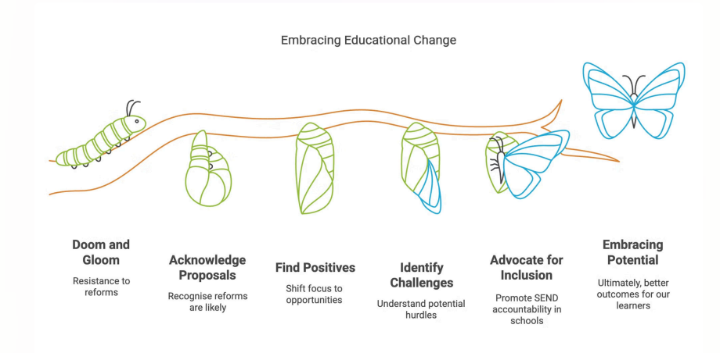

Every Child Achieving and Thriving
CASH Spring SENDCo Conference 2026

Slide 2

The new Ofsted inspection framework significantly impacts Special Educational Needs Coordinators (SENCOs) by elevating SEND from a "part of the story" to a central, standalone "Inclusion" grade.
SENCOs will face increased scrutiny on early identification, the graduated approach (assess, plan, do, review), and how well the curriculum is adapted for learners with SEND, with a focus on "lived experience" rather than just policies.

Slide 3
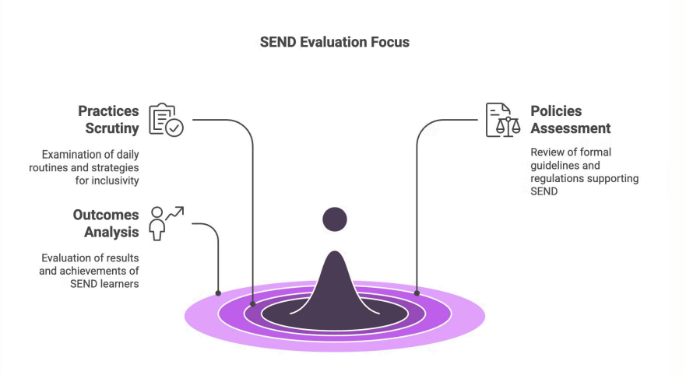

Slide 4
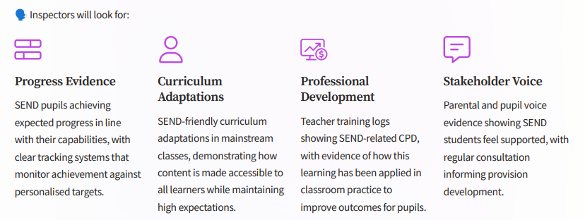

Slide 5
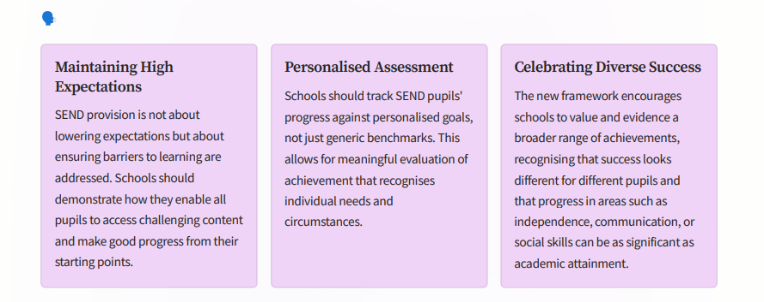

Slide 6
Key Impacts on SENCOs:
Standalone Inclusion Judgement: "Inclusion" is now one of the main evaluation areas graded on a 5-point scale (Urgent improvement to Exceptional).
Strategic Leadership Role: SENCOs will be expected to influence Senior Leadership Teams (SLT) on inclusion, as it now directly affects the school's ability to achieve high grades.
Individual Case Sampling: Inspectors will conduct in-depth case sampling of pupils with SEND/EHCPs on day one, reviewing their work and speaking with them directly.
Focus on Early Identification & Support: Increased focus on how SENCOs identify needs early, use external specialists, and manage Individual Support Plans (ISPs).
Reduced Reliance on Interventions: Shift away from simply "withdrawing" pupils for interventions towards "high-quality adaptive teaching" in the classroom.
Attendance & Belonging: Stronger focus on attendance of SEND pupils, with a "belonging" lens

Slide 7
1. Inclusion as a Standalone Judgement
Instead of a single "overall effectiveness" grade, schools now receive a report card with separate grades across six core areas, including Inclusion.
New 5-Point Scale: Inclusion is graded from Exceptional to Urgent Improvement.
No Hiding Place: A school cannot achieve a high overall rating if its SEND provision is inadequate; inclusion is now considered "the story" rather than just part of it.
2. Strategic Leadership & Direct Accountability
The SENCO's role shifts from an administrative one to a strategic leadership position.
Direct Inspector Engagement: Lead inspectors are now expected to meet directly with the SENCO on Day 1 to discuss strategy, provision, and outcomes.
Case Sampling: Inspectors will use "case sampling" to follow the "lived experience" of specific pupils with SEND, reviewing their work, observing them in class, and speaking to them directly.
Nominee Role: Schools can now appoint a "nominee" (often a senior leader or SENCO) to act as a primary point of contact and join reflection meetings with inspectors.

Slide 8
3. Focus on "Thrive, Belong, and Achieve"
The framework moves beyond mere academic data to evaluate how pupils with SEND belong and thrive within the school community.
Adaptive Teaching: There is a heavy emphasis on how the curriculum is adapted in the classroom, moving away from withdrawing pupils for external interventions.
Attendance & Behaviour: Inspectors will scrutinise how inclusive cultures reduce absences and avoid exclusions for vulnerable learners.
Parental Engagement: Schools must demonstrate strong collaboration with parents, taking their views and knowledge into account
4. Changes to Methodology
Removal of Deep Dives: The formal curriculum "deep dive" methodology has been removed to reduce middle-leader workload, replaced by broader "learning walks" and "reflection meetings".
Contextual Data: Inspectors will use an "Explore an Area" service to compare a school's SEND provision against its specific local context and challenges.
.

Slide 9
Preparation Checklist for SENCOs:
Review the new SEND Reform & Ofsted Toolkits: The 2025 inspection toolkit explains the new inspection methodology.
Audit SEND Provision: Evaluate how SEND is embedded across all inspection areas, not just as an add-on.
Strengthen Documentation: Ensure the Graduated Approach is clear, including evidence of how parent/pupil voice is captured.
Ensure the SEND Information Report is easily accessible and that Individual Support Plans (ISPs) are parent-friendly and actionable.
Prepare for 'Inclusion' Conversations: Be ready to discuss the school's "inclusion story" with inspectors, including how they tackle barriers to learning.
Collaborate with SLT: Ensure SEND priorities are in the school improvement plan and staff are trained in inclusive, adaptive teaching.

Slide 10
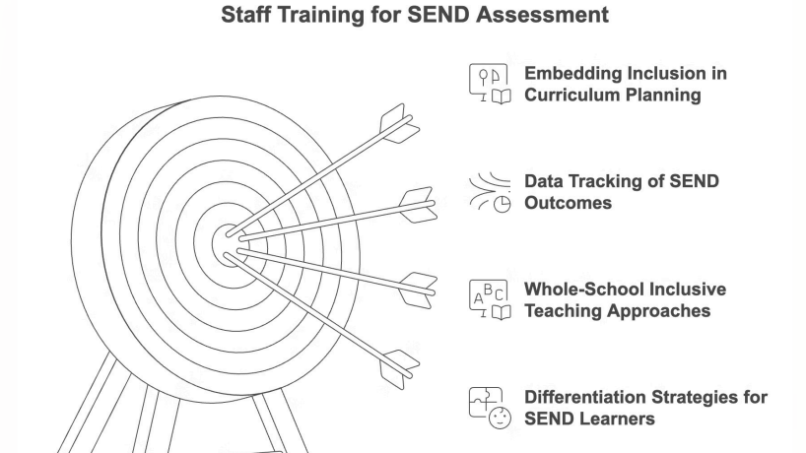

Slide 11
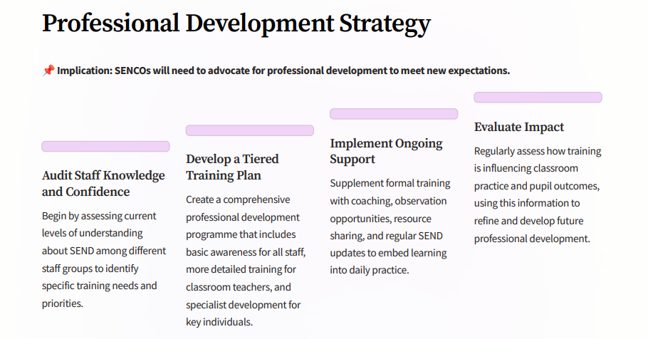

Slide 12
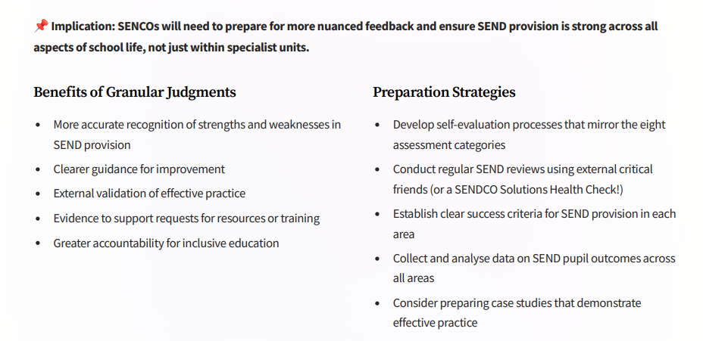

Slide 13
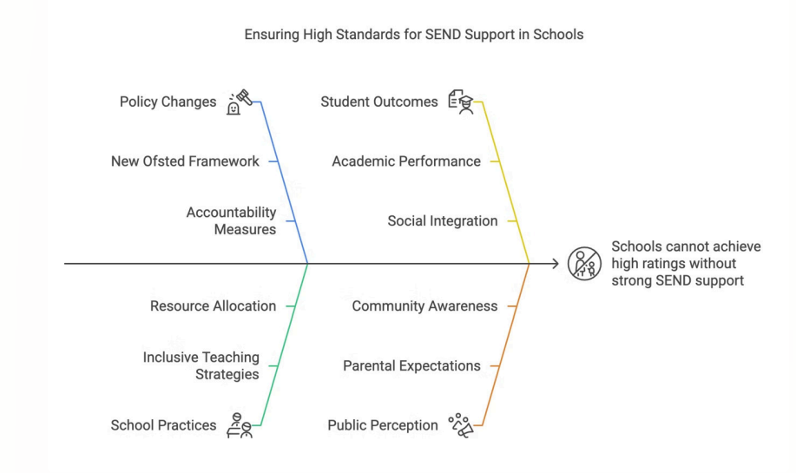

Slide 14
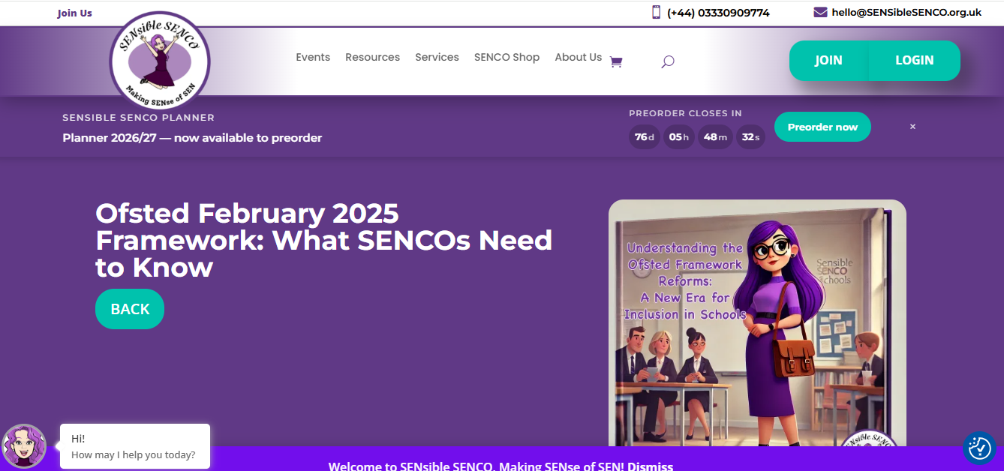
www.sensiblesenco.org.uk

Slide 15

SENCO
Hayley Gardner
Looe Community Academy
OFSTED experience
February 2026

Slide 16

New Head since April 2025
New SLT Team

Slide 17



Context
Small Secondary school
Data is never wrong
Attendance
Staffing
SEND
Behaviour

Slide 18
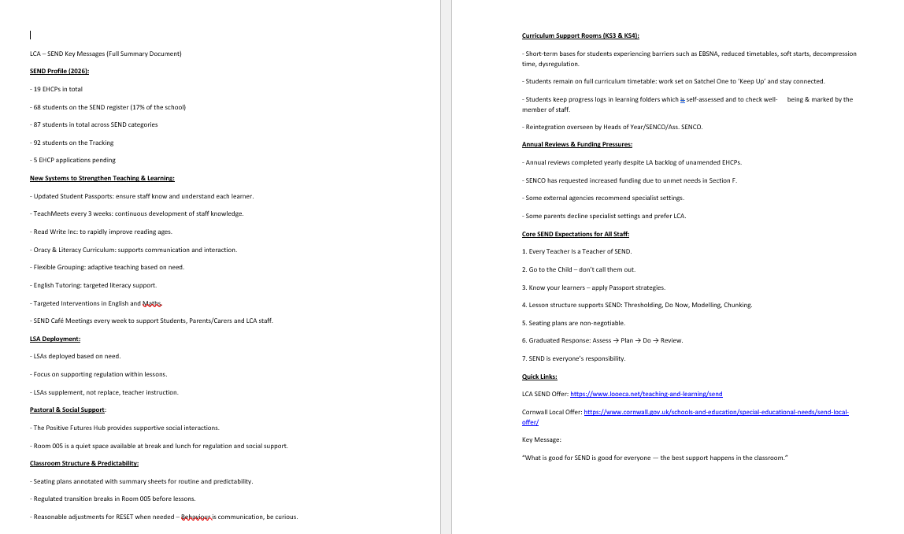
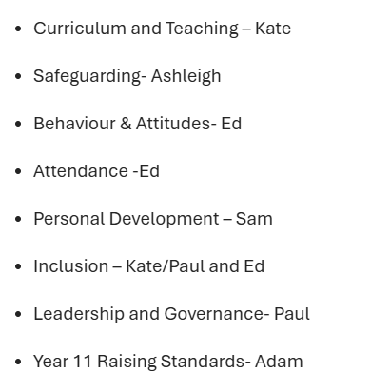
Summary sheets

Slide 19



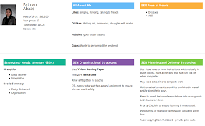
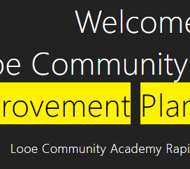
Paul also prepared the following
White boards for his table for staff ready for the call
White board with ALL information he needed in front of him
Registers were printed off before – PP, LAC, CIC, YC, SEND, EHCP etc
Improvement Plan
OFSTED Toolkit/internal folder

Slide 20

They asked if school wanted to go ahead
They will be calling at 11.30am
I was in a meeting, and everyone was
Trying to find me.

Slide 21



Slide 22

Day 1

Slide 23
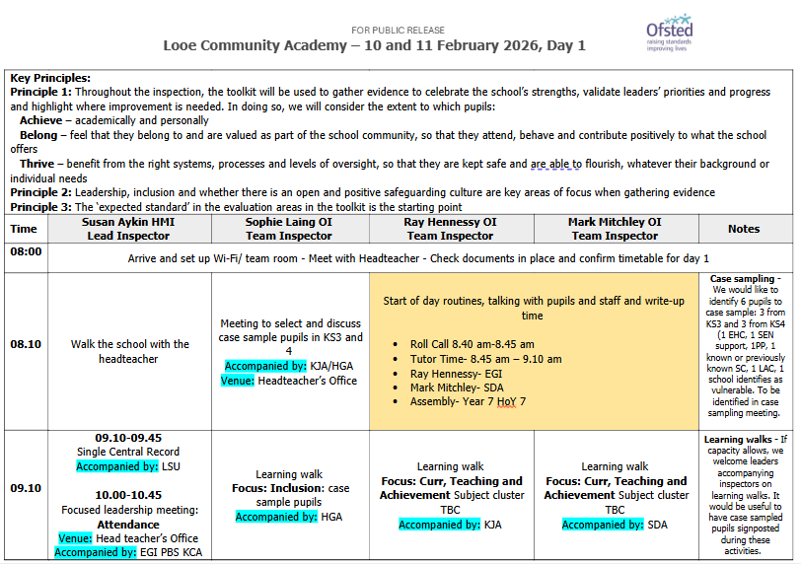
1. Met with Sophie and she selected 6 students and 3 back up students.
All students were in who she selected.
2. I printed out the selected students' passports.
3. We went to their lessons to see if the passport were being followed.
4. We discussed seating plans – annotations and adaptive teaching strategies and summary sheets.
5. She sat down next to students and looked through their books and spoke to them.
6. I explained backgrounds of the students and could produce reasons for their choices in the lessons.
7. We knew ALL our students and could explain each case study. We could JUSTIFY everything.
I showed Sophie the whole school and followed student passports.
READ WRITE INC
Handwriting
Curriculum support basis
These were another focus after following students.

Slide 24

Hotspots RAG

Slide 25
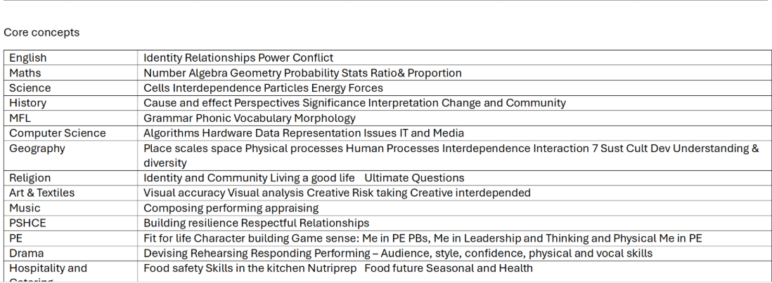
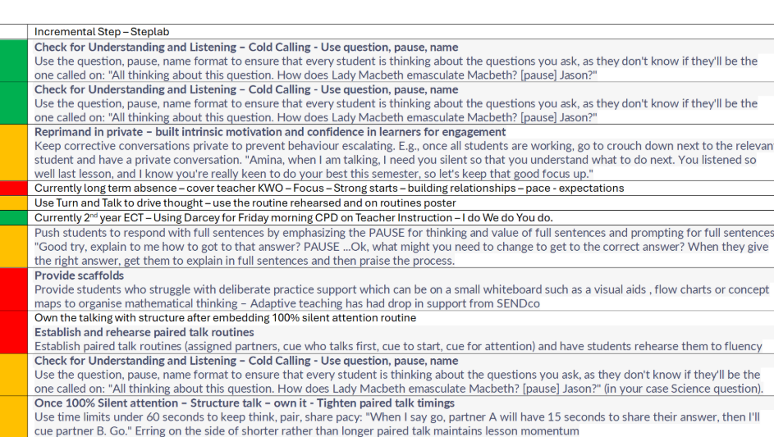
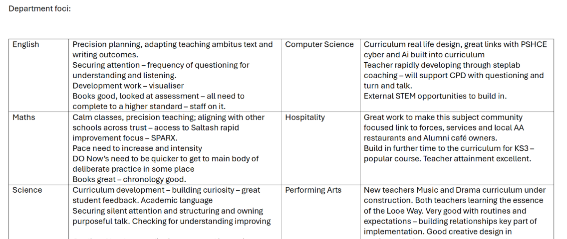
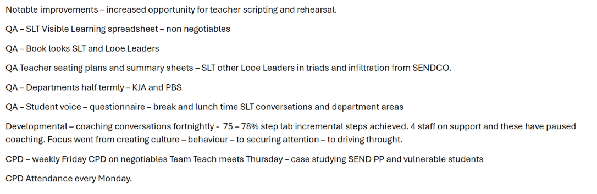

Slide 26
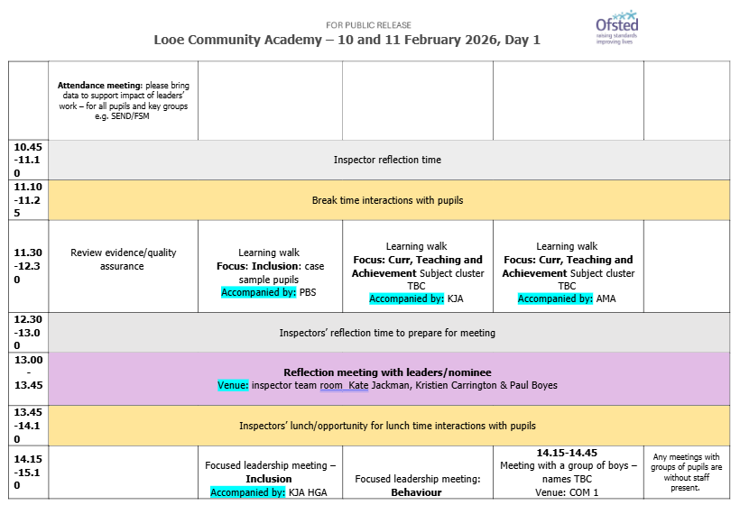

Slide 27
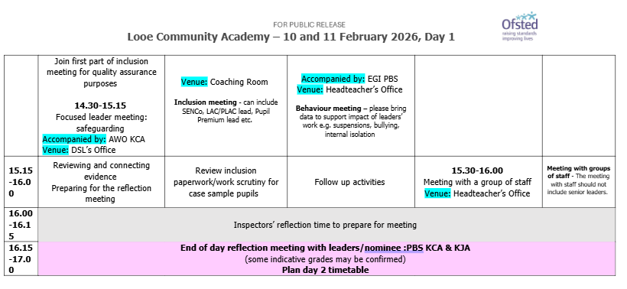

Slide 28
Day 2

Slide 29


Slide 30
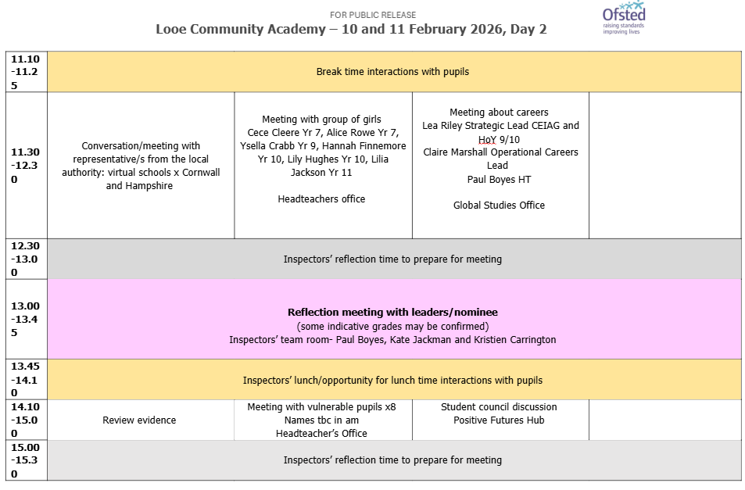

Slide 31


Slide 32
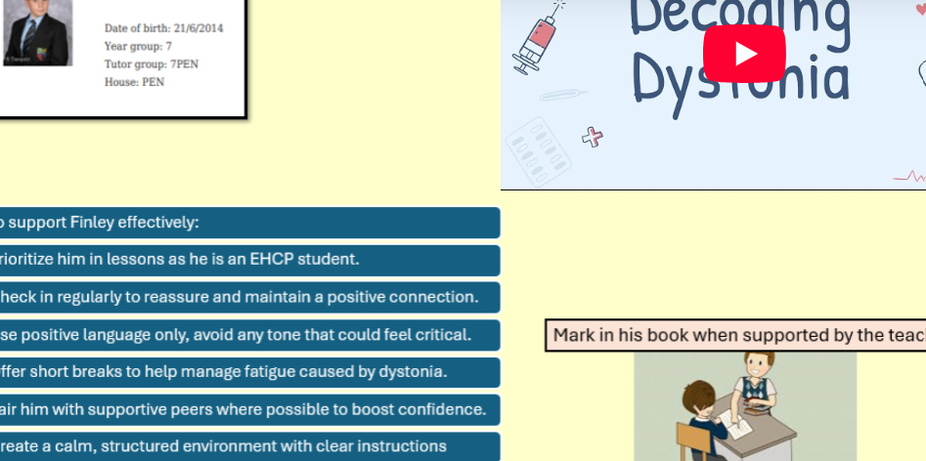



TEACHMEETs
Focus on Interventions
Impact of interventions
Reading ages 7,8,9,10 RAG and triangulated with English books
How are you going to use Reading ages to improve the curriculum through adaptive teaching

Slide 33

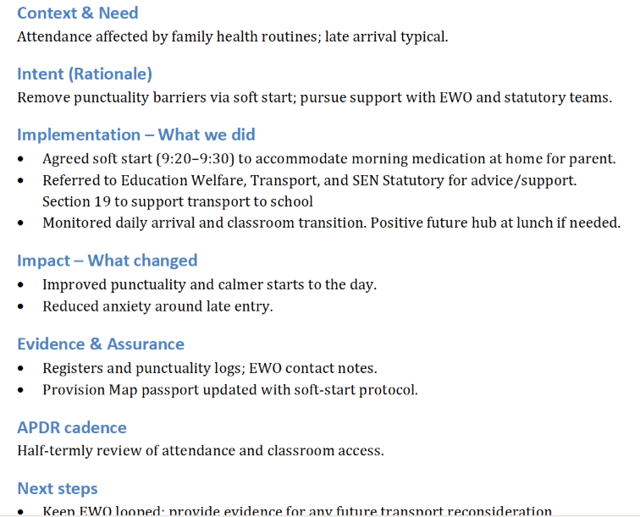
Case studies on SEND students & Attendance
SEND attendance is poor here and needed to show cases
Top 10 Cases studies and showed them the data and case studies

Slide 34



We had more control on Day 2

Slide 35

SEF was accurate
We were transparent with toolkit expectations
Highest expectations of everything.

Slide 36


Slide 37
Questions?

Slide 38

2026

Slide 39
The Schools White Paper 2026, "Every Child Achieving and Thriving," significantly impacts SENDCos by shifting the system toward earlier, mainstreamed intervention, increasing accountability, and replacing "SEN Support" with statutory Individual Support Plans (ISPs). SENCOs will face higher workloads managing these digital plans, coordinating new "Experts at Hand" services, and leading school-based "Inclusion Strategies" from 2028-2029.
The Schools White Paper 2026, titled Every Child Achieving and Thriving, introduces significant reforms that shift Special Educational Needs Coordinators (SENDCos) into more strategic leadership roles while also increasing their administrative and operational responsibilities. While the proposals aim to improve early intervention and mainstream inclusion, they are expected to significantly impact SENDCo workload.

Slide 40
Key impacts on SENDCos include:
Individual Support Plans (ISPs): Mandatory, digital plans for every child with SEND to be developed, replacing the current, non-statutory SEN Support framework.
Strategic Leadership Shift: Increased responsibility to manage "Targeted" and "Targeted Plus" support layers in-house before requiring EHCP assessment, creating a new "gatekeeper" role for accessing formal services.
Increased Workload: Need for intensified documentation, regular reviews of ISPs, increased family consultation, and managing new "Inclusion Strategies" (replacing SEND Information Reports).
New Accountability Metrics: Ofsted will inspect SEND inclusion separately, placing higher scrutiny on the SENCO’s strategic decisions and the efficacy of the school’s "Inclusion Strategy".
"Experts at Hand": Coordination with new, rapid-access local experts (educational psychologists, speech therapists) in "school clusters"

Slide 41
Key Impacts on SENDCo Responsibilities
Strategic Leadership and Inclusion:
Inclusion Strategy: SENDCos will likely lead the creation of a new, mandatory annual Inclusion Strategy, replacing the current SEN Information Report.
Whole-School Training: There is a new expectation for SENDCos to design and oversee whole-school SEND training for all staff, supported by a national £200 million CPD package.
National Inclusion Standards: SENDCos will be responsible for ensuring their school's practice aligns with new, evidence-based National Inclusion Standards due by 2028.

Slide 42
Key Impacts on the SENDCo Role
Statutory Individual Support Plans (ISPs): SENDCos will be legally required to create and manage digital ISPs for every child with identified SEND, not just those with Education, Health and Care Plans (EHCPs). This replaces the previous SEN Support or SEN Information Reports with a more detailed, parent-friendly record of day-to-day adjustments.
A Four-Tiered Support System: The SENDCo will lead a new model consisting of Universal, Targeted, Targeted Plus, and Specialist layers. They must oversee how support is organised across these tiers and ensure that specialist resources (like therapists) are accessed earlier.
Inclusive Mainstream Leadership: There is a heightened expectation for SENDCos to design and quality-assure "quality first" inclusive teaching across the whole school, rather than focusing solely on the most complex cases.

Slide 43
Creation of 'Inclusion Strategies’:
Schools must now publish an annual Inclusion Strategy. SENDCos will likely be responsible for drafting this document, which outlines how resources are deployed to benefit children with SEND.
Management of the 'Experts at Hand' Service: A new £1.8bn fund will provide schools with faster access to educational psychologists and speech therapists. SENDCos will be responsible for coordinating this earlier involvement to reduce delays in support.
New Performance and Accountability Measures: Inclusion will now be a standalone Ofsted judgement, meaning SENDCos must prepare for increased scrutiny on how well the school supports SEND progress separate from overall performance.

Slide 44
Dual-System Pressure: During the transition (expected to last until at least 2030), SENDCos must manage two legal frameworks simultaneously—the current EHCP system and the new ISP and tiered support expectations.
Gatekeeping and Bias: SENDCos may face increased pressure as "gatekeepers," tasked with managing limited resources and deciding which children meet the thresholds for higher tiers of support.
Staff Training Requirements: SENDCos will be expected to lead whole-school SEND training, as the white paper aims for every teacher to be a "teacher of SEND"

Slide 45
Key Timelines:
Present–2027: Planning and preparation, aligning to best practice.
2028-2029: Full implementation of National Inclusion Standards.
September 2029: Statutory Individual Support Plans (ISPs) become mandatory.
From 2030: Phased transition to new EHCP model during natural school transfers

Slide 46
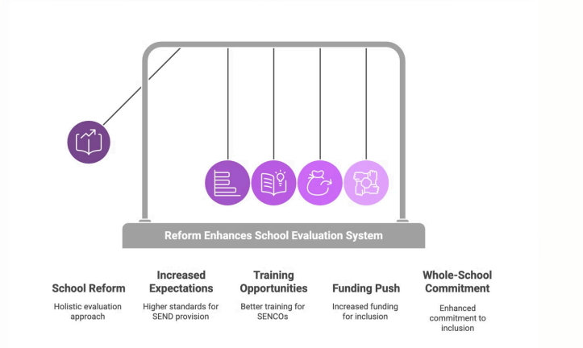

Slide 47

You are not alone!
Local Authority Support
SEND Centres of Excellence work
SENDCo networks
Inclusion is now front and central!

Slide 48


Trudy Chappell – SEND Support Services and Referrals
Dan Baker – Key information about travel applications
Coffee break

Slide 49
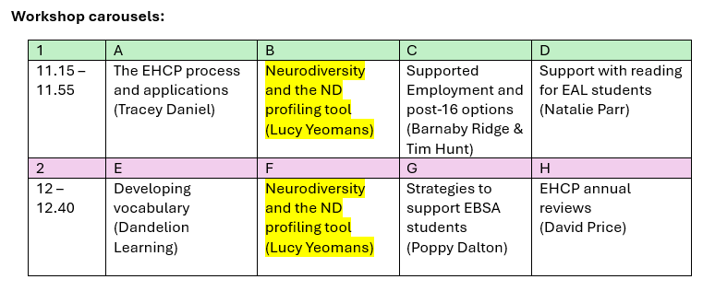
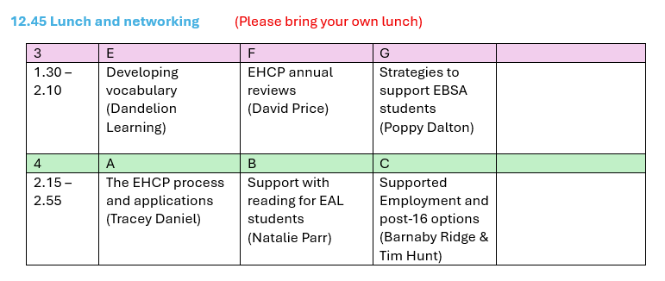

Slide 50


