Slide 1





TPAT and Cradle-to-Career
Our first steps: TPAT support and investment + Cradle-to-Career Methodology
Nine Trust schools, across three clusters:
  The Lizard – Foundations Phase complete
  West Penwith – Foundations Phase complete
  Hayle – Catalyst Phase complete
Working in collaboration with non-Trust schools from the LA and Crofty MAT to ensure a truly place-based approach
Building strong local relationships that extend beyond Cradle to Career
Delivering change via three strands:
  Local systems coherence
  Strengthening family relationships
  Educational coherance
Improving life chances for all

Slide 2
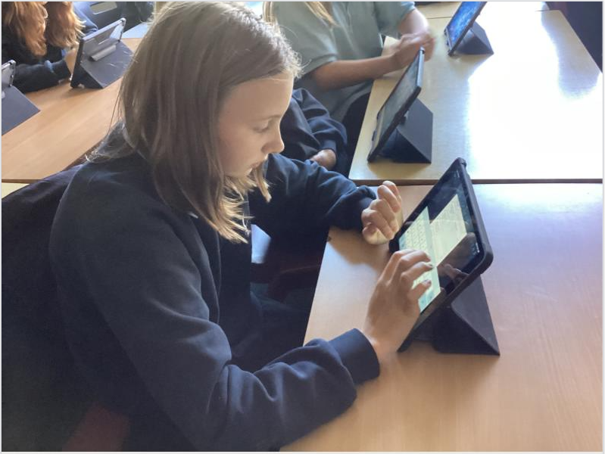
Our community: fractures we saw
Household view of education a stronger predictor of engagement than income in our cohort
Access barriers in a rural, coastal context: transport, things to do, spaces to belong
Disconnect between school and parts of the local parent community.
Improving life chances for all

Slide 3
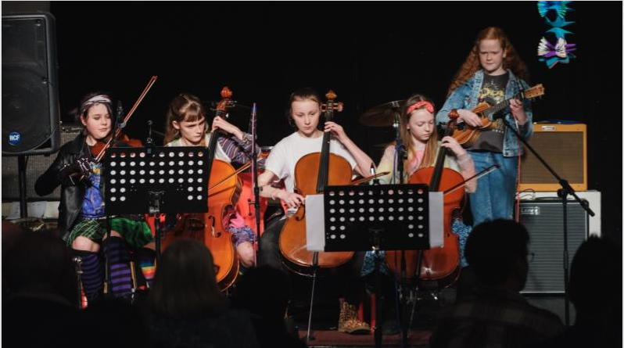
The Groundwork: rewiring connections
Curriculum coherence families recognise:
  Reading canon, art and learning from EYFS to Year 11
Joint monitoring committee across Mullion Primary and Mullion School (EYFS to Year 11)
Authentic collaboration between Heads in the Lizard
Our use of technology
The Connect Curriculum
ILPs for every Year 7
Improving life chances for all

Slide 4
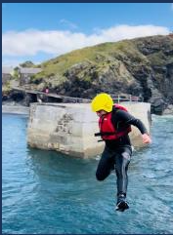
Our 10 Years – The AMBI Project
Define a 0-18+ experiences pipeline beyond the classroom: apprenticeships, university stays, local employer links.
Early Years use of secondary facilities, Year 10 residentials at universities, explicit routes into local work.
Children present plans to parents, building a shared ‘household view’ that values education.
Improving life chances for all

