Slide 1

Changing Careers!
Harnessing the power of Changes to Careers Related Learning
Carrie Childs and Dave Pollard
Cornwall & Isles of Scilly Careers Hub

Slide 2
What’s Changing?
Young people’s Aspirations
Policy
Careers Leadership
Approaches
Tools
How can you harness the power of Careers to tackle some of the challenges that you might be facing?

Slide 3
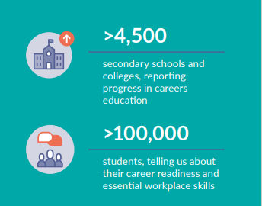
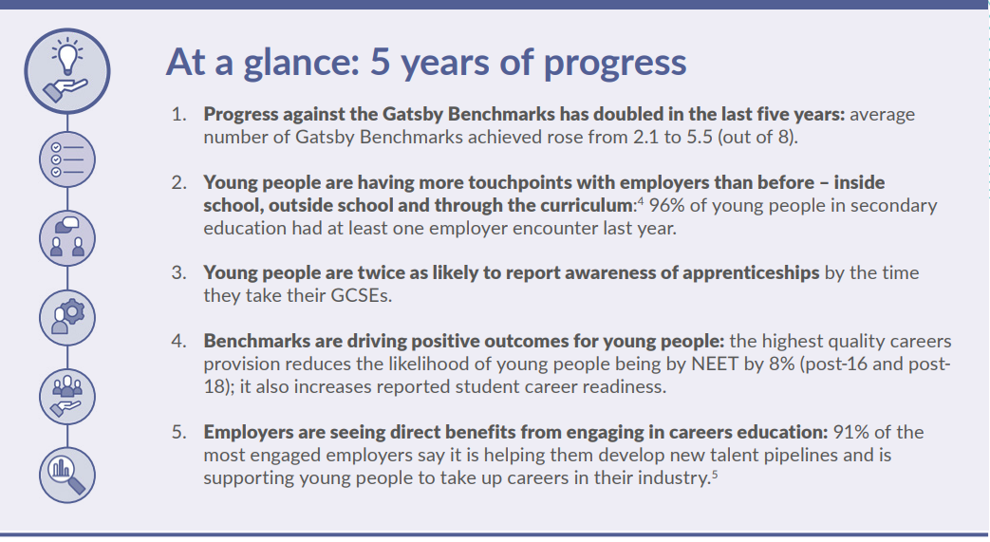
cec-now-next-report.pdf (careersandenterprise.co.uk)
Notes:
We now have deep insight across the careers landscape - from employers, Careers Hubs, schools and young people themselves.
Four years’ worth of data on student destinations gives us an opportunity to accurately describe how the current system impacts businesses and young people.
We can also begin to pinpoint the impact of specific activities on specific students.
Whilst there is undoubtedly more that can and should be done, this data allows us to say, with confidence, that young people and employers in England are benefitting from the systemic reinvention of careers education
A national careers system is now in place in England, having been scaled significantly over the past five years.
The system has been overseen – with a full range of partners – by The Careers & Enterprise Company, the national body for careers education.
• 92% of schools and colleges are part of a local Careers Hub.
• More than 3,000 Careers Leaders have been trained and all of them are supported by digital tools and resources.
• The eight Gatsby Benchmarks of good career guidance are well embedded and guide the work of educators and employers across the system
We have an established and coherent system where the Benchmarks are driving positive outcomes for young people – the highest quality careers provision reduces the likelihood of young people being NEET by 8%, it also increases reported student career readiness
Our commitment is to continue to drive standardised continuous improvement of career leadership and careers provision and to ensure quality assurance of careers leadership and careers provision across England
The Careers Impact System is how we are doing this

Slide 4
NEET/Not Known 16-18
Current programmes are having an impact on reducing NEET for young people. This is due to coordinated service, such as YEP, Your Future Kernow across Employment and Enterprise but also wider council and community sector.

Slide 5
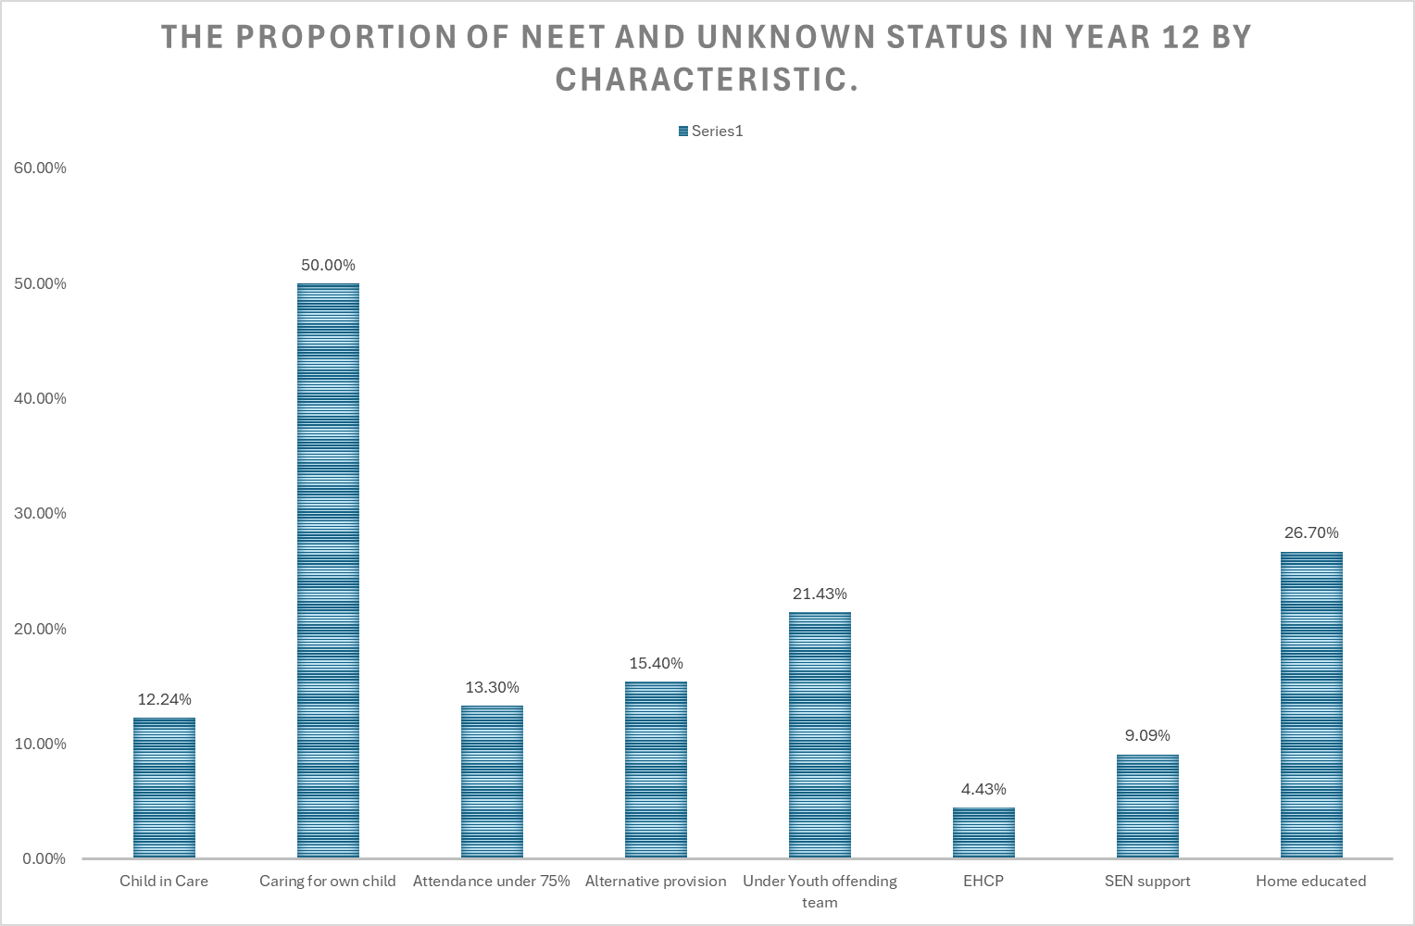
November 2025

Slide 6
  The average career readiness score in Cornwall among Year 11 students is slightly higher than the national average
Career readiness improves between Year 7 and Year 11
Average career readiness score (calculated as the % of questions students responded positively to) by Year group, by Careers Hub and national sample
+3%pts
Source: Future Skills Questionnaire (FSQ), 2024/25 academic year – (Cornwall and the Isle of Scilly, Year 7, N=945, Year 11, N=579)
Notes:
(Extra Slide for reference) Careers Readiness Scores – as demonstrated by the Future Skills Questionnaire

Slide 7
  Understanding of pathways options more than doubles at Year 11
  A large proportion of students in Cornwall and the Isle of Scilly report positive understanding of Apprenticeships in Year 11
% of students who understand each pathway in Year 7 by Careers Hub and National sample
% of students who understand each pathway in Year 11 by Careers Hub and National sample
+4%pts
+5%pts
Source: Future Skills Questionnaire (FSQ), 2024/25 academic year – (Cornwall and the Isle of Scilly, Year 7, N=945, Year 11, N=579)
Notes:
Extra Slide - for reference

Slide 8
  Interest in priority sectors and careers
  Relevant proportions of Year 11 students in the region are interested in careers and sectors adjacent
  to priority sectors: Clean Energy, Geo-resources, Space and Aerospace, the Visitor Economy, Agri-food, Creative Industries, Digital connectivity and Housing Infrastructure
% of Year 11 students interested in each career in Cornwall and the Isle of Scilly
% of Year 11 students interested in each industry in Cornwall and the Isle of Scilly
Source: Future Skills Questionnaire (FSQ), 2024/25 academic year – (Cornwall and the Isle of Scilly, Year 7, N=945, Year 11, N=579)
Notes:
Extra Slide – For reference

Slide 9
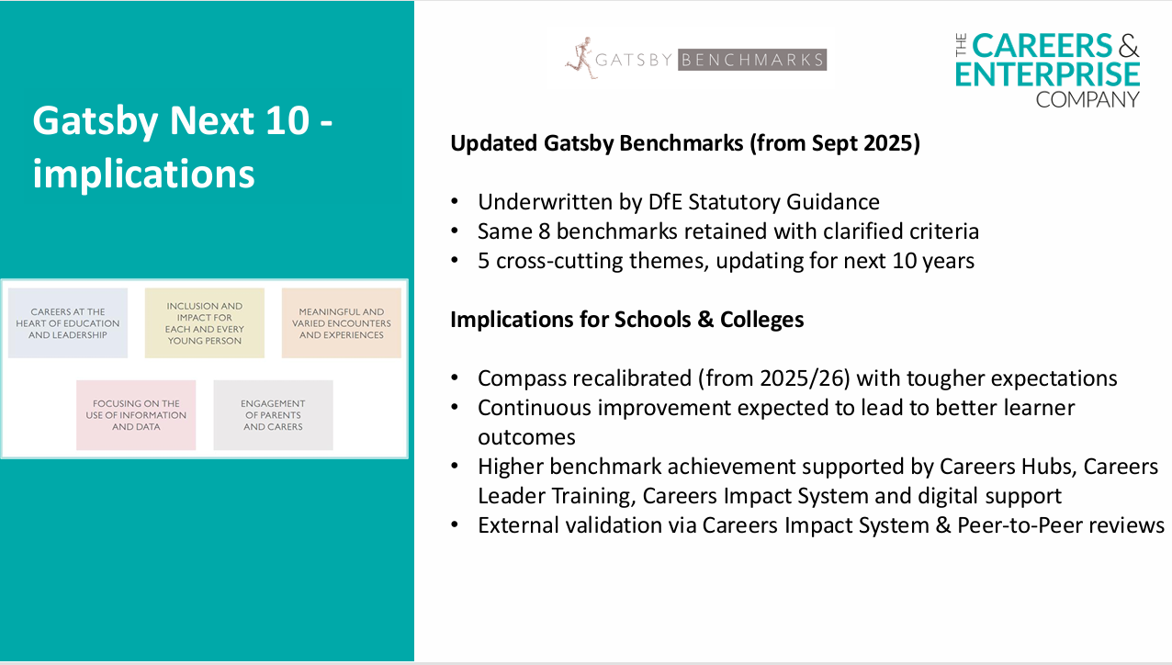

Slide 10

Work experience… or experiences of the workplace?
1-2 weeks work experience in Yr10 for most where possible
A range of experiences of work from Yr7 – 11 for all
Work experience wherever it could be found for as many as possible
A range of interactions for all, with a variety of employers and sectors aligned to interests
Part of what we’ve historically always done
Linked to careers for young people who want to live, work and thrive in Cornwall

Slide 11
A programme of Modern Work experience, what should it do?
1: Prioritise young people who are missing out and provide targeted support
2: Include experiences that are employer-led in their design
3: Enable meaningful relationships between the employer and the young person
4: Start early, allowing access to multiple, different industries and occupations
5: Be underpinned by learning outcomes, to ensure a progressive high-quality approach
6: Offer meaningful experiences as defined in updated Gatsby 6
Notes:
Extra Slide

Slide 12
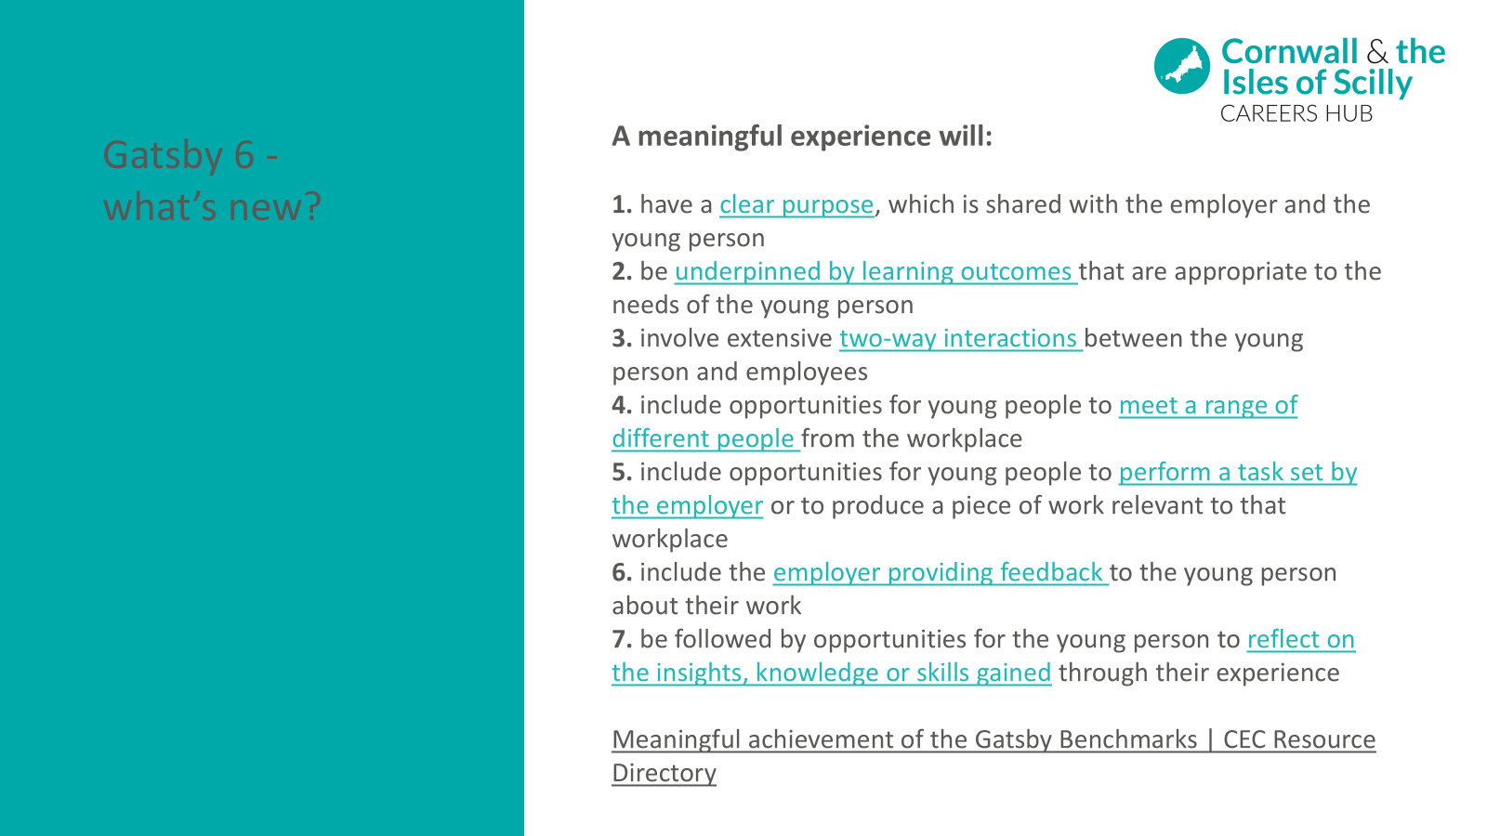

Slide 13
Trained CL
SLT and Governor backing
Link to leaders’ vision in supporting a whole institution approach
Link to institution strategic priorities
Distributed leadership of careers
Allocating relevant resource and distributed leadership of careers (inc SLT)
Notes:
The scale of ambition for leavers as learners cannot sit as the responsibility of one individual and a further identified condition for success was in distributed leadership of careers across a school, special school or college
This starts with ensuring that there is a named and trained Careers Leader who has the backing of SLT
Backing of SLT can be defined through the conditions for success, which provide tangible direction to how careers can be positioned in the schools, special school or college as a driver for improvement
The identification of a vision and priorities with a scaffolded careers learning journey provides opportunity for robust milestone progress monitoring and support and challenge from both SLT and Govs
A clearly articulated vision also supports a whole school, special school or college approach where all staff understand their roles and responsibilities within achieving the vision for learners as leavers of that institution

Slide 14
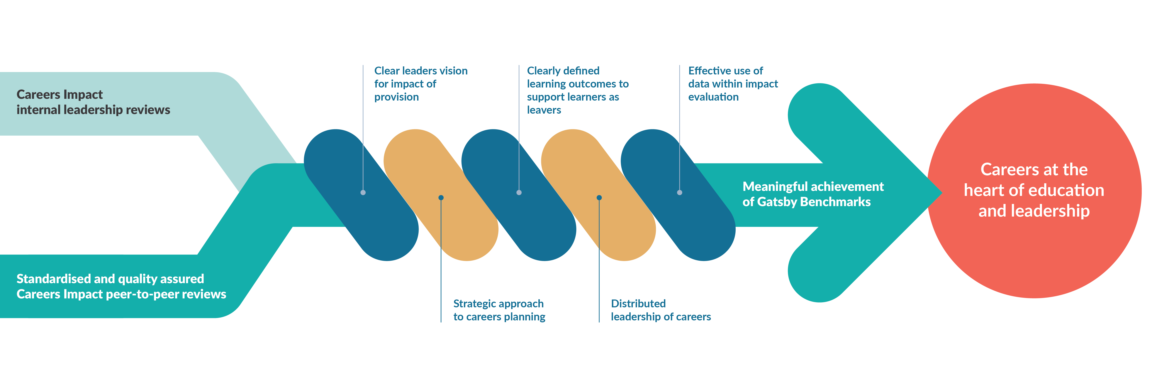

Slide 15
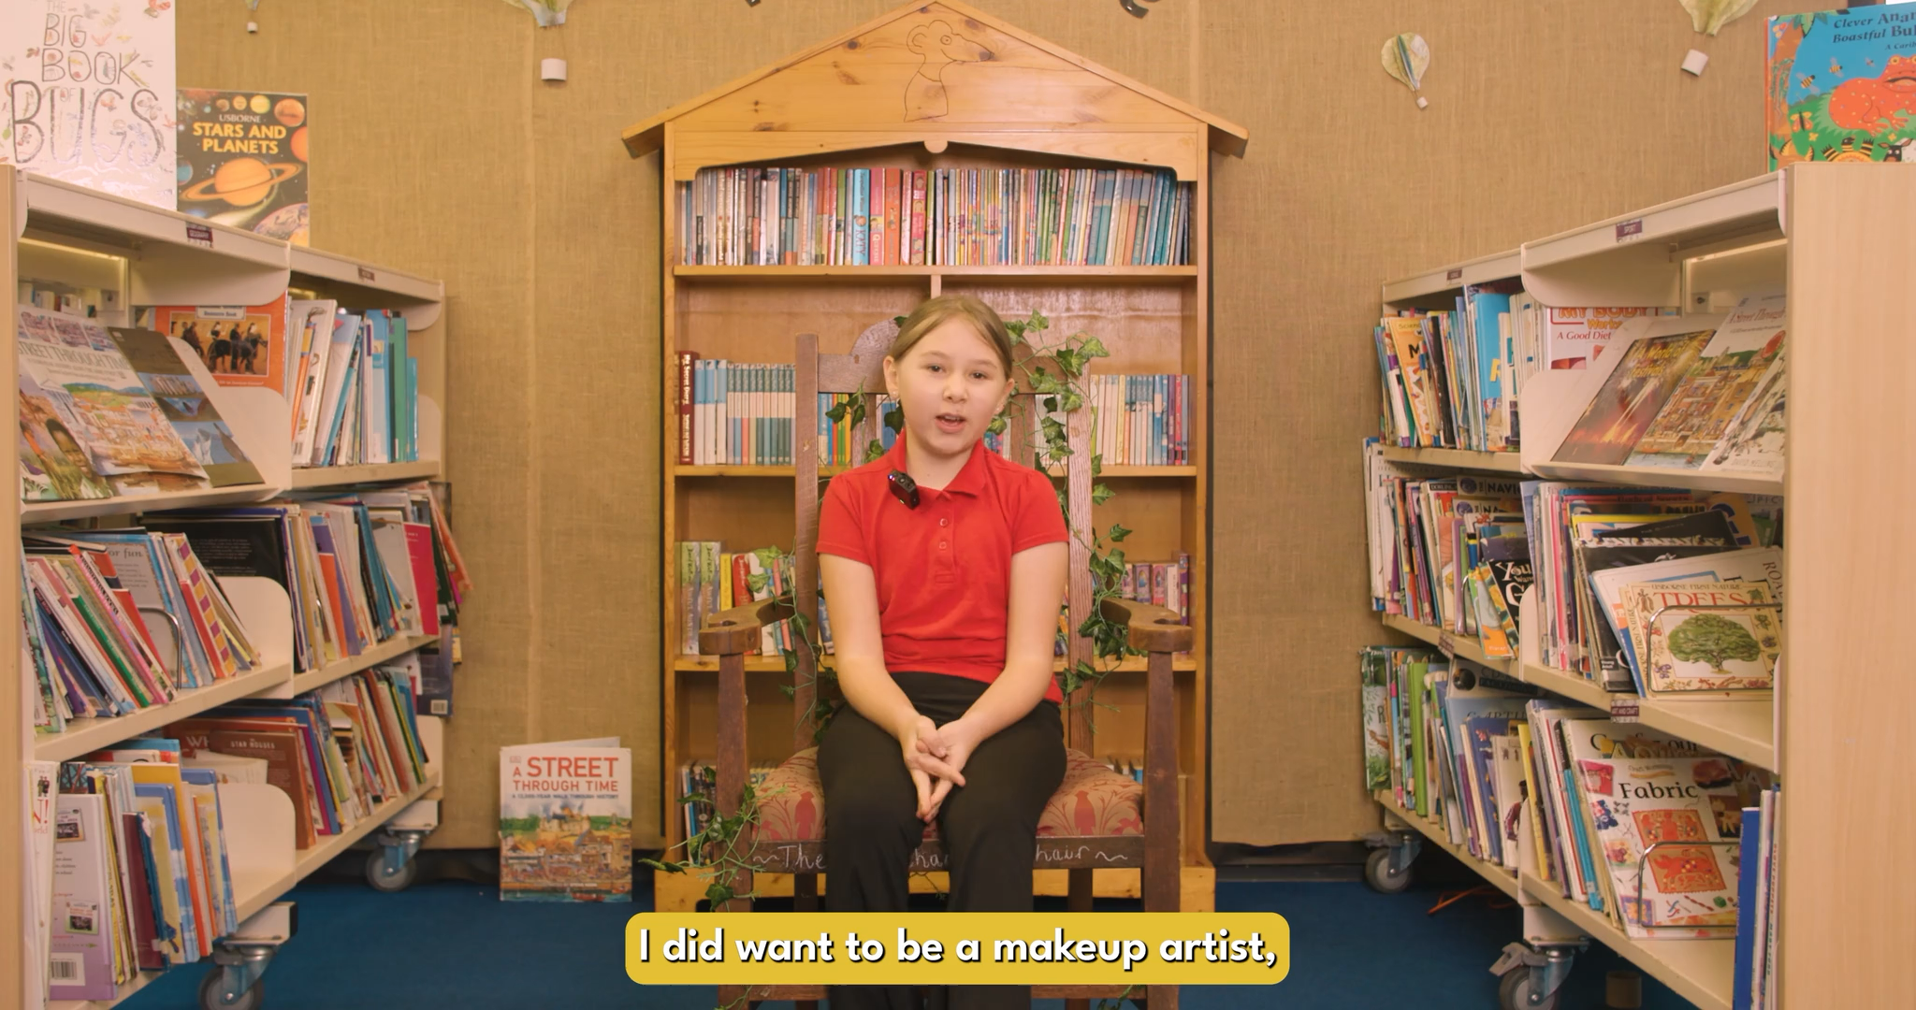
Notes:
Extra Slide – to be shared as follow up inspiration

Slide 16

Full Arsenal
Peer to Peer Review
Benchmarks
2 - 8
Future Skills Questionnaire
Internal Leadership Review
Benchmark 1
Every three years
OnTrack+ Data
Destination Data

Slide 17
Full Arsenal
OnTrack+ Data
Future Skills Questionnaire

Slide 18
Questions mapped against Gatsby Benchmarks, CDI framework learning outcomes and skills builder framework.
20 minutes to complete, carried out on a yearly basis
Five Questionnaires for Different Stages
  Starting Secondary (Year 7)
  Transition from KS3 (Year 8 and 9)
  GCSE Years (Year 10 and 11)
  Post 16 Study (Year 12 and 13)
Future
Skills
Questionnaire
(FSQ)

Slide 19
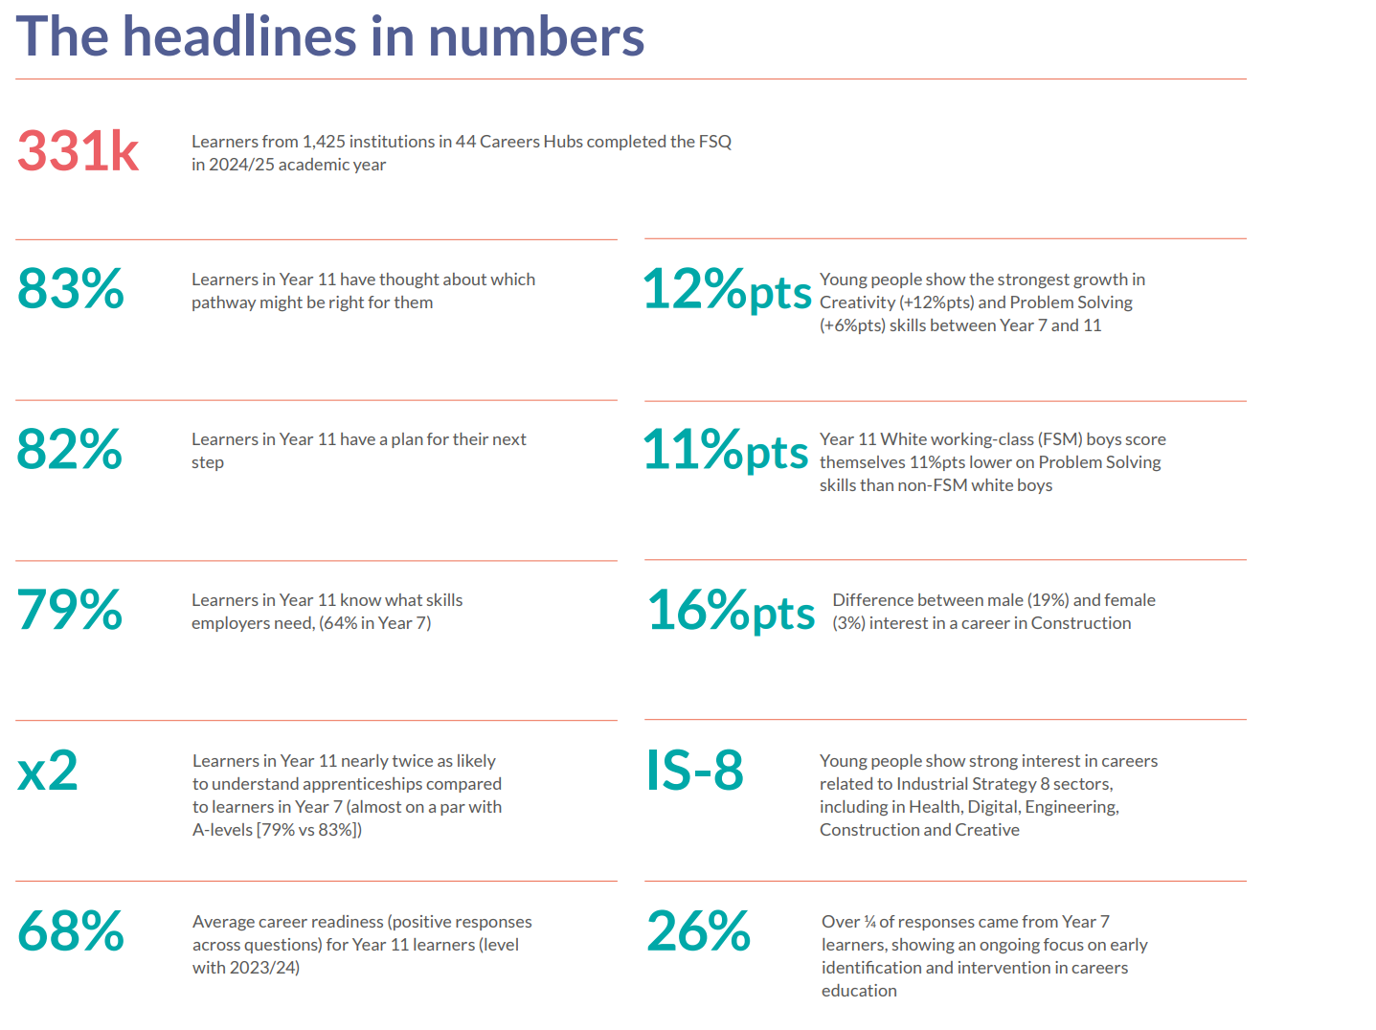

Slide 20
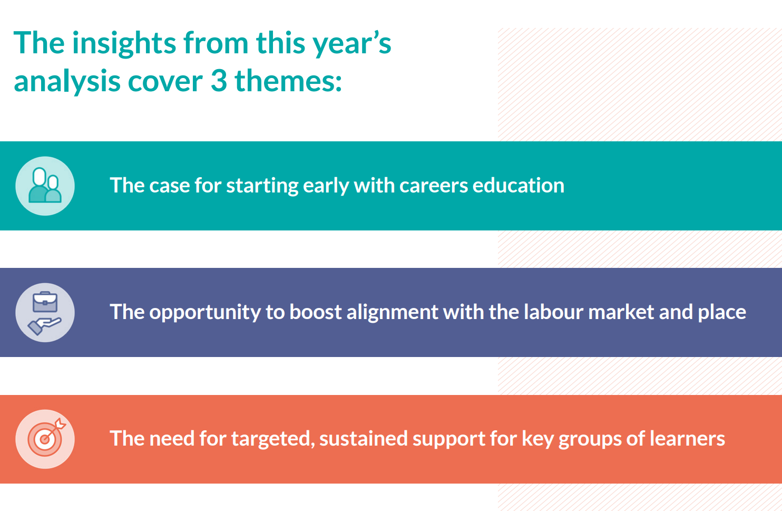

Slide 21

Internal Leadership Review
Activity linked to Benchmark 2 - 8
Future Skills Questionnaire
OnTrack+
Destinations Data
Benchmark 1
Peer to Peer reviews
Notes:
It is recommended in Statutory Guidance, that institutions undertake a Careers Impact internal leadership review. This process involves key senior staff and will support you in understanding what embedded good practice looks like and how to recognise it.
Engagement with this process also enables you more confidently articulate the intent, design and impact of your careers provision whether for internal reflection, external validation, during an Ofsted inspection or within stakeholder engagement.
Through this process, leaders gain:
a clear understanding of strengths and areas for development within their careers provision.
evidence-based insights to inform inspection discussions and stakeholder engagement.
increased confidence across leadership and staff in articulating impact and strategic direction.
a demonstration of a culture of continuous improvement and strategic oversight.
strengthened collaboration across departments, fostering shared ownership of careers education.
development of robust impact measures aligned with institutional priorities.
the ability to monitor progress over time and adapt strategies responsively.

Slide 22
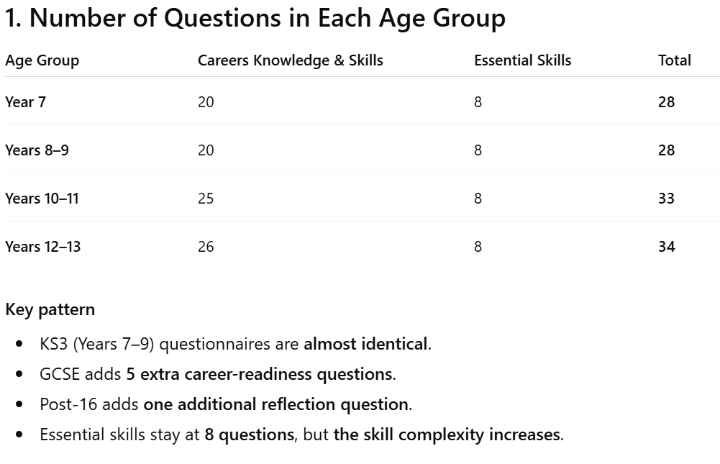

Slide 23
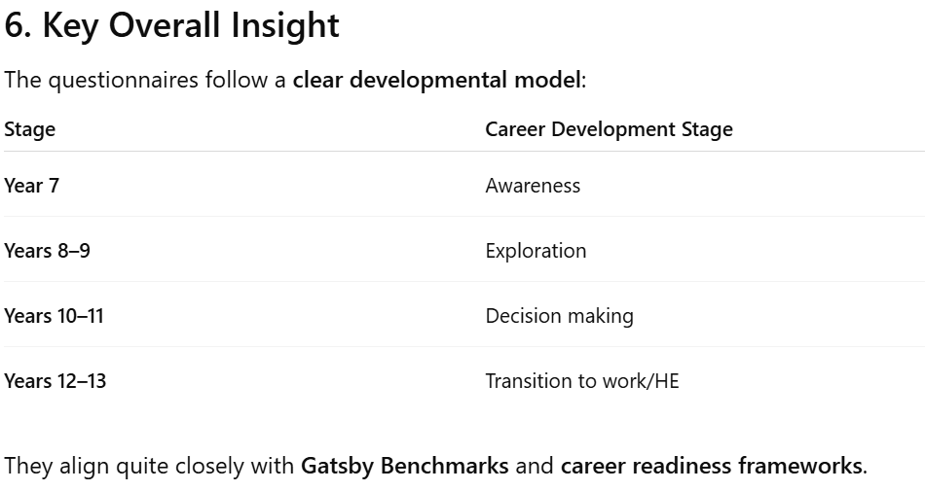

Slide 24
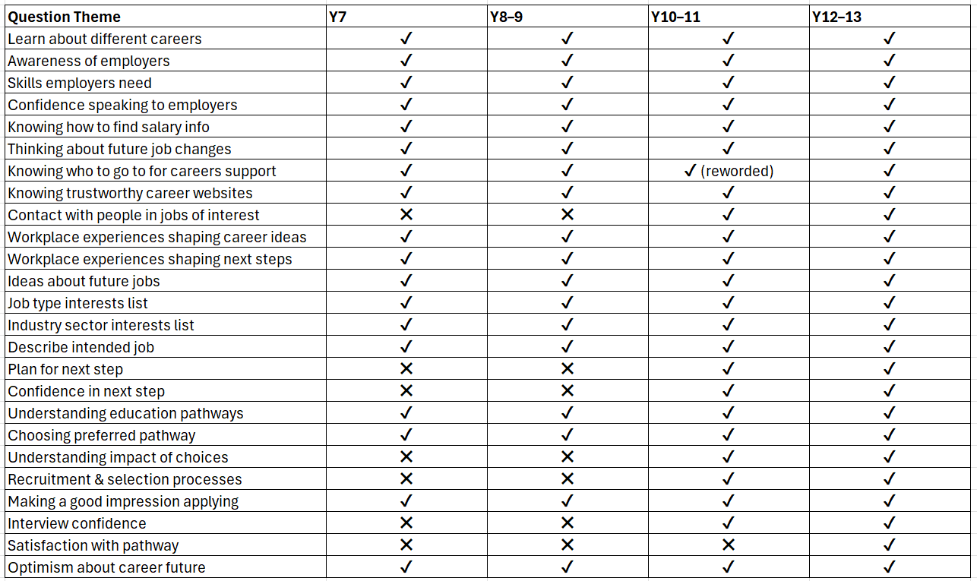

Slide 25
Live
Demonstration

Slide 26
Why Useful
School Perspective

Slide 27
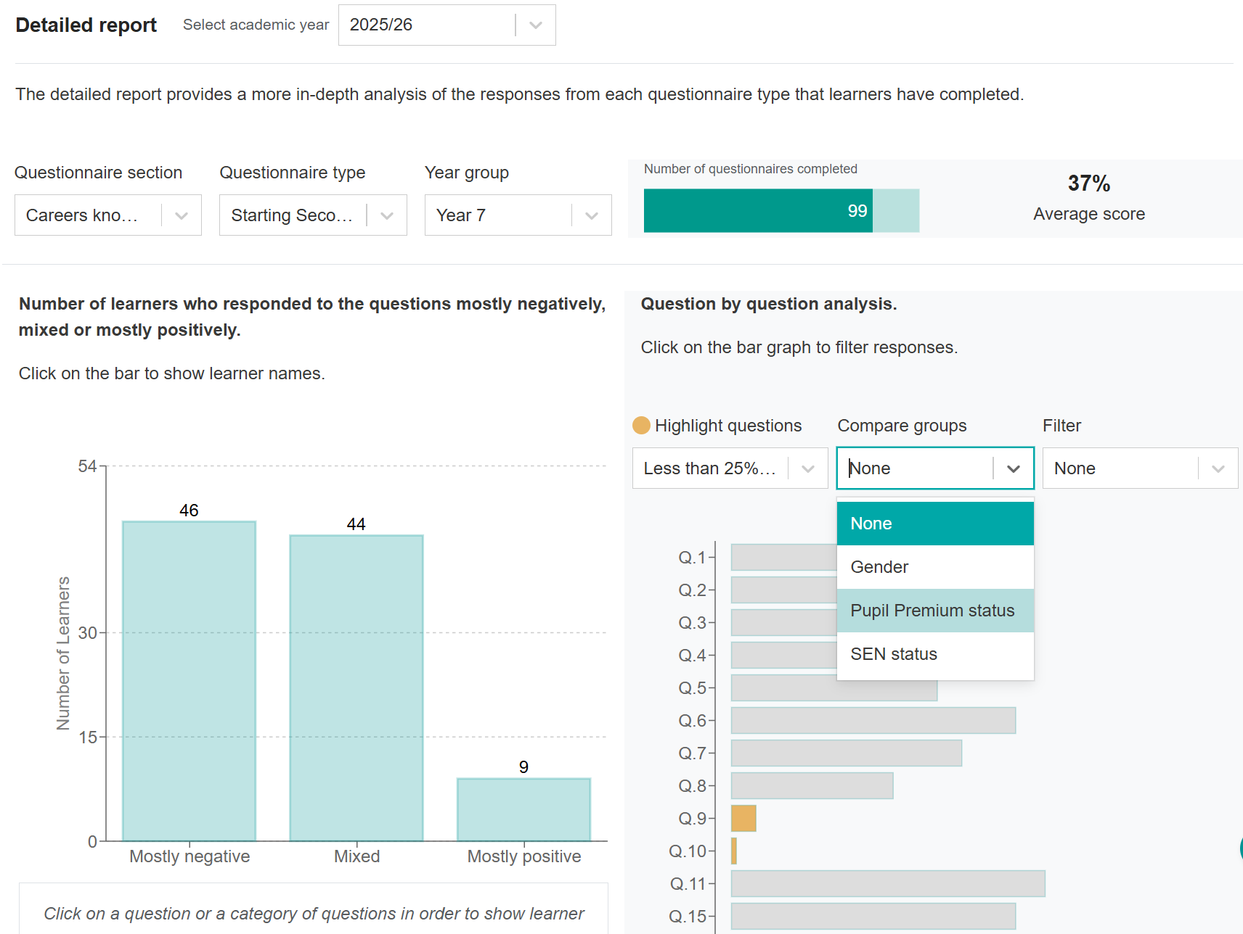

Slide 28
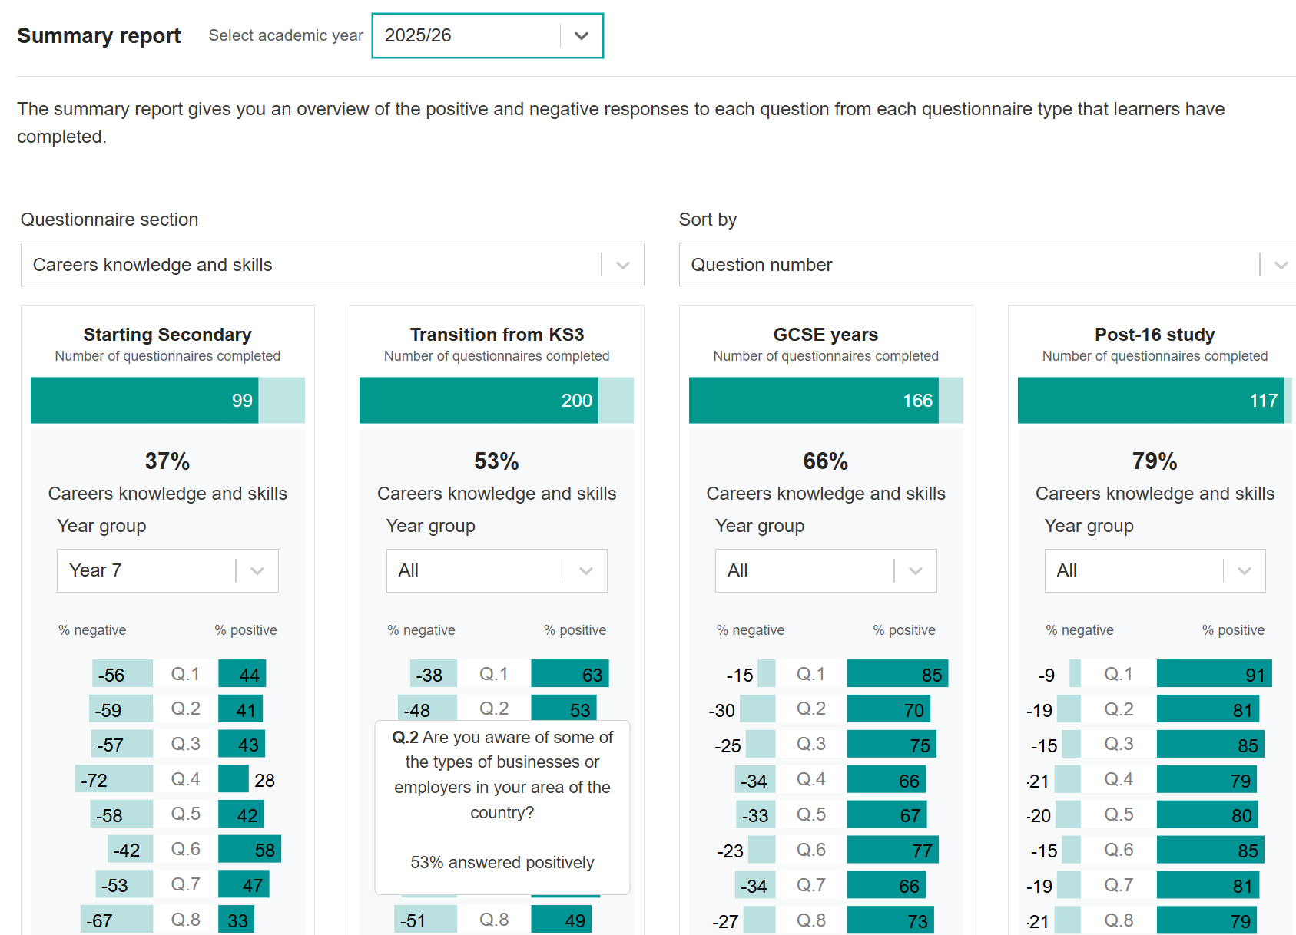

Slide 29
Alignment with school wide strategies
CELT MAT Example

Slide 30
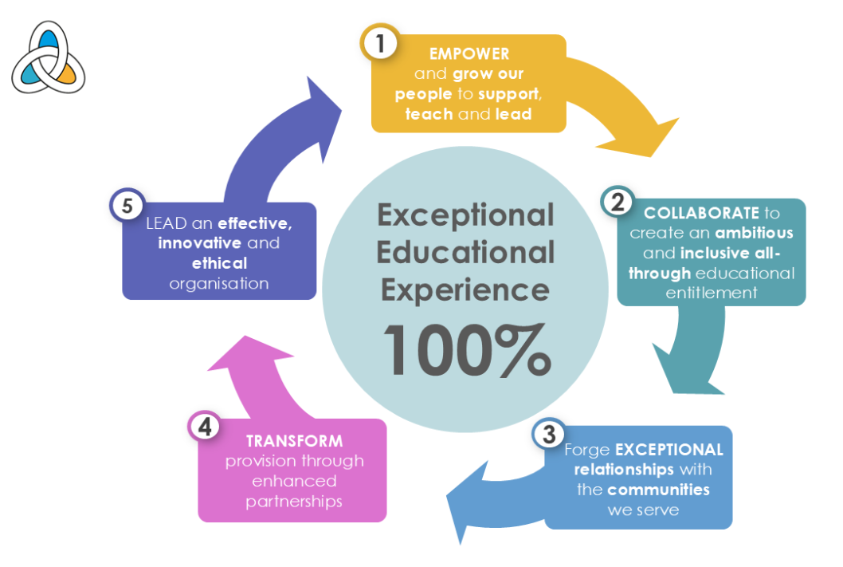

Slide 31

CELT aims to empower learners and staff, so every individual thrives and reaches their potential.
Most relevant FSQ questions
I feel confident in my own skills.
I understand my strengths.
I understand my interests.
I know which skills I need to develop.
I know how to improve my skills.
I can explain my strengths and skills to others.
I feel confident making decisions about my future.
Why these link
These measure self-belief, self-awareness and agency, which are core to CELT’s goal of learners leaving with confidence and purpose.

Slide 32

CELT emphasises thriving in life beyond school and raising aspirations for every learner.
Relevant FSQ questions
I know what I might like to do in the future.
I have ideas about jobs that might suit me.
I have clear career goals.
I understand what steps I need to take to achieve my career goals.
I feel prepared for my next step after school or college.
I feel confident about the pathway I plan to take.
I understand the different routes into careers.
I know what options are available after GCSEs.
I know what options are available after sixth form or college.
Why these link
These questions measure future orientation and ambition, which directly supports CELT’s commitment to learners achieving and succeeding in life.

Slide 33
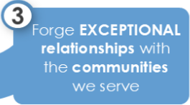
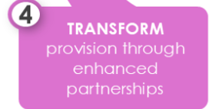
CELT strategy highlights working with communities and partners to improve opportunities for learners and transforming provision through strong and innovative partnerships
Relevant FSQ questions
I have learned about jobs from employers.
I have had opportunities to meet employers.
I have visited workplaces or taken part in workplace activities.
Experiences with employers have helped me think about my future.
Experiences in workplaces have helped shape the job I might like to do.
I know how to find information about jobs and careers.
I know how to research jobs that interest me.
I know what qualifications are needed for jobs that interest me.
Why these link
These measure the strength of employer and community links, a key indicator of how well the trust is connecting education with the wider world.

Slide 34


FSQ questions linked to innovation and effectiveness
CELT emphasises developing people who can lead and contribute to society. The SEND questionnaire and pupil premium filters can be used to support this area specifically.
Relevant FSQ questions
I know how to show my skills to employers.
I know about recruitment and selection processes.
I know how to write a CV or application.
I know how to prepare for an interview.
I feel confident talking about my skills in an interview.
I feel confident applying for courses or jobs.
Why these link
These measure practical employability skills and leadership readiness, aligning with CELT’s aim to effectively prepare learners for life beyond education.

Slide 35
Opportunity to link to other strategies

Slide 36
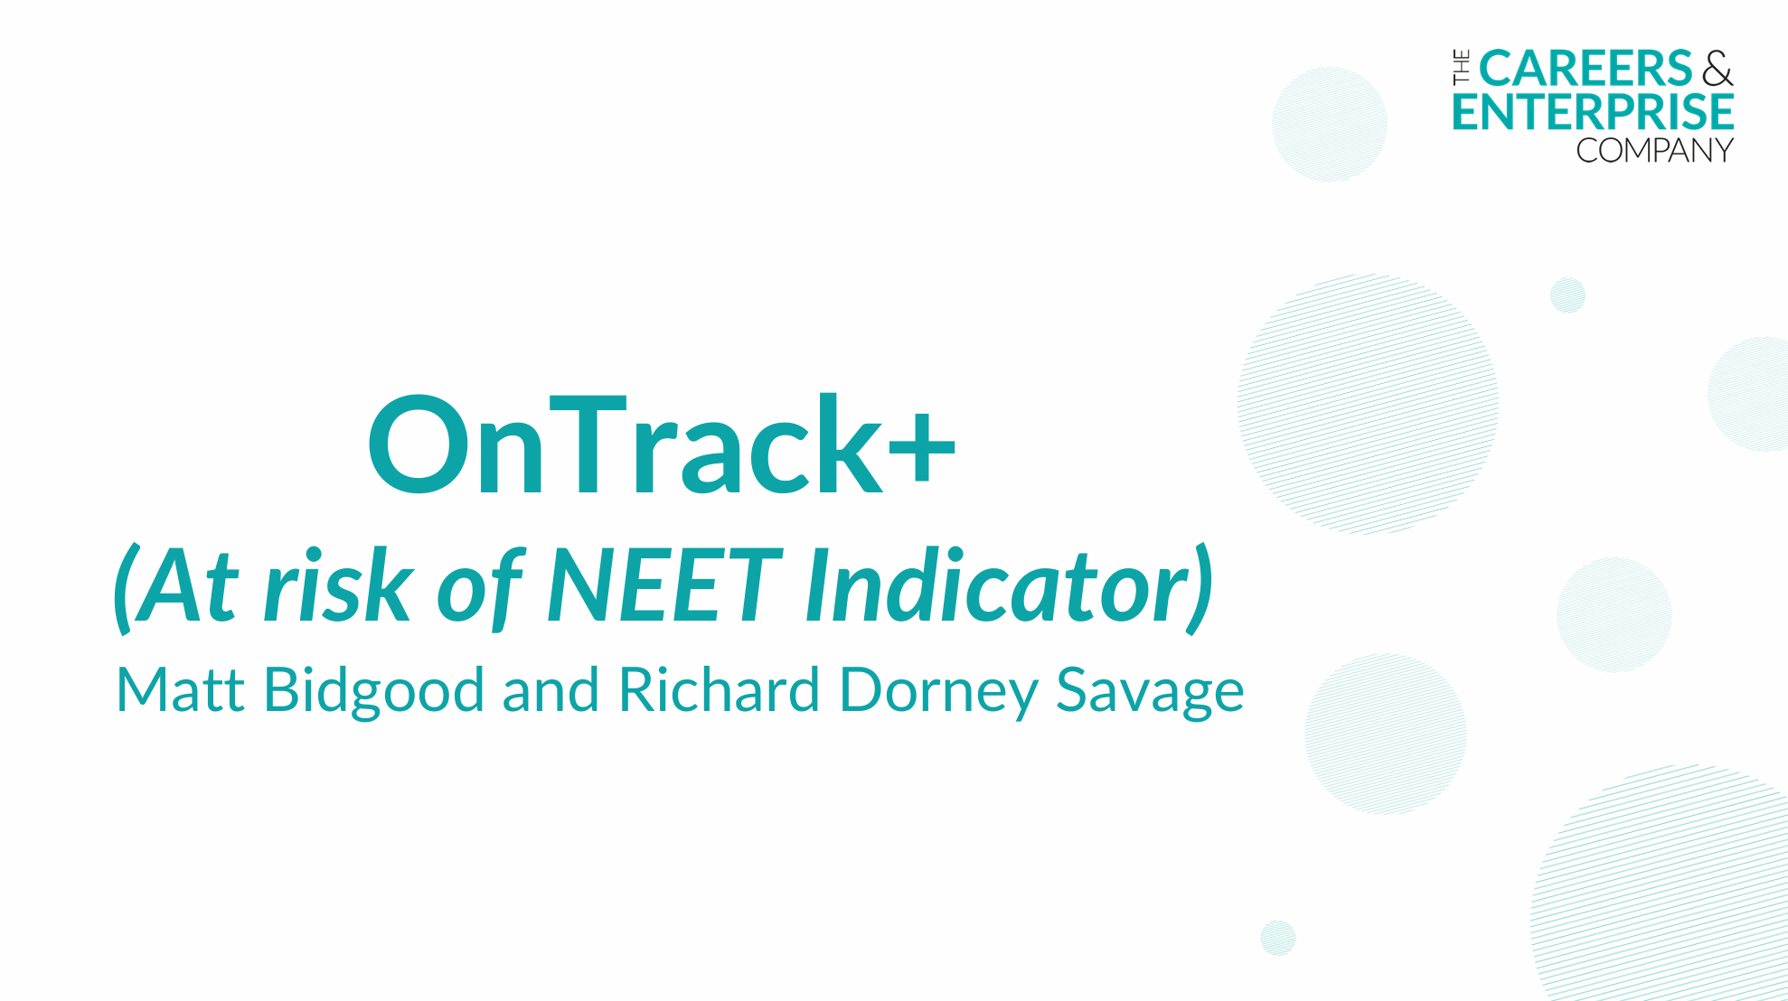

Slide 37
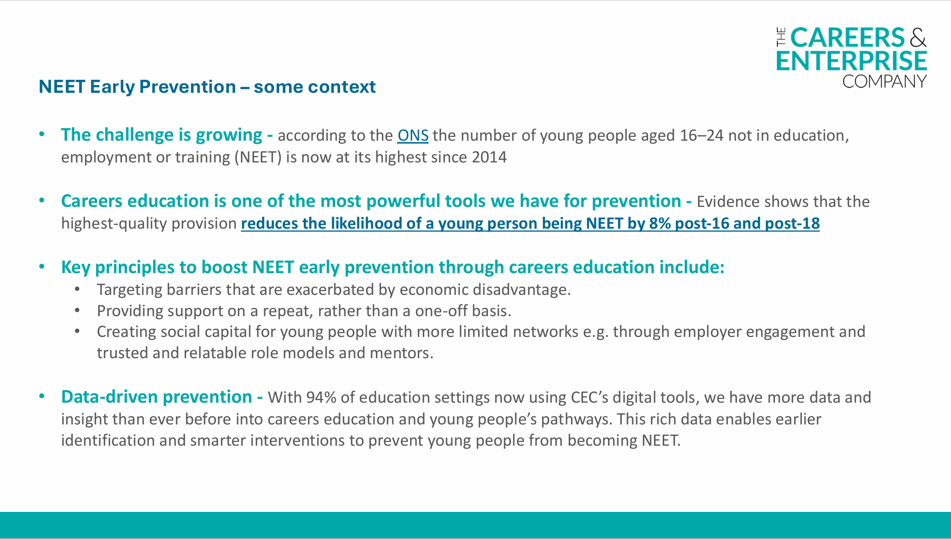

Slide 38
Live
Demonstration

Slide 39
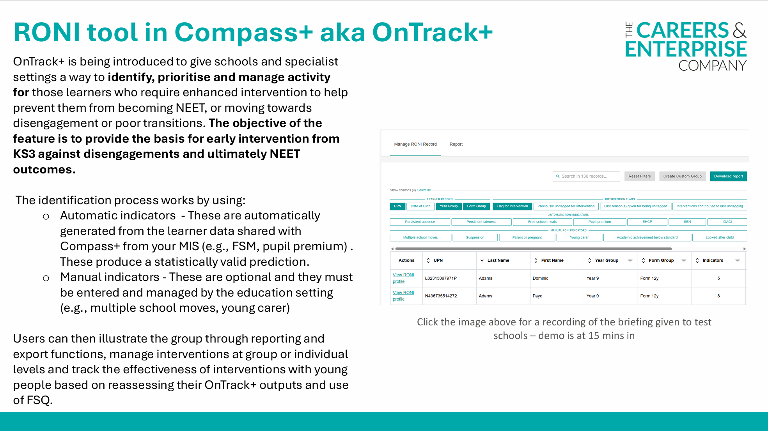

Slide 40
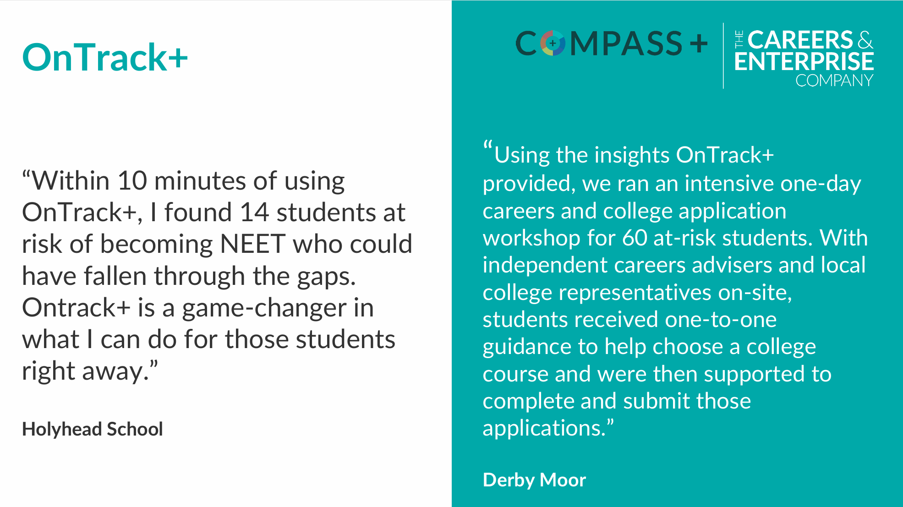

Slide 41
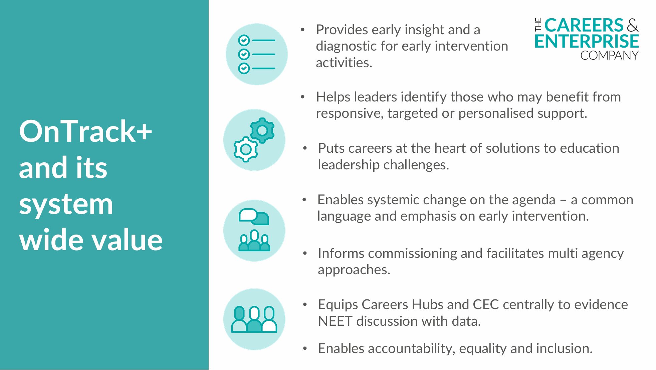
Attendance – Identifies pupils at risk of disengagement earlier, enabling targeted support before attendance declines
Attainment – Highlights barriers affecting progress and supports personalised interventions and pathways
Behaviour – Flags emerging risk indicators so pastoral teams can intervene earlier and more effectively
Inclusion – Brings together learner data to help SEND, pastoral and careers teams coordinate support for vulnerable students
Outcome – Supports earlier intervention to improve engagement and positive post‑16 destinations

Slide 42
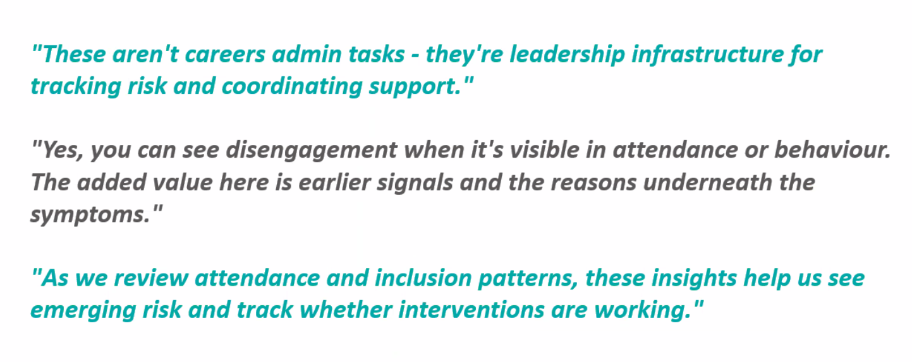
“Given the inspection focus on attendance and inclusion, this feature helps you identify learning who’s becoming disengaged earlier”

Slide 43
Discussion Point One
How can we support your school to embed OnTrack+ into your school setting so that it has the highest chance of having an impact on those most in need?

Slide 44
Factors to Consider
From a school perspective who needs to be involved?
What systems and processes will you have in place to ensure that data is maintained?
How will success be measured?
Where can the Careers Hub support?

Slide 45
Caroline.childs@cornwall.gov.uk
David.pollard@cornwall.gov.uk

