Slide 1
RISE Overview (February 2026)
The Regional Improvement for Standards and Excellence (RISE) programme supports schools to improve through two complementary strands:
  RISE Targeted – bespoke intervention for schools facing the greatest challenges, driven by Ofsted outcomes.
  RISE Universal – support for all schools and trusts to collaborate, learn from strong practice, diagnose needs and access improvement support.
RISE aims to ensure every school and its responsible body can navigate an effective path to improvement by drawing on the right support, partnerships and local expertise.
For more information on the programme please visit: RISE: South West - GOV.UK or contact SouthWest.RISERegionalMailbox@education.gov.uk
RISE Priorities
Links to guidance pages on each of the 4 RISE national priority areas:
RISE support for improving attainment in schools
RISE support for improving attendance in schools
RISE support for inclusive mainstream education
RISE support for reception improvement
RISE Targeted Support
Targeted support can provide 12–24 months of bespoke improvement work for schools eligible through Ofsted inspection outcomes and assessed by a RISE Adviser to be needed. This includes accessing support from a supporting organisation which would be a high‑quality MATs, LA partnerships and other improvement organisations.
New Eligibility Criteria
Schools become eligible when under the new Ofsted framework:
they receive an attention needed rating against leadership and governance, and which were graded below good - or equivalent - at their previous Ofsted inspection.
From September 2026, schools judged as Requiring significant improvement will be eligible.

Slide 2
RISE Overview (February 2026)
How Targeted RISE Works
  Identify – Ofsted outcome triggers eligibility.
  Initial diagnosis – RISE adviser assesses needs and Responsible Body (MAT or LA) capacity. NB at this stage some schools will not progress to matching.
  Match – School matched to an appropriate support organisation if needed.
  Diagnose & plan – Co‑development of an improvement plan.
  Implement – Up to 24 months of structured support.
  Monitor & Review – RISE team checks progress; Responsible Body remains accountable.
RISE Universal Offer
  The universal offer supports whole‑system improvement by:
  Convening collaboration, hubs, networks and peer review
  Supporting schools to diagnose needs and identify evidence‑based support
  Sharing strong practice and connecting schools to expertise
  Delivering activity linked to the four national priorities:
    Attendance
    Attainment (English and Maths)
    Reception Year Quality
    Inclusive Mainstream Education
RISE Universal SW offer in Spring 2026
There are three components to the Universal offer:
  Hubs - to connect schools and trusts to specialist hubs
  Sector excellence – to signpost to conference, discovery mornings, data tools and other expertise or good practice
  Networks and collaboration – to signpost towards sector led networks

Slide 3
RISE Overview (February 2026)
Hubs
RISE connects schools to specialist hubs that provide structured, high‑quality support across the national priority areas.
English Hub
  The Cornerstone English Hub (East Devon)
  Kernow English Hub (Cornwall, Isles of Scilly, ​Torridge, West Devon)
  Ilsham English Hub (Exeter, Mid Devon, North Devon, Plymouth, Taunton, South Hams, Teignbridge, Torbay)
Maths Hubs
  CODE Maths Hub - Home email: codemathshub@tpacademytrust.org (Cornwall, Districts in Devon (South Hams, Teignbridge, West Devon), Isles of Scilly, Plymouth, Torbay)
  Jurassic Maths Hub email: infojurassic@woodroffe.dorset.sch.uk (Districts in Devon (East Devon, Exeter, Mid Devon, North Devon, Torridge)
Teaching School Hubs
  One Cornwall Teaching School Hubs email hello@onecornwall.co.uk (Cornwall, Isles of Scilly)
  South West Institute for Teaching (SWIFT) Teaching School Hubs email info@sw-ift.org.uk (East Devon, Exeter, Mid Devon, North Devon, Plymouth, South Hams, Teignbridge, Torbay, Torridge, West Devon)
Music Hubs
  Devon Music Education Hub email: musiceducationhub@devon.gov.uk
  AsOne Perform Community Interest Company email hub@asoneperform.com
Early Years Stronger Practice Hubs - Stronger Practice Hubs help early years settings improve outcomes for children by sharing evidence‑based training, supporting inclusive practice, and fostering continuous professional learning across their local area. The early years stronger practice hub is led by Plym Bridge Nursery School and Day Care in Plymouth and partners with Ham Drive Nursery School, The Cabin and Willoughbee Childminding, please find information on the SW Stronger Practice Hub here.

Slide 4

RISE Overview (February 2026)
Attendance and Behaviour Hubs - Registration now open for South West schools who wish to be part of the hub support offer, deadline to apply is 27th February, express interest here.
Research Schools – The national network of research schools aims to break the link between family income and educational attainment through the better use of evide4nce. They work with schools, colleges and early years settings in regions to improve teaching and learning. Please see links to the local research schools here:
  Cornwall Research School
  Devon Research School
Sector Excellence
Conferences:
  RISE School Attendance & Attainment Conference for Primary Leaders 4^{th and} 5th March 2026 (online)Register via Eventbrite (NB different content on each day)
  RISE SW Year 6 Raising Attainment Conference –1.30-4pm 5 March 2026 (online) Register via Eventbrite

Slide 5
RISE Overview (February 2026)
  RISE Mainstream Inclusion Conference (Secondary Leaders) – 6 March 2026, Sandy Park Stadium Register via Eventbrite
  AI and technology Conference – to express an interest contact Jonathan Bishop at the Digital Skills and AI hub. Email: jonathan.bishop@tcat.education
Unlocking Reading: The Unlocking Reading programme provides funded training to help secondary schools build staff expertise in supporting struggling readers, offering in‑person and online CPD developed by FFT and Royal Holloway to promote a whole‑school approach to improving reading and attainment.
  To view a previously recorded session the link is available here
  To see more detail about the programme and to express interest in learning more about the programme and the training sessions in Spring 2026 please visit Unlocking Reading - Support struggling readers | FFT
Discovery Mornings – Discovery Mornings are opportunities for senior leaders to visit other schools to see good practice. We anticipate more events in the spring and summer term focused on reception year quality, primary attendance and KS4 attainment. More detail will be shared when available.
Early Years Data tools
  View Your Educational Data (VYED) is a data platform that provides schools and responsible bodies insights into your early years foundation stage profile compared to local, regional and national averages. There are two parts ‘Your good level of development data’ that focuses on 2024-2025 EYFSP data and the second part ‘Your contextual good level of development (GLD) score’ includes three years of data where available. More information can be found here Compare your good level of development (GLD) data - GOV.UK and to view data please use this link View your education data

Slide 6
RISE Overview (February 2026)
Networks and Collaboration
Networks create sustained opportunities for peer support, shared learning and place‑based problem‑solving across the South West. If you are interested in joining a network or finding out more, please contact the person named below.
Network Name | Contact | Upcoming Meetings
South West Primary School Improvement Network | Siobhan Meredith – Ted Wragg Trust; Jo Hicks – Diocese of Salisbury Academy Trust; Siobhan.Meredith@TedWraggTrust.co.uk | T3: TBC; T4: Locality meetings; T5: TBC; T6: Locality meetings
South West Secondary School Improvement Network | Jon Lunn – Ted Wragg Trust; Jon.Lunn@TedWraggTrust.co.uk | T4: 2 April; T6: 29 June conference
South West Attendance Network | Kate Richardson – Cabot Learning Federation | T3: 3 March; T5: 19 May
South West Disadvantage Network | Dr Dan Nicholls – The White Horse Federation; DNicholls@TWHF.org.uk | T3: 5 February; T4: 19 March; T5: 14 May; T6: 16 July
South West SEND & Inclusion Network | Tamara Dexter – Futura Learning Partnership; Tdexter@futuralearning.co.uk | T3: 29 January; T4: 10 March; T5: 7 May; T6: 9 July
South West Equity Network | David Watson – Sherborne Area Schools Trust; David.Watson@SAST.org.uk
South West CFO & Business Leaders Network | Paul Evry – Mosaic Partnership Trust; Paul.Evry@MosaicPT.org.uk | T4: 4 March; T6: 29 June
Trust Leaders’ Network | Sarah Gardner – Olympus Academy Trust; Sarah.Gardner@Olympustrust.co.uk | T3: 4 February; T4: 24 March; T5: 6 May; T6: 7 July
CEO Learning Sets | Chloe Olley – Department for Education; SouthWest.RISERegionalMailbox@education.gov.uk
Chair Learning Sets | Chloe Olley – Department for Education; SouthWest.RISERegionalMailbox@education.gov.uk
South West Leaders Sustainability Network | Claire Graham – Corinium Education Trust; c.graham@coriniumeducationtrust.net | T4: 19 March

Slide 7
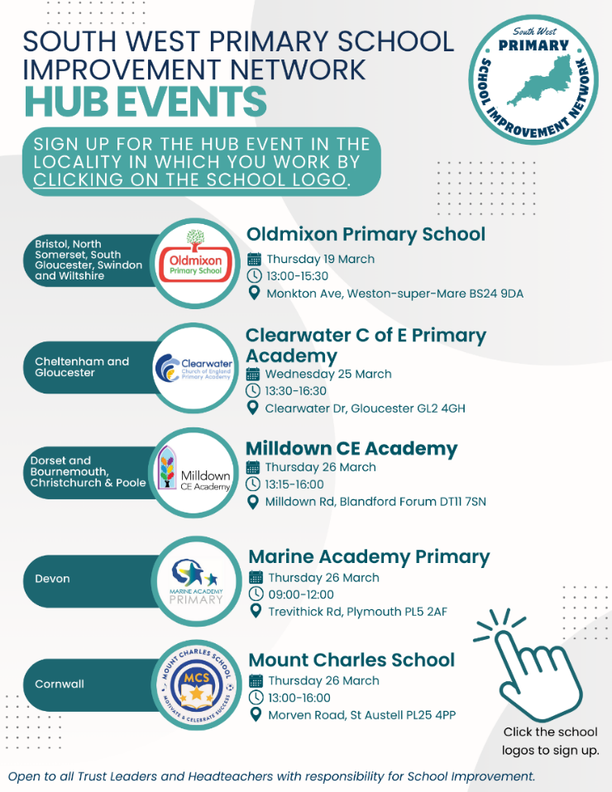
RISE Overview (February 2026)

