Slide 1



Education Support
Supporting the mental health and wellbeing of teachers and education staff
Notes:
Welcome, and thank you for tuning in.
Over the 10 minutes we’ll be introducing you to Education Support. The UK’s only mental health and wellbeing charity dedicated to teachers and education staff.
We’ll start with a general overview of the charity before we share further details with you about the types of support we offer that you can start using today.
Since this is a recorded session, feel free to pause, take notes, or revisit any part as you need.
So let’s get started on this journey to a healthier education workforce.

Slide 2




120,000
supported through EAP
4083
people suppported by our helpline
737
grants awarded
Notes:
Our mission is to improve the mental health and wellbeing of teachers and education staff. We believe that better mental health leads to better education.
We support individuals and help schools, colleges and universities to improve the mental health and wellbeing of their staff. We also carry out research and advocate for changes in Government policy for the benefit of the education workforce.

Slide 3
How we work
System
Workplace
Individual
Notes:
We often talk to teachers and education staff about setting boundaries and caring for yourselves. Sometimes this involves meditation, yoga, or other stuff that might make you roll your eyes.
And We get it.
No amount of yoga can make you feel well at a school with an unkind culture. And meditation can’t fix challenges in the education system. That’s why we focus our efforts at three distinct levels: Individual, Workplace and System.

Slide 4
How we work
System
Workplace
Individual
Notes:
Individual teachers and education staff are working hard as part of this system.
And While we believe that the system needs to do better for you, we also know there are skills that can be learned to help you manage your stress and hopefully make your day a bit easier… perhaps even enjoyable!
And we want to arm you with these skills, because system and culture change is gradual.

Slide 5


Helpline
Free and confidential
Open 24/7
Staffed by qualified counsellors
08000 562 561
Notes:
Our helpline is available for everyone working in education, including teachers, support staff, lecturers, administrators and teaching assistants. Our helpline offers immediate, emotional support that can be access any time, day or night.

Slide 6


Helpline
“The helpline counsellor gave me permission to feel what I was feeling. Get in touch as soon as you feel things aren’t right. The call really helped me.”
- Teacher
Notes:
Over the last year, our free and confidential helpline supported 4,083 individuals who spoke to a qualified counsellor in their moment of need.

Slide 7



Online resources
Notes:
We also have a wealth of resources available online – these serve as a great starting point for education staff and teachers who are not quite ready to use and call our helpline service, but want to receive mental health support.
We also have articles, videos and guides to help your organisation with mental health and wellbeing. Including tools to help you plan and audit your current approach.
Access our resources on our website: educationsupport.org.uk/resources.

Slide 8



Professional supervision for school and FE leaders
Professional supervision offers a safe and confidential space to talk about, and process what is going on for you at work
Fully funded for leaders in England and Wales
Notes:
V1: with Professional Supervision. V2: Without.
Up next we have some information about our professional supervision service. This service is fully funded by the Department of Education and Welsh Government.
Supervision has a professional focus and is totally confidential.
Different leadership roles are eligible, depending on if you’re based in England and Wales, so please go to the website for more information. www.educationsupport.org.uk/leaders

Slide 9




“It was completely life-changing. Each session enabled such food for thought and tools for self-care. It is impossible to say how grateful I am.”
- Headteacher
Notes:
Supervision makes a real difference to the lives and wellbeing of leaders and Studies show that supervision is associated with job satisfaction, improved emotional wellbeing and less burnout
So far, We’ve supported over 1300 school and college leaders and 99% of participants said that they would recommend the service to a colleague.
You can find out more and apply at: educationsupport.org.uk/leaders

Slide 10
How we work
System
Workplace
Individual
Notes:
We also work with leaders, governors and anyone else running education institutions, to create cultures that care. Cultures where mental and emotional health are a priority for all members of staff.

Slide 11
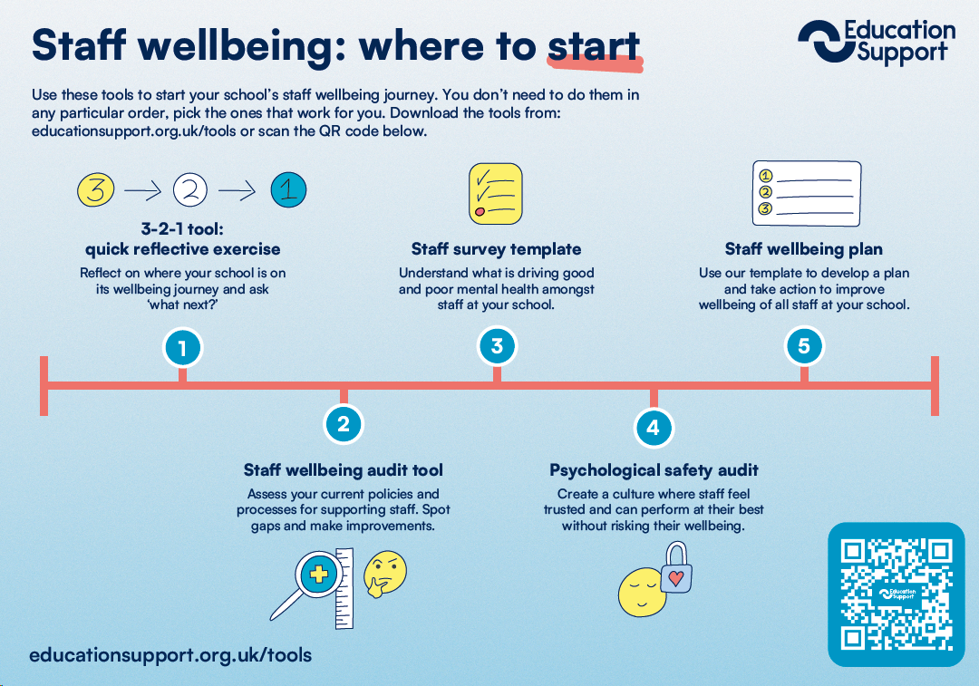
Are you a leader?
Here is how you can start your school’s journey to better wellbeing
Notes:
That said, We understand that it can be difficult to transform your school immediately when it comes to staff wellbeing.
Which is why we offer tools, support and advice to help you put wellbeing at the heart of your school’s community.
So why not Let us help.
We have plenty of tried and tested resources, like the one you can see on the screen now, to help you get started.
We’ve also put together a free wellbeing pack for schools which includes this resource, along side several of our other popular wellbeing tools.
A downloadable version of our ‘Love Teaching, time for change wellbeing pack will be shared toward the end of this presentation.

Slide 12

What is an Employee Assistance Programme?
Impartial and confidential support service
24 hour phoneline, 365 days a year
Access to practical resources on a dedicated website
Assistance with personal or work issues
Fast track support by BACP accredited counsellors
Information and guidance for financial and legal queries
Notes:
With the increasing pressures in education, many schools find that supporting staff wellbeing isn’t just a ‘nice-to-have’ but a necessity to maintain a positive school environment and a stable workforce.
We understand how staff wellbeing can directly affect day-to-day school operations, attendance, and overall staff morale.
With our EAP school staff feel valued and supported. They are provided with practical, confidential support to help manage stress, workload, and personal challenges.
And all for less than the cost of a couple of cups of coffee for each staff member each year.

Slide 13
How we work
System
Workplace
Individual
Notes:
And last but not least,
We call for change at a government level. We advocate for you and your colleagues to encourage policy decisions that work with you and your wellbeing in mind.

Slide 14





Building evidence and influencing
Notes:
We publish comprehensive and robust research about the mental health and wellbeing of teachers and all education staff.
A couple of examples of this include:
Our annual Teacher Wellbeing Index, in conjunction with YouGov, has been running for the past seven years. and involves over 3000 education staff from around the UK. This report is published each November.
Teaching: The new reality was a separate piece of research that looks at how the role of teachers and education staff expanded with added responsibilities.
And finally our Commission on Teacher Retention, supported by Public First, examines the drivers behind why so many secondary school teachers (and leaders) in the state sector are leaving the profession.

Slide 15

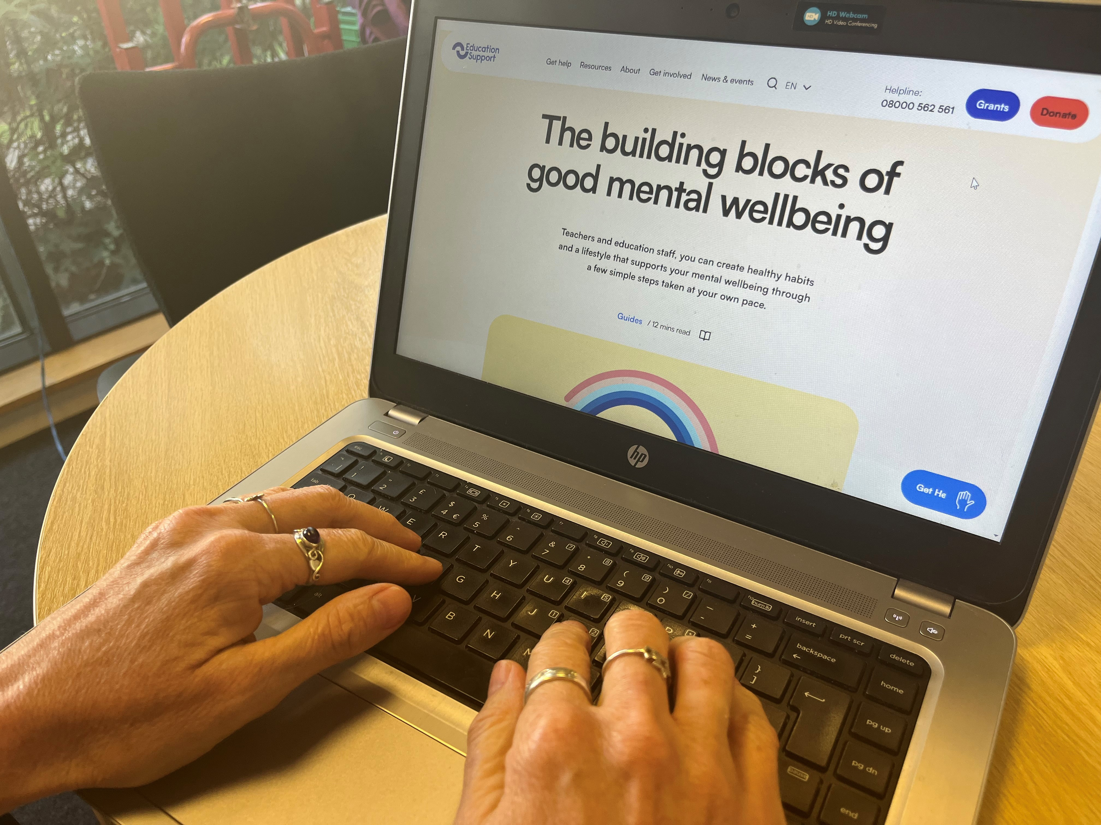
There’s more…
Our website has a wealth of free resources, all the latest news as
well as wellbeing events you are welcome to join.
Sign up for our newsletter!
educationsupport.org.uk/subscribe
Notes:
If you’d like to find out more about us or explore any of the resources you’ve seen today
Please visit our website: educationsupport.org.uk
You can also sign up to our monthly newsletter to get the latest staff wellbeing resource, events and news direct to your inbox: educationsupport.org.uk/subscribe

Slide 16



Love Teaching, Time for Change educationsupport.org.uk/loveteaching
Notes:
Alternatively, If you’re a school or wellbeing leader ready to start your journey to improve the mental health and wellbeing of your staff make sure to download a copy of our free Love Teaching, Time for Change wellbeing pack today.
This pack includes:
Practical tools to start your school’s staff wellbeing journey
These tools can help you put staff wellbeing at the heart of your school.
An interactive staff wellbeing toolkit
which is a carefully selected range of wellbeing tips and exercises to keep your staff mentally well. It includes interactive exercises to put things into practice, posters to pop around school, along with information about our services so staff know support is always available.
If you love teaching, it’s time for change.
Please visit: educationsupport.org.uk/loveteaching to sign up for your free pack.

Slide 17

Get Involved
As a charity, our services are funded
by the generous support of our donors.
Help us be there for teachers and
education staff whenever they need support.
Notes:
We couldn’t do this without you.
Your donation can make a huge difference, helping to support a teacher when they are facing a crisis.
For information on how to fundraise or donate to us, please visit our website: educationsupport.org.uk/donate

Slide 18


Thank you
educationsupport.org.uk
@edsupportuk
Notes:
Thank you for your time, we look forward to staying in touch

