Slide 1




COACHING WITH WALKTHRUs
Tom Sherrington

Slide 2
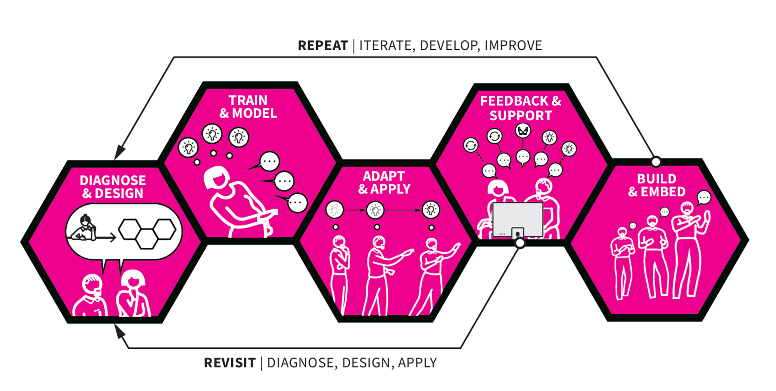
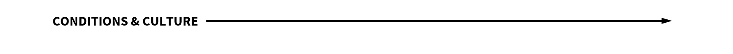

The WalkThrus Coaching Process | overview

Slide 3

NEXT…
WHY?

Slide 4

The classroom | a complicated environment

Slide 5
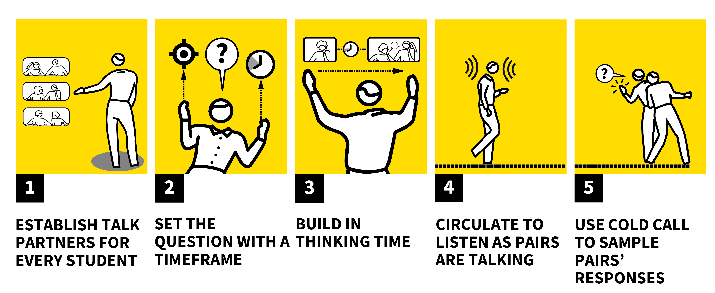
Core strategies | Think, Pair, Share

Slide 6


Meaningful Coaching | three domains

Slide 7

The classroom | a complicated environment

Slide 8
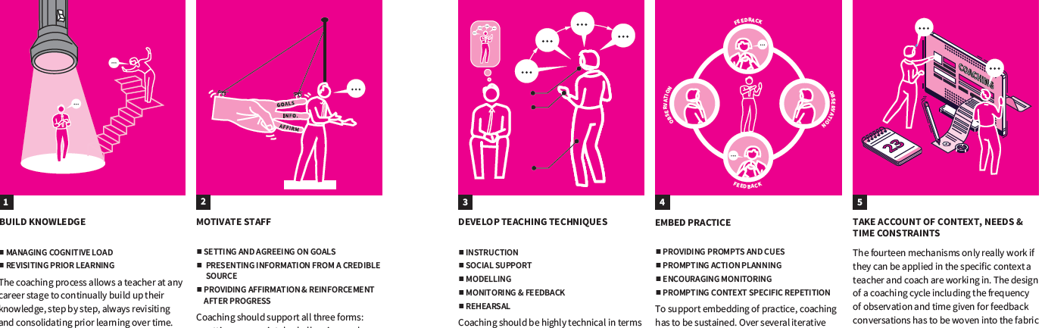
BUILD KNOWLEDGE
MOTIVATE STAFF
DEVELOP TEACHING TECHNIQUES
EMBED PRACTICE
CONTEXT, NEEDS, CONSTRAINTS
Effective PD | The EEF Mechanisms

Slide 9
NEXT…
HOW?

Slide 10
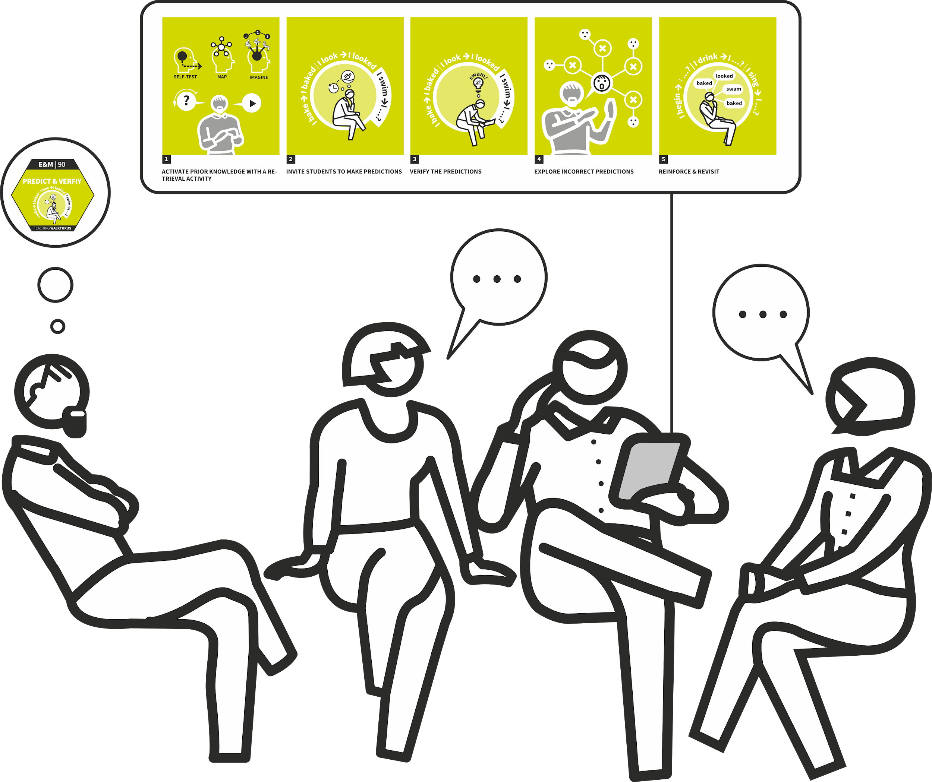
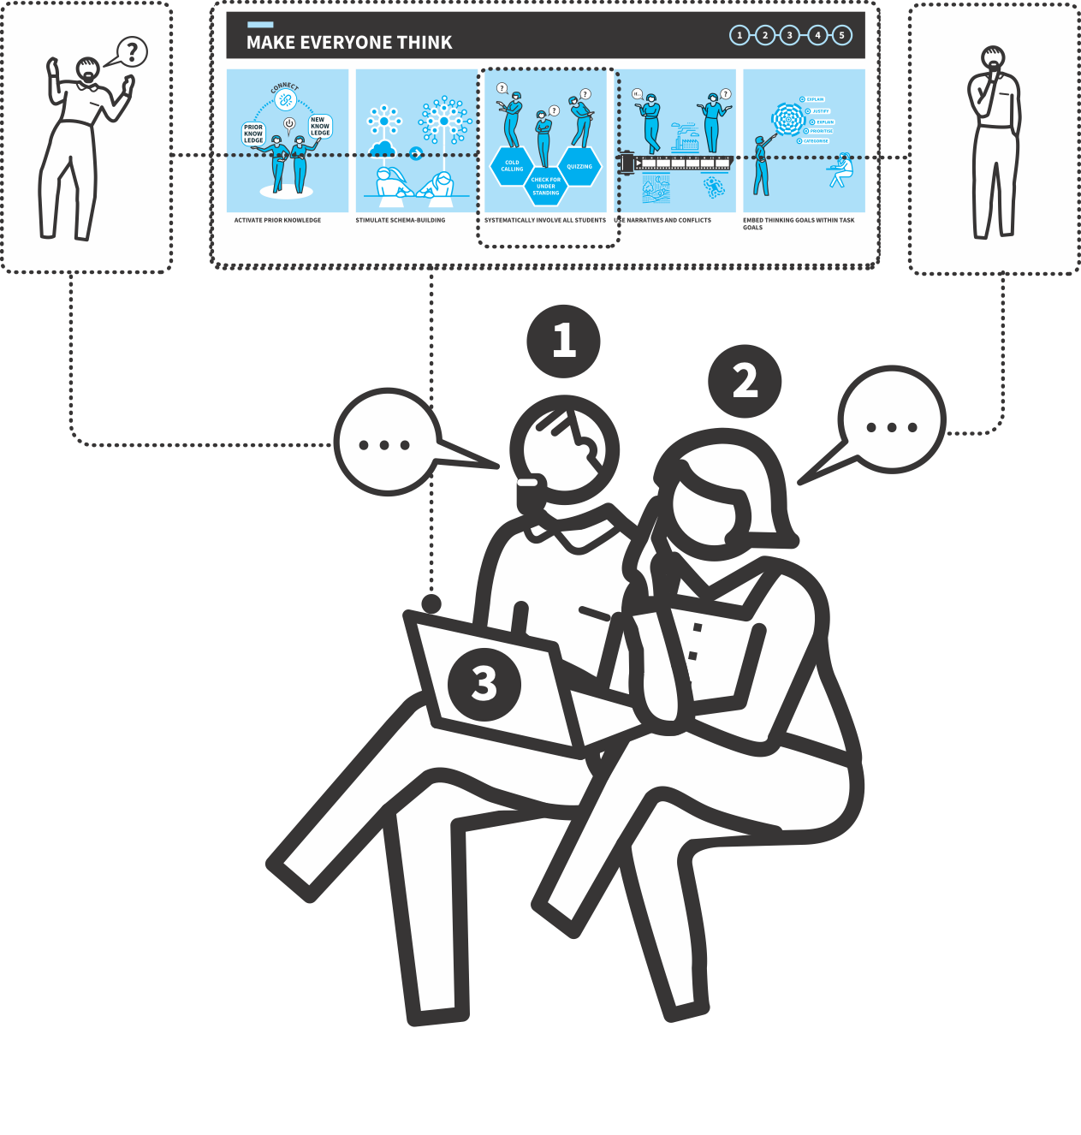
CENTRAL TO REASONING | ENGINE OF INFERENCE
Coaching only happens if there’s a system where it can happen | How?

Slide 11
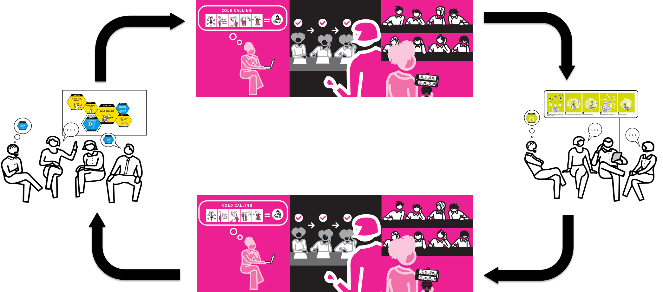
The WalkThrus Coaching Process | cycles

Slide 12
The WalkThrus Coaching Process | cycles

Slide 13
2. A shared understanding and language for common teaching problems and solutions supports team discussions to generate meaningful actions.
3. External reality checks are undertaken within each cycle by planned observation, learning walks or using video asynchronously
CENTRAL TO REASONING | ENGINE OF INFERENCE
4. Meetings are sufficiently frequent to drive change and keep a focus on specifics. 2-4 weeks
1. Teams of teachers with a common agenda meet regularly. Team leaders drive the process. x
5. Defined coaching protocols for teams or groups support iterative reflection and action leading to change. (5Ps)
The Theory of Action | How?

Slide 14
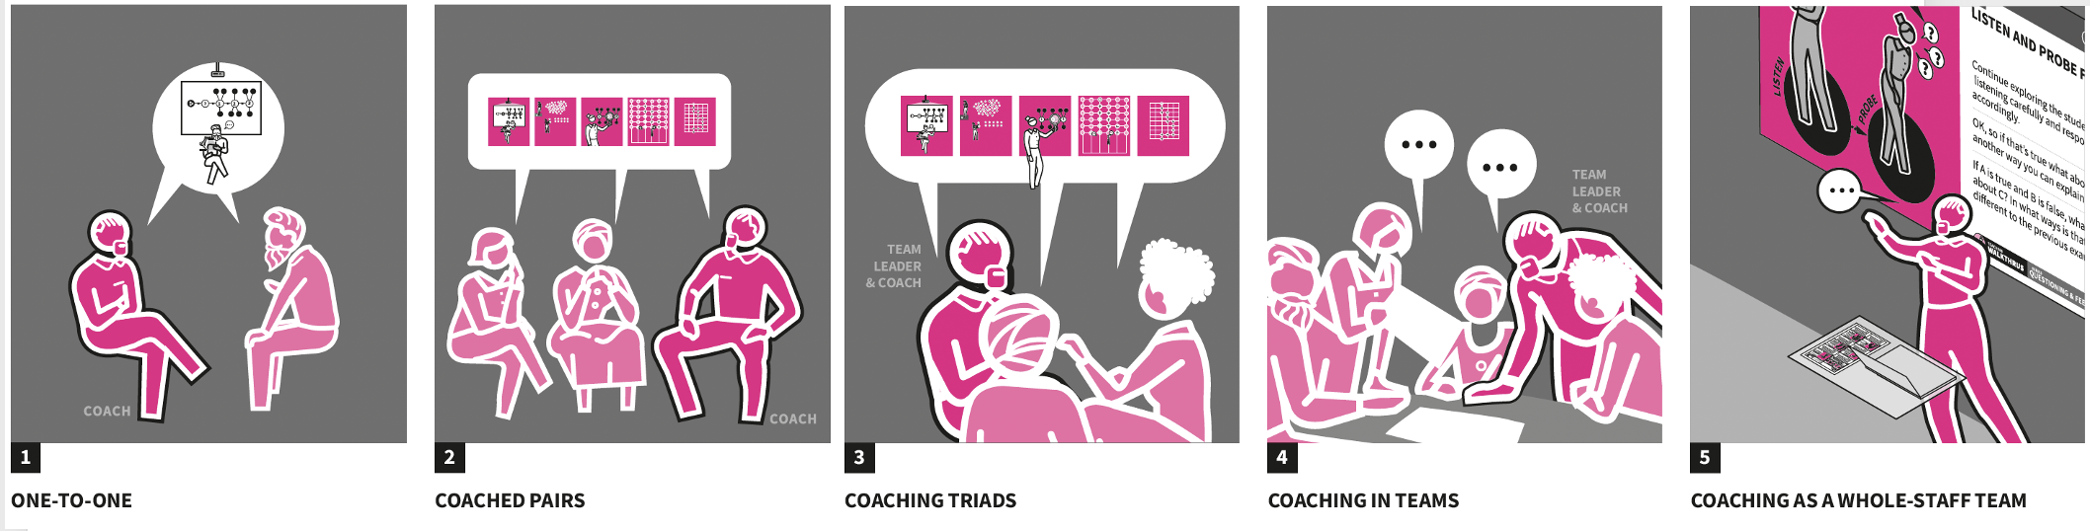
ONE TO ONE
COACHED PAIRS
COACHED TRIADS
COACHING IN TEAMS
COACHING AS WHOLE STAFF TEAM
Coaching Configurations | How

Slide 15
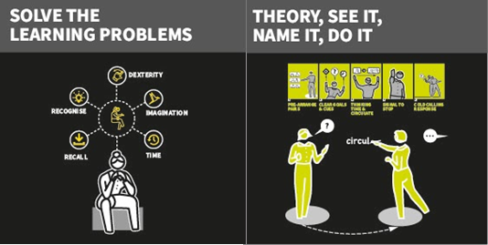
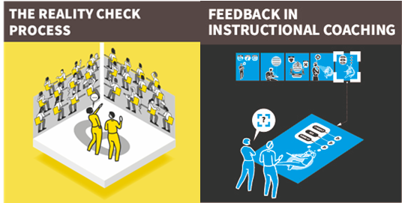


1
2
3
4
5
6
7
START
LESSON VISITS
REVIEW
LESSON VISITS
EVALUATE
TRAINING INPUT
GROUP FEEDBACK
STICK or TWIST
Example System | How?

Slide 16
NEXT…
CONDITIONS
& CULTURE

Slide 17
CONDITIONS & CULTURE
  Shared Problems
  Shared Language
  Shared Solutions
  Collective Action
Walkthrus Coaching Process | Conditions & Culture

Slide 18
The WalkThrus Coaching Process | overview

Slide 19
NEXT…
DIAGNOSE & DESIGN

Slide 20

The WalkThrus Coaching Process | diagnose & design

Slide 21

DIAGNOSE & DESIGN
  Identifying learning problems and designing goals for coaching.
Walkthrus Coaching Process | Diagnose & Design

Slide 22
The classroom | a complicated environment

Slide 23

SOLVING LEARNING PROBLEMS
Page 104 | Coaching WalkThrus
  Helping teachers to spot, understand and solve problems.
Core move | Solving Learning Problems

Slide 24
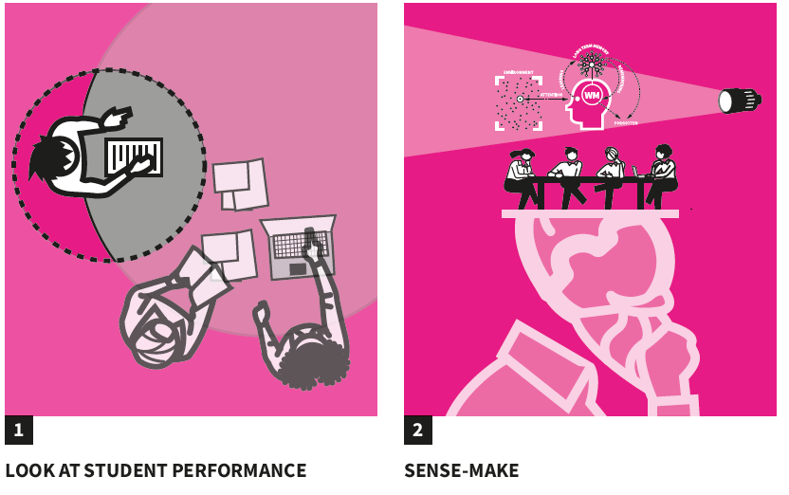
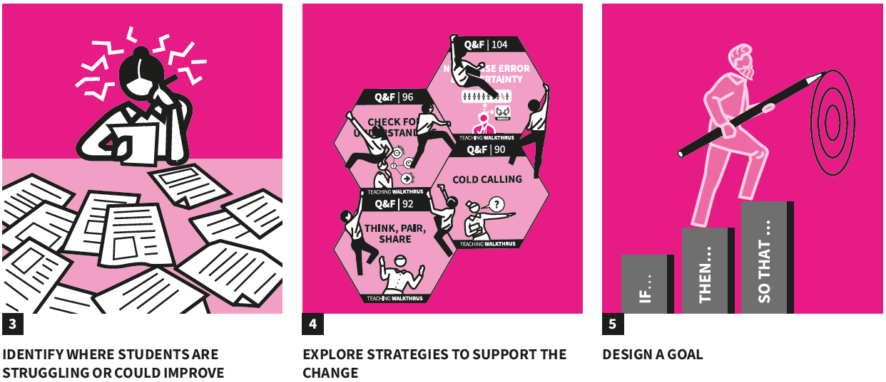
LOOK AT STUDENT PERFORMANCE
SENSE-MAKE
IDENTIFY WHERE STUDENTS ARE STRUGGLING OR COULD IMPROVE
EXPLORE STRATEGIES TO SUPPORT THE CHANGE
DESIGN A GOAL
Core framework | solving learning problems
Notes:
LOOK AT STUDENT PERFORMANCE
SENSE-MAKE
IDENTIFY WHERE STUDENTS ARE STRUGGLING OR COULD IMPROVE
EXPLORE STRATEGIES TO SUPPORT THE CHANGE
DESIGN A GOAL

Slide 25
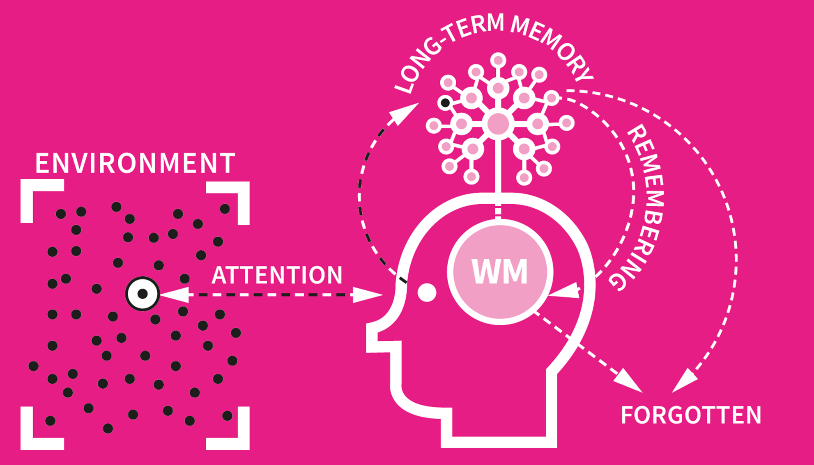
1
ATTENTION
2
COGNITIVE LOAD
3
THINKING
4
MAKING MEANING
5
REMEMBERING
The Learning Model | for students & teachers

Slide 26
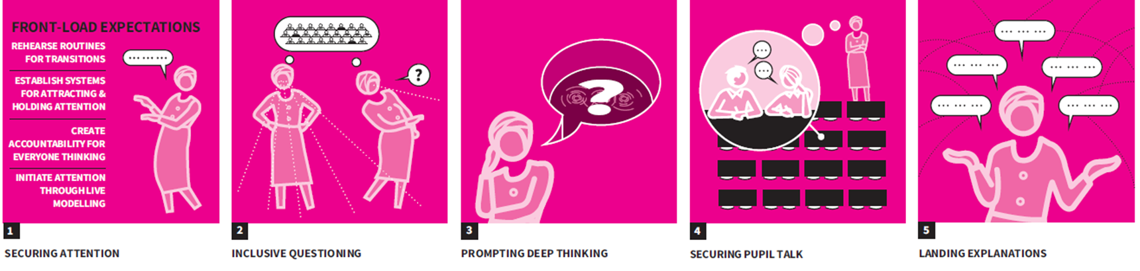
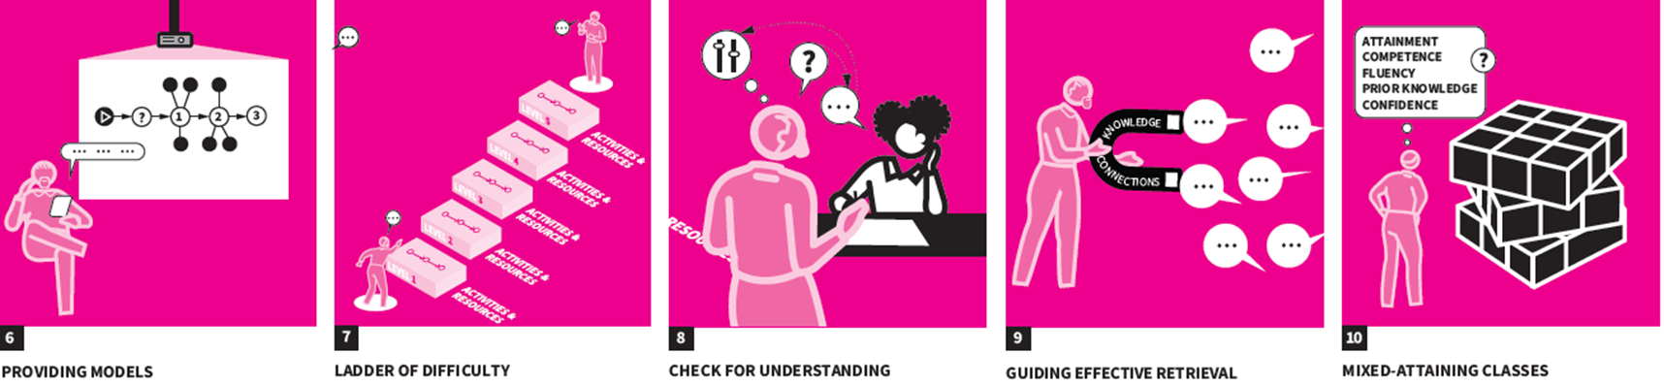
SECURING ATTENTION
INCLUSIVE QUESTIONING
PROMPTING DEEP THINKING
SECURING PUPIL TALK
LANDING EXPLANATIONS
PROVIDING
MODELS
LADDER OF DIFFICULTY
CHECK FOR UNDERSTANDING
GUIDING EFFECTIVE RETRIEVAL
MIXED-ATTAINING CLASSES
Notes:
LOOK AT STUDENT PERFORMANCE, SENSE MAKE, EXPLORE STRATEGIES
Select your ‘wicked’ problem – study the full detail in your booklet. What might this problem look like in reality? What might you expect to be the root causes?

Slide 27
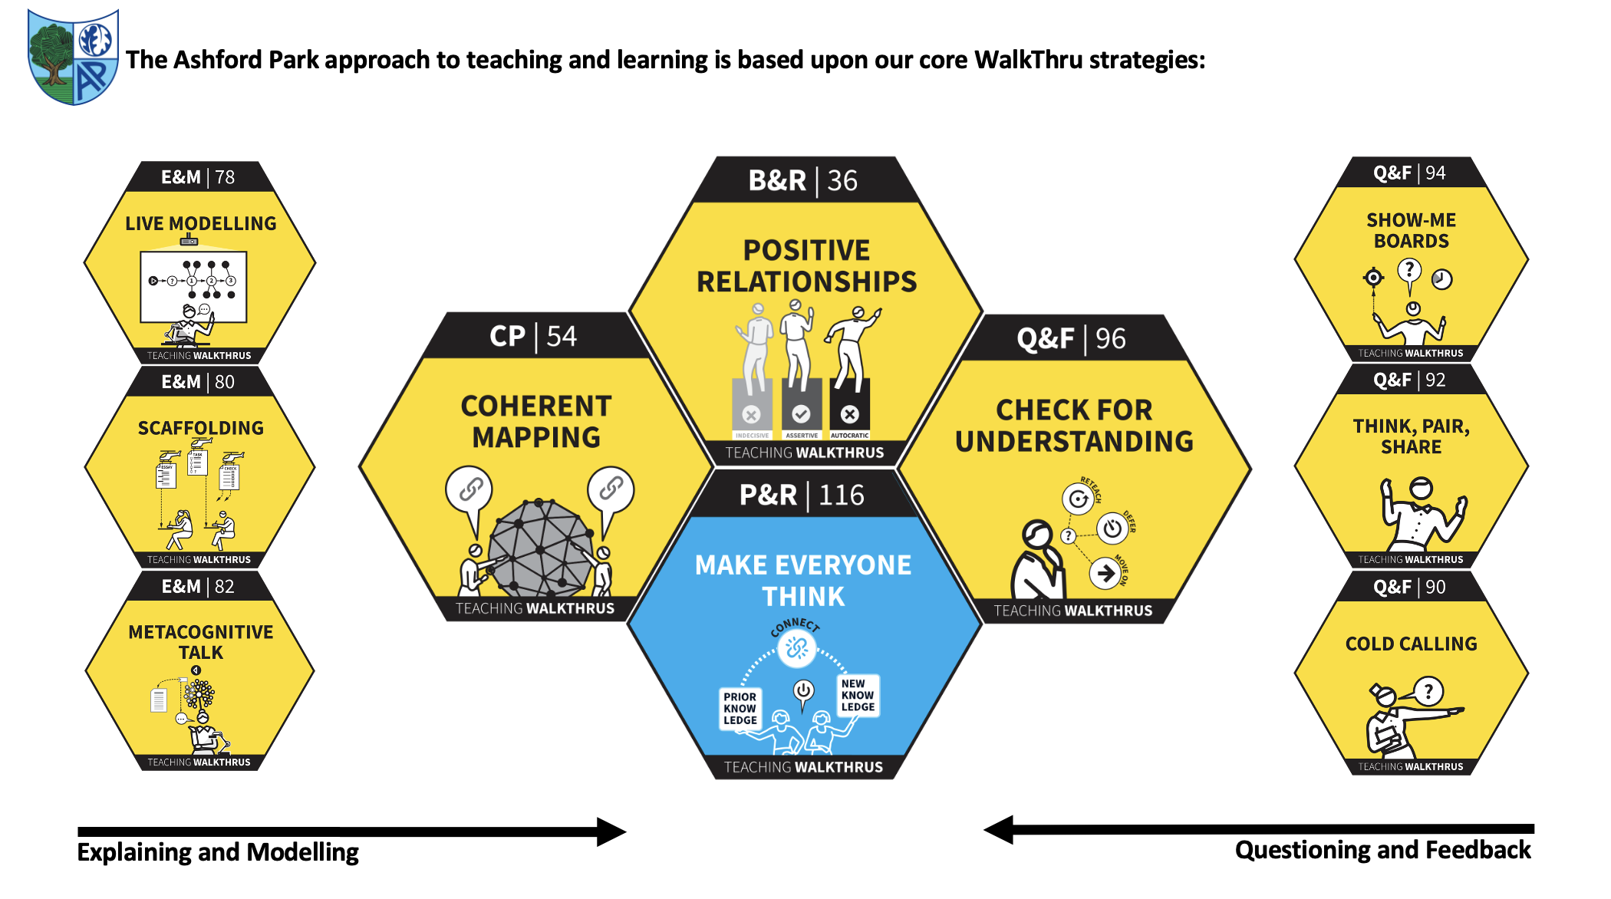

Slide 28
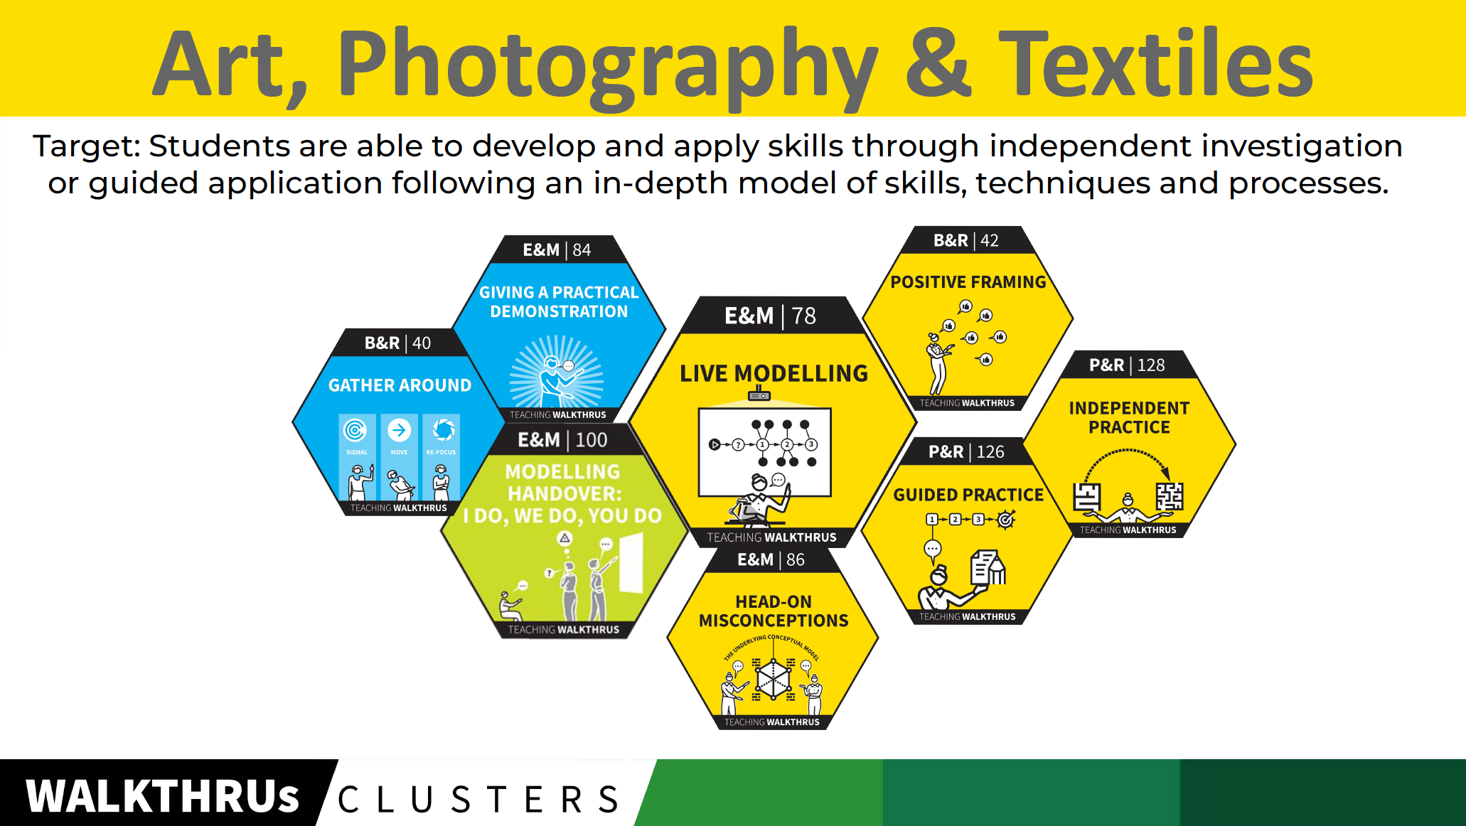
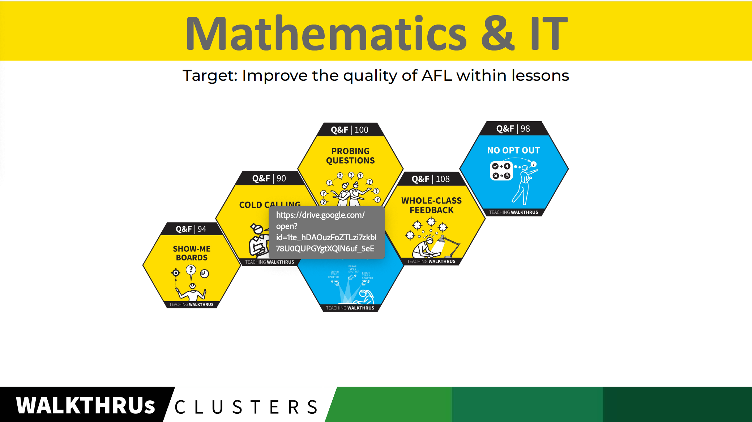
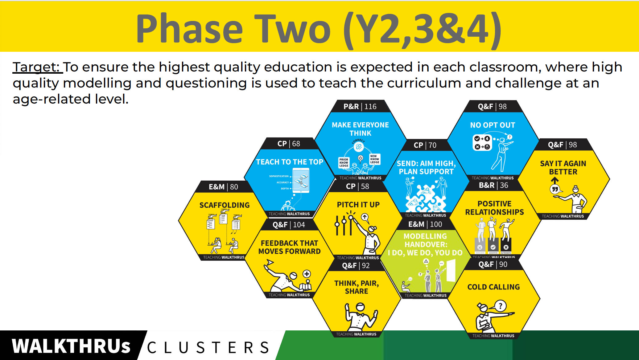
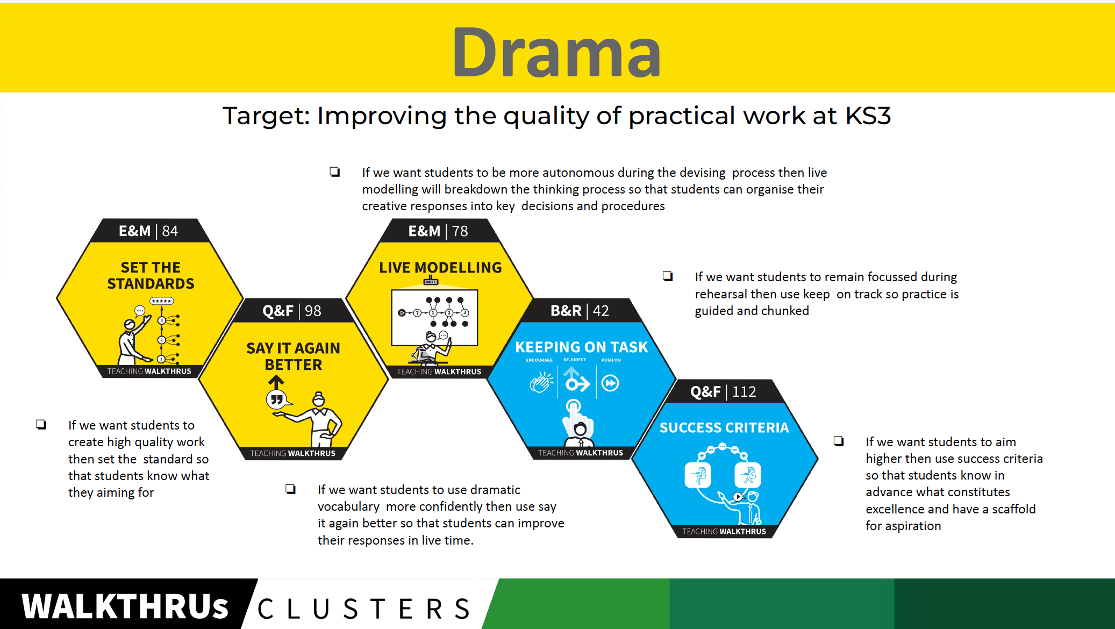

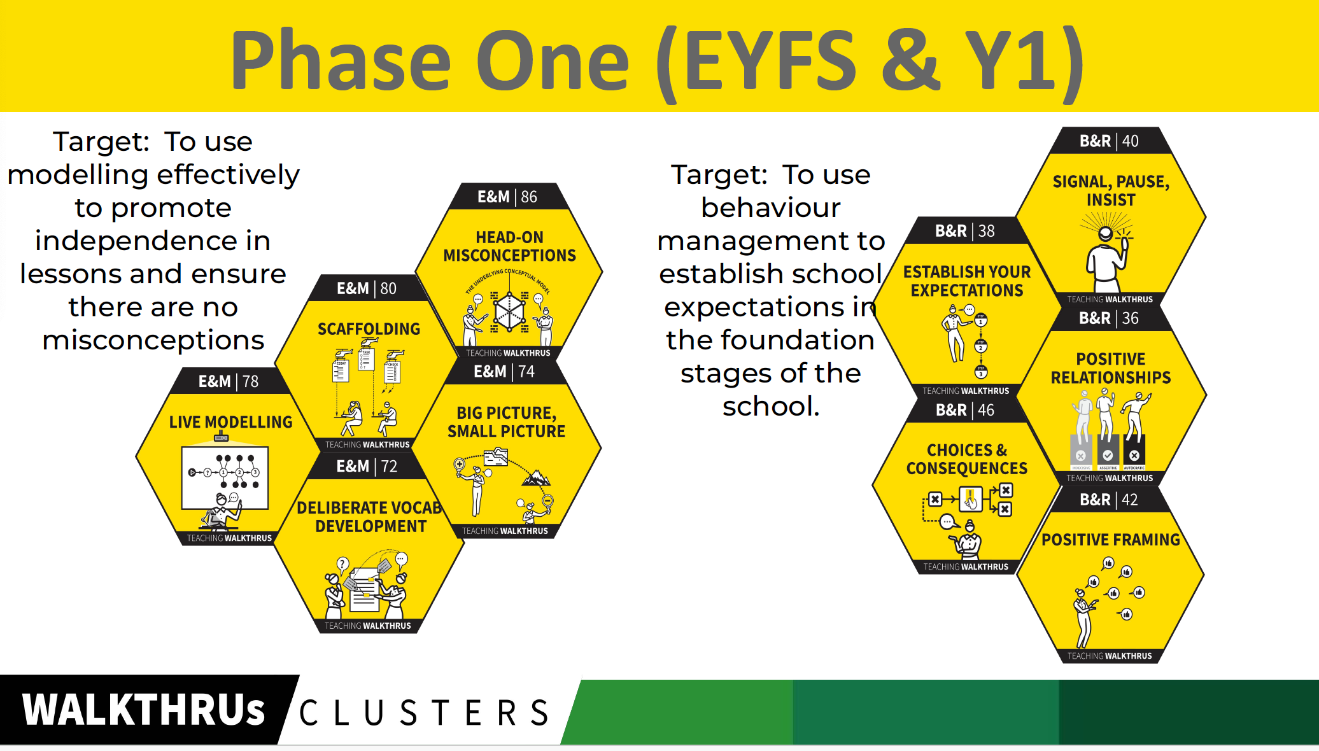
TRAIN & MODEL
The WalkThrus Cluster Builder | Departmental flexibility

Slide 29
NEXT…
TRAIN & MODEL

Slide 30

The WalkThrus Coaching Process | train & model

Slide 31

TRAIN & MODEL
  Planning training, securing understanding and modelling techniques.
Walkthrus Coaching Process | Train & Model

Slide 32
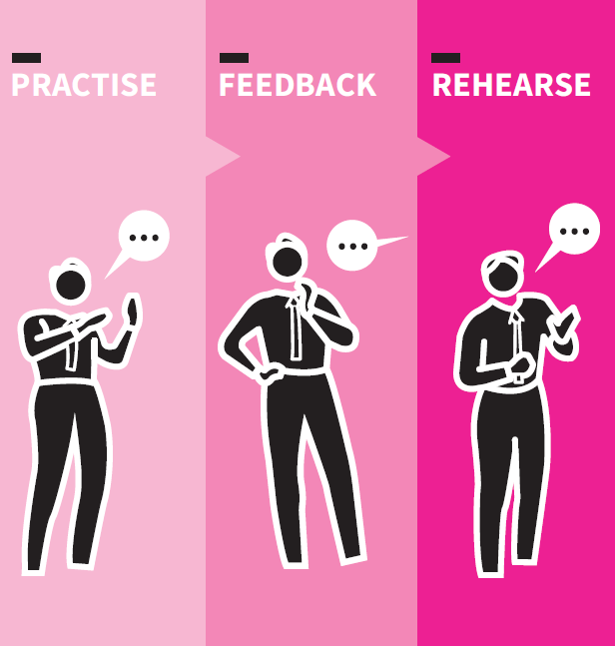
THEORY, SEE IT, NAME IT, DO IT
Page 102 | Coaching WalkThrus
  A structure for delivering training workshops.
Core move | Theory, See It, Name It, Do It

Slide 33


Train & Model | The Tennis Player Analogy
Notes:
A central idea that is often overlooked – the 98% problem
Average full time teacher in the UK teaches 875 hours a year (contact time) 4 hours of total observed time is actually over 99%

Slide 34
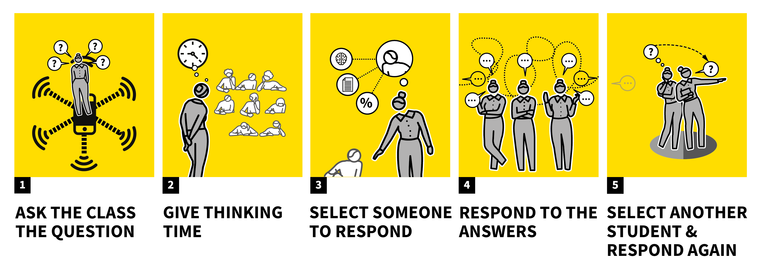
Core strategies | Cold Calling for accountability

Slide 35
What are all the colours the sky can be and when do we see them?
Accountability | Cold Calling

Slide 36
CENTRAL TO REASONING | ENGINE OF INFERENCE
?
?
?
?
?
Shared Understanding | See it, Name it, Do it.

Slide 37
DECOMPOSITION
RECOMPOSITION
PROVISIONAL TECHNIQUE
A|D|A|P|T -ED TECHNIQUE
1
2
3
4
5
1
2
3
4
5
Train & Model | Decomposition, recomposition

Slide 38
NEXT…
ADAPT & APPLY

Slide 39
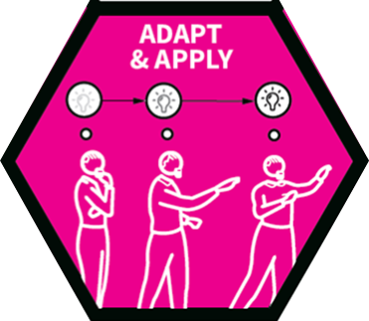
The WalkThrus Coaching Process | adapt & apply

Slide 40

ADAPT & APPLY
  Adapting and rehearsing new techniques, and helping teachers apply them.
Walkthrus Coaching Process | Adapt & Apply

Slide 41





Decision-making | checking for understanding

Slide 42
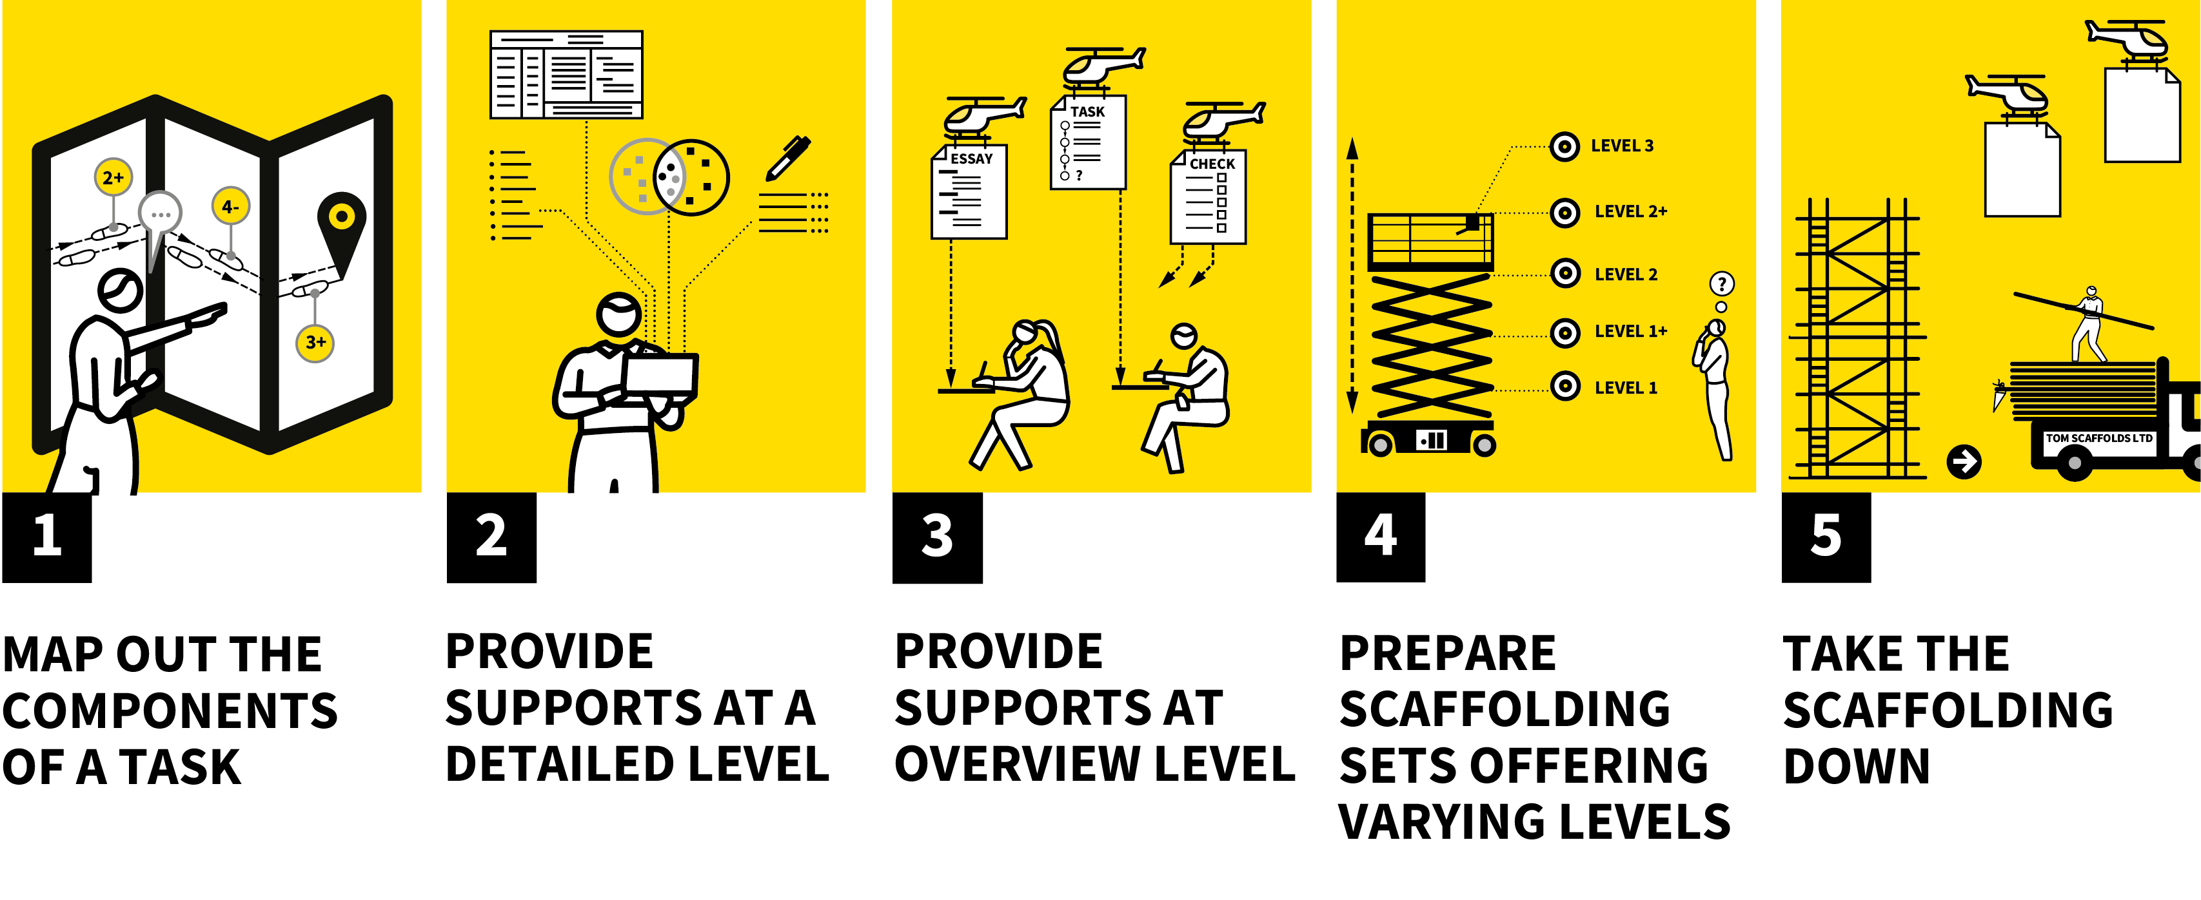
Core strategies | Scaffolding

Slide 43
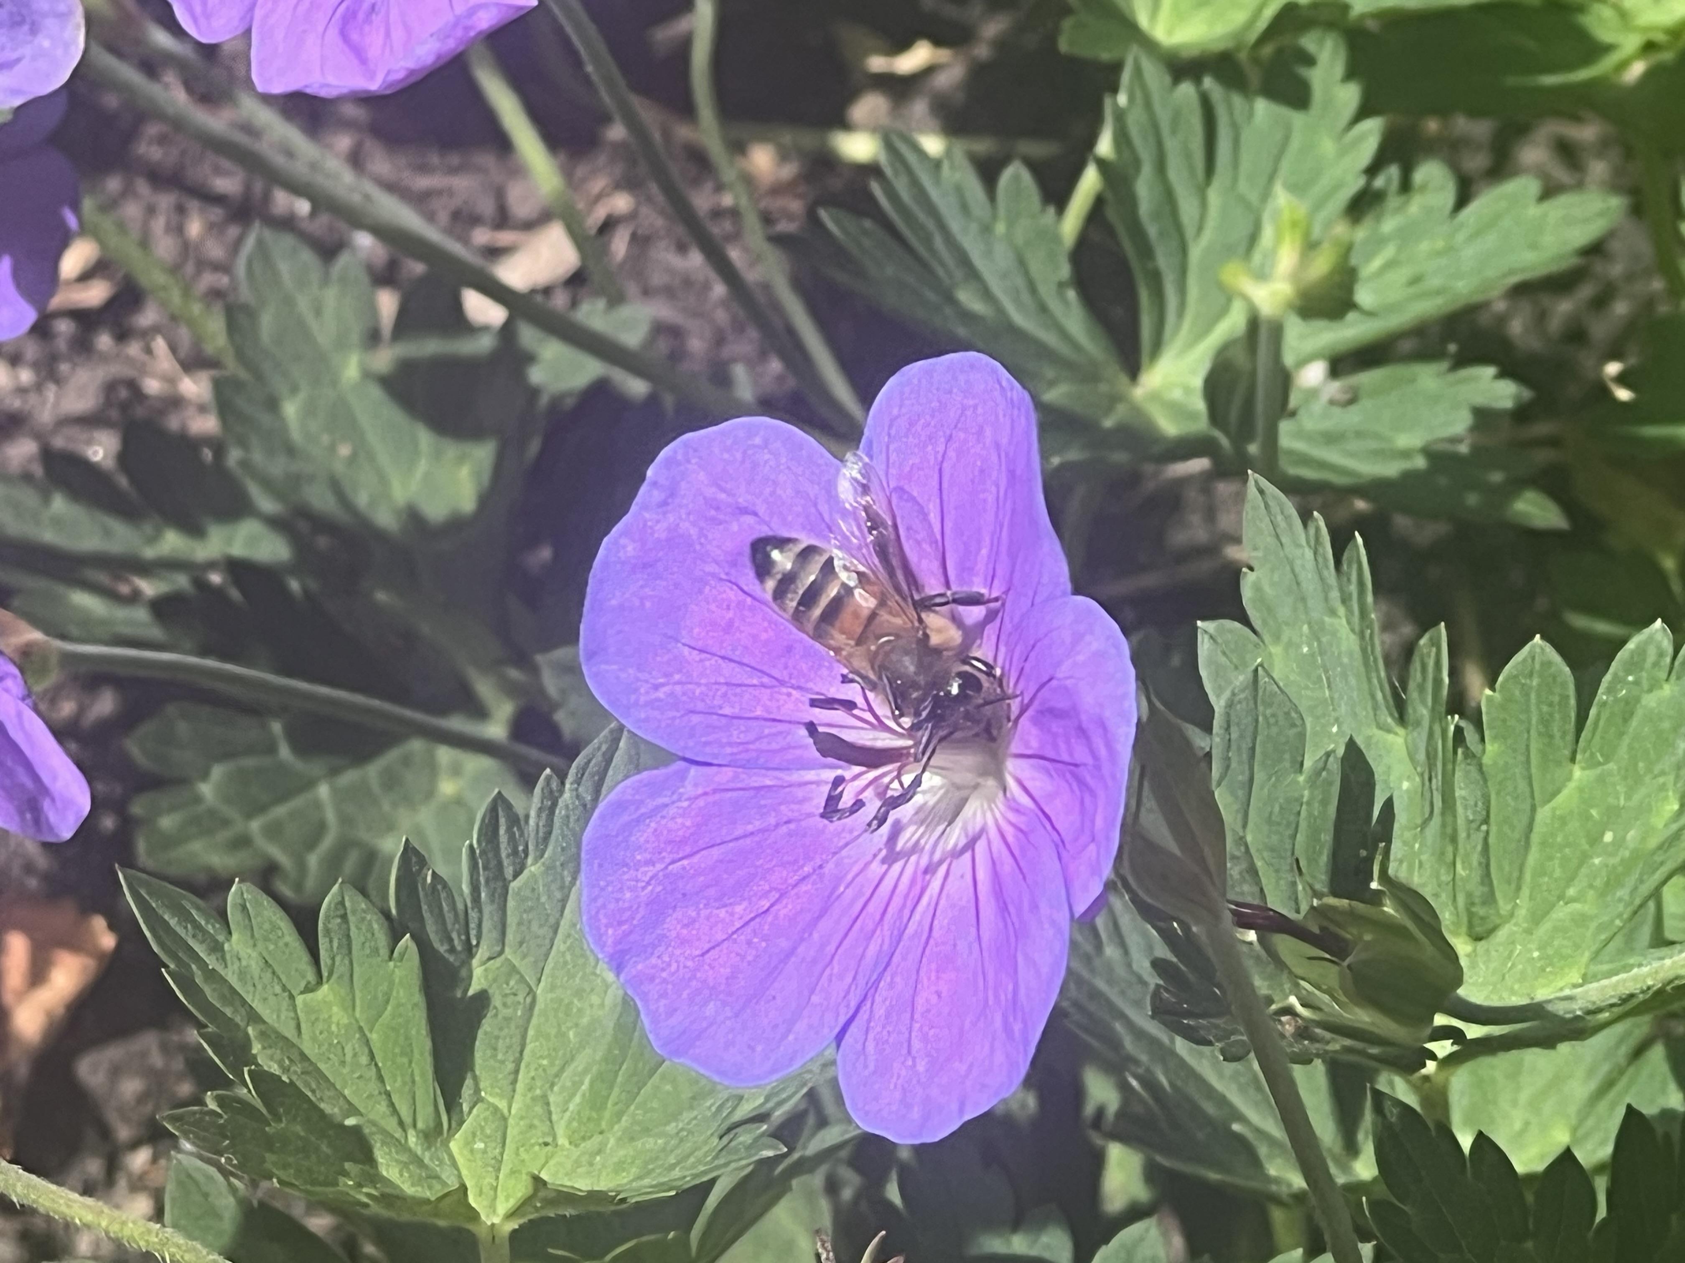

Honeybee Pollination
Useful strategies | Practise Explaining

Slide 44

Honeybee Pollination
Anther
Pollen
Stigma
Pistil
Fertilise
Stamen
Ovules
Filament
Nectar
(future seed)
Schema building | practise explaining with scaffolding

Slide 45
Honeybee Pollination
Schema building | practise explaining with scaffolding

Slide 46

The WalkThrus Coaching Process | feedback & support

Slide 47

I need to leave them feeling good about themselves, fired up and ready to go –
and make sure that they have a concrete plan of action…
Coaching conversations | spirit

Slide 48

THE 5Ps FRAMEWORK
Page 132 | Coaching WalkThrus
  A powerful framework for coaching feedback.
Core move | The 5Ps Framework

Slide 49
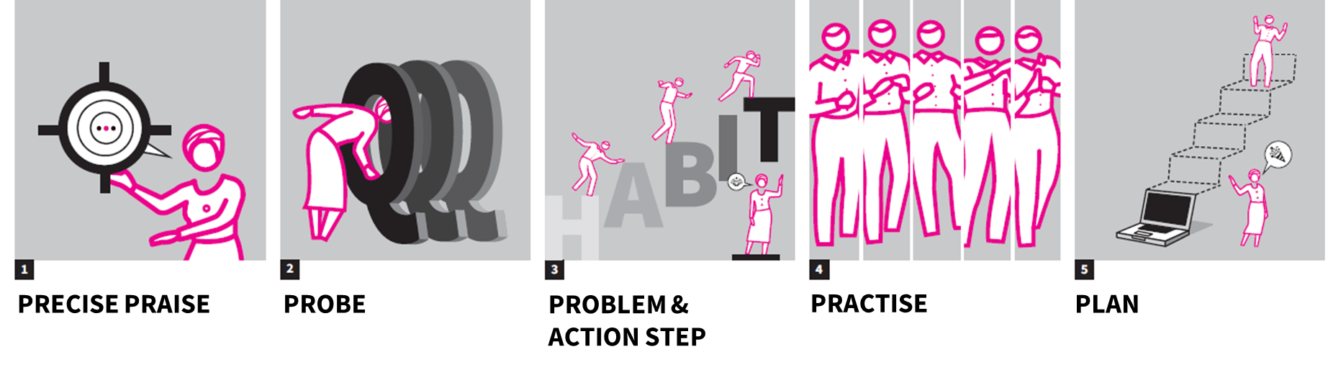
Feedback & Support | The 5Ps framework

Slide 50

Notes:
Video 1
What is the context?
What are the observable issues?
What are the learning problems?

Slide 51
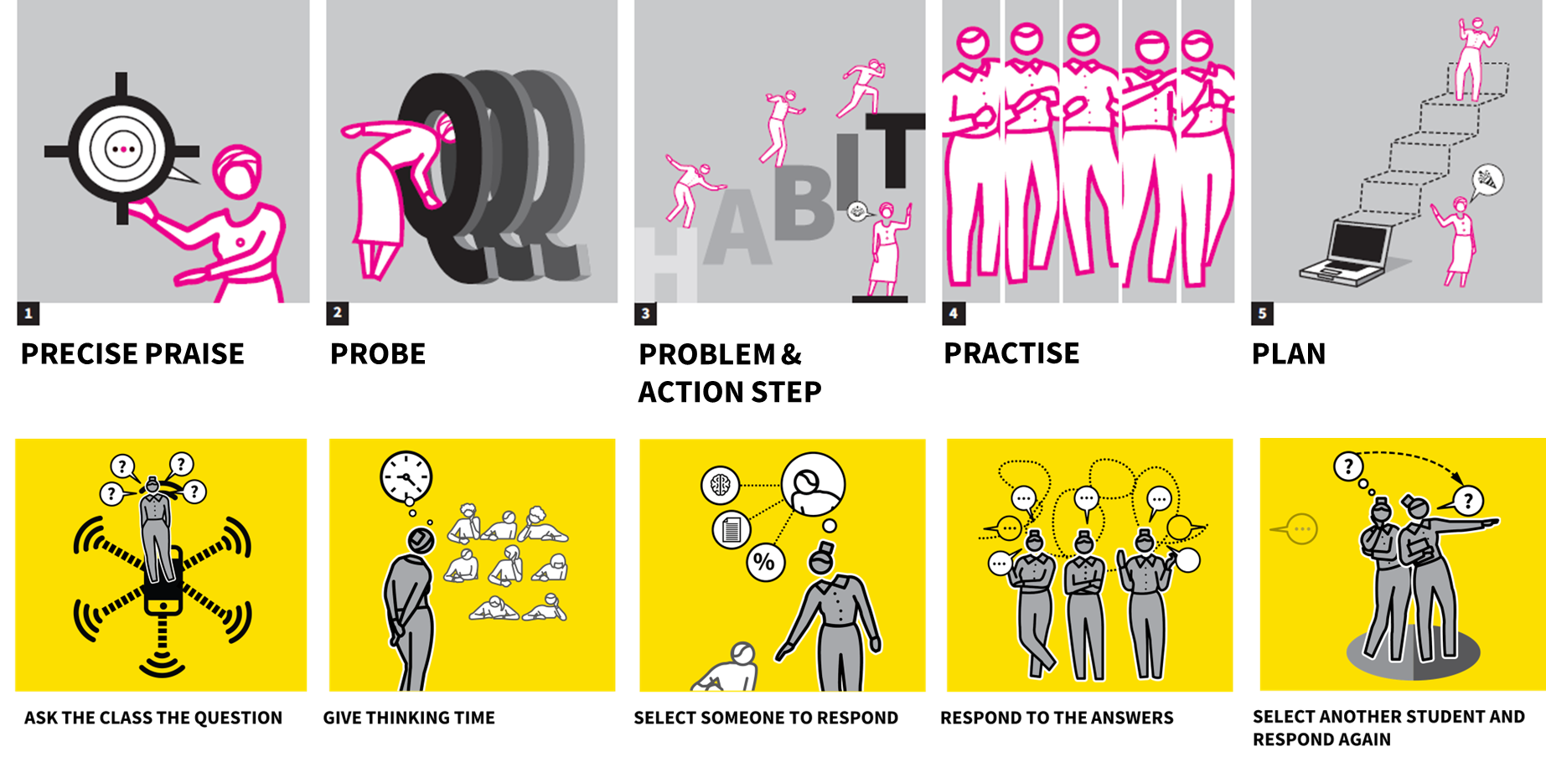
Feedback & Support | The 5Ps Framework

Slide 52

PRECISE PRAISE
  Affirm the elements of the step/ techniques that have landed successfully.
The 5ps Framework | precise praise

Slide 53

PROBE
  Uncover the elements of the step / technique that might need further work.
The 5Ps Framework | probe

Slide 54

PROBLEM
  Select a specific problem to focus on an identify the action steps needed to address it.
The 5Ps Framework | problem

Slide 55

PRACTISE
  Model, adapt and rehearse new action steps.
The 5Ps framework | practise

Slide 56

PLAN
  Be clear about what happens next and when.
The 5Ps Framework | plan

Slide 57
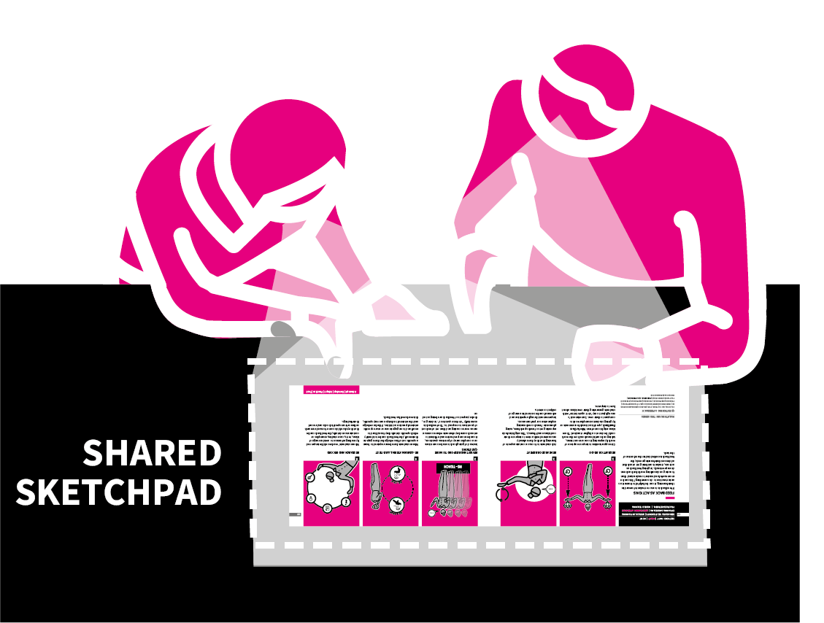
STEP 5
  Build a problem-solving partnership. Think of the visual as your shared cognitive sketchpad.
Three Point Communication

Slide 58
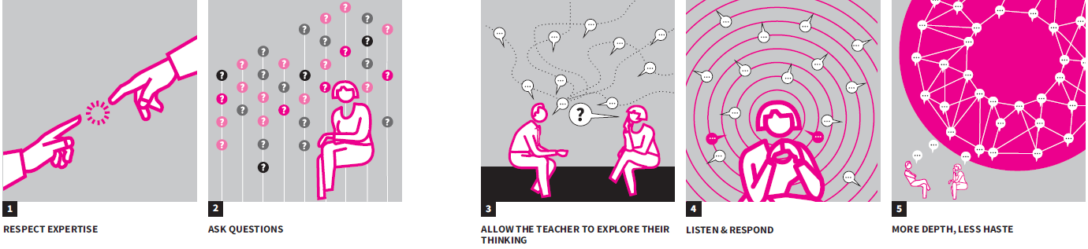
RESPECT EXPERTISE
ASK QUESTIONS
ALLOW TEACHER TO EXPLORE THEIR THINKING
LISTEN & RESPOND
MORE DEPTH LESS HASTE
Feedback & Support | the dynamics of dialogue

Slide 59

STEP 1
  Respect teacher expertise. If you start by telling, not listening, nothing sticks. Let the teacher go first.
The Dynamics 0f Dialogue | Respect Expertise

Slide 60

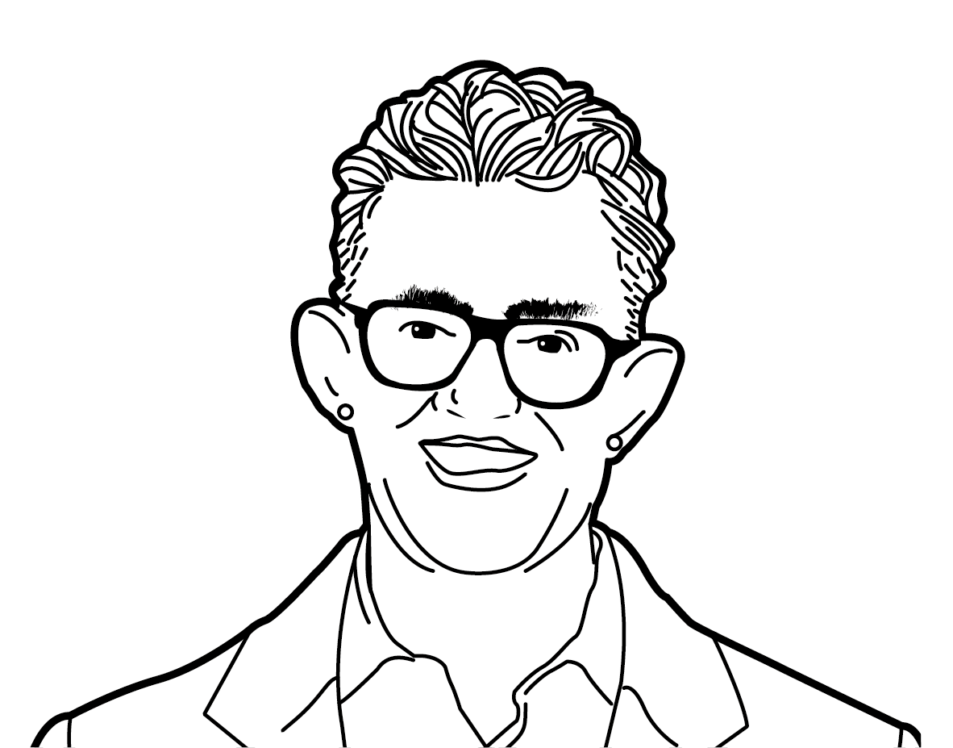
CENTRAL TO REASONING | ENGINE OF INFERENCE
You tame the advice monster.
Tell less and ask more.
Your advice is not as good
As you think it is.
Michael Bungay Stanier
Dynamics Of Dialogue | Listen & Respond

Slide 61
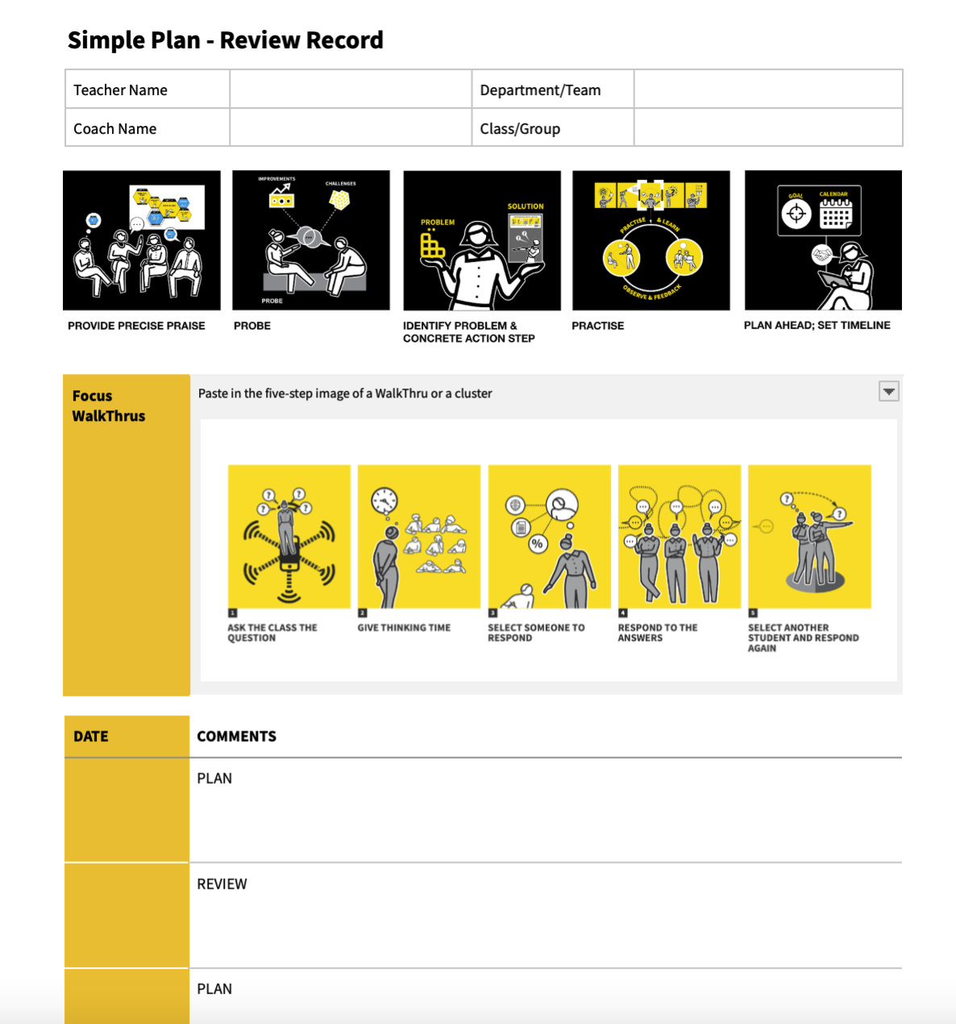
CENTRAL TO REASONING | ENGINE OF INFERENCE
Simple Plan-Review Record
Light touch documentation.
Focus on clear action steps for the next cycle.
Tracking for accountability is a byproduct - never the purpose.

Slide 62

Watch each video and match Tom’s coaching to the 5Ps
They are not perfect by any means.
Use 5Ps to construct feedback for Tom
Dynamics Of Dialogue | Apply the 5Ps to your coaching

Slide 63
NEXT…
EMBED & BUILD

Slide 64

The WalkThrus Coaching Process | embed & build

Slide 65

EMBED & BUILD
  Embedding techniques, building habits and moving on.
Walkthrus Coaching Process | Embed & Build

Slide 66
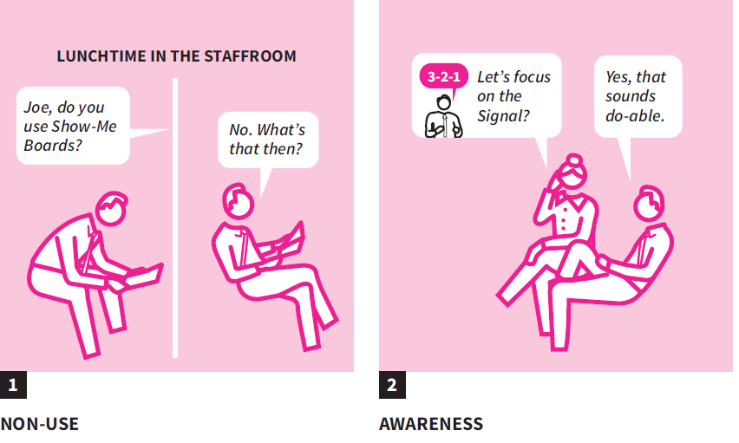
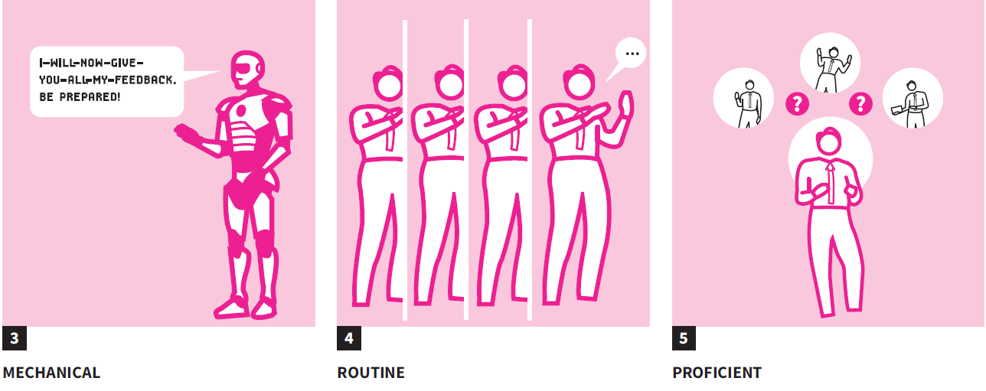
NON-USE
AWARENESS
MECHANICAL
ROUTINE
PROFICIENT
Embed & Build | Stages Of Learning

Slide 67
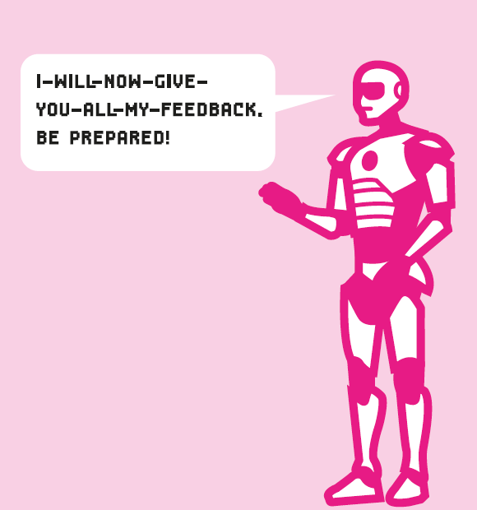
Stages Of Learning | Mechanical Implementation
Notes:
It’s quite common to see teachers trying
a technique, but it coming off as clunky
or forced. This is the mental demand of
juggling new habits and old routines. Think
of a teacher awkwardly trying to embed
Cold Call, stumbling over their phrasing or
accepting called-out responses.
In reality, this is a sign that while they’re
heading in the right direction, they’re
not there yet. Give continued, focused
feedback on small refinements, avoiding
overwhelming them with too many
changes at once.

Slide 68
Meaningful Coaching | Three Domains

Slide 69

IMPLEMENTATION PATHWAY
For Senior Leaders, Middle Leaders, System Leaders

Slide 70
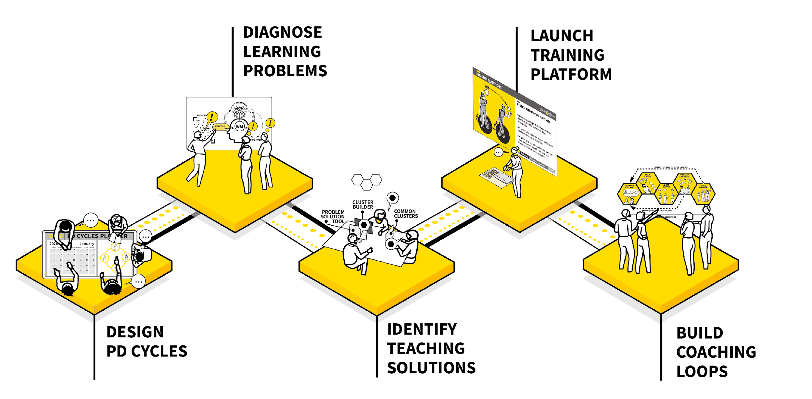


Slide 71
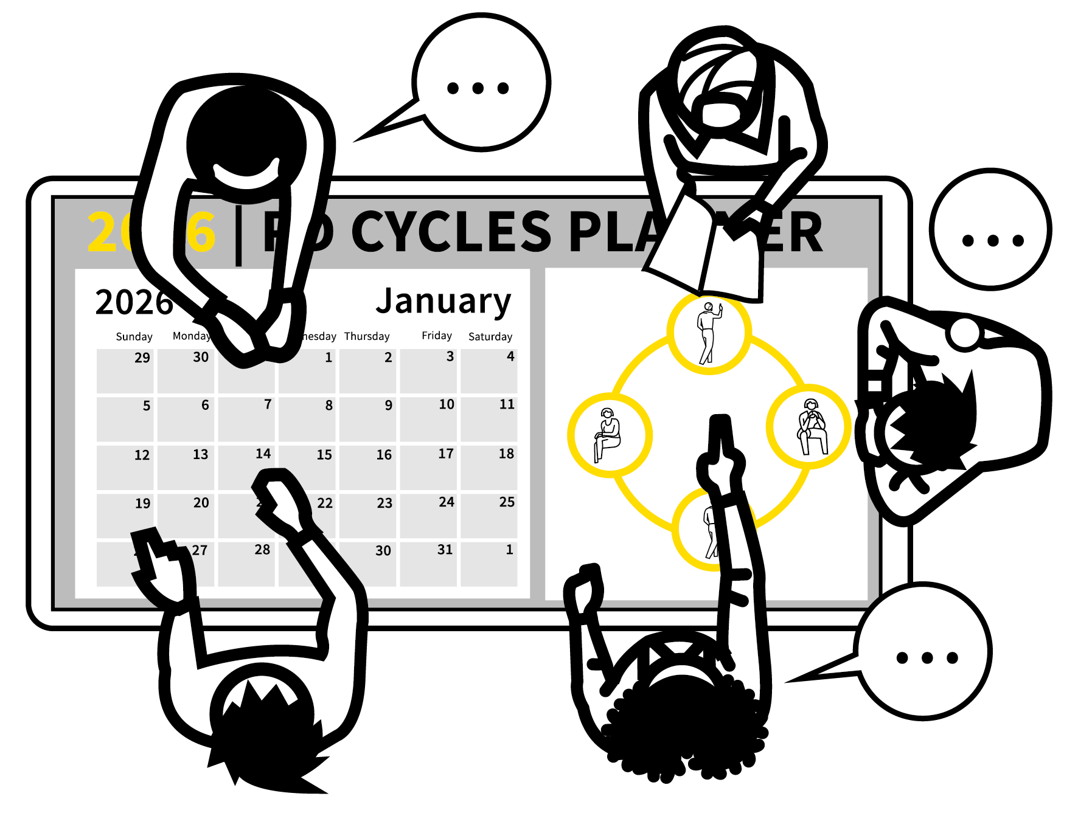
DESIGN YOUR PD CYCLES.
Set up calendared meeting structures and observation routines allowing PD activities to happen on a sustained basis within the time constraints present in your context.
Key design decisions include:
WHO: Identifying the configuration of people and teams who will work together in coaching cycles.
WHEN: Establishing the full schedule of coaching cycle meetings in the calendar, ideally with a 2–4 week timeframe.
Without these structures, sustained PD and coaching can’t happen.
STEPS |
1 | 2 | 3 | 4 | 5
Notes:
Set up calendared meeting structures and observation routines allowing PD activities to happen on a sustained basis within the time constraints present in your context.
Key design decisions include:
WHO: Identifying the configuration of people and teams who will work together in coaching cycles
WHEN: Establishing the full schedule of coaching cycle meetings in the calendar, ideally with a 2–4 week timeframe.
Without these structures, sustained PD and coaching can’t happen.

Slide 72
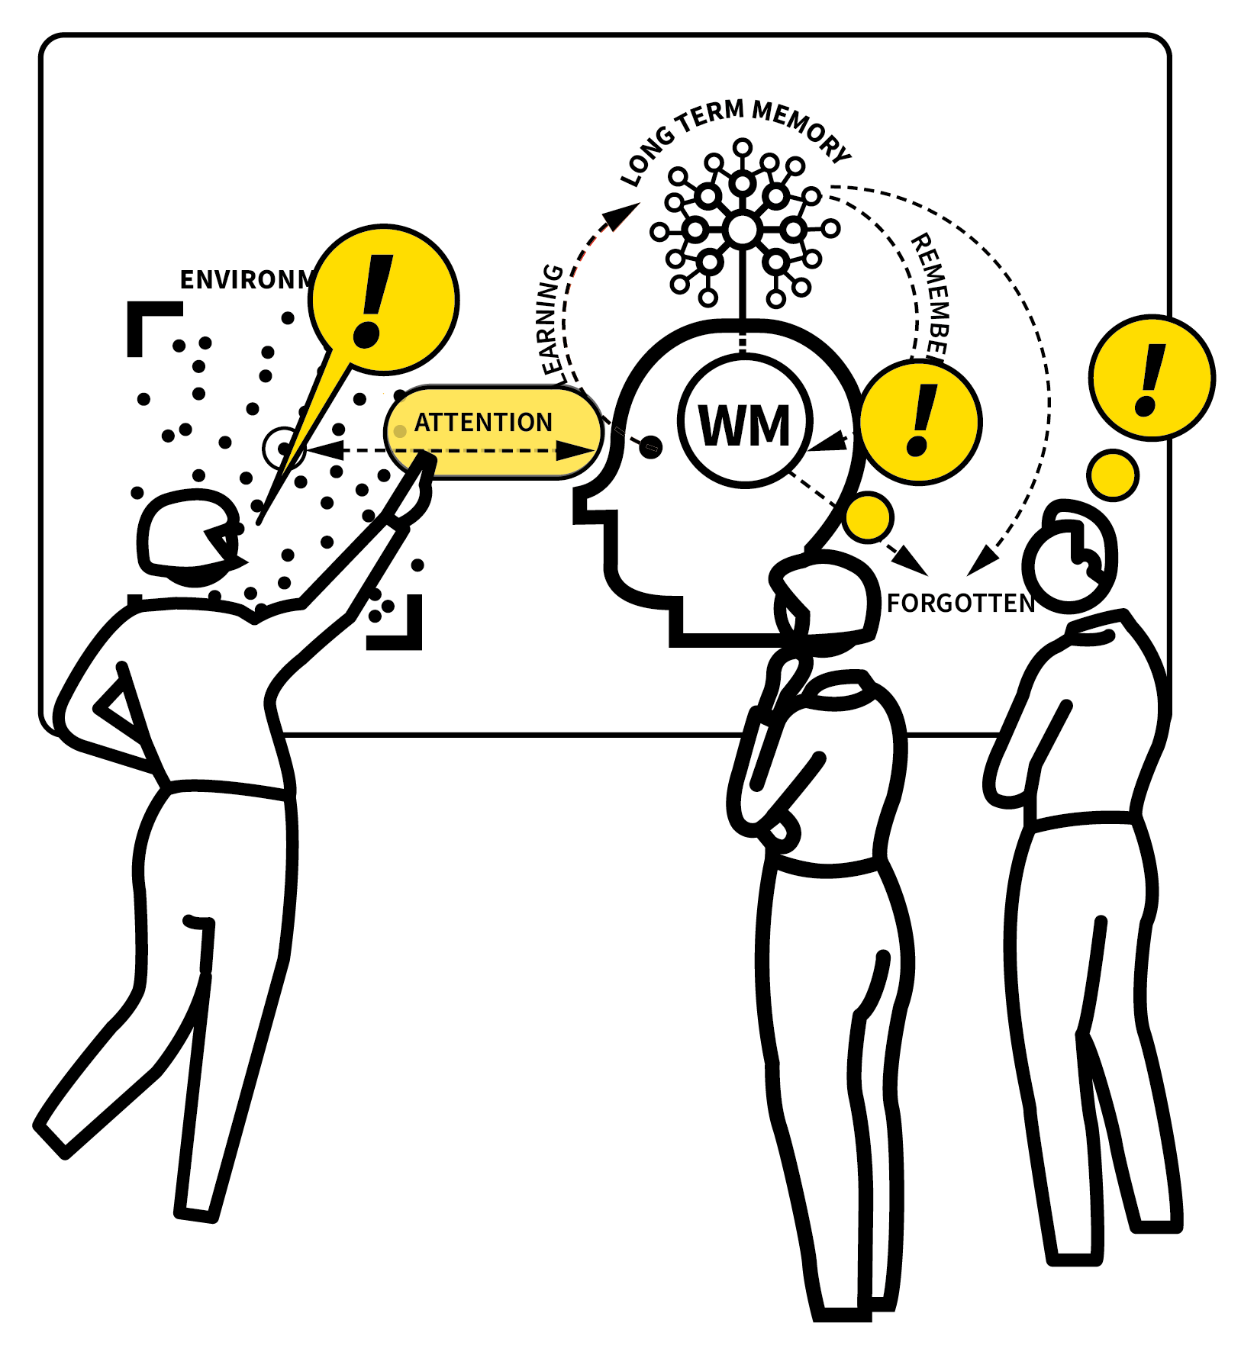
DIAGNOSE YOUR LEARNING PROBLEMS.
Before you focus on techniques, take time to evaluate the range of key learning problems your students experience.
WHY: Explore the learning model and key theories of learning so deliberations are evidence-informed.
Use lesson study, data analysis and teacher discussion to identify common learning problems in curriculum areas or across the school.
STEPS |
1 | 2 | 3 | 4 | 5
Notes:
Set up calendared meeting structures and observation routines allowing PD activities to happen on a sustained basis within the time constraints present in your context.
Key design decisions include:
WHO: Identifying the configuration of people and teams who will work together in coaching cycles
WHEN: Establishing the full schedule of coaching cycle meetings in the calendar, ideally with a 2–4 week timeframe.
Without these structures, sustained PD and coaching can’t happen.

Slide 73
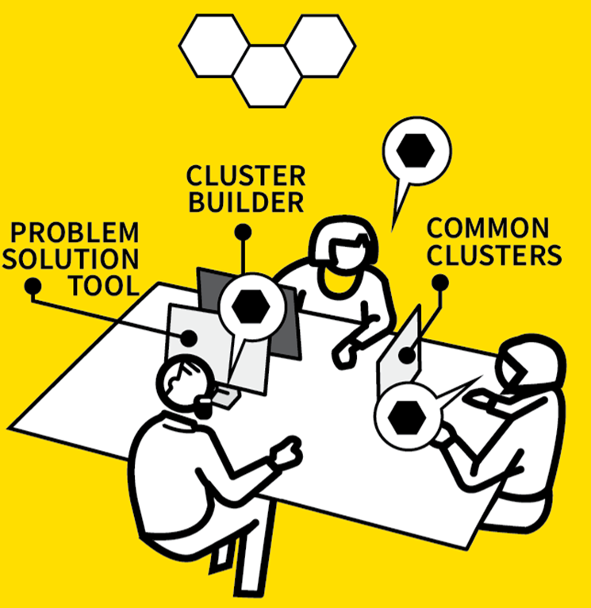
IDENTIFY YOUR TEACHING SOLUTIONS.
WHAT: Use the WalkThrus Resource Hub to identify a set of core techniques that are designed to solve the learning problems identified.
Use the Cluster Builder, Core and Common Clusters and Problem–Solution tools to help curate a set of techniques around which to focus your PD and coaching.
Ensure that the clusters you create directly address the common learning problems you need to tackle.
STEPS |
1 | 2 | 3 | 4 | 5
Notes:
Set up calendared meeting structures and observation routines allowing PD activities to happen on a sustained basis within the time constraints present in your context.
Key design decisions include:
WHO: Identifying the configuration of people and teams who will work together in coaching cycles
WHEN: Establishing the full schedule of coaching cycle meetings in the calendar, ideally with a 2–4 week timeframe.
Without these structures, sustained PD and coaching can’t happen.

Slide 74
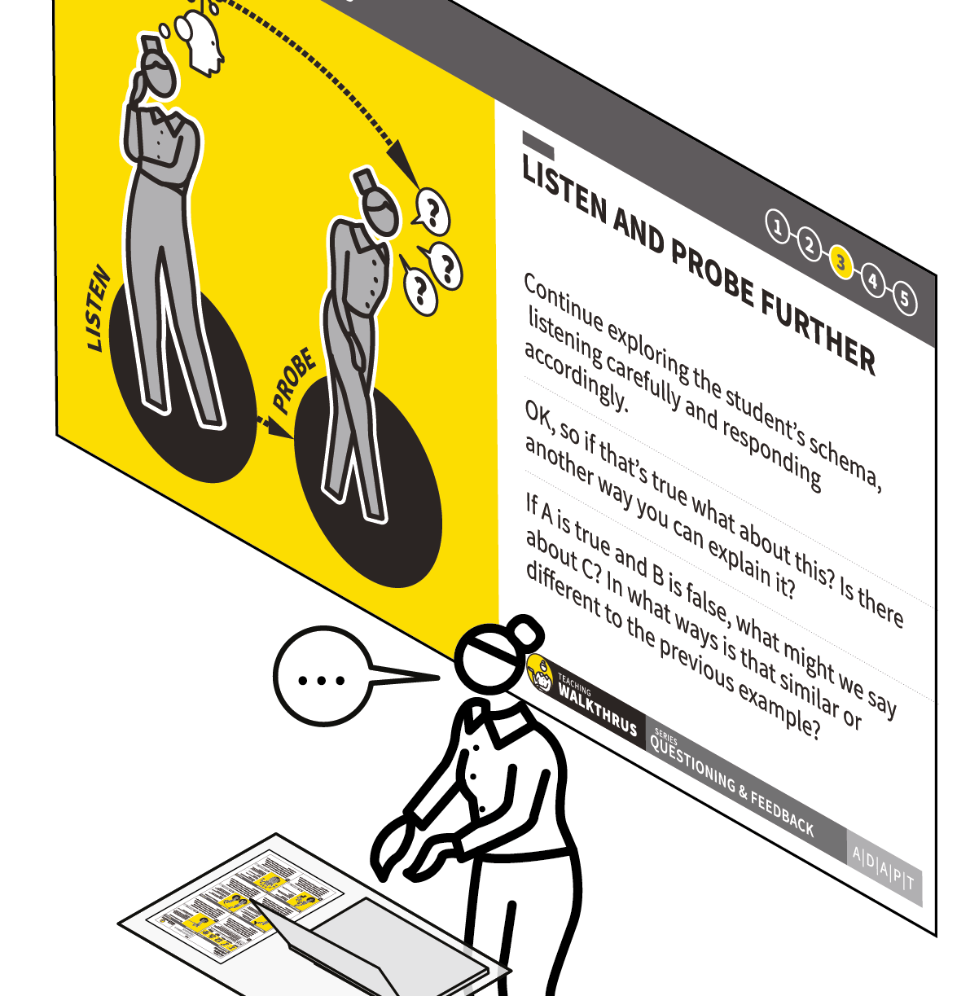
LAUNCH YOUR TRAINING.
HOW: Run training sessions for the appropriate staff that cover:
For Teachers:
The learning model and its implications.
The nature of WalkThrus as a tool to support teacher PD.
A set of core techniques with the Theory, See it, Name it, Do it approach.
For Coaches and Middle Leaders:
The coaching process, including how to conduct lesson visits and feedback meetings.
STEPS |
1 | 2 | 3 | 4 | 5
Notes:
Set up calendared meeting structures and observation routines allowing PD activities to happen on a sustained basis within the time constraints present in your context.
Key design decisions include:
WHO: Identifying the configuration of people and teams who will work together in coaching cycles
WHEN: Establishing the full schedule of coaching cycle meetings in the calendar, ideally with a 2–4 week timeframe.
Without these structures, sustained PD and coaching can’t happen.

Slide 75
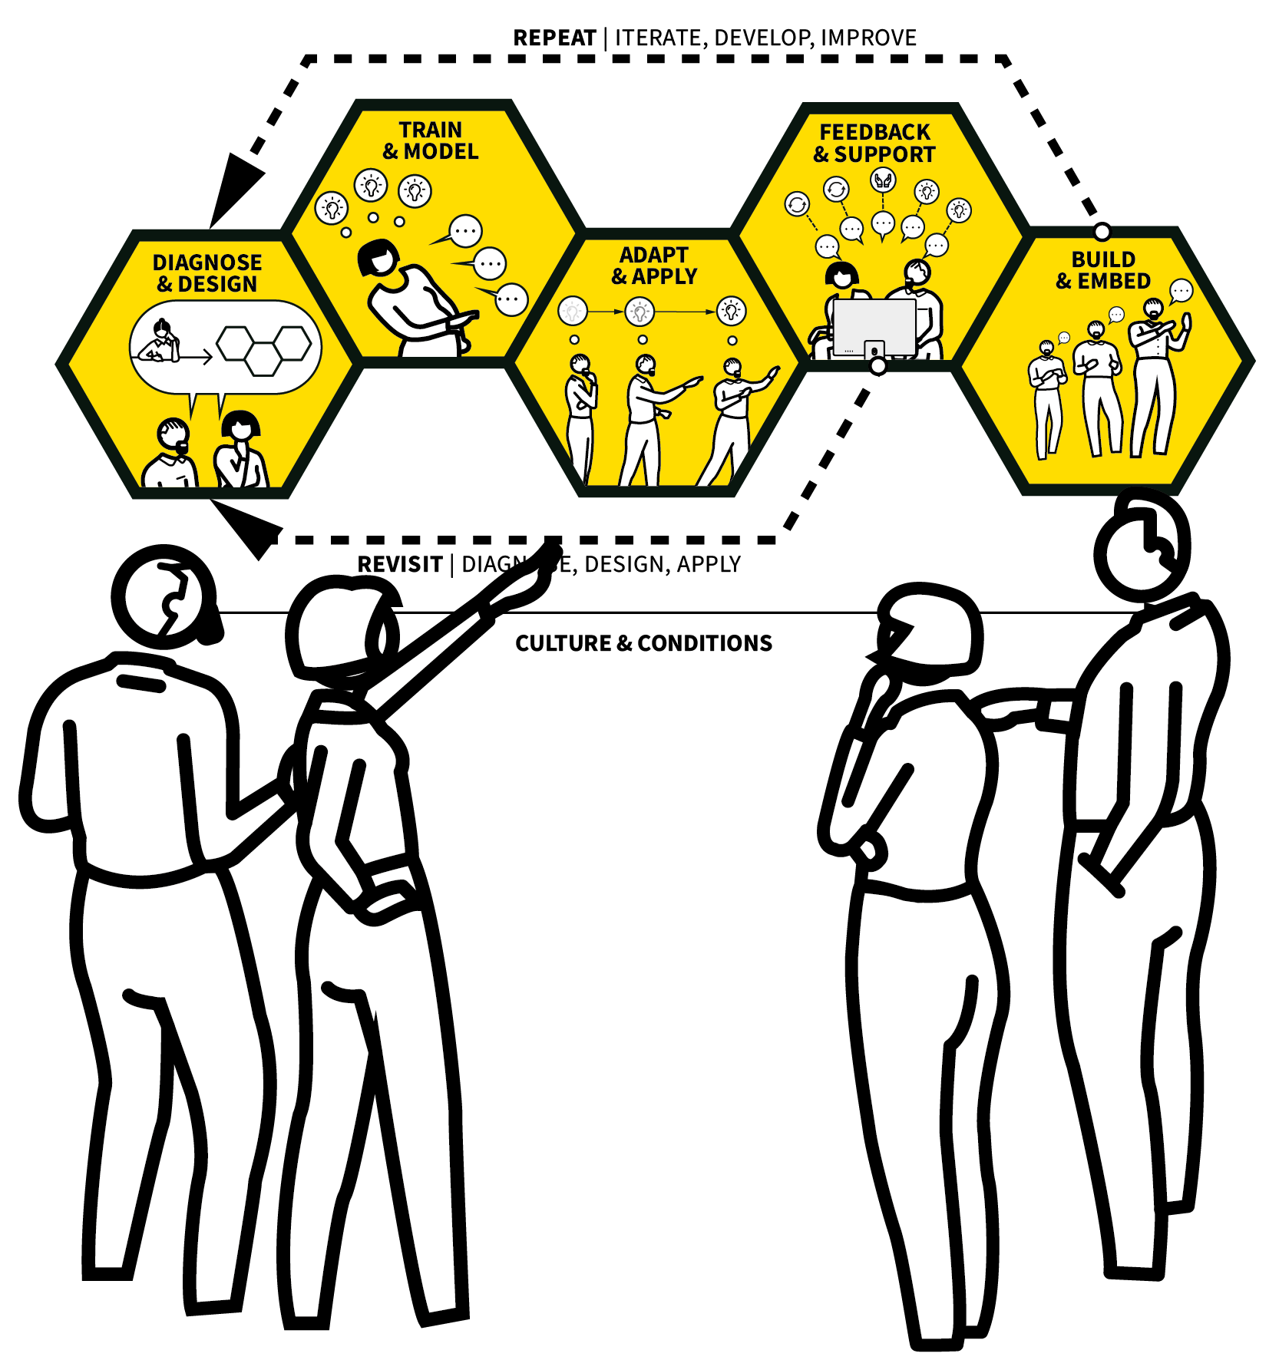
INITIATE & SUSTAIN YOUR COACHING PROCESSES.
HOW: Run the cycles that you have designed, ensuring the time is always safeguarded.
Use the WalkThrus Coaching Process to guide your whole approach. Follow the guidance around each of the five elements ensuring your observations and meetings form iterative feedback loops.
Review progress in solving the learning problems and refocus your training and coaching as needed in light of the assessment of progress being made.
STEPS |
1 | 2 | 3 | 4 | 5
Notes:
Set up calendared meeting structures and observation routines allowing PD activities to happen on a sustained basis within the time constraints present in your context.
Key design decisions include:
WHO: Identifying the configuration of people and teams who will work together in coaching cycles
WHEN: Establishing the full schedule of coaching cycle meetings in the calendar, ideally with a 2–4 week timeframe.
Without these structures, sustained PD and coaching can’t happen.

Slide 76
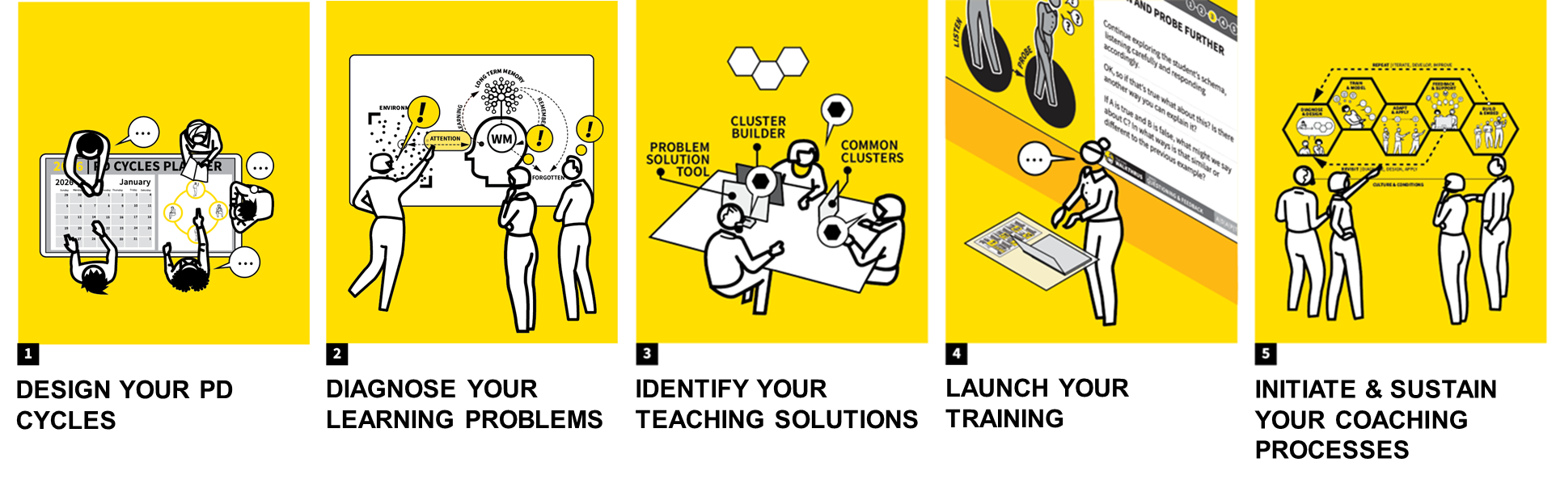
Notes:
Set up calendared meeting structures and observation routines allowing PD activities to happen on a sustained basis within the time constraints present in your context.
Key design decisions include:
WHO: Identifying the configuration of people and teams who will work together in coaching cycles
WHEN: Establishing the full schedule of coaching cycle meetings in the calendar, ideally with a 2–4 week timeframe.
Without these structures, sustained PD and coaching can’t happen.

Slide 77
Finished!!
Thank You & Good Luck !!
walkthrus.co.uk

