Slide 1

Collaborating
Action-planning
Strategising
Headspace
Collaboration
Time for creating thinking, strategic discussions and action planning regarding conference content and next steps for schools.

Slide 2

The Educational Landscape

Slide 3

LA
The Cornwall Plan
SEND Board
SEND Centres of Excellence
Exclusions & Suspensions Steering Group
Mental Health Steering Group
Neurodiversity Steering Group
Health & Wellbeing network
Young People Cornwall
Headstart Kernow
Parental Engagement framework
CEP
Cornwall Education Strategy
Inclusive Education Communities
Attendance and Belonging
DfE
KCSIE
New Ofsted Framework
Curriculum and Assessment Review
Education & Skills White Paper
Solving the SEND crisis
Regions Group SW
National
Regional
Local
Charities &
Voluntary Organisations
VapeANON
Smokefree alliance
Smartphone free childhood
Restorative Justice
Carefree Cornwall
Research
EEF
Cornwall Research School
SWSMC
Pretty Poverty Report
EPI
Breaking Down the Gap
The Chartered College
Professional Teaching Institute
CCE (Creativity, Culture & Education)
Universities
OSCP
Prevent Board
Safer Cornwall
Carefree Cornwall

Slide 4


Curriculum & Community
Accountability & Attendance
Safeguarding & SEND
Health & Happiness

Slide 5

The Curriculum Review offers a more up-to-date experience for children, with an increased focus on oracy, ‘life skills’ (including AI); and additional support for SEND students.
The new Ofsted framework places disadvantaged children at its heart.
Local groups (CEP, the LA, the OSCP) are all focussing on our most vulnerable children.
There is an appetite for collaborative working across groups to improve outcomes for Cornish children.

Slide 6
Curriculum & Assessment Review
As set out in the Terms of Reference, the Review has a commitment to ‘Remediate existing blocks to progress and good outcomes, with an especial concern for equity and ensuring positive outcomes for children and young people who are from socio-economically disadvantaged backgrounds, have a special education need (SEN) or disability and/or are otherwise vulnerable’.
We have applied a social justice lens to all aspects of our work, seeking to identify and remove barriers to progress within the curriculum and assessment system. We have also made recommendations to support better equity, access and inclusivity in subject areas where we have identified specific barriers to progress.
We have also taken steps to ensure that the curriculum (and related material) is inclusive so that all young people can see themselves represented. This should also help them to broaden their horizons and better understand the perspectives of others.

Slide 7
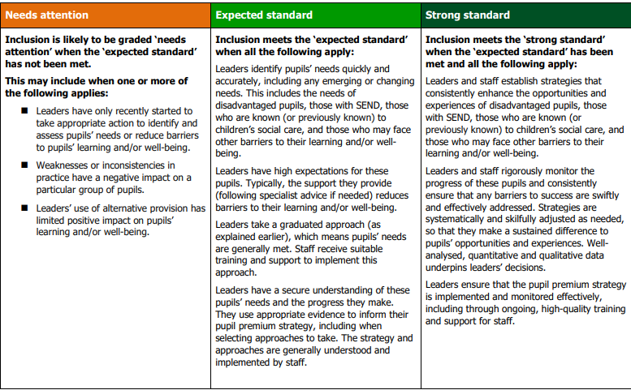

Slide 8
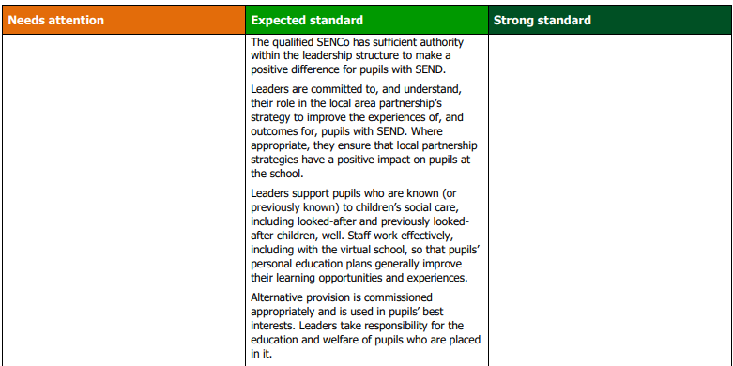

Slide 9


Schools, colleges, Early Years settings and other education settings foster a sense of belonging for children and young people, their families, and the wider school community, through inclusive practices that celebrate diversity, resulting in high levels of wellbeing, attendance and engagement.
Pupils with SEND, pupils from disadvantaged backgrounds and other vulnerable pupil groups are given the support they need to achieve highly and realise their potential, with the same opportunities and outcomes as their peers.
Ensuring that all children and young people aged 2-18 in Cornwall have the best possible opportunities, outcomes and life chances.

Slide 10



Collaboration within and beyond CASH to support our most vulnerable children
CEP – working across organisations to improve outcomes
Monthly CCC meetings (CASH, CAPH, CACE) to align
Mapping to reduce duplication, to streamline and to signpost
Joint ‘FlourishEd’ Headteachers conference: 14.10.26
How can we as Secondary leaders and CASH members work together to improve outcomes for all children in Cornwall?
Please commit to the pledge where you
can CASH-in-on each others’ expertise.

Slide 11
FlourishEd: Collaborative Cornwall, Headteacher Conference
Leading Together for Cornwall’s Future
Date: Wednesday 14th October 2026
Time: Full Day Conference
Location: The Eden Project
Join colleagues from across Cornwall for FlourishEd, a day of inspiration, collaboration and connection designed to celebrate and strengthen leadership across our schools.
The event will explore leadership, wellbeing and professional growth through keynote speakers, interactive workshops, and local case studies showcasing the power of collaboration in Cornish education.

Slide 12









Working together for the benefit of all
u
b

Slide 13


Slide 14

PTI Unlimited:
PTI Teacher Leaders Certificate
CPD Subject Days
CPD Online
Subject Expertise Certificate
Middle Leader Certificate: Curriculum Design
Subject Enrichment Residential
Department Development Programme
PTI Subject Marks
Leadership Symposium: Residential
PTI Leadership Programme
PTI Leadership Mark

Slide 15


Leadership Symposium
12th-13th February
£575 + VAT (Price pre-discount)
Subject Leader Enrichment Professional Learning Residentials
£545 + VAT (3 days)
Hub package, eg:
3 x bespoke CPD subject pedagogy
Leadership programme
Leadership symposium place
Online package ‘Thought Leadership’
Virtual Hub access
Unlimited Costs:
Usual price £3995 + VAT per school
Two school discount £3,700
20% CASHHub discount: £3196 per school for 9 schools (£799 saving!)
Further discount for 10+ schools (I’m trying to negotiate 25% discount – a saving of £998: £2996).
They are also prepared to offer a reduced price for small schools as part of CASHHub.

Slide 16

Free CASHHub trial: 10 pupils x 2 sessions x 4 weeks
Reduced cost enrolment for CASHHub schools
Reduced costs for small schools

Slide 17
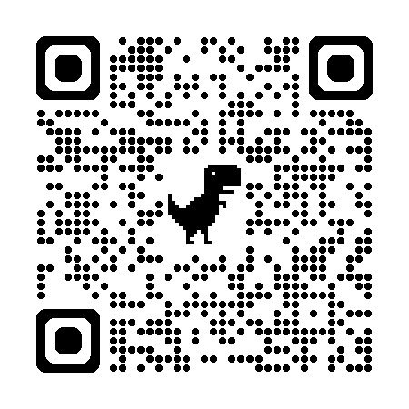



Collaborating
Action-planning
Strategising
Headspace
Collaboration
Time for creating thinking, strategic discussions and action planning regarding conference content and next steps for schools.
Sign up to indicate interest in

