Slide 1














MHST Secondary School Offer

Slide 2










About the MHST
(Mental Health Support Team):
The MHST is made up of Support Workers, Education Mental Health Practitioners (EMHPs) both Trainees and Qualified, Supervisors to the EMHPs and Line Managers/Clinical Leads.
We are an NHS service hosted by CAMHS, currently working in over 70% primary schools across Cornwall, and with secondary schools through our peer mentoring programme for years 6/7.
We work with young people and their parent carers using low intensity CBT for low to moderate mental health difficulties, and emotional regulation.
Next Steps – expanding provision for year 7’s.

Slide 3
The Decider Skills
“The Decider Skills use Cognitive Behaviour Therapy (CBT) to teach children, young people and adults the skills to recognise their own thoughts, feelings and behaviours, enabling them to monitor and manage their own emotions and mental health.”
“The Decider Skills are strongly grounded in theory summarising 12 CBT and DBT (Dialectical Behaviour Therapy) skills which have an impressive evidence base” This has proven to provide self-regulation skills for home, school and the community.
You can find out more information about the evidence and research that underpins The Decider Skills here: Studies | The Decider

Slide 4
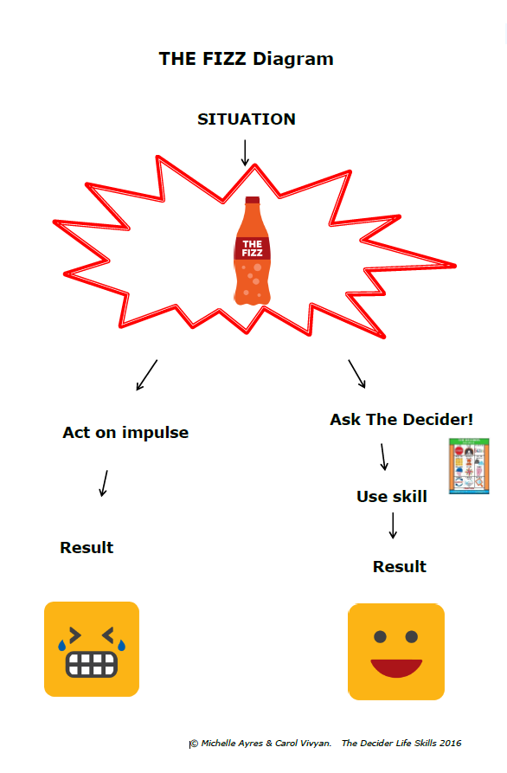
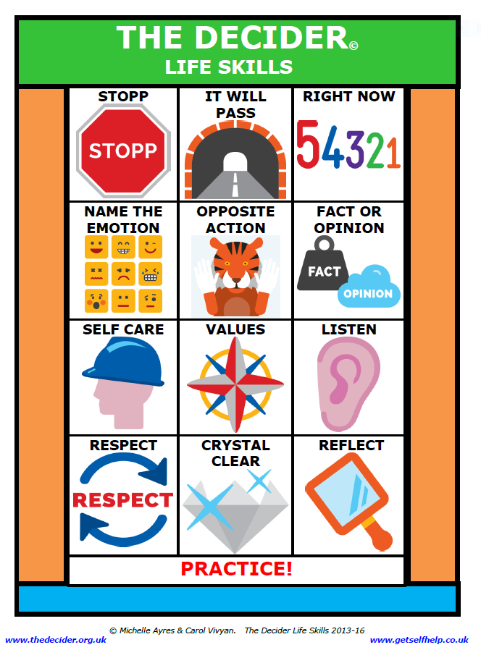

The Decider Skills

Slide 5


Why Decider Skills?:
Helps with self regulation.
Gives young people the choice of which skills works for them.
Skills can be shared with others.
Can be used in any situation and at any age where CBT is appropriate, including adults.
It is evidence based.
It is fun and interactive to learn.

Slide 6

MHST Offer
Step 1 – To meet with Secondary School and discuss MHST year 7 offer. This includes booking dates and agreeing delivery options.
Step 2 - Two MHST practitioners to deliver the Decider Skills training to 30/60 year 7 children chosen by the school over a 4-week period to show effectiveness of the intervention.
Step 3 - Two MHST practitioners to deliver the Decider Skills training to a minimum of 4 members of Secondary School staff. This may include linking with other Secondary Schools depending on timings and logistics.
Step 4 - The MHST will be available for consultation to the school for 3 months from the start date of step 2 (Delivery to children). This will allow you to discuss your implementation of further training and the possibility of accessing an MHST Support Worker to support you with delivery (depending on SW availability).
Step 5 - MHST practitioner will make contact with your school approximately 6-12 months later to review how you have implemented the training and gain feedback.
Notes:
Give the school an idea of using the trained children to act as 'mentors' to help cascade DS across the school/year group.

Slide 7
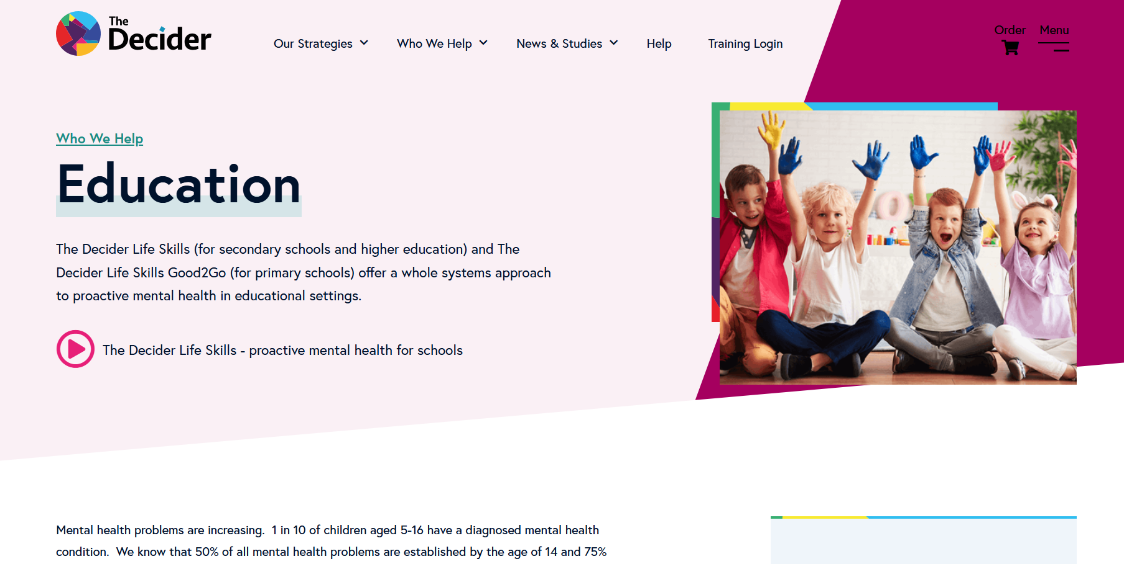
MHST – Decider Skills
Useful links and information:
Who we help: Schools | The Decider

Slide 8
MHST – Decider Skills
Contact Information:
Your link Decider Skills MHST Practitioner is:
Contact Details:
MHST Main Office: Cornwall Partnership NHS Foundation Trust
Shaw House, Porthpean Road, St Austell PL26 6AD
Tel: 01726 873204 Website: Children's Mental Health Support Team | Cornwall Partnership NHS Foundation Trust
MHST area manager:
MHST Service Lead: Paul Winstanley

