Slide 1
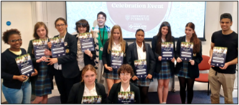

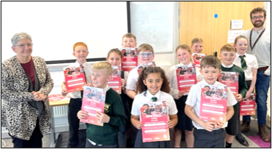
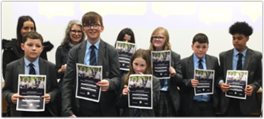


Mentoring for Attendance, Aspiration, and Belonging
Professor Sonia Blandford
Professor Suanne Gibson

Slide 2

A Crisis for Young People in England:
25.6% of state Primary and Secondary school pupils were Persistently Absent (>10% of sessions missed) during 2024-25
(up from 13.7% in 2018-19).
149,900 ‘Children Missing Education’ (not registered at any setting) reported throughout 2023-24
(compared to 94,900 in 2021-22).
In 2024-25, 19.2% of state school pupils have a known Special Educational Need and/or Disability. (Up from 14.9% in 2018-19)
5.3% of pupils have an EHCP. (Up from 3.6% in 2020-21)
304,040 state school pupils Suspended once or more during 2022-23; 3.6% of each school’s population on average
(188,503 and 2.4% in 2018/19).
(Statistics from LG Inform and Gov.uk)

Slide 3

An Increase in ‘Challenged Children’
Students who are challenged on a daily basis by their circumstance:
Children whose education and lives are negatively impacted through no fault of their own.
Unstable home-lives
Poverty at home (FSM, Ever 6, NRPF)
Special Educational Needs or Disability
Excluded children
Children missing from LA schools register
School refusal/school avoidance
(Elective) home-education
Ethnic Minorities (BAME)
LGBTQIA+
Homelessness
Domestic violence
Young Carers
Armed Forces
Traveller communities
Refugee children
Children in care/ Children looked after

Slide 4

A working definition of inclusion:
  Inclusion is: 100% of children learning and having their needs met in high quality education, 100% of the time.
  Inclusion is: aspiration, progression and success for ALL.
  Inclusive thinking means we keep our minds, ears and doors open – building our reach, growing opportunities, and keeping a focus on progression and success for all.
  The truly included child:
    Attends regular classroom lessons with appropriate provision,
    Participates in all activities offered to other students,
    Is accepted by the rest of the school community,
    Achieves in all learning domains,
    Has a strong sense of belonging and feels happy to be part of the school community.
  Blandford, S., Casson, W., Gibson, S., Munn, G., and Shute, J. (2023)
Notes:
This is what we developed in Plymouth

Slide 5


‘Are We Included?’ – Mentoring for Self-Esteem, Inclusion + Belonging
A collaboration between University of Plymouth and Plymouth Marjon
Evidenced programmes for Primary (KS2), Secondary, and CLA (KS3+4)
8-10 weeks of weekly 1hr sessions, with Campus Celebration Event finale
Developed in partnership with pupils, teachers, school leaders, and parents/carers
informed by our ongoing academic research and publications
Improve access: through increased attendance and engagement
Grow aspirations and think about future goals
Set strong foundations for attainment
Celebrate a sense of achievement
Nurture confidence and self-esteem
Develop a sense of belonging within the school community
Supporting pupils to:
Notes:
Emphasis on AWI Primary – there are limited similar programmes available for Primary phase, and AWI is distinct in it’s focus on self-esteem and belonging. Supporting pupils early on in their school career reduces the likelihood of need for further support later on in life.

Slide 6
The ‘AWI?’ Programme
Introductions - Getting to know each other and positive role models
Aspirations - The end goal, university, career…
Building Confidence - What makes me feel confident? Building self-esteem and achievement
Attainment - The importance of ‘doing your best’ and how you do that
Communication – how we talk to others and why that’s important
Presentations – sharing something you know about and practicing speech skills
Celebration event at university – feeling proud of our achievements, and sparking aspirations
Available as a 7, 9, or 10 week intervention, with weekly 1hr sessions
KS2, KS3, or bespoke cohorts, specifically those pupils who struggle with confidence, aspiration, or are beginning to struggle to engage in school
Delivered by UG and PG university students as trained AWI? Mentors
Academic evaluation: Pupil, parent, teacher questionnaires; report data; and pupil interviews

Slide 7

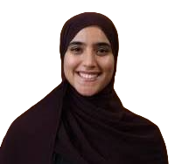
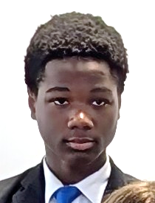
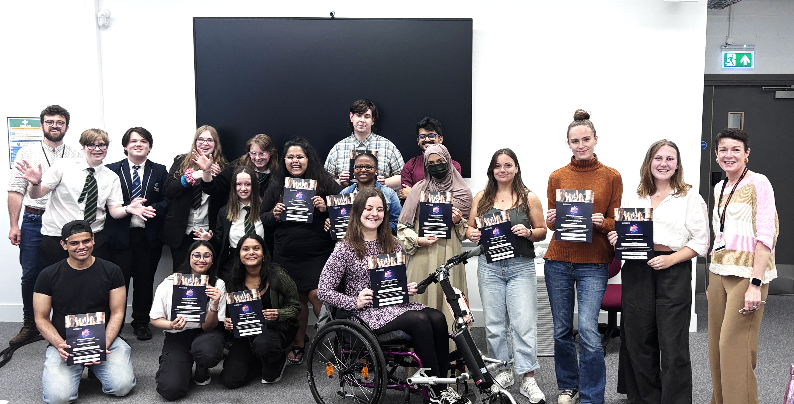
Our Mentors
Students from across Plymouth University,
with diverse backgrounds and life stories...
Undergraduate, Post-graduate, Doctoral study
A wide variety of subject specialisms
Various ages: from 18yrs – mature students
Diverse cultural and educational backgrounds
Varied career aspirations and insights
Eclectic hobbies, interests, + life stories to share!
Emmanuel – Yr 10 student
Born in Nigeria, and has aspirations for a career in medicine.
Samuel – AWI, OP, and E4I Mentor
Was also born and grew up in Nigeria
Esra – AWI and OP Mentor
Studying BMBS Medicine + Surgery
Benefits for our Mentors:
Many go on to work with young people
Paid work alongside study
Enhanced employability skills
Chance to reflect on their own career
CV experience

Slide 8
Evaluating Impact
Termly evaluations to capture impact:
  ‘AWI?’ Questionnaires:
    Student
    Parent/carer
    Teacher/leader
  Pre- and post-programme pupil report data: inc. behaviour, attendance, attainment.
  School staff comments
  Mentor comments
  Video interviews

Slide 9





Evidenced Impact across communities:
Students
Increased feelings of inclusion and belonging amongst their peers and wider school community
An improvement in attendance, behaviour, and academic progress data
School staff report increased confidence and self-esteem amongst students
Increased number of parents reporting that students enjoy attending school and look forward to classroom activities
Parents
  Improved parental satisfaction surrounding school’s Inclusion agenda
School Staff
  Improved attitudes to Inclusion, and willingness to undertake CPD
Whole School
  A catalyst for positive discussion and ethos building around inclusion…

Slide 10
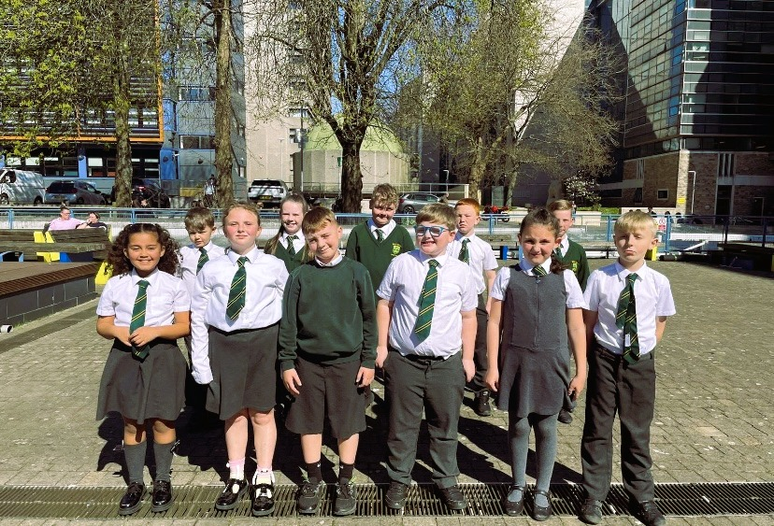
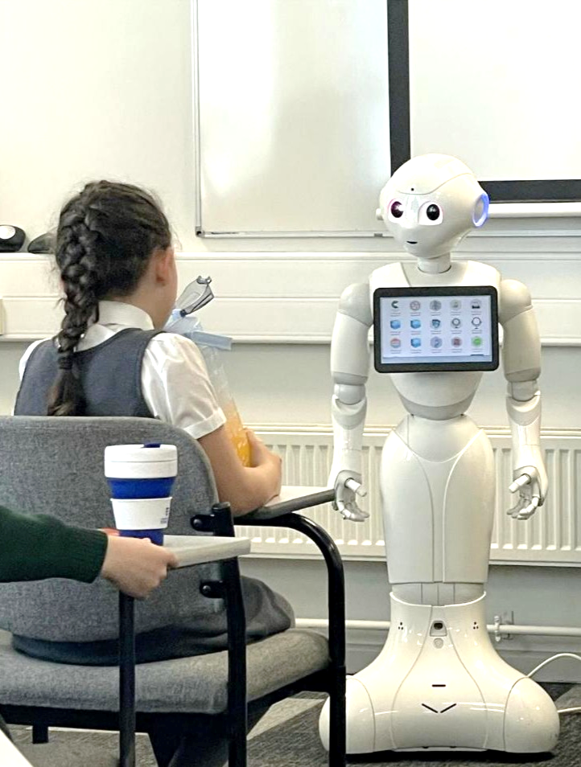
Following our Spring 2025 ‘AWI Primary’ programme…
95% of pupils were thinking more about their future
95% had been trying harder to improve their schoolwork
100% had been feeling prouder of their achievements
91% had been feeling more like they belong at school
91% had been more focused on improving their behaviour
Notes:
Emphasis on AWI Primary – there are limited similar programmes available for Primary phase, and AWI is distinct in it’s focus on self-esteem and belonging. Supporting pupils early on in their school career reduces the likelihood of need for further support later on in life.

Slide 11

Following our Spring 2025 ‘AWI Secondary’ programme…
100% of parents had noticed that their child was thinking more about their plans for the future
80% had noticed that their child was trying harder to improve their schoolwork
100% had noticed that their child had been feeling prouder of their achievements
Wider Outcomes and Additionality:
Initiating pupil’s better access to support systems long term
Improvement in communication, behaviour, friendships
Envisioning post-16 plans, with practical next steps taken
Strengthening school communities and belonging
Notes:
Emphasis on AWI Primary – there are limited similar programmes available for Primary phase, and AWI is distinct in it’s focus on self-esteem and belonging. Supporting pupils early on in their school career reduces the likelihood of need for further support later on in life.

Slide 12

Pupil Voices Video...
AWI Pupil Voices 2025.mp4

Slide 13



Pupil, Mentor, and Teacher voices…
“
It’s changed the way I feel about myself… it can make you feel better about yourself – that’s what it did for me!
“
This ground-breaking project has provided me with a valuable addition to my pastoral toolbox…
(Year 8 Student at Hele’s School)
”
”
(Staff member from Hele’s School)
“
Being a mentor for ‘Are we Included?’ was a great experience for my own personal growth and for the growth of my mentees.
“
I saw a significant improvement in the confidence levels of 2 of our quieter pupils over the programme. It was really great to see them speaking out in groups and laughing with the mentors
”
(UoP Student / Mentor)
”
(School Staff at UTC Plymouth)
It has changed the way I think about my future. I’ve always wanted to be a writer but now I feel like I can actually do it!
“
“
This programme is a great tool to build aspirations in our young people and give them hope for the future
(Year 9 Student at UTC Plymouth)
”
”
(Assistant Headteacher at Notre Dame School)
“
There was one girl in particular who exhibited the most change… Her pastoral teacher told me that they had noticed a new openness in her and that she had started working more effectively with the support systems…
(UoP Student / Mentor)
”

Slide 14
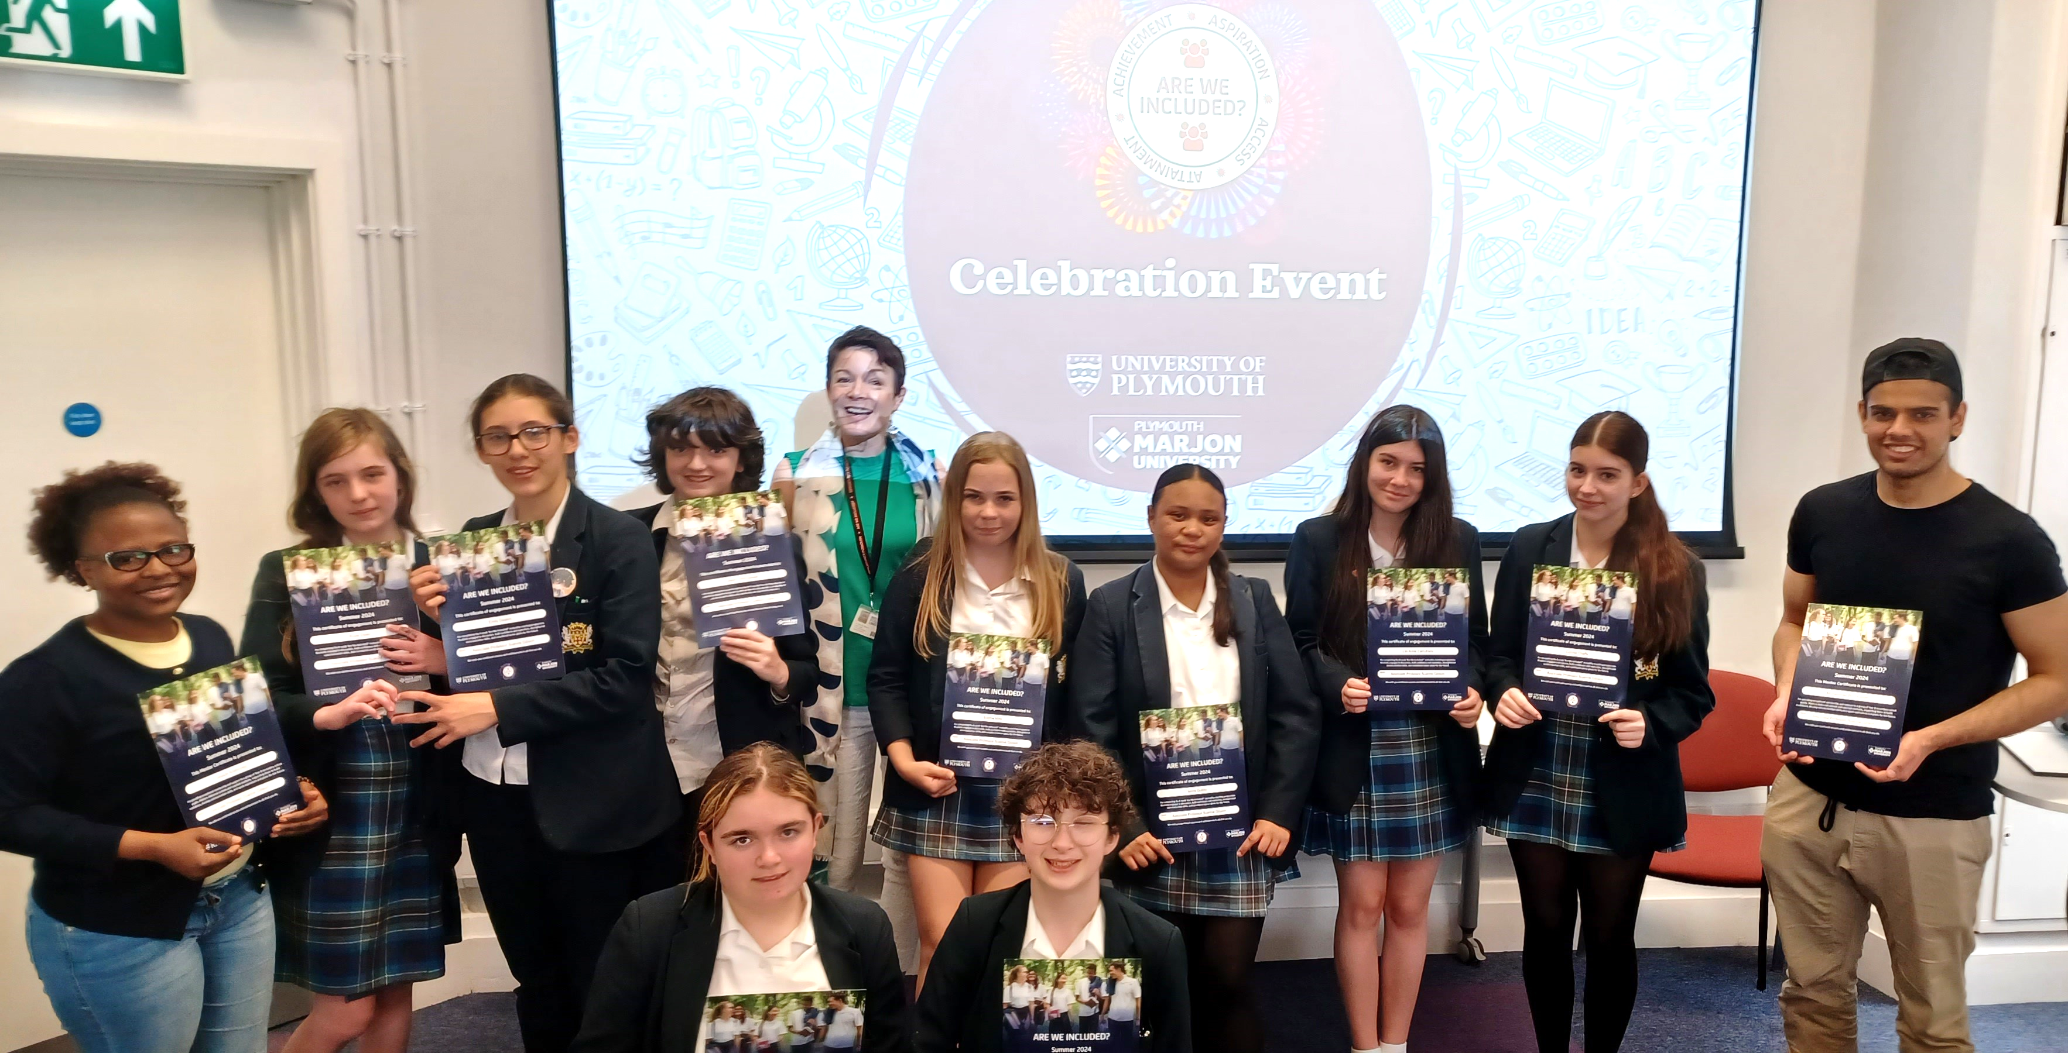

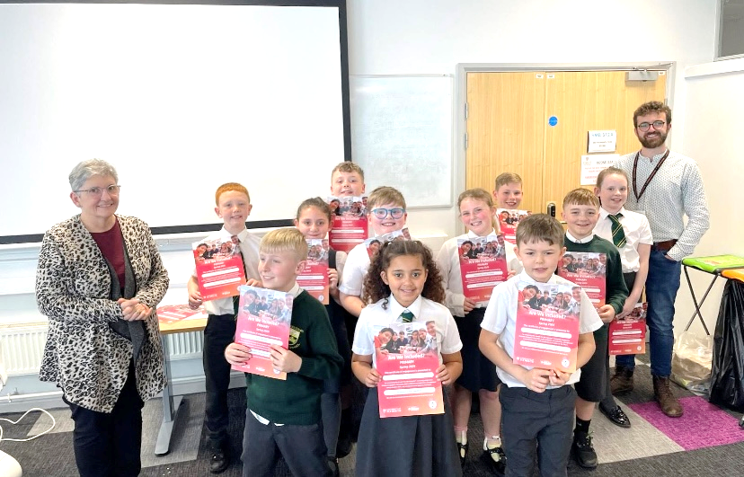



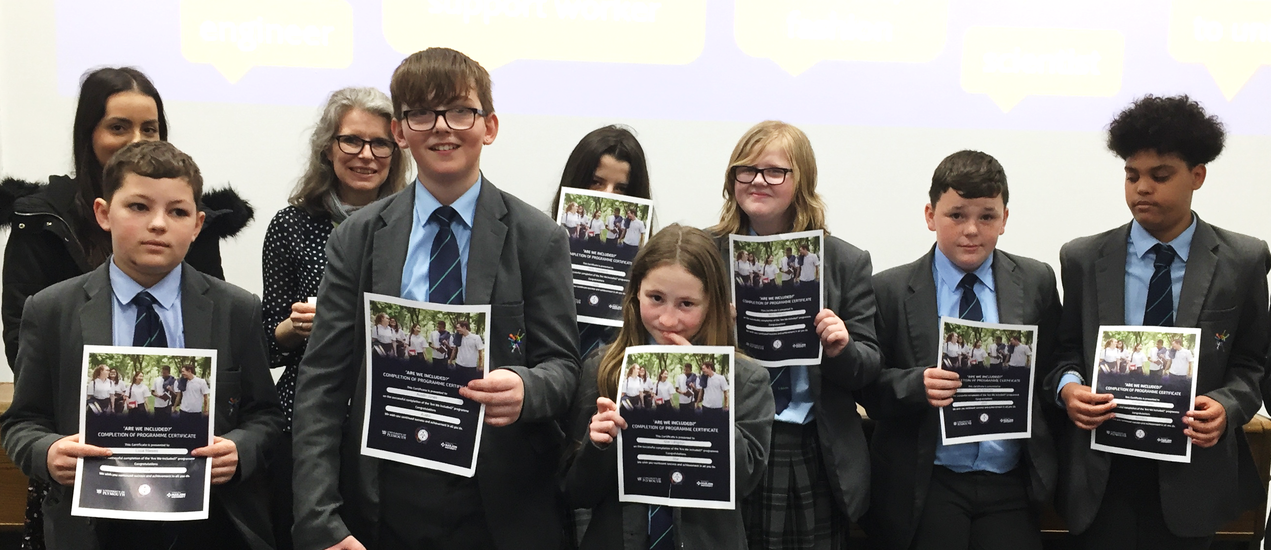

‘Our ‘AWI?’ Impact so far…
203 School Pupils mentored
18 University student mentors
15 programmes delivered
Across 9 Plymouth schools
24 School Staff took part

Slide 15









Our ‘AWI?’ Impact in Plymouth…
… and looking to add more schools in 2025-26
Notes:
Primary:
St Budeaux CofE Primary Academy
Tor Bridge Primary School
Shakespeare Primary School
Plaistow Hill Primary and Nursery School
Victoria Road Primary
Knowle Primary School
Woodfield Primary School
Eggbuckland Vale Primary School
Beechwood Primary Academy
Weston Mill Community Primary Academy
Leigham Primary School
Thornbury Primary School
Oakwood Primary Academy
Ernsettle Community School
St Edwards CofE Primary School
St Peter's RC Primary School
St Paul's RC Primary School
St Matthew's CofE Primary and Nursery Academy
Mayflower Academy
Marine Academy Primary
Widewell Primary Academy
Riverside Community Primary School
Whitleigh Community Primary School
Pennycross Primary School
Mary Dean's CofE Primary School and Nursery
Secondary (!! we've worked with all on the PBSI Evaluation and AWI Stage 1):
All Saints Church of England Academy
Eggbuckland Community College
St Boniface's RC College
Marine Academy Plymouth

Slide 16
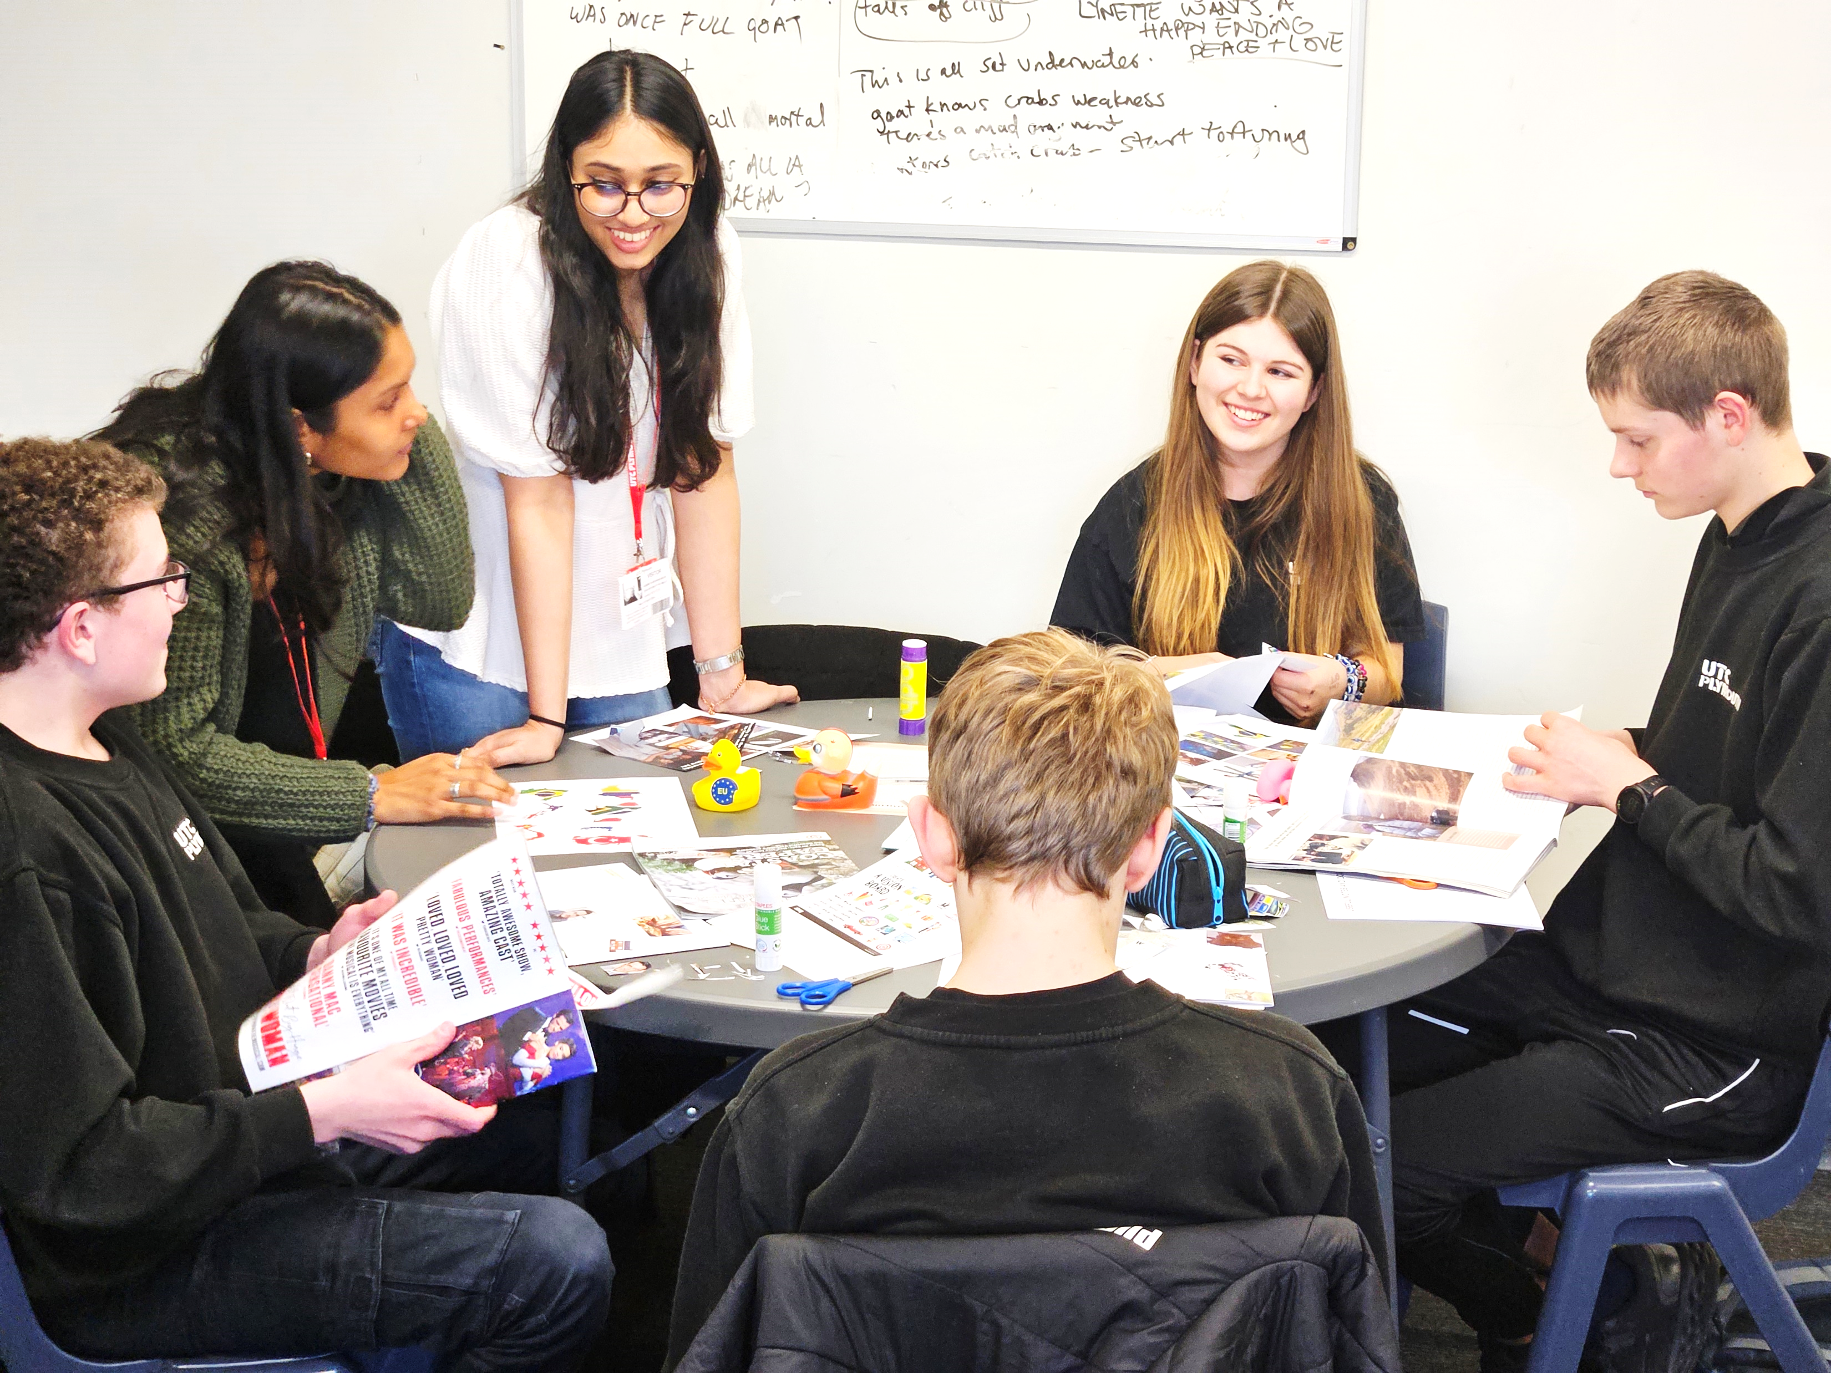


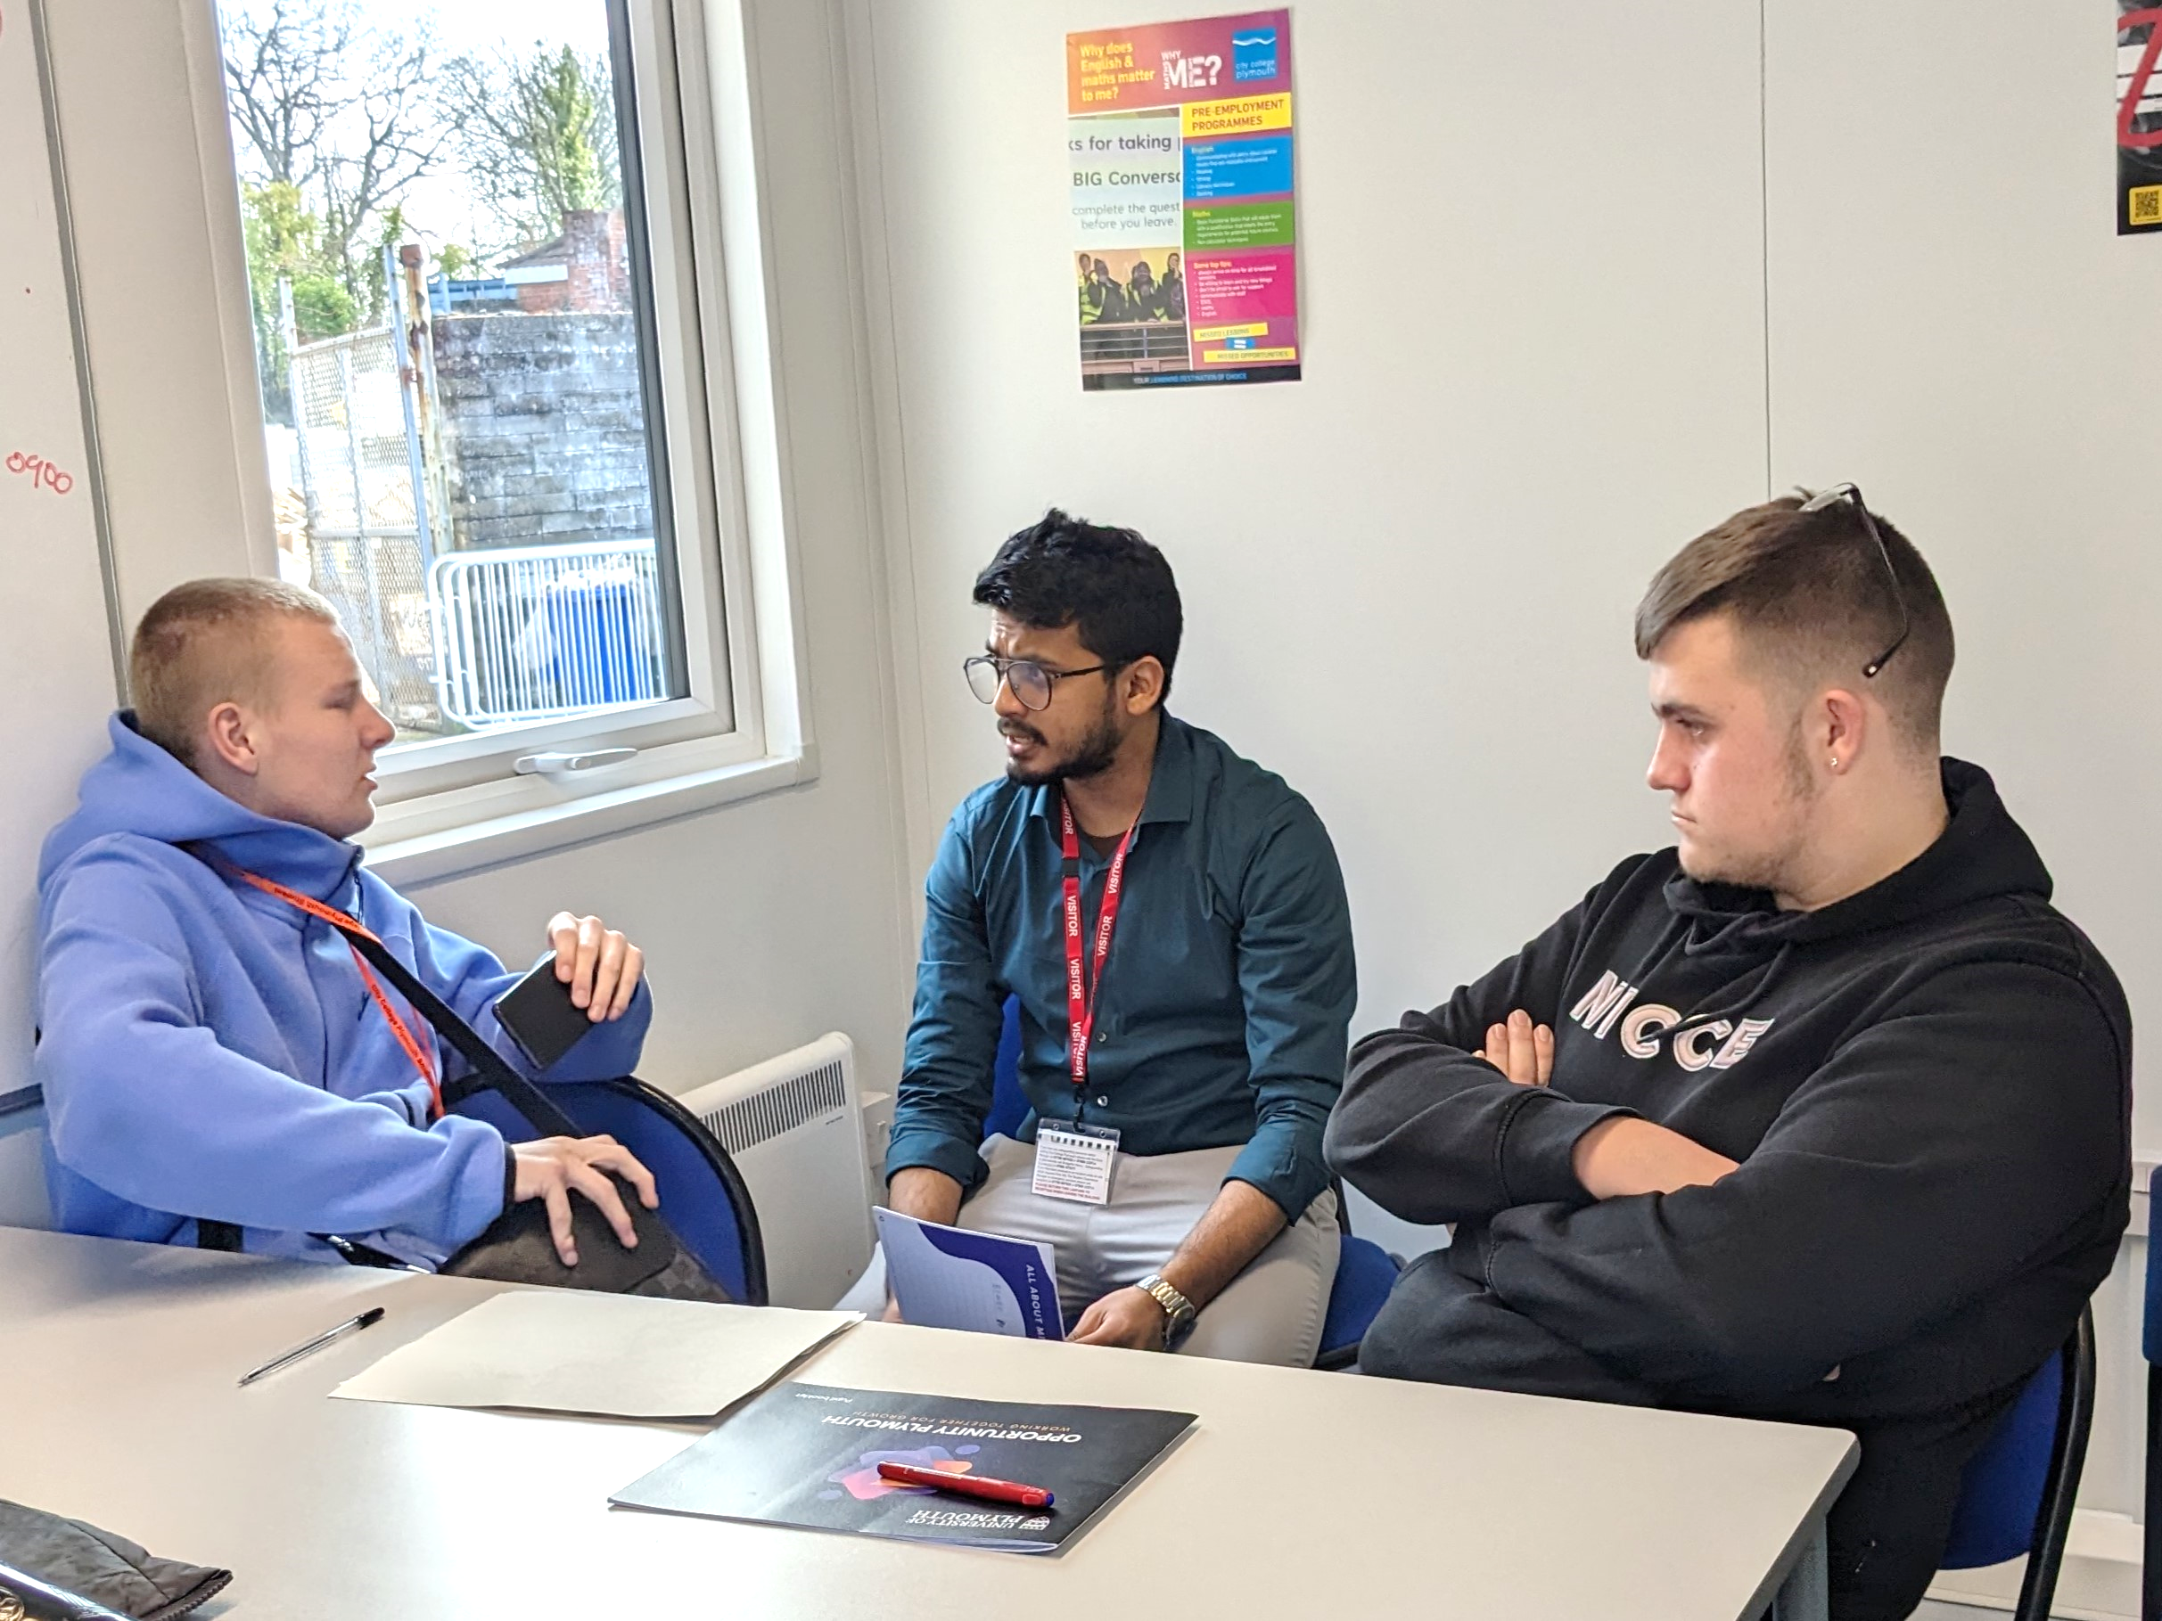
Across our Programmes…
532 School Pupils mentored
89 University students as mentors
39 programmes delivered
Across 16 Plymouth schools
40 School Staff took part

Slide 17


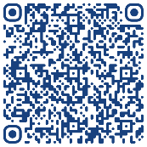
Discussion and Questions…
More on our website: Scan below… Or click here
Notes:
Menti meter 5382 6607
What do you know about Inclusive Education now?- Any questions?

Slide 18
Our Recent Publications…
Achtaridou, E.; Blandford, S.; Gibson, S. and Sharma, U. (2022), A Framework for Inclusion, Teaching Times, Available from https://www.teachingtimes.com/a-framework-for-inclusion/
Bamsey, V., Blandford, S., Gibson, S., Traling, J. and Vasello, T (2022), SEND Green paper 2022- Some Critical Insights, Teaching Times, Available from https://www.teachingtimes.com/send-green-paper-2022-some-critical-insights/
Blandford, S., Casson, W., Gibson, S., Munn, G., and Shute, J. (2023): Evaluation of the approach and impact of the Place-Based work in Plymouth (September 2020 - August 2022) on 19 Plymouth Secondary schools and an Alternative Provision Provider, Plymouth Marjon and Plymouth University, Plymouth.
Blandford, S., Casson, W., Gibson, S., Munn, G., and Shute, J. (2023). Schools Collaborate To Make Inclusion Work. Teaching Times. Available at: https://www.teachingtimes.com/schools-collaborate-to-make-inclusion-work/
Blandford, S. (2024). Why Are 1.5 Million Children In England Failing To Attend School? Teaching Times. Available at: https://www.teachingtimes.com/why-are-2-million-children-in-england-failing-to-attend-school/
Munn, G. (2024). A Vision for True Inclusion in Plymouth Schools and Beyond. Teaching Times. Available at: https://www.teachingtimes.com/a-vision-for-true-inclusion-in-plymouth-schools-and-beyond/
Gibson, S. (2025). Collaborating through Place-Based Partnerships for Inclusion. Plymouth Institute of Education Open Journal: Vol. 3: Iss. 3, Article 4. DOI: https://doi.org/10.70156/2634-8594.1027

Slide 19
Programme Evaluations…
Blandford, S., Casson, W., Gibson, S., Munn, G., and Shute, J. (2023). ‘Are We Included?’ – Study 3: Findings from the Autumn 2022 ‘Are We Included?’ Mutuality Coaching Programme. Plymouth Marjon University and University of Plymouth, Plymouth. Available at: https://www.plymouth.ac.uk/research/education/university-practice-partnerships/research-in-practice/are-we-included?
Blandford, S., Casson, W., Gibson, S., Munn, G., and Shute, J. (2023). ‘Are We Included?’ – Study 3: Findings from the Spring 2023 ‘Are We Included?’ Mutuality Coaching Programme. Plymouth Marjon University and University of Plymouth, Plymouth. Available at: https://www.plymouth.ac.uk/research/education/university-practice-partnerships/research-in-practice/are-we-included.
Blandford, S., Casson, W., Gibson, S., Munn, G., and Shute, J. (2023). ‘Are We Included?’ – Study 3: Findings from the Summer 2023 ‘Are We Included?’ Mutuality Coaching Programme. Plymouth Marjon University and University of Plymouth, Plymouth. Available at: https://www.plymouth.ac.uk/research/education/university-practice-partnerships/research-in-practice/are-we-included.
Blandford, S., Casson, W., Gibson, S., Munn, G., and Shute, J. (2024). ‘Are We Included?’ – Study 3: Findings from the Spring 2024 ‘Are We Included?’ Mutuality Coaching Programme. Plymouth Marjon University and University of Plymouth, Plymouth. Available at: https://www.plymouth.ac.uk/research/education/university-practice-partnerships/research-in-practice/are-we-included?
Blandford, S., Gibson, S., Munn, G. (2025). ‘Are We Included?’ Mentoring: Secondary – Spring 2025 Interim Impact Summary. Plymouth Marjon University and University of Plymouth, Plymouth.
Blandford, S., Gibson, S., Munn, G. (2025). ‘Are We Included?’ Mentoring: Primary – Spring 2025 Interim Impact Summary. Plymouth Marjon University and University of Plymouth, Plymouth.

