Slide 1
Children’s Services
Lynsey Attwood – Associate Director Children’s Services, Cornwall Partnership NHS Foundation Trust

Slide 2

Hello!
Overview of services
Focus on;
CAMHs (Child and Adolescent Mental Health service)
Neurodevelopmental service
MHST (Mental Health Support Teams in Schools)
Time to hear from you!

Slide 3
Overview of Cornwall Partnership NHS Foundation Trust Children’s Services
Youth Justice Service
Community Nursing, epilepsy, palliative care, short breaks
Speech & language, neurodiversity diagnosis & assessment, learning disabilities
Pre-birth
Pre-school
School
Adulthood
Thriving Together
MHST
Special Parenting
CAMHS, ADHD, Eating Disorders including ARFID (avoidant restrictive food intake disorder), Crisis Mental Health Services including COAST and LD Key workers
Sowenna – General Adolescent Unit

Slide 4

Celebrating Success
Mental Health
Number 1 in England for CAMHs Access 2024/25
27% reduction in Emergency Department attendance for CYP in Mental Health crisis
Safe place at Sowenna
Thriving Together; Multiagency consultation model embedded and effective
COAST (Community Outreach and Support Team); Zero Specialist Eating Disorder Unit admissions
Gender Identity Service pathway established

Slide 5
Celebrating Success
Health
Increased training and delivery of phlebotomy in the community to reduce attendance to RCHT
New SaLT pathway within Youth Justice Service
Short Breaks rated ‘good’ by Ofsted
Joint epilepsy transition clinic with RCHT
SaLT, ND and ADHD investment and recovery plans in place to reduce waits

Slide 6
CAMHS

Slide 7
Overview of CAMHS Community Services
Provides assessment, consultation, and treatment for children and young people (ages 5-18) with moderate to severe mental health difficulties.
Focus on complex, co-occurring needs, involving families, carers, and professional networks.
Conditions include mood, anxiety, eating disorders, trauma, autism spectrum disorder, and more.
Offers psychological interventions tailored to individual goals and needs.
Collaborates with education, social care, the voluntary care sector and community groups.

Slide 8
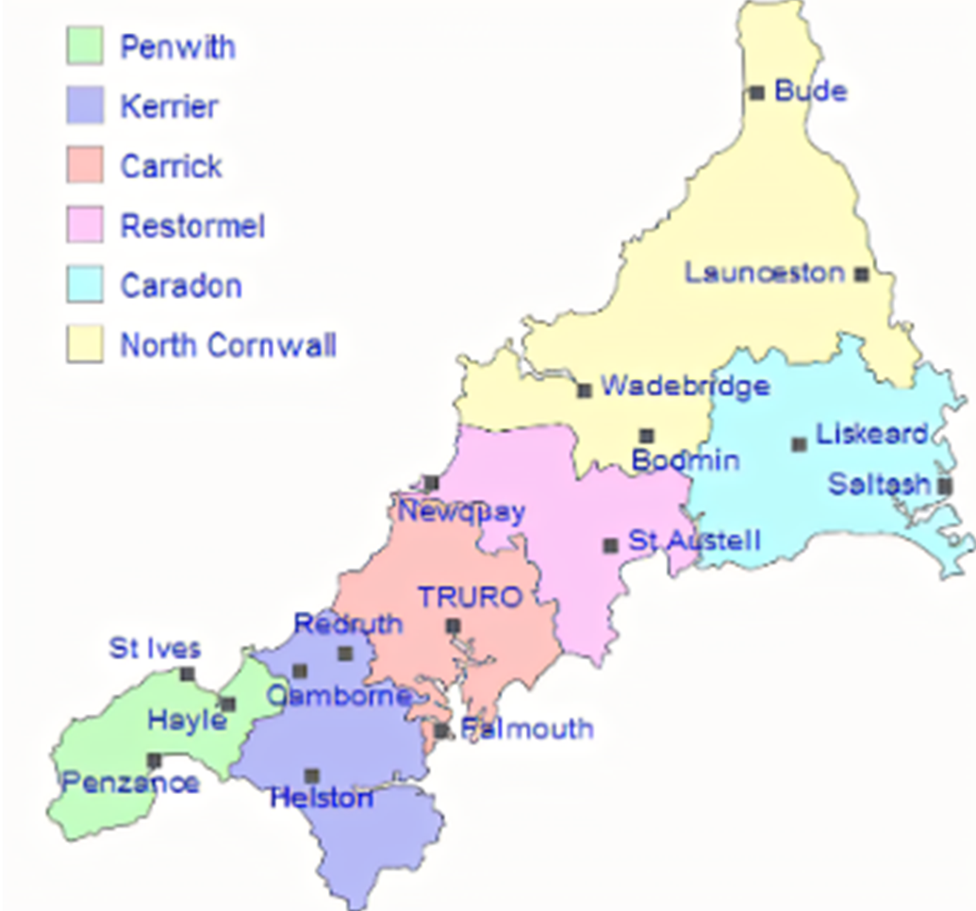
Service Structure & Offer
Service divided into Integrated Care Areas - East, Mid, West, moving to place-based model as per 10 year plan.
Available Monday-Friday, 9am-5pm.
Initial, targeted, and intensive treatments based on NICE guidelines.
Patient choice options meeting central to decision making
First intervention: holistic, reviewed after 6 sessions.
Follow-up treatments: goal-focused and evidence-based.
Multi-disciplinary team includes psychiatrists, psychologists, clinical associate psychologists, allied health professionals, nurses, psychotherapists and support workers.
EAST
MID
WEST

Slide 9
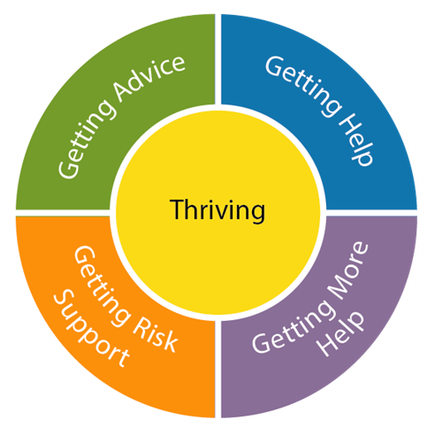

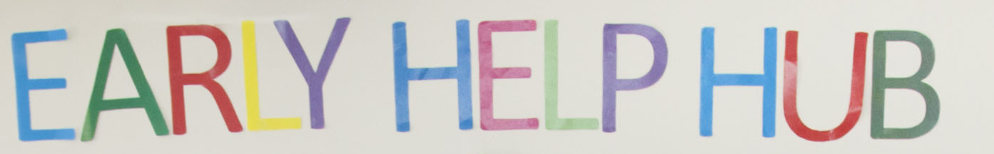
Referral & Support Process
Referral triage by qualified mental health professionals
Acceptance letter and invite to options meeting
Targeted NICE guidance intervention alongside individual care, safety and risk plans
Needs may be better met elsewhere in the system

Slide 10
CAMHS Contact Details
Child and Adolescent Mental Health Service (CAMHS)
West Cornwall ICA
Call the Redruth (the Hive) on
01209 204 000.
Call Penzance on
01736 571 070.
Email the CAMHS West Referrals Team.
Mid-Cornwall ICA
Call St Austell on
01726 873 292.
Call Truro on
01872 246 980.
Email the CAMHS Mid Referrals Team.
East Cornwall ICA
Call Launceston on
01566 765 660.
Call Liskeard on
01579 373 850.
Email the CAMHS East Referrals Team.

Slide 11
Children’s Eating Disorders Access
Referral Routes:
GP, school, social care, CAMHS, voluntary sector or self referral; client/family
GPs are responsible for the initial physical risk assessment/examination.
What we help with:
8 to 18 years old with suspected or diagnosed:
Anorexia nervosa
Bulimia nervosa
Binge eating disorder
Other specified feeding or eating disorders (OSFED)
Disordered eating, including in the context of self-harm (RISH - restrictive intake self-harm)

Slide 12
Eating Disorders
Countywide team delivering across the 3 integrated care areas.
Full multi-disciplinary team offering evidence-based systemic and family therapy interventions for eating disorders, individual therapy, and group-based pathways.
Eating disorders deliver in-house physical monitoring to those on caseload only as part of their holistic mental and physical health care.
Pilot for COAST (Community Outreach and Support Team) to support complex and acute eating disorder children with aim to avoid admission to acute paediatric and/or mental health settings

Slide 13
Childrens Eating Disorders Access
Advice and Guidance
In hours (Mon-Fri 9-5pm): CYPEDS clinical lead: (01579) 373781
Children and Young People’s Eating Disorder Service
Support For patients and parents/carers:
BEAT
CCI Looking After Yourself: Self Help Resources for Mental Health Problems
Eva Musby: Helping you free your child of an eating disorder
Kelty Eating Disorders
Cornwall’s CYPDS patient information leaflet

Slide 14
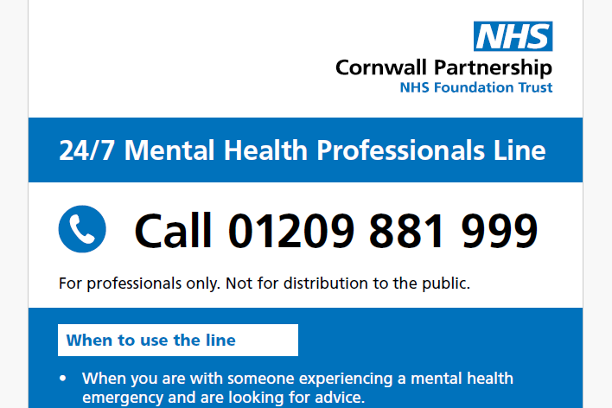
Accessing Crisis Mental Health Services
If the young person has a medical need, call NHS 111.
In a medical emergency, go to the emergency department

Slide 15
Neurodevelopmental Service

Slide 16
Shifting the focus from deficit to difference
Shifting the Focus from Deficit to Difference
We view conditions like autism and ADHD not as disorders to be cured, but as natural variations in how a person's brain is wired.
Instead of focusing on what a young person can't do, we see these differences as a part of their identity.
Our goal isn't to change the neurodivergent person, but to help them, their family, and team understand and navigate the world with their unique traits.
We use non-pathologising language, for example, saying "the student is autistic" instead of "the student suffers from autism."

Slide 17
Strategic partnership key to enabling a needs-led approach
Identify needs early as they are emerging in a variety of touchpoints in the system.
To stop children, young people and their family's hitting crisis point.
Help access advice, help and support to meet needs irrespective of a diagnostic assessment.
Acknowledge different lived experiences such as school and/or home.
Use the information from people who know the child or young person the most, to identify the right support.
Ensure diagnostic assessments are available to those who need them.
More timely diagnostic assessments, reducing long waits.
Recognition of the impact of COVID and other adverse experiences on child development.

Slide 18
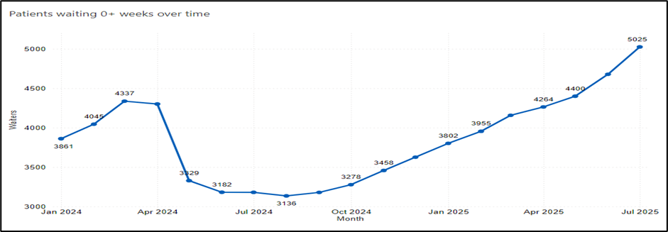
Concern re; continuing rise of ND referrals
July saw over 400 referrals, +27% vs. June. This level of demand is not sustainable, there is a wealth of Early help available.
Source: RiO January 2024 to July 2025

Slide 19
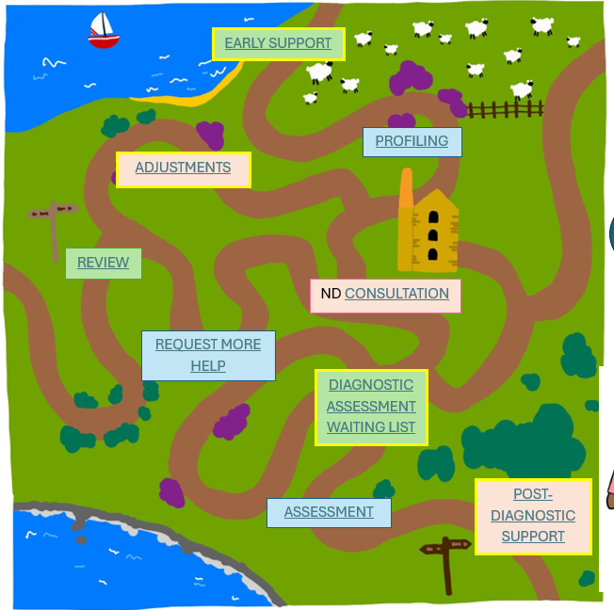
The neurodiversity pathway in Cornwall is not linear
Whole system approach
Wealth of early help information and support available to young people and their families/carers
Profiling can understand emerging and established needs
Diagnostic assessment if this is where the evidence takes us
Notes:
Profiling is not appropriate for every child who has additional needs and, or behaviour concerns – it has a specific focus on neurodivergence where there is a big impact of differences.
If there is only 1 area of need, then a comprehensive neurodevelopmental profile is not required. Follow existing pathways.
Diagnostic assessment if this is where the evidence takes us – KEY ROLE OF SECONDARY SERVICES

Slide 20
Early Help – have these been explored before a referral to secondary services?
ChatHealth
Early Help Hub
Workshops for parents
Family Hub offer
WRAPS (school facing, 3 tiered support for sensory needs)
Graduated Response in Schools
Homestart Kernow
Developmental Co-ordination Disorder pathway
Steps (dietetic support for restricted eating)

Slide 21
How to find the right support
What is it that the young person needs help with?
What are they struggling with at school, home and other places?
What are they/their family most worried about? What matters to them and the young person the most?
What help and support have they/the school already tried?
What has worked, what hasn’t, and do we know why?
Does the young person need a Neurodiversity profile or is there a service out there already that could help?

Slide 22

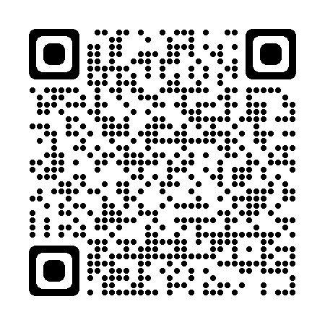
Neurodiversity Hub offers a wealth of support for families
https://parentcarerscornwall.org.uk/neurodiversity/

Slide 23
CAMHS ND pathway to diagnosis
Getting Help Intervention
(12 weeks)
Getting More Help Intervention
Completed alongside Therapeutic intervention by bespoke ND pathway Clinicians in CAMHS
These Clinicians will liaise with local schools to allow development of relationships, and support between CAMHS & Education
ND profiling tool
ND Profiling tool (not essential)
Sign posting to ND Hub for information
Refer to NDAT for Diagnosis
Full ASD work up (6 weeks +)

Slide 24
Access to treatment
Where Neurodiversity is indicated adaptations will be made for the Young Person in their treatment sessions across our services
Shorter or longer appointments if needed
Turning off bright lights
Using drawing or writing if speaking is hard
Providing fidget toys
Taking a break during appointments
Giving more time to process information

Slide 25
Mental Health Support Teams in Schools

Slide 26

MHST expansion clearly mandated in the NHS 10 year plan
Three key shifts
  From hospital to community
  From analogue to digital
  From treatment to prevention
For MHSTs
  100% coverage by 2029/30
  Schools, colleges, alternative provision, electively home educated
  Deliver the national model, evidence-based interventions, supporting mental health lead and giving advice to secondary school staff
Notes:
FROM TREATMENT TO PREVENTION – ROLE OF MHSTs in MH wellbeing

Slide 27
MHST expansion – 2025/26
One new team, Restormel
Our first dedicated team for secondary schools
Supported by a new strategic partnership board
Co-produced with system partners, families and young people

Slide 28

What need are you seeing?
How can we work together to deliver what secondary schools and their pupils need?

Slide 29

Any questions?

Slide 30
Appendix

Slide 31
Neurodiversity - sources of help
Accessing the Early Help Hub EARLY HELP CORNWALL COUNCIL for advice and information on parent-focused workshops, family workers. Such as:
Understanding your child with additional needs (free online course for all parents, carers and grandparents.)
reading your child's behaviour and understanding their feelings.
effective communication techniques.
reflecting on your relationship and how to nurture your child's emotional health.
a transformative journey that can strengthen your bond with your child at every age.
Find out more on the In Our Place website, including a short video that provides an overview. Use the Access Code TAMAR.
HOME START KERNOW – workshops and parent support
CHAT HEALTH text and advice line
Health Visiting and School nursing service
NEURODIVERSITY HUB
Family Hubs in your locality
Autism in Schools Team advice line
PARENT CARER CORNWALL for support
SEND IASS – support for parents in relation to navigating the SEND system
YOUNG PEOPLE CORNWALL to support young people directly
Parenting cornwall podcasts

