Slide 1

"Every day a student is in school is a day we shape their future — attendance is not just a number, it's a reflection of hope, belonging, and opportunity."
Reflect: what implications does this have for you strategic planning?

Slide 2
What
Why
What challenge are we trying to solve?
How
If
Habits
Student’s habits of attending every day are very shaky
Inconsistencies
Less than 100% attendance leads to students missing both curriculum time and weakening their connection to the school community.
Lost learning
As a result of absence, students don’t always learn as much as they could. 80% attendance is 240 hours lost per year

Slide 3
What
Why
What was our goal at the start of the year, for July 2025?
How
If
All students Attend well; with clear and consistent follow up.
Turn and Talk. Name a student success/turnaround story, from not Attending well to being in every day and able to lead much better in their lives.
Extension: what was the ONE biggest reason for them turning things around?
Reflect: Is attendance everyone's responsibility in your Schools? How connected are you as Headteachers? Could you have greater knowledge?

Slide 4
What
Why
What was our goal at the start of the year?
How
If
All our students attend well with consistent follow up for all absence.
Turn and talk: What do you feel most excited about and proud of when considering:
Progress in your Headline attendance figure?
Progress in developing a culture of attending well?
Progress in developing world class teams?

Slide 5
What
Why
What progress have we made at ATHENA for students attending well?
How
If
3 Schools ranked in the top 5 in cornwall
7/9 Schools above the national average
Consistently Top ranked School in the county
2 Most improved Schools in the county
1000’s students celebrated daily, weekly and each half term
229580 of hours of additional learning

Slide 6
What
Why
How has this impacted learning at 3 Cornish Schools?
How
If
 | A | B | C
Compared to national | 1.7 | 1.6 | 0.4
Compared to South West | 2.4 | 2.3 | 1.1
Overall attendance Rank End HT5 | 1st | 2nd | 5th
% Improvement from last year | 4.5 | 2.6 | 4.7
Additional hours of Learning since Sep 24 | 92,120 | 38,069 | 36,980
 | 229,580 Additional hours of learning this academic year across all Athena Schools
Cornish schools ranking out of 30:
Reflect:
Have you improved your Schools attendance this year?
Notes:
Cornish schools ranking out of 30: Devon schools ranking out of 42

Slide 7
What
Why
Top new strategies since Sept 24 to boost Attendance
How
If
Appointed Trust Attend Lead
High Performance planning - Shared visits (Half termly Cycle)
High quality CPD for staff
Fortnightly bulletins and actions
Fortnightly 1:1s between School and Trust Attend Lead.
Daily and weekly support from Trust Lead
Massive celebration - Streaks
New feedback loops to ensure high support and the escalation process
Connections (meetings and calls). Floor standard: 5/week/year group

Slide 8
What
Why
Streaks - Why did we link Behaviour and Attendance?
How
If
Streaks
Celebrates and recognises students with 5 consecutive days attended and zero negative behaviour points (5 day or 10 day streaks)
Builds motivation through positive reinforcement.
Sets a clear goal for all students.
Encourages short-term success that supports long-term habit change.
Promotes pride, consistency, and a sense of achievement
Share: What success has it made so far?

Slide 9
What
Why
What is our goal for 2025-6?
How
If
All Schools to have an Attendance of >94%

Slide 10
What
Why
Why is our goal challenging to achieve?
How
If
Knowledge & Expertise
Our knowledge-building is not yet world-class (1).
Clarity & Prioritising
Leadership at all levels does not yet bring clarity needed to secure high-impact implementation (2).
Responsibility & Habits
A fully embedded culture of personal ownership is not yet fully in place across every team (3).
Turn and talk: which is the biggest challenge in your school? (1), (2), (3), or all?

Slide 11
What
Why
How will our Attend Strategic Plan 2025-6 address this?
2 Pillars; 5 systems
How
If
Pillar 1: Supporting Absentees
Pillar 2: Celebrating Attendees
1.1 Attendance Team Leadership (Attend Daily Debriefs, Timetables, Concern Escalation, Threshold automations, EWO)
1.2 Family Support (Calls, Texts, Meetings, Home Visits, EHE)
1.3 Student Support (Workshops, Mentoring, Buddy System, Rewards, Adapted Timetables)
2.1 Warm Connection (WWF, Tutoring, Knowing Tutees, Missed You Messages, Tutor Check-In calls, YearTeams)
2.2 Massive Celebration (100% Club, Top&Tailed Assemblies&Greetings, Streak Automation, Recognition Events, Motivating Texts)

Slide 12
What
What
What have we learned from 2023-24?
Why
How will we improve Systems
Why
How
How
If
If
We will keep:
Streaks
Tracking
Escalation process
High number of meetings
Implementation plans
We will add/improve:
Weekly Celebrations - 100% club, targeted rewards.
Early intervention and Shared ownership- HOY workshops, Tutor mentoring, AHT mentoring.
Follow up - 3 pm calls
Messaging - Greetings, assemblies, Socials
Tutor well being check ins
Notes:
Focus on three top systems

Slide 13
What
Why
Why are we adding to our strategy?
How
If
100% Club
Encourages short-term success that supports long-term habit change.
Celebrates and recognises students with full weekly attendance.
Builds motivation through positive reinforcement.
Sets a clear goal for all students.
Promotes pride, consistency, and a sense of achievement
Reflect: how do you recognise positive habits weekly?

Slide 14
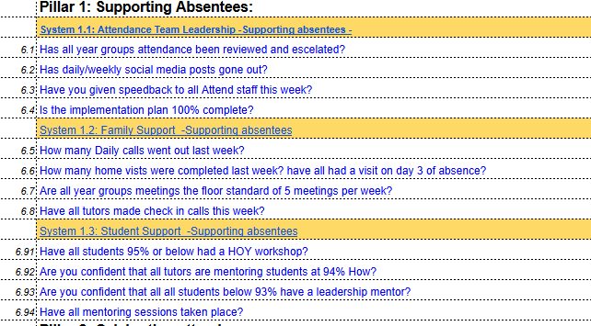
What
Why
Attend leadership - Making the most of 1:1s
How
If
Attendance lead, mentor and HOY 1:1 template
Suggest: Calendar in 15 minutes prep for each 1:1
Share: Consider who you will line manage from September: How can you maximise the time during their 1:1 to reach 100% on all key metrics?

Slide 15
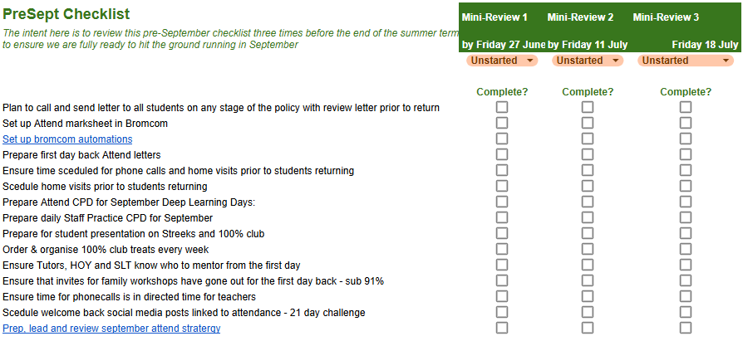
What
Why
Attend leadership - How will our Attend Strategic Plan 2025-6 address this? Implementation plans
How
If
Reflect: what steps are needed before September?

Slide 16
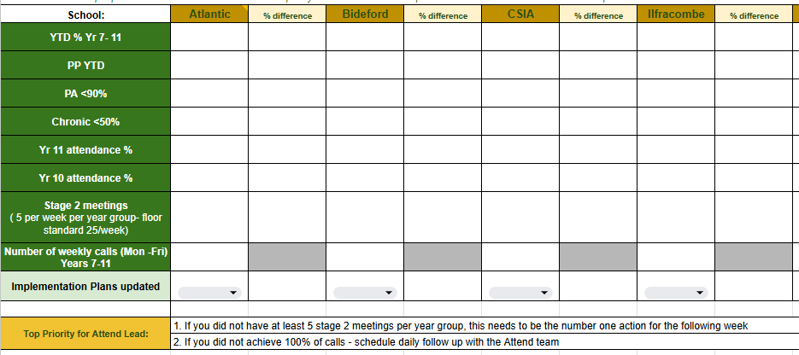
What
Why
Attend leadership - How can I have oversight at a glance?
How
If
Reflect: Which is the most useful metric as a Headteacher? Are there any gaps?

Slide 17
What
Why
What if… Top 3 pitfalls, Top 3 preemptions
How
If
Pastoral leaders are not conducting enough meetings
Develop timetables and block out time
Students/parents concern over ‘pressure’ of attendance
Ensure all challenge is foregrounded in support alongside the message that attendance matters!
Concern from SEND students & families around inflexibility
Attendance mentors to create bespoke plans with SEND team for all students to improve attendance

Slide 18
What
Why
Takeaways
How
If
Our goal is: for all schools to have >94% attendance
The three main barriers preventing us from achieving this well yet are knowledge, clarity and responsibility.
We set out to achieve the plan through 2 pillars and 3 systems.
Self-reflect: What question is most on your mind now?

